Slide 1
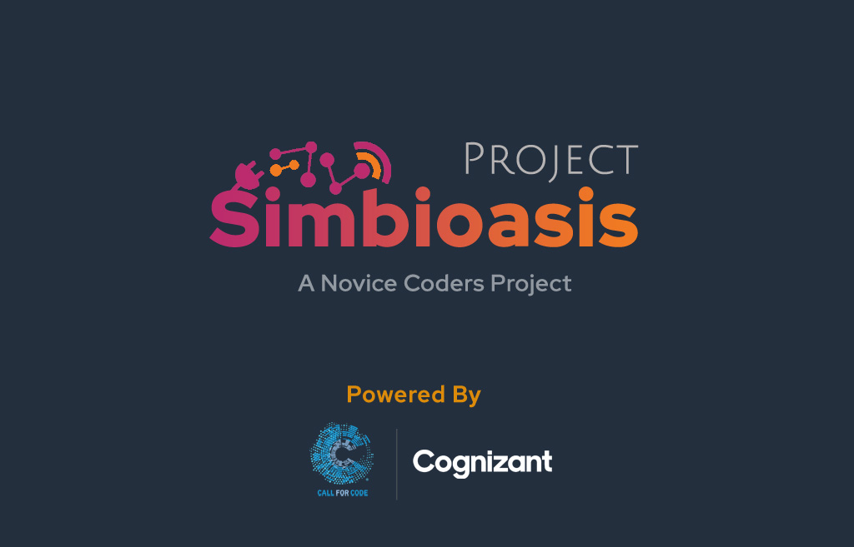

Slide 2
PROBLEM DESCRIPTION
At the time of a natural calamity, having the network down can be a great distress
Identification and estimation of the location, size, and the needs of the affected populace in remote areas can be a herculean task for the rescue teams.
Rescuing people from ongoing or after-effect of a disaster is a race against time.
Even with ample resources at hand, rescue teams are in a difficult position to efficiently coordinate, attend, and uniformly distribute helpful resources to proper location.

Slide 3
SOLUTION
Project SIMBIoasis is envisioned to connect the needs of a population in a remote area with no network connectivity
It facilitates gathering of information (such as exact location, need for food and/or medical attention, etc.) from android smartphones of affected users - via deployed IOT devices
It relays the information to a cloud interface through Long Range, Low Bandwidth Radio Frequency communication
The cloud data can be accessed by the responders via a front-end.
The rescue team can be aware of the situation in any particular area before physically going/carrying the essential supplies to the affected place

Slide 4
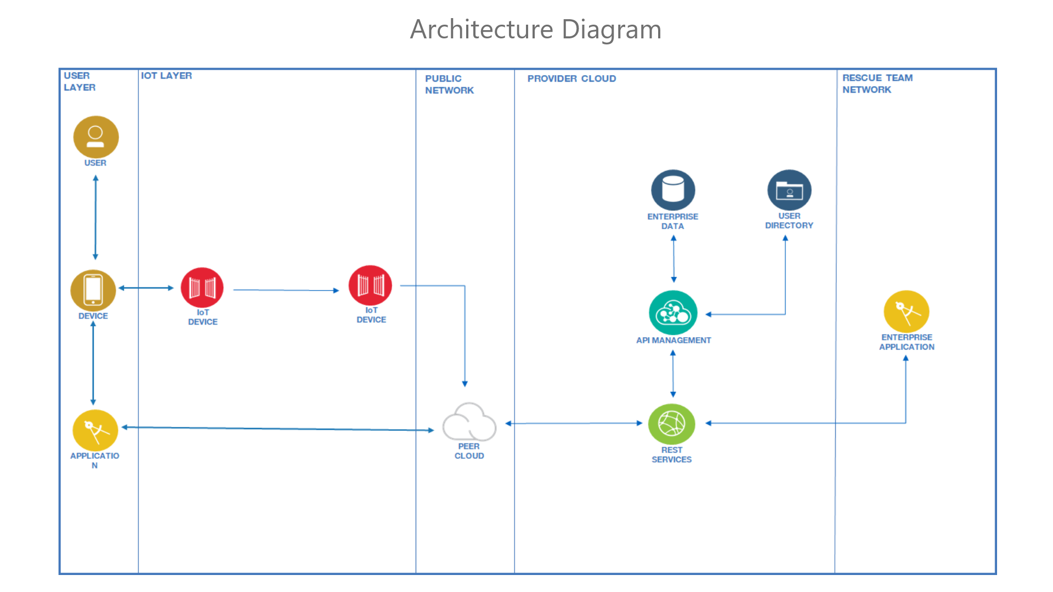

Slide 5
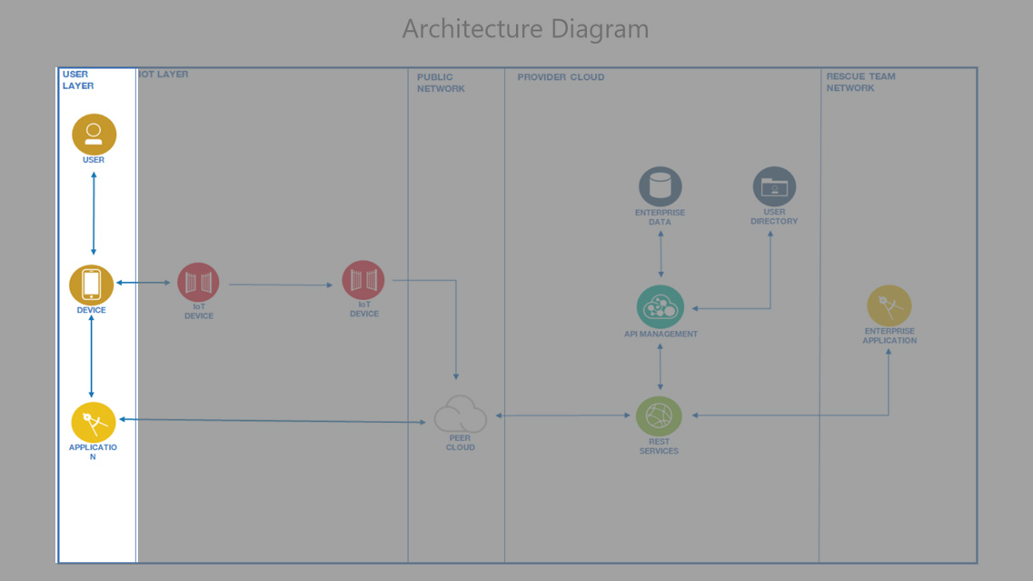

Slide 6
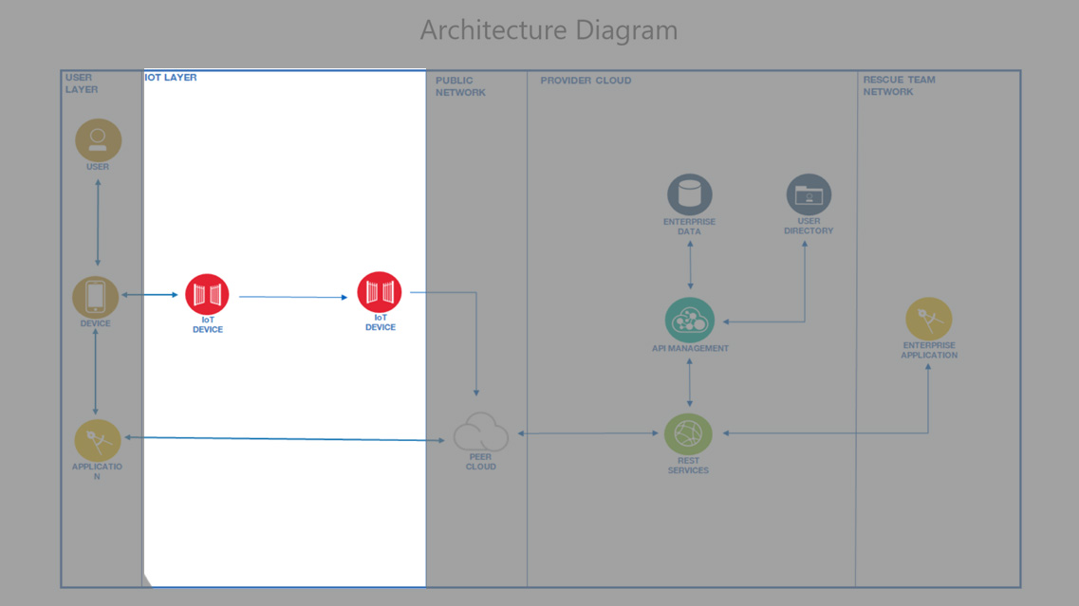

Slide 7
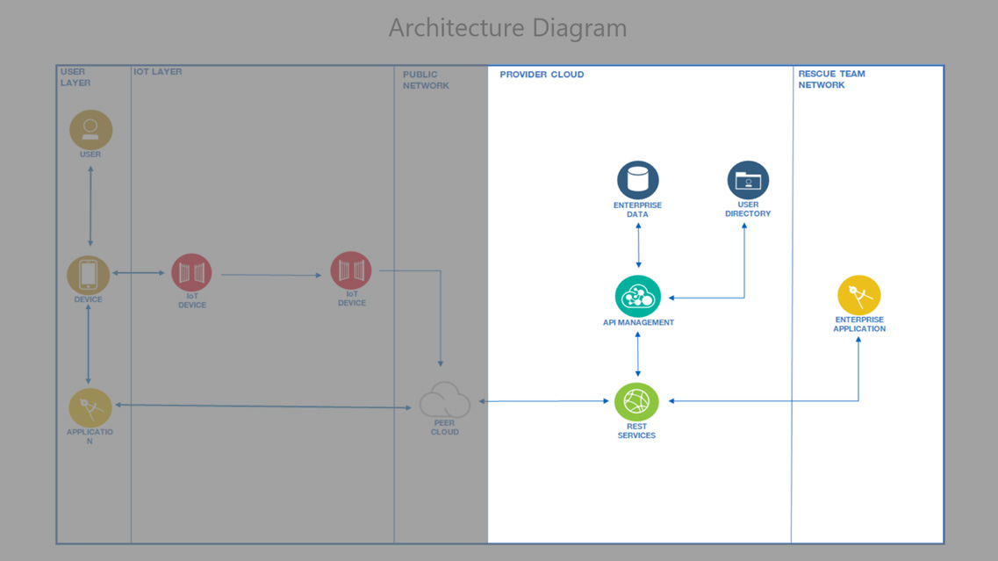

Slide 8
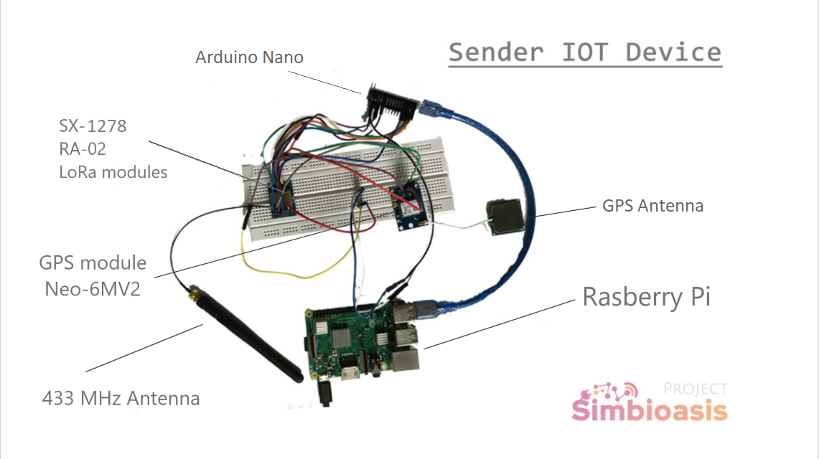

Slide 9
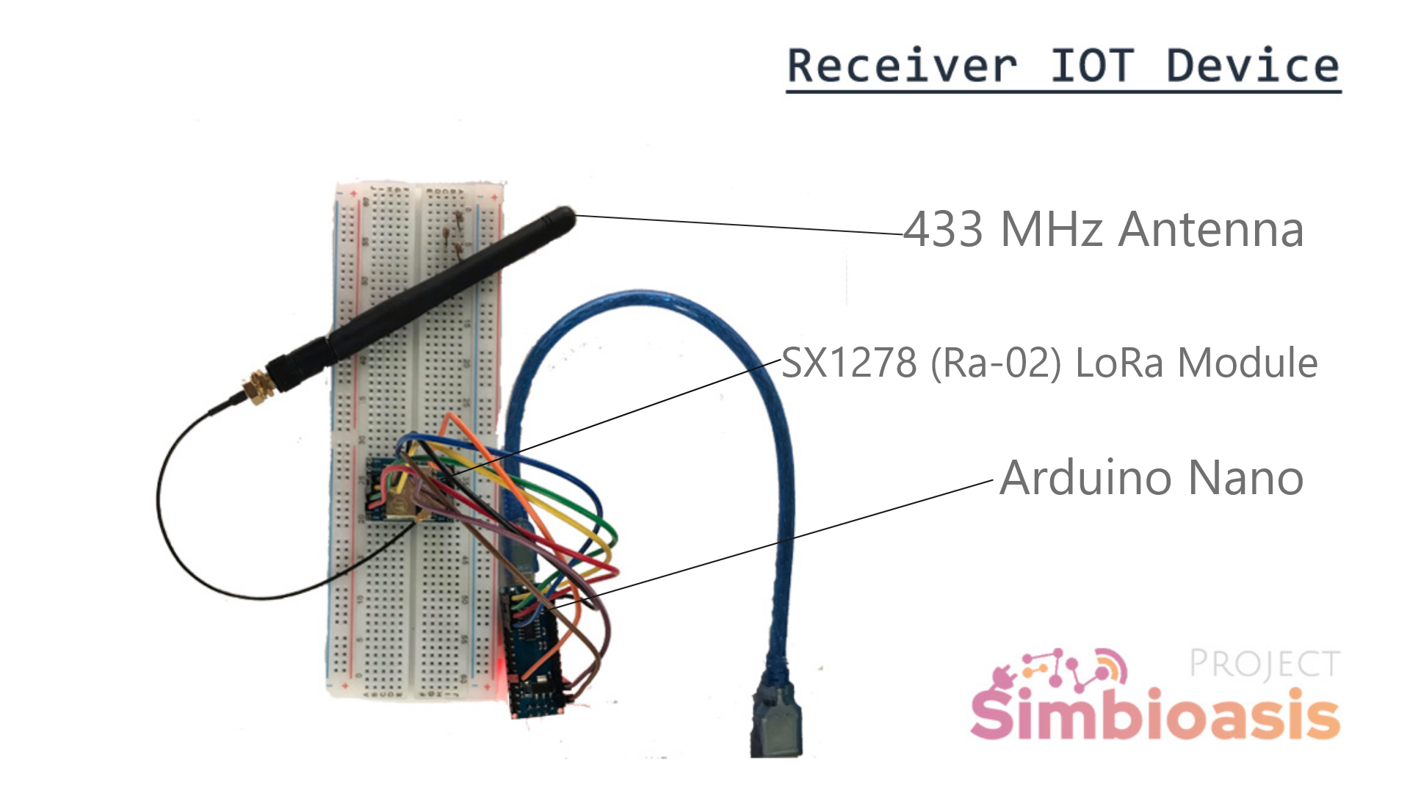

Slide 10
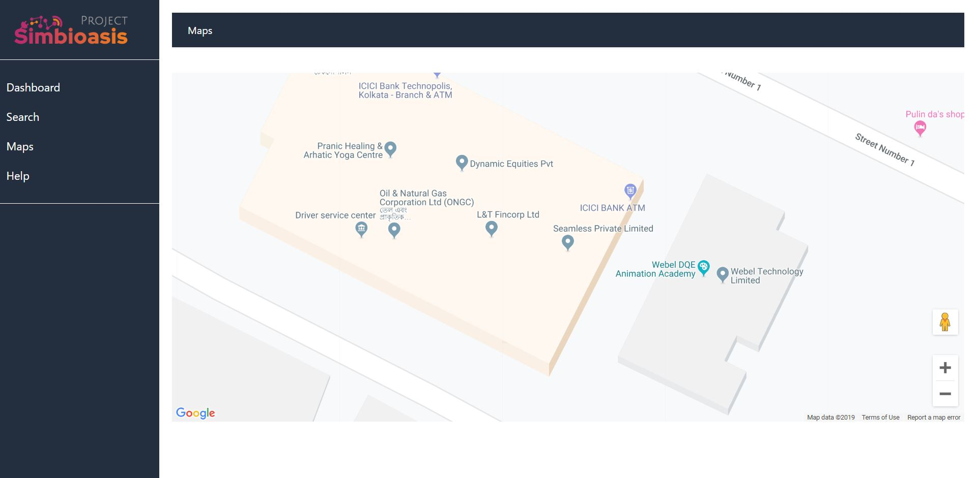

Slide 11
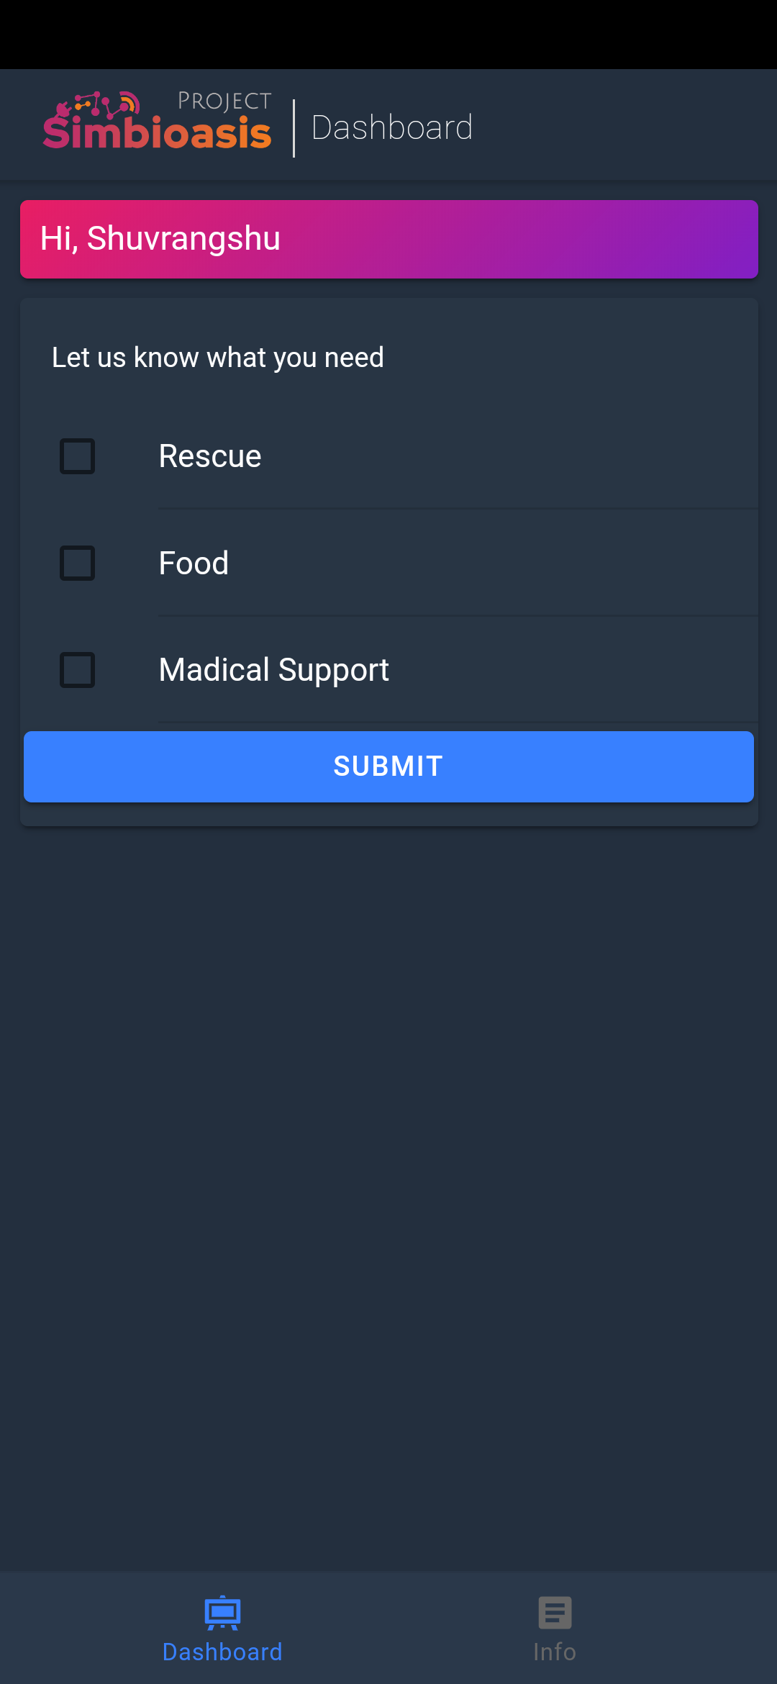
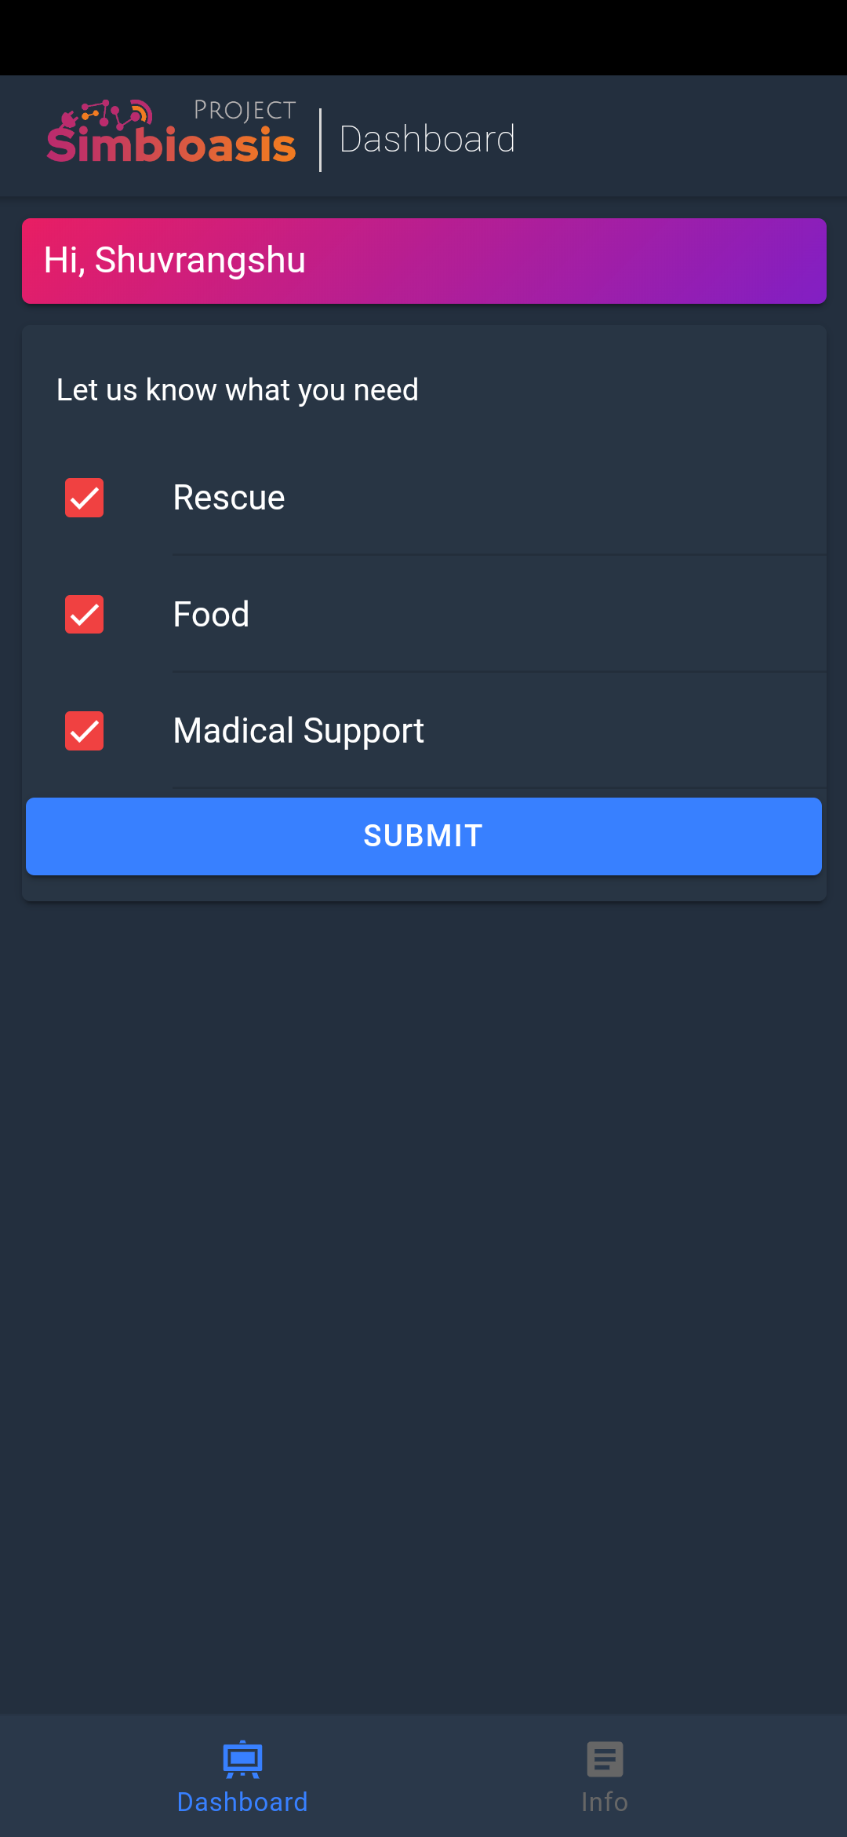
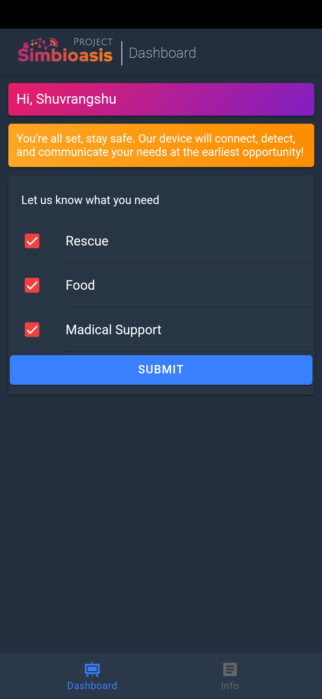

Slide 12
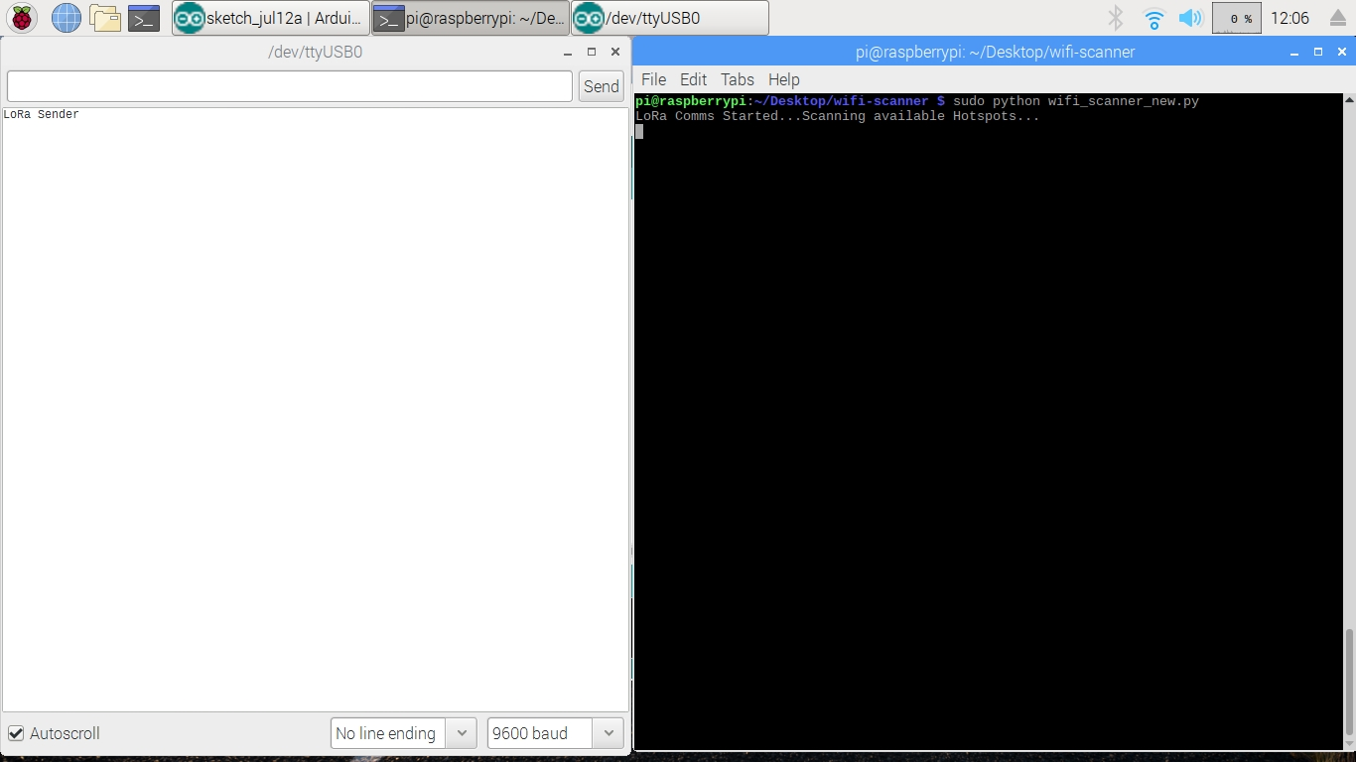

Slide 13


Slide 14


Slide 15
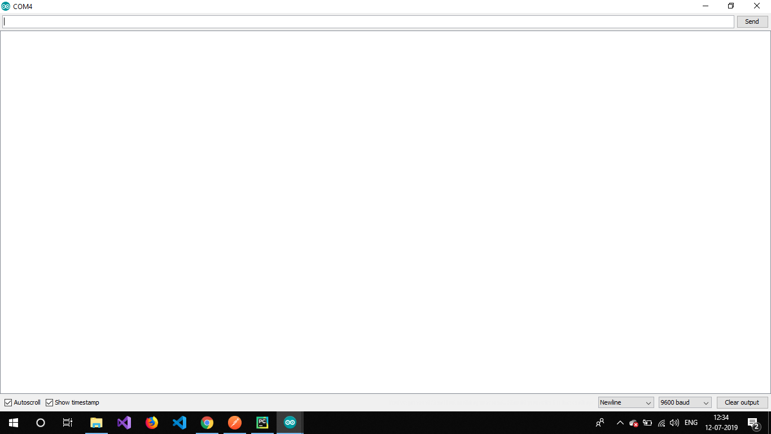

Slide 16
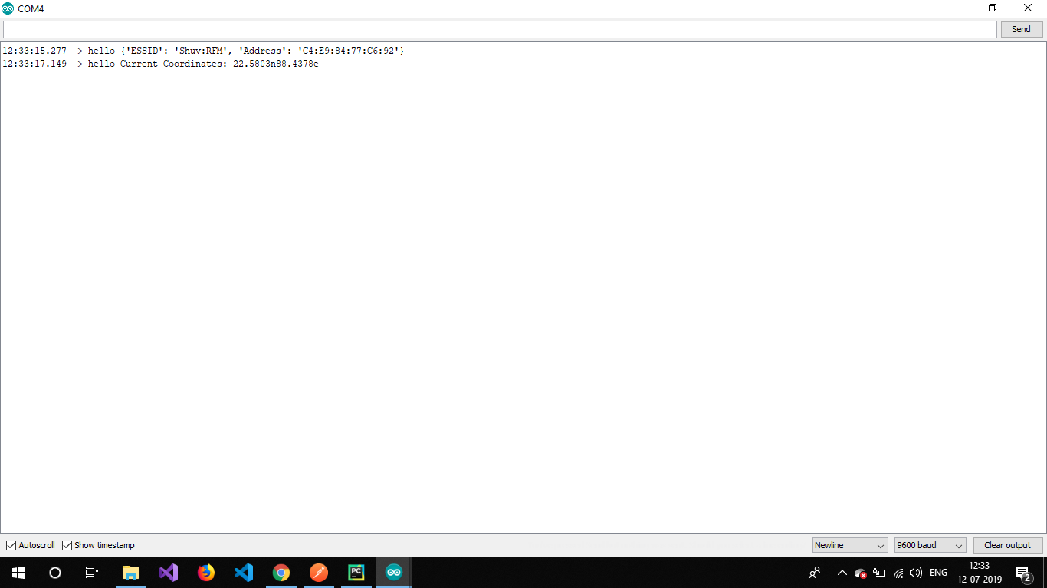

Slide 17


Slide 18
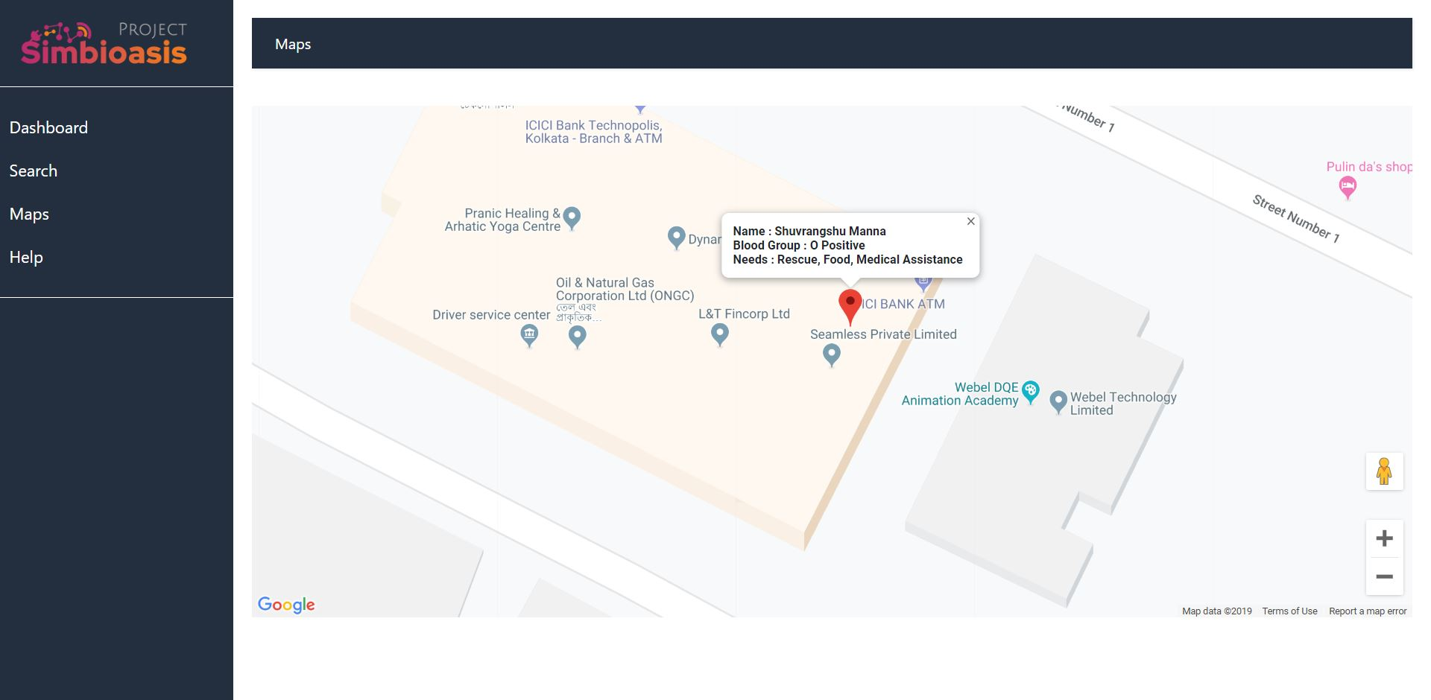

Slide 19
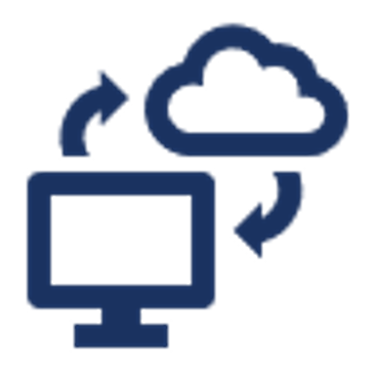

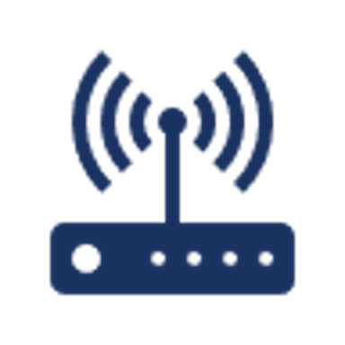
TECH REQUIREMENTS
Hardware
Rasberry Pi
Arduino Nano
SX-1798 RA-02 LoRa modules
GPS module Neo-6MV2
433 MHz Antennae
Software
IBM Cloud
IBM Node Server
IBM Cloudant DB
IBM Cloud ToolChain
Maps
Technologies
Angular7
ExpressJS
Python
Cloudant
LoRa Communication
Android

Slide 20
WORKFLOW
The workflow essentially starts from one deployable IOT device, the spotter
The spotter is envisaged to be deployed in a remote area, where network gets disrupted or becomes ineffective.
The spotter collects the survivors' information by scanning all available hotspots in its vicinity.
It parses the hotspot names to identify the survivors' requirements and sends the consolidated data to the second IOT device.
The Receiver is second IOT device that is responsible for receiving the radio signal transmitted by the spotter.
It is envisaged to be stationed in an area with proper network connectivity.
Its LoRa module receives the radio signal and posts the same on the cloud server.
A responder can log into the SIMBIoasis dashboard and see the data posted by the Receiver into the cloud server. The rescue team can be aware of the situation in any particular area

Slide 21
WHERE CAN WE USE IT?
As a preparative measure for being aware of the existence and needs of the survivors in a remote area.
When multiple devices are deployed in different regions, the SIMBIoasis dashboard shows consolidated data and helps prioritize rescue team deployments.

Slide 22
THANK YOU
SHUVRANGSHU MANNA
INDRAYAN GANGULY
MITHUN SEN
BISHWADEEP SHIKDER
INDRANIL MAITI

