Slide 1
Java Web Job
How It works:

Slide 2
What does this Java Web Job Do?
Overview
Input Page
Progress Page
Result Page
File Upload
Save Input
Update Progress
Save Result
Input Validation
Run Process
Create Result
On the surface, there are three pages; Input, Progress, and Output.
Beneath that, there are different actions done to produce the result from the entered data.

Slide 3
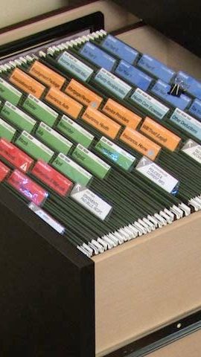
A further breakdown
Overview

Slide 4

Model View Controller* (MVC) Architectural Pattern
Overview
View - What the user of the program can see. Displays relevant information in a readable way.
Model - Stores both data entered by the user and data entered for use in application processes beforehand.
Controller - Updates the Model with user input and provides the View with data from the Model.
* More specifically, the Model 2 implementation of MVC is used.

Slide 5
MVC in Java Web Job
View
HTML, CSS, Javascript, JSP
Controller
Tomcat Web Container,
Servlets, View Controllers
Model
Java Beans, Database

Slide 6
Another Lens, the three parts of the program
Overview
The MVC Pattern closely corresponds to another way of organizing the functions of this project:
Web Browser/ Client - Everything that relates to what the user sees and can interact with.
Web Server - Everything that is generated server-side and links the Web Browser to the Database
Database - Storage and retrieval of data related to the project.
MVC and the Browser/Server/Storage categorizations are very closely related.

Slide 7
Web Browser/ Client - A More Detailed Look
Technology Stack
FileUpload Extension (JS)
JQuery UI
JQuery FileUpload
JQuery
Javascript
HTML
CSS

Slide 8
Web SERVER - A More Detailed Look
Technology Stack
JavaServer Pages
Handler Servlets
View Controllers
Utility Classes/ Job Processing
Web Container
Apache Tomcat

Slide 9
Database - A More Detailed Look
Technology Stack
Java BeanS (Annotated)
DataProvider (Java Class)
Morphia (MongoDB Object-Document Mapper)
MongoDB Java Driver
MongoDB (NoSQL Database)

Slide 10
Diagrams
Input, Progress, and Result

Slide 11
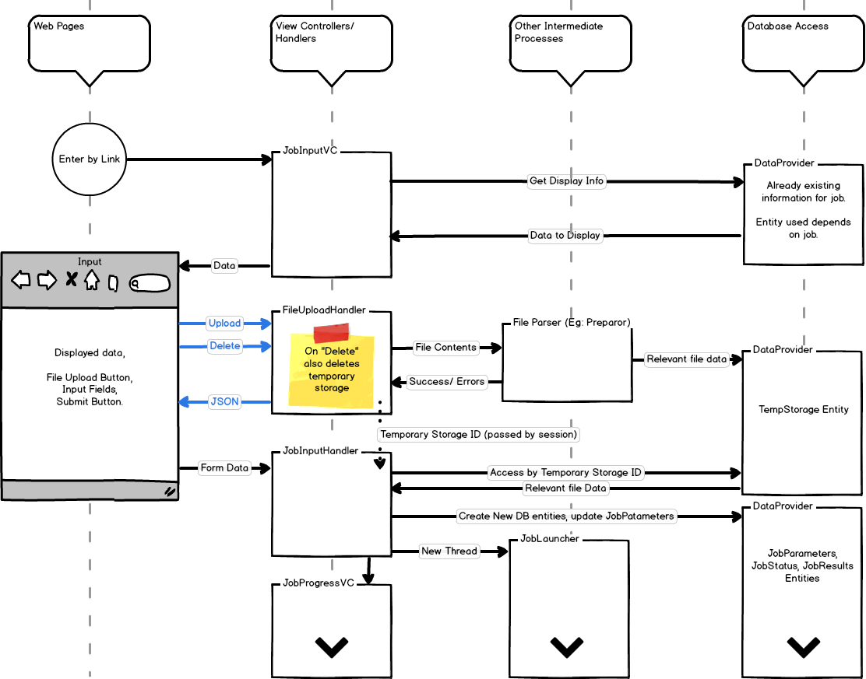

Slide 12
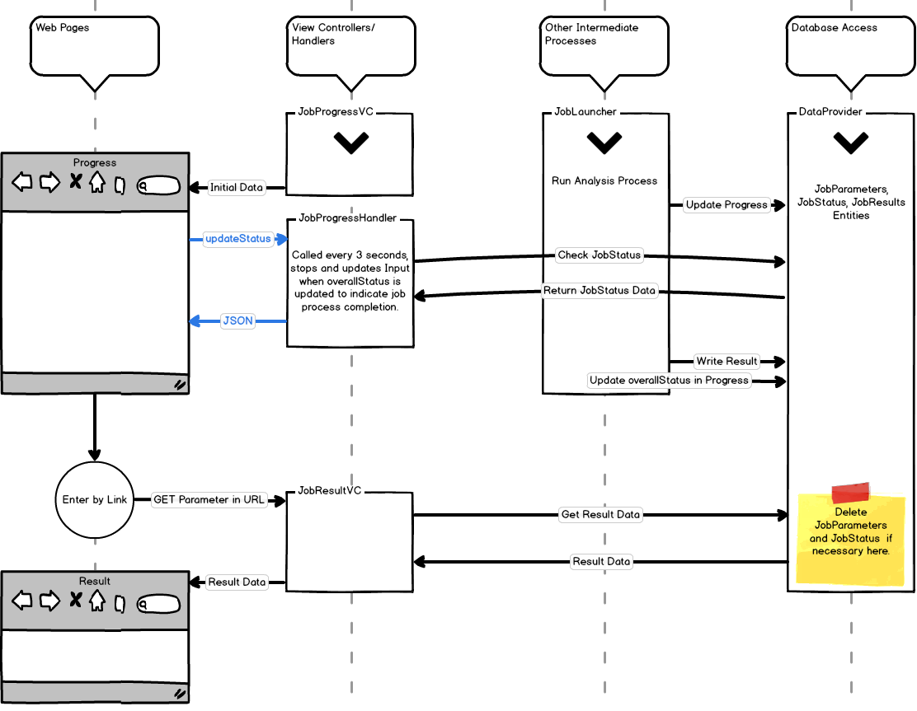

Slide 13

What goes into the Database?
Database Objects

Slide 14
Job Parameters
Database Objects
objectId - Needed for database use.
jobId - Random UUID representing the job that created the object.
created - Time the object was created.
Other variables important to the function of your analysis.

Slide 15
Job Status
Database Objects
objectId and jobId - Same function as in Job Parameters.
created - Time when the object was created.
lastUpdated - The last time when the object’s values were changed.
finished - If a record of Job Status is kept, this marks the last time when Status was updated.
jobName - Name to display on processing page.
tasks - An arraylist of objects representing each step in the job analysis process. These are embedded in Job Status.

Slide 16
Task Collection
Database Objects
taskName - The name of the task.
taskStatus - Integer representing state of the task. “0” for not completed, “1” for completed, “-1” for failed.
taskId - A randomly generated ID number to reference this task by.
subTasks - An arrayList of TaskCollections in this one.
subTaskLevel - The depth of the current task within the taskCollection tree. Helpful for data visualization.

Slide 17
Job Result
Database Objects
objectId and jobId - Same function as in Job Parameters.
Other relevant data for visualizing and displaying the result of your analysis.

Slide 18
Temporary Storage
Database Objects
objectId - Needed for database use.
created - Time when the object was created.
lastAccessed - The last time when the object’s values were changed.
okToDelete - If the storage is to be kept for a longer period of time this can help with DB maintenance.
Any other fields that are necessary to store file information. Generic objects cannot be stored in the database without a defined class.

Slide 19
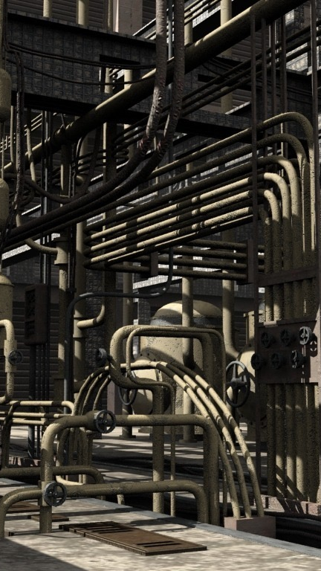
Installation and RUntime Setup
Configuration

Slide 20
Web XML Configuration
Configuration
Context parameter “file-upload” should point to a directory in which to store uploaded files temporarily. Remaining files in this directory should be manually deleted as needed.
Environmental variable “mongoPath” points to the location of the server where the database is stored.
Environmental variable “dbName” should be the name of the database used to store data associated with this web project.

Slide 21
Libraries (Included In Template)
Configuration
Morphia 1.2.1
Mongo Java Driver 3.0.4
Commons-fileupload 1.3.2
Commons-io 2.5
JSTL core
JQuery UI
JSON for Java

Slide 22
Tomcat
Configuration
You will need to install Apache Tomcat in order to run the web project in a web. Version 8.0.35 was used in this project.
$CATALINA_HOME environmental variable needs to be set to point to the root of your Tomcat Installation.

Slide 23
MongoDB
Configuration
You will need to install the MongoDB Community Server to create and store information for this project.
As with Tomcat, you’ll need to set environmental variable, $PATH, to the directory of your MongoDB installation.
If you are not using the default location (/data/db) as your database directory, you can set a new one with dbpath.
Launch the mongod daemon to start mongodb and launch the mongo process to access the database from the command line.

Slide 24

Template Alterations Checklist
Configuration
Add input fields appropriate for your project to JobInput.jsp.
Add javascript to prevent form submission without required fields.
Alter the JobParameters.java entity to store relevant field values.
If you are using FileUpload, create a class that can:
Extract the relevant information from your file.
Return true in a function if data was successfully parsed.
Return a list of error codes (of value other than -1, 0, or 1) representing any mistake which occurs during parsing.

Slide 25
Configuration
If you are using FileUpload, alter FileUploadHandler.java and TempStorage.java to temporarily hold relevant field values.
In JobInputHandler.java, create JobStatus and JobResult entity objects containing values you need to save. Create a TaskCollection object to place into a JobStatus object to show progress on the Progress.jsp visually.
In JobLauncher, complete your process step by stem, making sure to updateJobStatus for every relevant stage of the process. Write the results of your process to the JobResult object. Make sure the placeholder Thread.sleep() functions are removed beforehand.
Make sure the last thing you do in JobLauncher is update the overallStatus of the job to “1” (meaning complete).
Update RobResultVC.java and JobResult.jsp to display result information from your job.
Edit the config.properties file to include strings for any error codes caused by incorrect parsing of input.

