Slide 1

Final Submission Virtual Internship Data Engineer – Kalbe Nutritionals
Novin Ardian Yulianto

Slide 2
Introducing Ourselves: A Glimpse into Who We Are
Novin Ardian Yulianto
19th, Lamongan, East Java
Information System 2021
Universitas Islam Negeri Sunan Ampel Surabaya
https://linkvin.netlify.app/

Slide 3
Case Study
Kalbe Nutritionals Data Engineer Virtual Internship Program

Slide 4
Access and Explore!!
Result
Github
Video
Next slide !!!!
Venus has a beautiful name and is the second planet from the Sun
Despite being red, Mars is actually a cold place. It’s full of iron oxide dust

Slide 5
01/02
Bash and Scripting
Create a shell/bash script to check whether
directory exists inside a given path,
Using the question number 1 script, add another
condition if directory exists inside the path

Slide 6
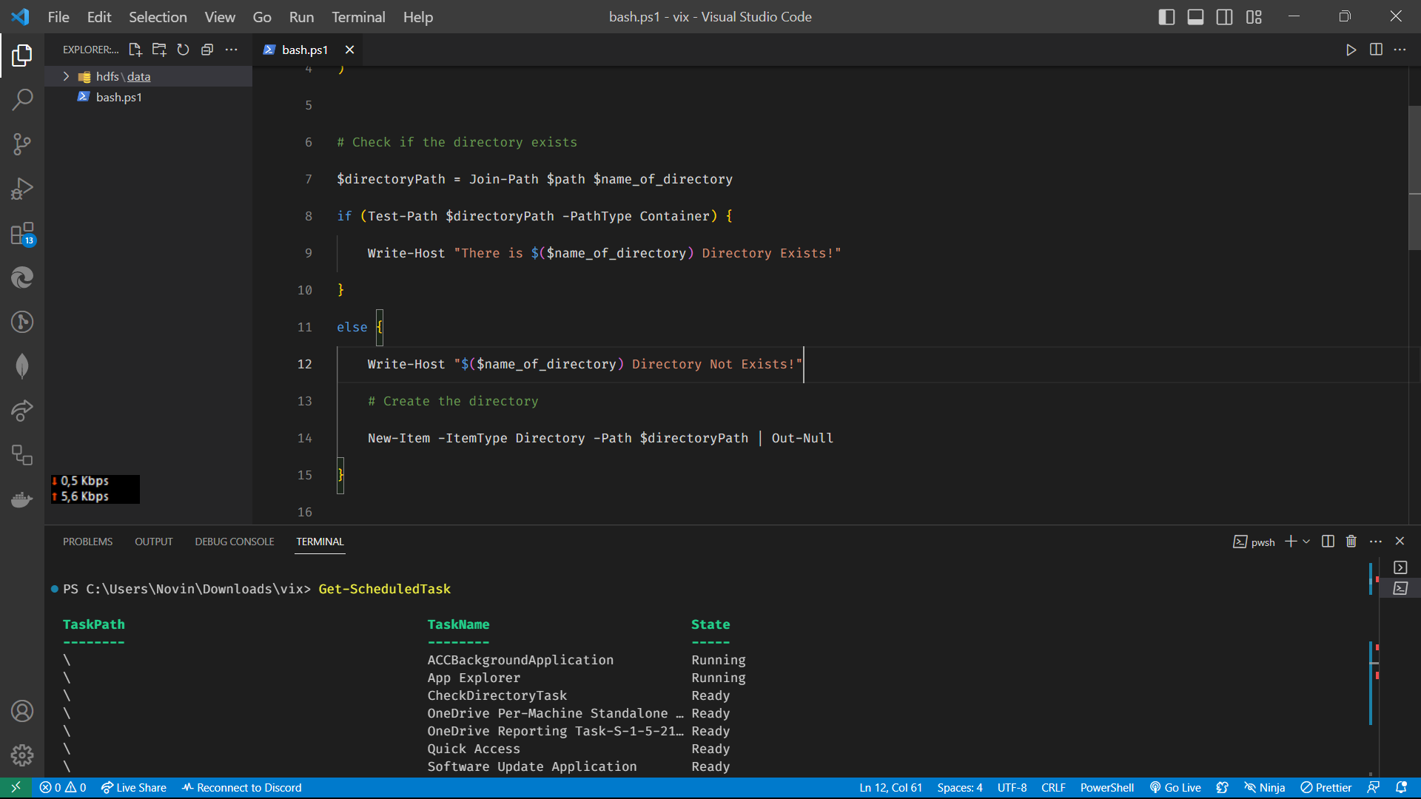
Context

Slide 7
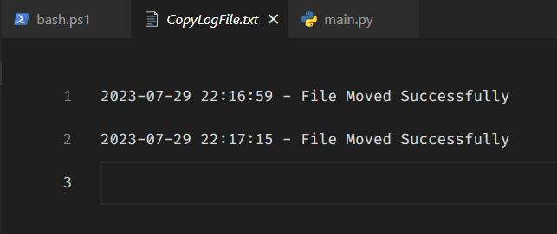
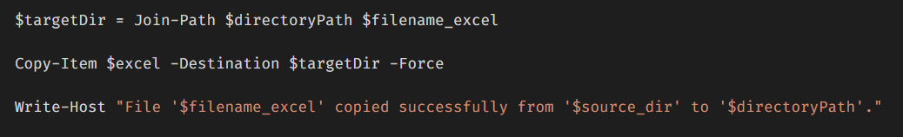
Moveeeee

Slide 8
03
Python with Postgresql
Complete below Syntax {Highlighted Sentence} to
insert data from Python to MySQL

Slide 9
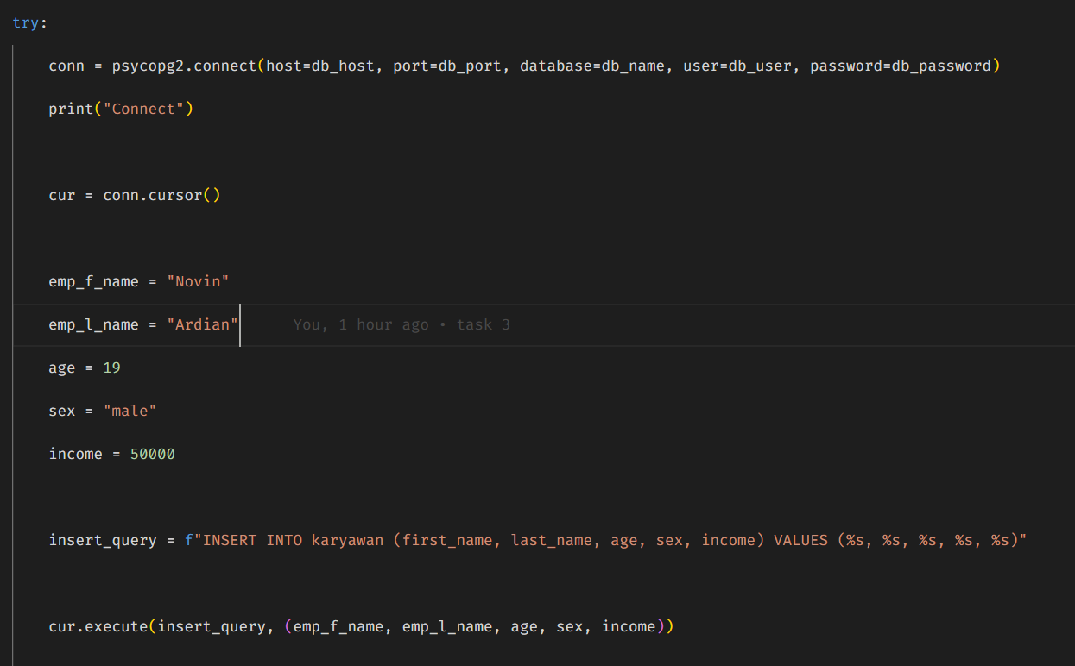
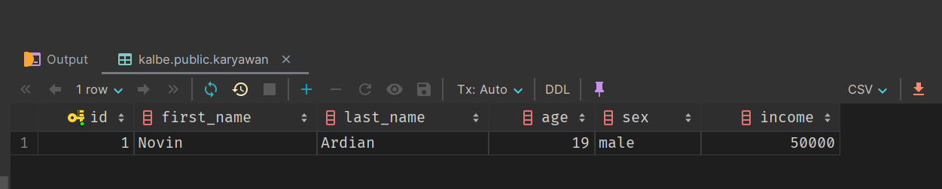
Querying

Slide 10
04
Datagrip with Postgresql
Convert this instruction into SQL Query Language

Slide 11
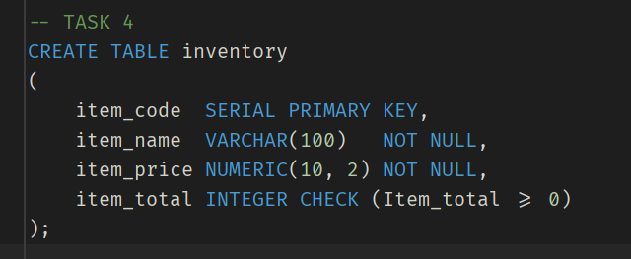
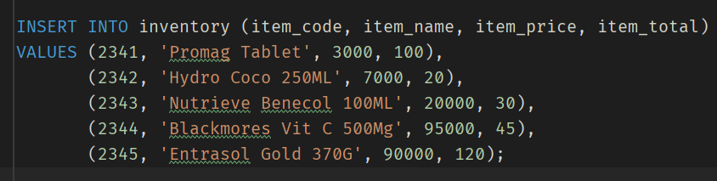
Create Table
Create
Insert

Slide 12
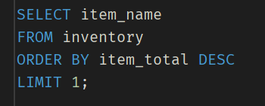
Show Item_name that has the highest number in Item_total.

Slide 13
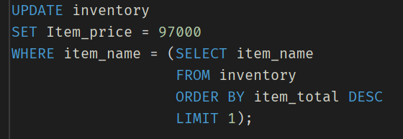
Update the Item_price of the output of question bullet

Slide 14

What will happen if we insert another Item_name with Item_code of 2343 into the table?

Slide 15
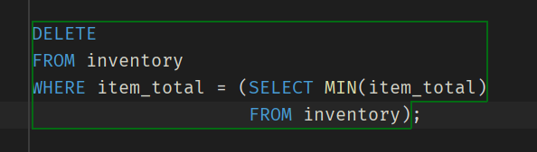
Delete the Item_name that has the lowest number of Item_total

Slide 16
05
Querying with Postgresql
Create a Query to display all customer orders where
purchase amount is less than 100 or exclude those
orders which order date is on or greater than 25 Aug
2022 and customer id is above 2001

Slide 17
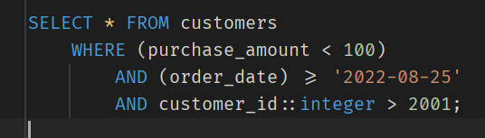

Slide 18
06
Explaining
Please explain what is wrong with this picture and
give the best solution for this case

Slide 19
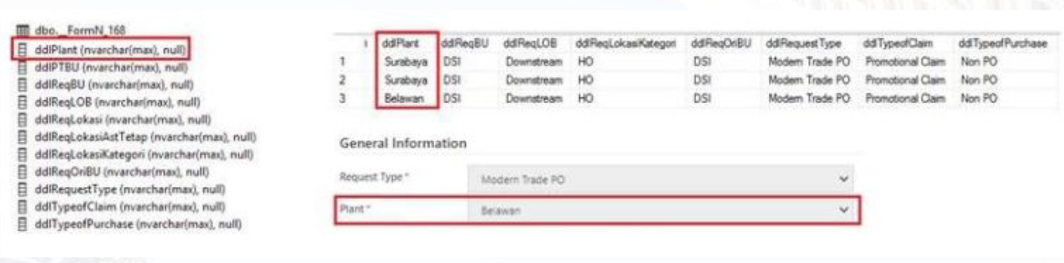

Slide 20
07
Star Schema
Create a simple star schema for KALBE database
consist of 1 Fact and 5 Dimensions using Physical
Data Model Theory

Slide 21
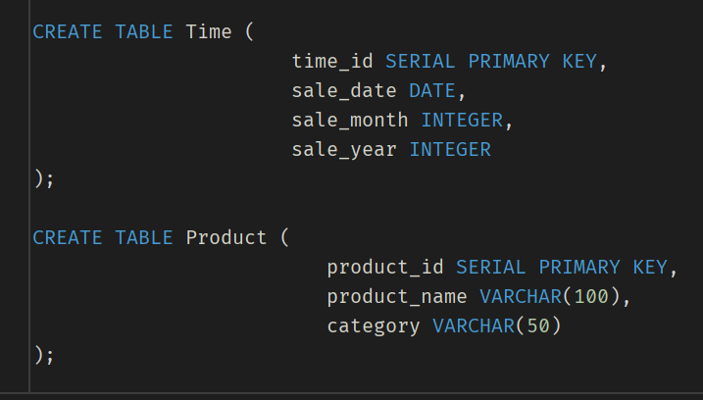
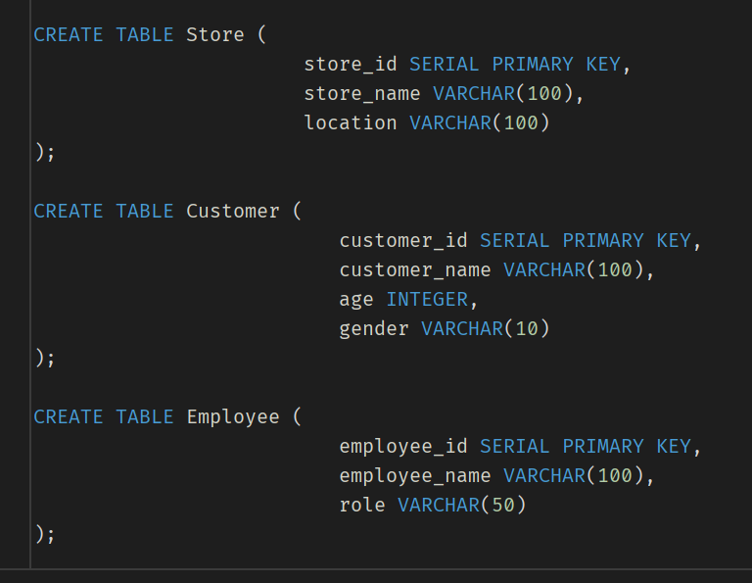
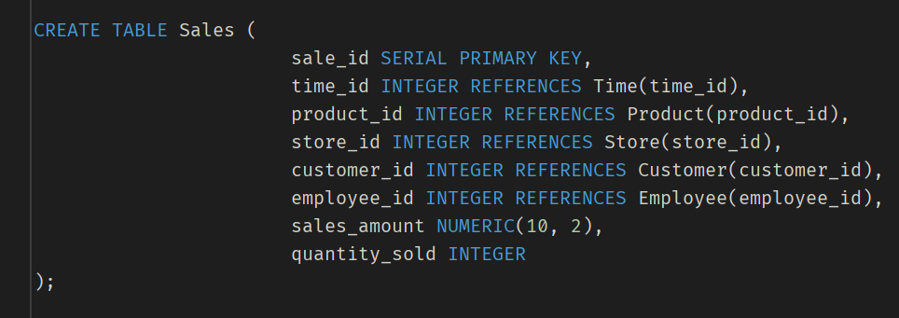

Slide 22
;
Thanks ☺

