Slide 1
Final Submission Virtual Internship Data Engineer – IDX
Novin Ardian Yulianto

Slide 2
Introducing Ourselves: A Glimpse into Who We Are
Novin Ardian Yulianto
19th, Lamongan, East Java
Information System 2021
Universitas Islam Negeri Sunan Ampel Surabaya
https://linkvin.netlify.app/

Slide 3
Case Study
ID/X Partners Data Engineer Project Based Internship ProgramA

Slide 4
Access and Explore!!
Result
Github
Video
Next slide !!!!

Slide 5
01
Restore Database

Slide 6
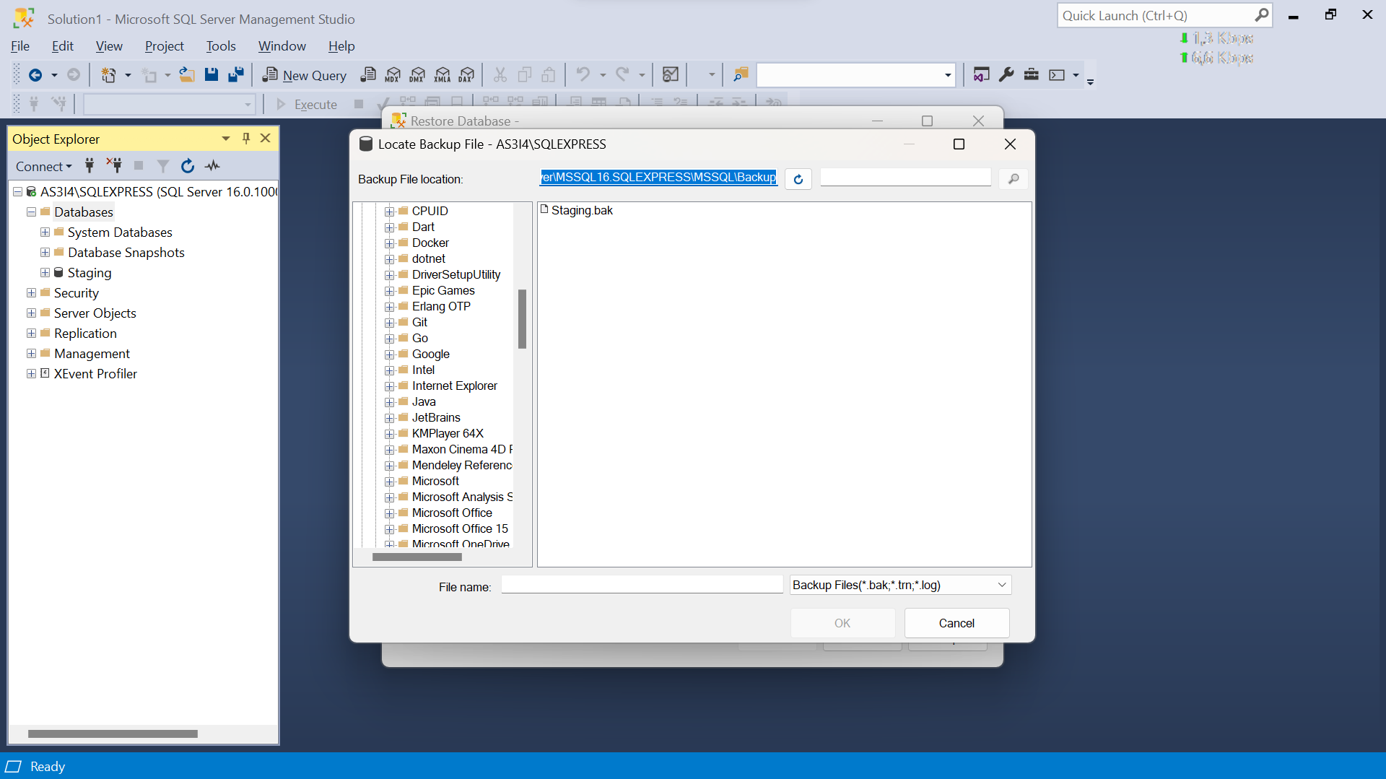
Context

Slide 7
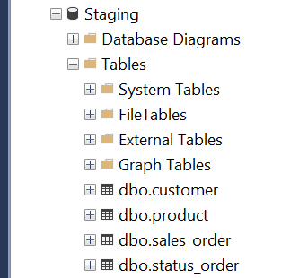
Context

Slide 8
02
Create Table

Slide 9
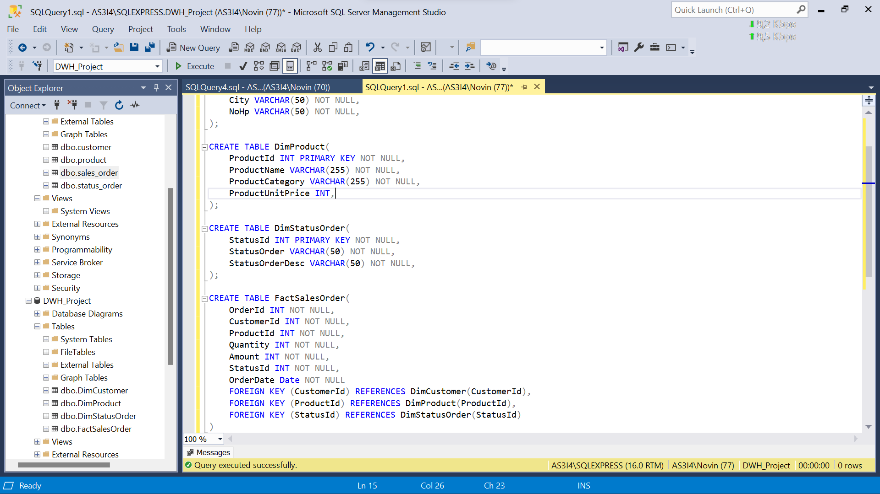
Querying

Slide 10
03
Talend
From Staging

Slide 11
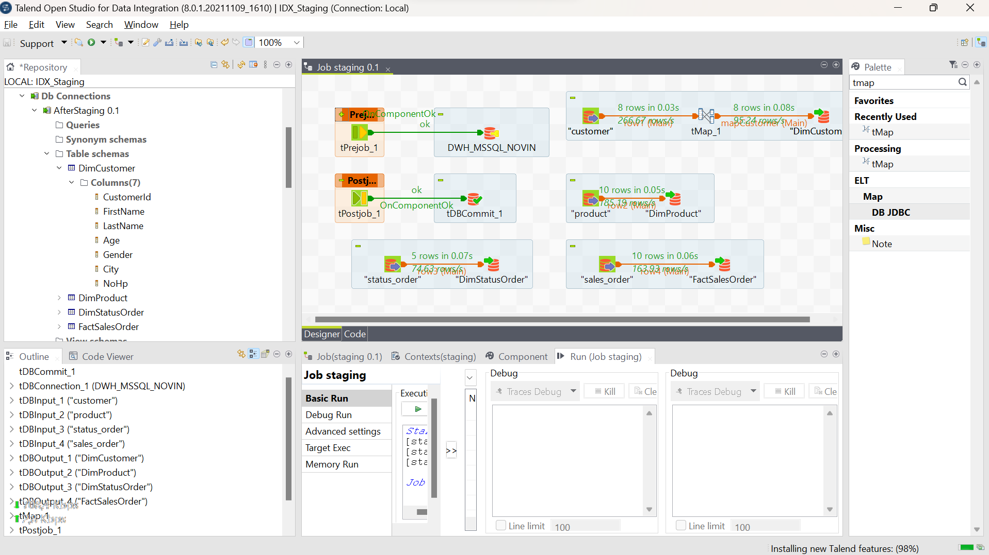
Talend

Slide 12
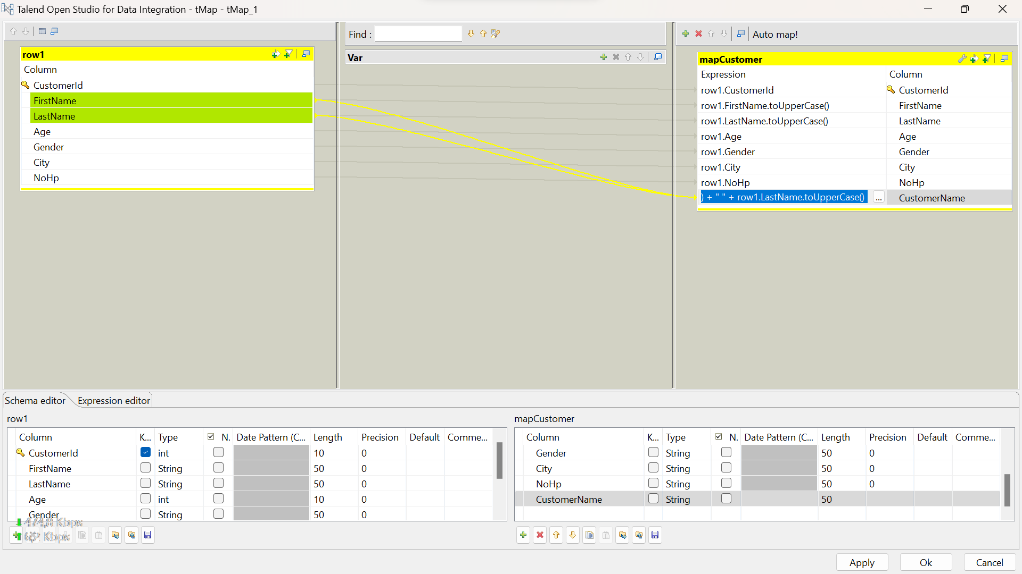
tMap

Slide 13
04
Store Procedure

Slide 14
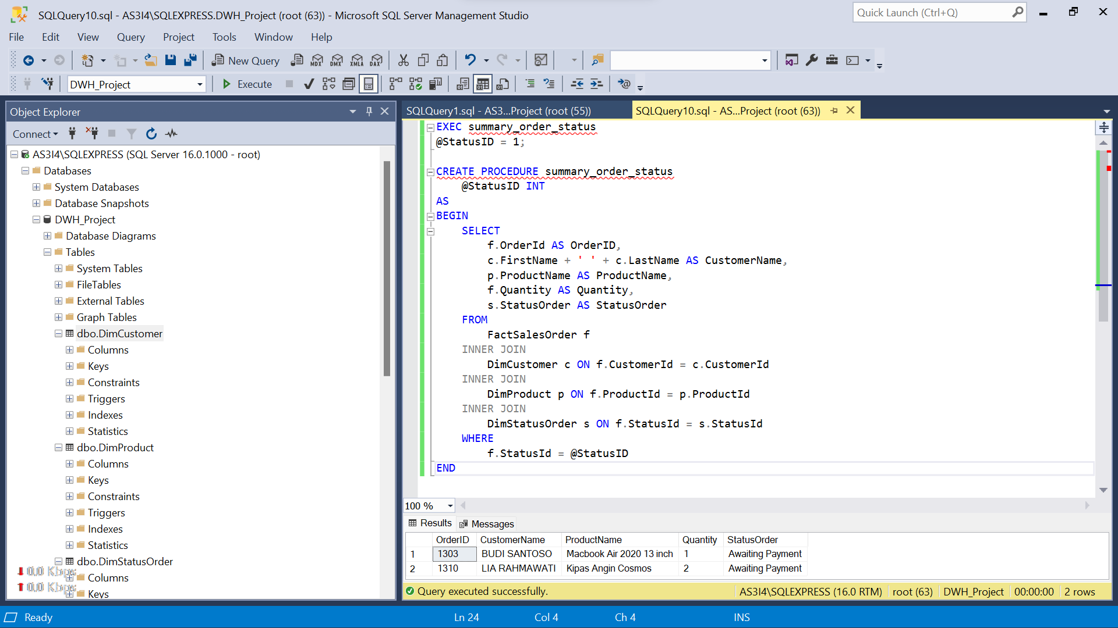

Slide 15
;
Thanks ☺

