Slide 1
AST from custom linters to writing transpilers
Grzegorz Nowiński

Slide 2

About me
Grzegorz Nowiński
Senior Test Automation Developer @ Demant (Development, DevOps work)
Expertise:
Test Platform | Infrastructure | Internal Tools
DevOps | CI/CD | Jenkins SysAdmin
Python | .NET | Azure
Speaker at:
Expert Summit 2022
ZS BIT 1000
Outside of work: Husband, father and sailing enthusiast ⛵

Slide 3
Who worked with Abstract Syntax Trees ?

Slide 4
Agenda
What is Abstract Syntax Tree?
AST in Python execution process
Usage in Python ecosystem
Examples
Linter rules/checks
Code generation
Transpilers

Slide 5
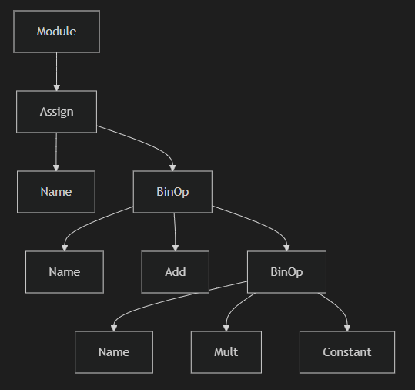
What is Abstract Syntax Tree?
A tree shaped structure
Represents the hierarchical structure of the program
Abstract – ignores all syntax details
Semicolons
Parentheses
Whitespaces
Result of parsing/syntactic analysis
x = a + b * 2

Slide 6
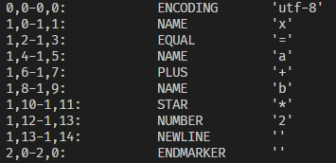
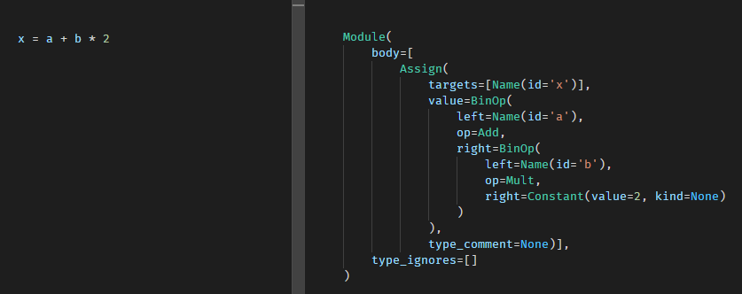
AST in Python execution process

Slide 7
How many are fake ?
ast_lite
astor
astroid
baron
gast
libCST
parso
pytrunk
typed_ast

Slide 8
Usage in Python ecosystem
Language engines
Jedi – parso
Pyright - built in custom parser
Refactoring
rope – ast ?
redbaron –baron
libCST
Static analysis
mypy – own extended AST
Pylint – asteroid
flake8 - ast
Testing
mutmut – mutation testing

Slide 9
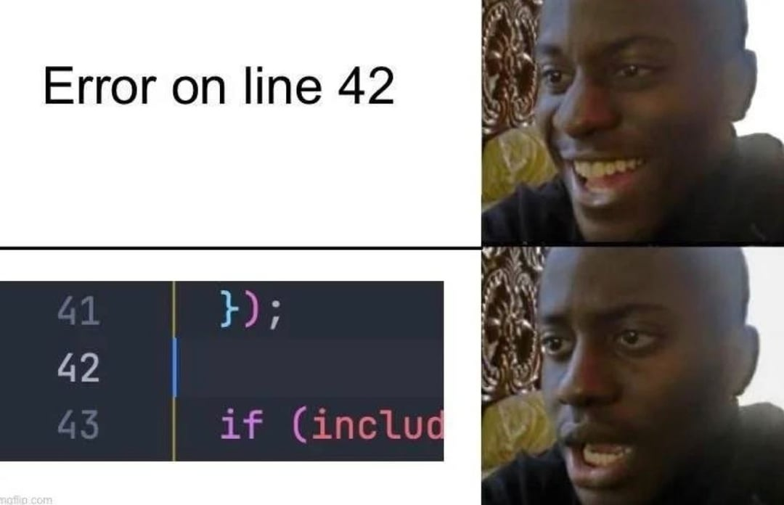
Examples

Slide 10
Linter rules/checks

Slide 11
Code generation

Slide 12
Transpilers
salazaar
Idea from working on legacy codebase at Demant
Converts JavaScript to Python
Translating JavaScript AST to Python AST
https://github.com/novinxy/salazaar

Slide 13
QA

