Slide 1
INDUSTRIAL AI, 2026
RootIQ
PLC Error Intelligence, a secure agent harness
RootIQ reads a controller fault log, reuses past fixes, mines the IQAN community forum, and synthesises a cited solution. Every action is screened by a security interlock before it runs.
Victor Otu Hayford
GitHub github.com/novoha/rootiq Live app rootiq.streamlit.app

Slide 2
THE PROBLEM
A cryptic fault, and the fix is buried in a forum
# IQAN controller system log
XC44 ; No contact
COUT-Suction hose 1 ; Open load
VIN-Joystick (C1:26) ; Low error
MC43FS[0] ; No contact
▪ The answer lives across forum threads and comments, slow to find by hand
▪ The same faults recur, yet nothing is captured or reused
▪ Sensitive sites need it offline, with no cloud and no API key
RootIQ turns that moment into a guided, cited fix, and remembers it for next time.
RootIQ, PLC Error Intelligence
rootiq.streamlit.app 2 / 15

Slide 3
WHAT ROOTIQ IS
A reusable, secure agent harness for fault diagnosis
Intake
Upload a PDF or image, type a code, or load a whole CSV export
Reuse
Instant history cache hit, with no LLM and no network
Retrieve
Offline forum index, then scrape threads and comments
Synthesise
The LLM reasons across sources into a cited JSON fix
Remember
Auto-saved, then a knowledge map of related faults
Guard
security_check() screens every tool call first
Offline, local Ollama Online, any OpenAI-compatible API One sidebar toggle
RootIQ, PLC Error Intelligence
rootiq.streamlit.app 3 / 15

Slide 4
WHY IT MATTERS
A working bridge between PLC programming and software
Known faults resolve instantly
The history cache turns a recurring fault into a zero-effort answer, with no LLM and no network. The same faults come back, and now they are solved on sight. This saves the most time.
New faults are reasoned and searched
Unseen faults are searched against the forum index, scraped with their community comments, and reasoned into a cited fix. Then they are remembered, so next time they are known too.
The knowledge compounds. Every diagnosis grows the cache and the map, so the tool gets faster and more useful the more it runs.
RootIQ, PLC Error Intelligence
rootiq.streamlit.app 4 / 15

Slide 5
HOW IT WORKS
An orchestrated pipeline. The harness routes; the LLM only synthesises
Intake
upload, type, CSV
›
History
instant reuse
›
Search
offline index
›
Scrape
threads, comments
›
Synthesise
cited JSON
›
Remember
map, history
security_check() runs before every tool, and every rejection is logged to rejection_log.jsonl
Known faults short-circuit at History: instant, no LLM, no network. Only new faults reach scrape and synthesis.
RootIQ, PLC Error Intelligence
rootiq.streamlit.app 5 / 15

Slide 6
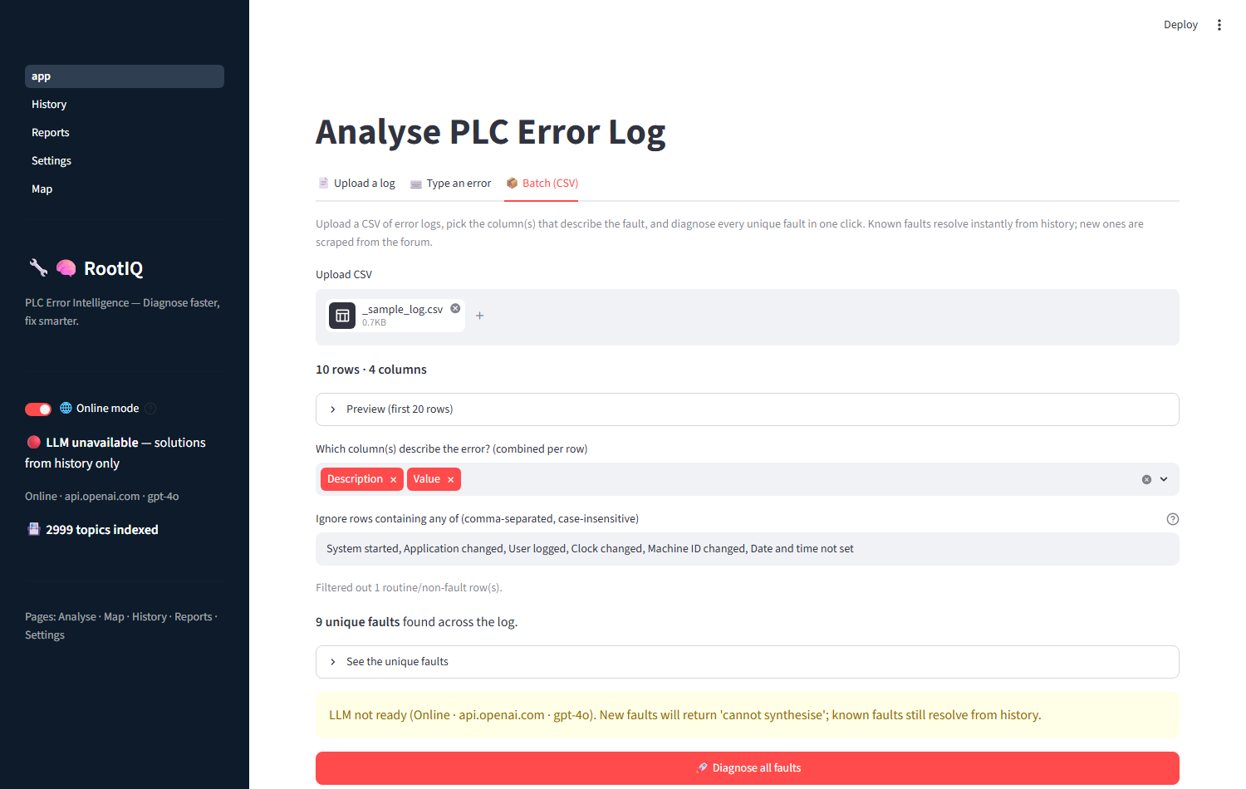
THREE WAYS IN
Upload a log, type a code, or batch a whole CSV
▪ A real IQAN system log, semicolon-delimited with a BOM, parsed cleanly
▪ De-duplicated to nine unique faults across the log
▪ One click: known faults instant, new ones scraped and reasoned
Routine entries such as System started are filtered out automatically.
RootIQ, PLC Error Intelligence
rootiq.streamlit.app 6 / 15

Slide 7
A CITED ANSWER
Reasoned across multiple threads, never a single page
XC44, No contact
▪ Inline citations [1][2] on every step, plus all source links
▪ Weighs higher-voted, answered community comments
▪ Output is parsed only as JSON. The model is never wired to a file or command tool
High confidence
Root cause: the expansion module lost CAN communication, usually termination or wiring [1].
1. Verify 120 ohm termination at both ends [1]
2. Inspect CAN_H and CAN_L for opens or shorts [1][2]
Sources: No contact and critical CAN error, CAN bus-off termination
RootIQ, PLC Error Intelligence
rootiq.streamlit.app 7 / 15

Slide 8
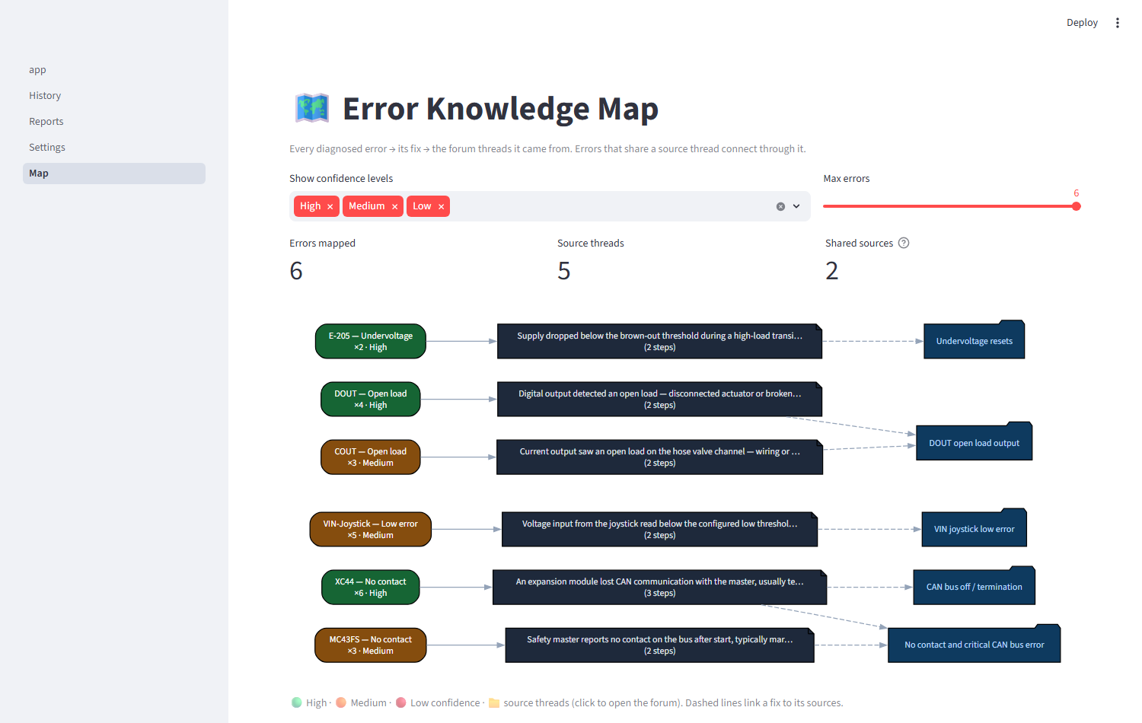
THE KNOWLEDGE MAP
Related faults connect through shared forum threads
▪ Each unique error is one node, sized by occurrence
▪ Linked to its fix and the forum threads it cited
▪ Shared threads converge, so related faults visibly connect
RootIQ, PLC Error Intelligence
rootiq.streamlit.app 8 / 15

Slide 9
THE HARNESS
Sandboxed tools, drop-in skills, editable config
Sandboxed tools
read, write, create, list, transform_markdown (md to HTML), and run_command. Every path passes through _safe_path().
Drop-in skills
Any skills/*.py with a SKILL dict is auto-discovered. Add one and it appears, with no harness edit.
Editable config
mcp.json sets the LLM provider, forums, and scraping limits, with no code change.
The loaded extension is extract_log (problem log to text and codes), alongside lookup_history, save_solution, phase1_crawl, and phase2_scrape.
RootIQ, PLC Error Intelligence
rootiq.streamlit.app 9 / 15

Slide 10
SECURITY, DEFENSE IN DEPTH
A wide attack surface, guarded in four layers
1
security_check(tool, args)
Pattern and command screen before every tool call
2
_safe_path()
Authoritative sandbox using resolve() and is_relative_to
3
check_url()
Scheme check and domain allowlist before any HTTP
4
rejection_log.jsonl
Every block recorded and shown in Settings
security_check("run_command", {"command":"rm -rf /"}) returns (False, 'Blocked command: rm')
_safe_path("../../etc/passwd") raises SandboxError
RootIQ, PLC Error Intelligence
rootiq.streamlit.app 10 / 15

Slide 11
SECURITY, PER-TOOL VERDICTS
Each risk is blocked, mitigated, or honestly accepted
Tool or surface | Risk | Verdict
File operations | path traversal out of the sandbox | Blocked
run_command | shell injection from tool output | Mitigated
transform_markdown | HTML or script injection | Mitigated
Outbound HTTP | SSRF and scraping abuse | Mitigated
Prompt injection | scraped or file text as instructions | By design
Secrets | API key leakage | Mitigated
Skills folder | arbitrary code at import time | Accepted
Honest acceptance of a risk that is understood, rather than pretending it is not there.
RootIQ, PLC Error Intelligence
rootiq.streamlit.app 11 / 15

Slide 12
HOW IT MAPS TO THE ASSIGNMENT
All four deliverables are in the repository
✓ The harness
Working code. The app runs headless with zero exceptions
✓ A loaded extension
Five drop-in skills, led by extract_log
✓ README and security
Per-tool risks marked blocked, mitigated, or accepted, with diagrams
✓ Presentation
This deck, with screenshots from the live app
Offline (Ollama) Safety interlock and log Evaluation and retry loop Context caps Staged multi-agent roles
RootIQ, PLC Error Intelligence
rootiq.streamlit.app 12 / 15

Slide 13
HONESTY NOTES
Stated plainly, because the brief rewards it
▪ mcp.json is config, not a literal MCP server. The real extension mechanism is the drop-in skills loader.
▪ Skills are not sandboxed. They are trusted first-party code; adding one is equivalent to editing the app.
▪ python is allow-listed for run_command. It is fully capable, an accepted convenience.
▪ No robots.txt parsing. The crawler rate-limits, identifies itself, and reads only public threads.
▪ Hosted history is ephemeral. Streamlit Cloud resets on reboot; persistence would need a database.
RootIQ, PLC Error Intelligence
rootiq.streamlit.app 13 / 15

Slide 14
DEPLOYMENT
Runs in two modes
# Offline, local, no key
ollama serve && ollama pull phi3
streamlit run app.py
# toggle Online off
# Online, hosted LLM
export OPENAI_API_KEY=sk-...
streamlit run app.py
# toggle Online on
The hosted instance runs live at rootiq.streamlit.app, with the API key held in Streamlit secrets.
GitHub github.com/novoha/rootiq Live app rootiq.streamlit.app
RootIQ, PLC Error Intelligence
rootiq.streamlit.app 14 / 15

Slide 15
Thank you
Secure, dual-mode PLC error intelligence
Victor Otu Hayford, Industrial AI, 2026
GitHub github.com/novoha/rootiq Live app rootiq.streamlit.app

