Slide 1
More Than Testing
Ondřej Šerý

Slide 2
Testing
How?
  Create a (unit) testing scenario
    Choice of input parameters and success criterion
  Run the test and interpret results
What shall I reveal?
  Bugs that manifest themselves
    In the given scenario
    Under a particular thread schedule
What shall I miss?
  Bugs that don’t occur
    Different (limit) cases of inputs
    Different thread schedule
  Bugs that don’t manifest themselves as an observable error
    Correct result by accident
    Exception caught by a too loose catch
Summary of issues:
  Data and scheduling non-determinism
  Result interpretation
“You can never be sure of testing everything in every situation”

Slide 3
Static analysis
Idea
  Take a static look on code
    Abstract syntax tree
    Control flow graph
How?
  Run a tool (e.g., FindBugs) on an arbitrary (even incomplete) code
What shall I reveal?
  Bugs that can be derived from the static view
    Relating to a single statement (e.g., possible null pointer dereference)
    Bug patterns (locking the same locks in different order)
What shall I miss?
  Bugs that depend on a particular execution trace
  Bugs for which no pattern is available
Summary of issues:
  Number of bug patterns
  False negatives due to over-approximation
    Typical answer: “There might be an error”

Slide 4
Static analysis
EXAMPLE
public class Example0 {
public String doMagic(int magic) {
String s;
if (magic > 10) {
s = "big magic";
}
if (magic > 20) {
return "really " + s;
}
return "small magic";
}
}
Ø
decl s
{s}
Ø
magic > 10
{s}
Ø
magic <= 10
s = "big magic"
{s}
Ø
magic > 20
{s}
magic <= 20
Ø
ret "really"+s
{s}
Ø
ret “small magic"

Slide 5
Static analysis – FindBugs
EXAMPLE
FindBugs http://findbugs.sourceforge.net/
  Searches Java bytecode for bug patterns:
    Bad practice
      e.g., Method might drop exception
    Correctness
      e.g., Null pointer dereference
    Malicious code vulnerability
      e.g., (Final static) field is a mutable array
    Multithreaded correctness
      e.g., Synchronization on Boolean could lead to deadlock
    Performance
      e.g., Primitive value is boxed and then immediately unboxed
    Security
      e.g., HTTP cookie formed from untrusted input
    Dodgy
      e.g., Self assignment of local variable

Slide 6
Model-checking
Idea
  Exploration of all reachable states of a program
How?
  Run a tool (e.g., JPF) but
    Complete executable program necessary
    JNI libraries have to be replaced by stubs
    Wait for a long time…
What shall I reveal?
  Bugs in all possible execution paths and scheduling
    Assertion violation
    Exceptions
    Race conditions
What shall I miss?
  Will not check functional correctness (unless asserted in the code)
  Probably will not finish for large programs…
Summary of issues:
  State space explosion
    All states = a hell of a lot of states
    → Typical answer: “Please wait…”

Slide 7
Model-checking
public class Example0 {
public String doMagic(int magic) {
String s;
if (magic > 10) {
s = "big magic";
}
if (magic > 20) {
return "really " + s;
}
return "small magic";
}
}
decl s
magic > 10
magic <= 10
s = "big magic"
magic > 20
magic <= 20
ret "really"+s
ret “small magic"

Slide 8
Model-checking
decl s
Different value of s
→
different state
magic > 10
magic <= 10
s = "big magic"
magic > 20
magic <= 20
ret "really"+s
ret “small magic"
Q: Where do I cheat here?

Slide 9
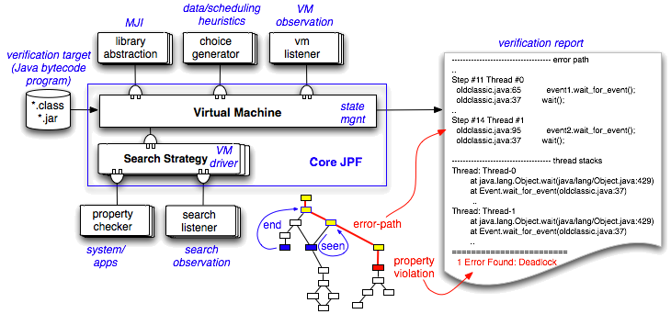
Model-checking – Java PathFinder
EXAMPLE
Java PathFinder http://javapathfinder.sourceforge.net/
  Originally from NASA
  Explicit exploration of state space of Java programs
Image taken from: http://javapathfinder.sourceforge.net/

Slide 10
Advertisement
MFF-UK
NSWI132: Analýza programů a verifikace kódu (Pavel Parízek + Já)
Introduction to theorem proving for software verification
  SAT solvers, SMT solvers, and Theorem provers
Model checking programs
  In general (approaches and tools)
  Explicit state model checking in detail (JPF)
Predicate abstraction and CEGAR (SLAM, Blast, SATABS)
  Basic idea + application of theorem proving
  Extensions: Lazy abstraction, SAT-based abstraction/verifikace
Other applications of theorem proving in software verification
  Contracts (pre/post-conditions, invariants, ...) and verification conditions (Spec#, JML)
Introduction to static program analysis
  Basic idea, comparison with model checking and theorem proving
  Detection of "patternu" in code (Jlint, FindBugs), tools by Coverity, ...
“Traditional" data/control flow analysis + applications (tools)
  Pointer/alias analysis, escape analysis, ...
Abstract interpretation
  Applications in program verification (Blast), Definitions of other analyses via Abstract interpretation
Shape analysis
  Use of Separation logic (or Three value logic) for description of heap structure
Other possible topics (if there is time):
  Compositional techniques (assume-guarantee, thread-modular, ...), Proof-carrying code
Preliminary

