Slide 1
Terracotta
Petr Šmíd
Clustering aplikací jinak
Notes:
Starting slide during load and intro

Slide 2
Terracotta
Terracotta is Network Attached Memory (NAM)
Agglomerates virtual machines
Uses “super” VM
Works very transparently

Slide 3
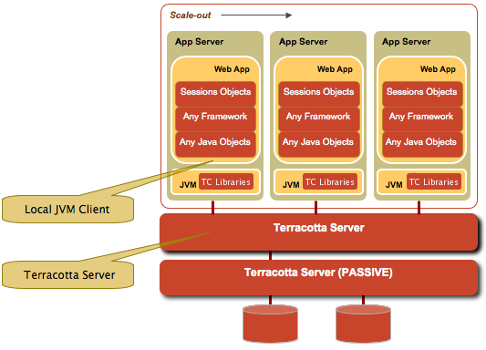
How it works
Terracotta is Network Attached Memory (NAM)

Slide 4
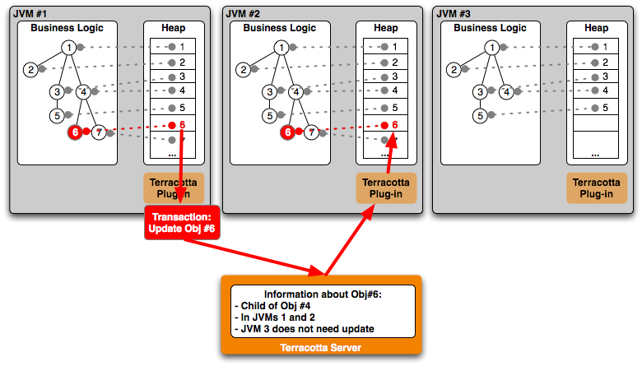
How it works
Fine grained clustering
Distributes only deltas

Slide 5
Basic features
Clustered variable, POJO
Clustered singleton
Clustered method calls
Distributed locks

Slide 6
Demo – clustering a Swing application

Slide 7
Terracotta works like NAM
Linear Scalability - hundreds of connected JVMs
Large Virtual Heaps – up to terabyte of heap
Low Development Impact - JVM plugin approach that allows low-effort, low-impact development

Slide 8
Easy to use
No Required APIs
No Serialization
Declarative

Slide 9
Easy to use
Clustering singletons
Clustering method calls
Cluster Wide Synchronization - synchronized(), wait() & notify() work exactly the same across VMs as across threads
Cluster-wide garbage collector

Slide 10
Usage examples
Distributed caching
Hibernate (second level cache)
HTTP Session
POJO clustering

Slide 11
Easy integration
Application Servers - Geronimo, JBoss, Jetty, Resin, Tomcat, WebLogic, WebSphere CE, WebSphere
O/R Mappers - Hibernate, iBatis
etc...

Slide 12
Where Terracotta helps
Terracotta Helps Reduce Database Load
Terracotta Helps Reduce Development Effort and Dependencies on Application Servers and Frameworks

Slide 13
Hands on
Clustered POJO example

Slide 14
Hands on
Clustered web application
- Two Tomcats with clustered HTTP session

Slide 15
Thank You!
Notes:
Go to this slide at 17:40

