Slide 1
User-Mode Linux
http://user-mode-linux.sourceforge.net/
http://user-mode-linux.sourceforge.net/slides/ols2001/index.html
Ken C.K. Lee
cklee@cse.psu.edu

Slide 2
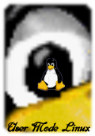
User-Mode Linux
What is User-Model Linux?
  Ported to run itself as a set of Linux (non-root user) process on itself.
  Short form as UML
  UML started by Jeff Dike since Feb 1999
  Use simulated hardware i.e., services provided by host kernel.
  Run (nearly) all applications and services available on the host architecture.

Slide 3
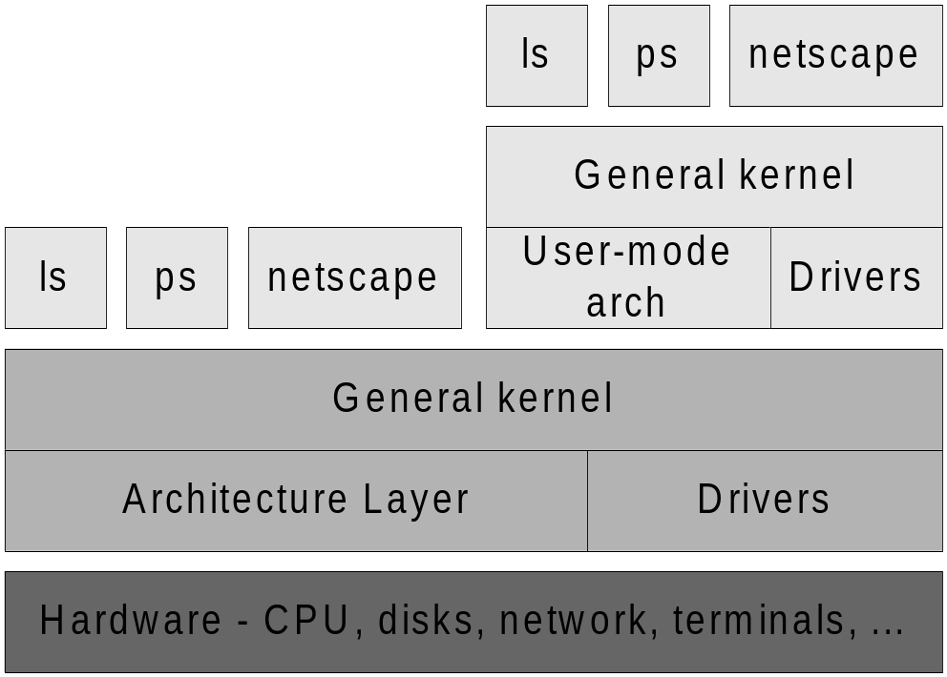
User-Mode Linux
  Provides a self-contained environment:
    Identical as hosting Linux kernel,
    Processes have no access to host resources that were not explicitly provided
  Layer diagram:

Slide 4
User-Mode Linux
All UML devices are virtual; constructed from the abstractions provided by the host kernel.
The UML devices:
  Consoles and serial lines
    Main console, virtual console and serial lines.
  Block devices
    Access to anything on the host which can be mounted, e.g. CDROM, disk partition
  Network devices
    Network access between UML to host OS/UML and between UML to host in outside network.

Slide 5
User-Mode Linux
Focus of the presentation:
  Applications
  Design and Implementation
  Some mentioned future works

Slide 6
User-Mode Linux Applications
Kernel debugging
  on top of software OS, not on separate test machine.
  standard suite of process debugging tools such as gdb, gcov and gprof can be utilized.
Prototyping
  Realizing virtual network with a single physical network.
  Testing software configuration.

Slide 7
User-Mode Linux
Applications
Isolation
  separating users/applications of virtual machines from each other and from the host.
  purposes:
    Against possibly hostile/untrusted processes,
    performance control - allocation of resources (e.g. CPU, memory, disk space), avoidance of race
Multiple environments
  Especially for Linux applications, some incompatibility problems may exists and need to test.
A Linux environment for other operating systems
  Many Linux applications are free and open-source. With UML, those applications can run upon other hosting OS like MS Windows.

Slide 8
User-Mode Linux
Design and Implementation
Kernel mode and user mode
System call virtualization
Traps and faults
Context switching
Virtual memory emulation
Host filesystem access

Slide 9
User-Mode Linux
Design and Implementation
Kernel mode and user mode
  Hardware platforms a built-in mechanism for switching between priviledged kernel mode and unpriviledged user mode, but Linux does not.
  UML constructs it using ptrace system call tracing mechanism.
    When a process in user space, its system called are intercepted by ptrace. When it is in the kernel, no interception.
    When a process executes a system call or receives signal, the tracing thread forces the process to run in the kernel.
    After the transition, the process state is restored and it continues.

Slide 10
User-Mode Linux
Design and Implementation
System call virtualization
  By switching the user and kernel and system calls interception
  Note: the system call must be annulled in the host kernel.
  The process state is preserved.
  When the system call is complete, the process obtains the returned value in its saved registers and returned to user mode.

Slide 11
User-Mode Linux
Design and Implementation
Traps and faults
  A processor trap is the other mechanism which can cause a process to enter the kernel
  On UML, these are implemented with Linux signals.
  UML sets up its own handlers for all important signals, so when the process continues into one of these handlers, that implement the kernel’s interpretation of the signal.
  Interrupts:
    Device interrupts - implemented with SIGIO.
    Timer interruptes - implemented using Linux timers
    Memory faults – implemented with SIGSEGV

Slide 12
User-Mode Linux
Design and Implementation
Context switching
  Stopping the outgoing process and continuing the incoming one.
  Rather than only one address space multiplexed among all processes. each of its processes upon UML has own address space ➔ speed up the context switch.
  Pages of an outgoing process are unmaped before pages of an incoming process are mapped.

Slide 13
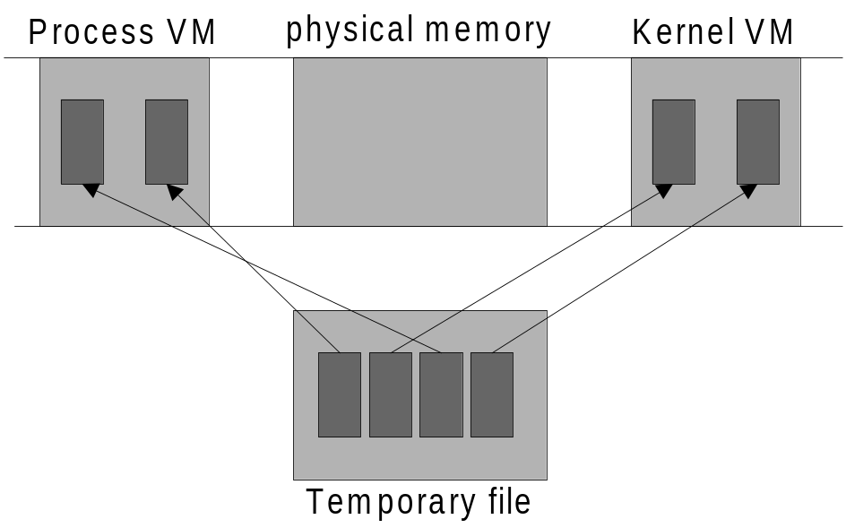
User-Mode Linux
Design and Implementation
Virtual memory emulation
  Virtual machine’s physical memory area
    A physical memory sized file
    Mapping the sized file as a block into address space
  Kernel and process virtual memory by
    Mapping individual pages in file into virtual address spaces.
    Temporary File

Slide 14
User-Mode Linux
Design and Implementation
Host filesystem access
  Local virtual filessystem, hostfs
  Implemented with VFS interface in terms of file access calls on the host.
  VFS operation translate into equivalent libc calls on the host.

Slide 15
User-Mode Linux
Future Works
SMP (Symmetric Multiprocessing)
  This can be done by starting one idle thread per processor and then let them schedule normally
Hostfs extensions
  Other than files, hostfs can mount various/remote filesystems
Performance
  Bottleneck: context switches and memory mapping
Ports
  Architecture ports – ptrace limiting porting on Linux/i386
  Operation system ports – based on Linux system calls
UML as a development platform
  As a support of applications, e.g.,
    Memory management system for languages objects
    Scheduler for task, not process

