Slide 1

DATA GUARD

Slide 2


Slide 3

fail

Slide 4



PHYSICAL
LOGICAL
PHYSICAL
SNAPSHOT
PRIMARY

Slide 5
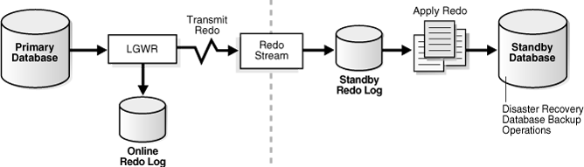

Slide 6

PRIMARY
PHYSICAL
LOGICAL
COPY BY RMAN
TRANSFORM TO
SWITCHOVER / FAILOVER

Slide 7
Configure ODG: PRIMARY [PFILE]
LOG_ARCHIVE_DEST_1 = 'LOCATION=C:\oracle\primary\logs
VALID_FOR=(ALL_LOGFILES,ALL_ROLES)
DB_UNIQUE_NAME=primaryDB'

Slide 8
Configure ODG: PRIMARY [PFILE]
LOG_ARCHIVE_DEST_1 = 'LOCATION=C:\oracle\primary\logs
VALID_FOR=(ALL_LOGFILES,ALL_ROLES)
DB_UNIQUE_NAME=primaryDB'
LOG_ARCHIVE_DEST_2 = 'SERVICE=StandbyNetServiceName1 ASYNC
VALID_FOR=(ONLINE_LOGFILES,PRIMARY_ROLE)
DB_UNIQUE_NAME=StandbyDB1'
LOG_ARCHIVE_DEST_3 = 'SERVICE=StandbyNetServiceName2 ASYNC
VALID_FOR=(ONLINE_LOGFILES,PRIMARY_ROLE)
DB_UNIQUE_NAME=StandbyDB2'

Slide 9
Configure ODG: STANDBY [PFILE]
FAL_SERVER = PrimaryNetServiceName

Slide 10
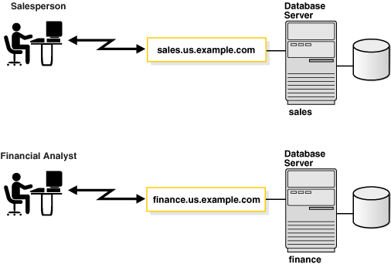
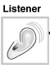
Oracle Database Naming Principles
CONNECT user/pwd
@NetServiceName
INSTANCE
SERVICE_NAME

Slide 11
Oracle Database Naming Principles
Net Service Name
=
Listener IP + Protocol + SERVICE_NAME
Registered in tnsnames.ora

Slide 12
What we need to restore ODG?
PFILEs (for all databases)
Network files: tnsnames.ora, listener.ora (for all hosts)
Database Role -> Host IP or DNS name
Primary or Physical Standby database in backup
(+ Logical database)

Slide 13
Q&A

