Slide 1

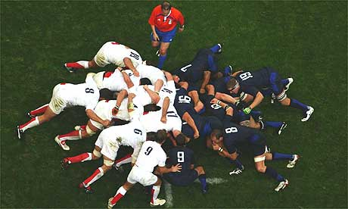
An Introduction
to Scrum
Róbert Šoffa
@UPJŠ
22.02.2010
Notes:
Use whichever opening slide you prefer

Slide 2
Motivation
Small percentage of successfully finished projects
High complexity/Expectations
Non-realistic schedules
Wrong customer requirement priorities
Test failures
Input from developers

Slide 3


The Agile Manifesto–a statement of values
Individuals and interactions
Process and tools
over
Working software
Comprehensive documentation
over
Customer collaboration
Contract negotiation
over
Responding to change
Following a plan
over
Source: www.agilemanifesto.org

Slide 4
Agile Methods
Extreme Programming (XP)
Feature Driven Development (FDD)
Scrum
Lean Programming
Dynamic Systems Development Method

Slide 5
Agile Practices
Test Driven Development (TDD)
Behavior Driven Development (BDD)
Continuous Integration
Pair Programming
Planning Poker

Slide 6
Scrum in 100 words
Scrum is an agile method that allows us to focus on delivering the highest business value in the shortest time.
It allows us to rapidly and repeatedly inspect actual working software (every two weeks to one month).
The business sets the priorities. Teams self-organize to determine the best way to deliver the highest priority features.
Every two weeks to a month anyone can see real working software and decide to release it as is or continue to enhance it for another sprint.

Slide 7
Scrum has been used by:
Microsoft
Yahoo
Google
Electronic Arts
Lockheed Martin
Philips
Siemens
Nokia
IBM
Capital One
BBC
Intuit
Nielsen Media
First American Real Estate
BMC Software
Ipswitch
John Deere
Lexis Nexis
Sabre
Salesforce.com
Time Warner
Turner Broadcasting
Toyota

Slide 8
Scrum has been used for:
Video game development
FDA-approved, life-critical systems
Satellite-control software
Websites
Handheld software
Mobile phones
Network switching applications
ISV applications
Some of the largest applications in use
Commercial software
In-house development
Contract development
Fixed-price projects
Financial applications
ISO 9001-certified applications
Embedded systems
24x7 systems with 99.999% uptime requirements
the Joint Strike Fighter

Slide 9
Characteristics
Self-organizing teams
Product progresses in a series of two- to four-week “sprints”
Requirements are captured as items in a list of “product backlog”
No specific engineering practices prescribed
Uses generative rules to create an agile environment for delivering projects
One of the “agile processes”
Allows changes

Slide 10

Putting it all together

Slide 11
Sprints
Scrum projects make progress in a series of “sprints”
  Analogous to Extreme Programming iterations
Typical duration is 2–4 weeks or a calendar month at most
A constant duration leads to a better rhythm
Product is designed, coded, and tested during the sprint

Slide 12



No changes during a sprint
Change
Plan sprint durations around how long you can commit to keeping change out of the sprint

Slide 13
Scrum framework
Roles
Product owner
ScrumMaster
Team
Ceremonies
Sprint planning
Sprint review
Sprint retrospective
Daily scrum meeting
Artifacts
Product backlog
Sprint backlog
Burndown charts

Slide 14
Scrum framework
Roles
Product owner
ScrumMaster
Team
Ceremonies
Sprint planning
Sprint review
Sprint retrospective
Daily scrum meeting
Artifacts
Product backlog
Sprint backlog
Burndown charts

Slide 15

Product owner
Define the features of the product
Decide on release date and content
Be responsible for the profitability of the product
Prioritize features according to market value
Adjust features and priority every iteration, as needed
Accept or reject work results

Slide 16

The ScrumMaster
Represents management to the project
Responsible for enacting Scrum values and practices
Removes impediments
Ensure that the team is fully functional and productive
Enable close cooperation across all roles and functions
Shield the team from external interferences

Slide 17





The team
Typically 5-9 people
Cross-functional:
  Programmers, testers, user experience designers, etc.
Members should be full-time
  May be exceptions (e.g., database administrator)
Teams are self-organizing
  Ideally, no titles but rarely a possibility
Membership should change only between sprints

Slide 18
Scrum framework
Roles
Product owner
ScrumMaster
Team
Ceremonies
Sprint planning
Sprint review
Sprint retrospective
Daily scrum meeting
Artifacts
Product backlog
Sprint backlog
Burndown charts

Slide 19


Team capacity
Sprint planning meeting
Sprint prioritization
Product backlog
Sprint
goal
Analyze and evaluate product backlog
Select sprint goal
Business conditions
Sprint planning
Decide how to achieve sprint goal (design)
Create sprint backlog (tasks) from product backlog items (user stories / features)
Estimate sprint backlog in hours
Current product
Sprint
backlog
Techno-logy

Slide 20

Sprint planning
Team selects items from the product backlog they can commit to completing
Sprint backlog is created
  Tasks are identified and each is estimated (1-16 hours)
  Collaboratively, not done alone by the ScrumMaster
  Planning poker
High-level design is considered
As a vacation planner, I want to see photos of the hotels.
Code the middle tier (8 hours)
Code the user interface (4)
Write test fixtures (4)
Code the foo class (6)
Update performance tests (4)

Slide 21
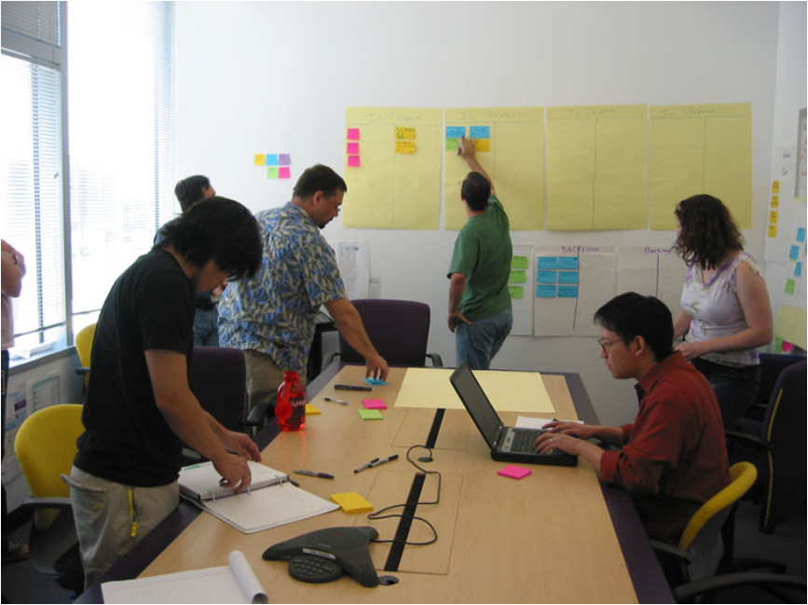
The daily scrum
Parameters
  Daily
  15-minutes
  Stand-up
Not for problem solving
  Whole world is invited
  Only team members, ScrumMaster, product owner, can talk
Helps avoid other unnecessary meetings

Slide 22

Everyone answers 3 questions
1
What did you do yesterday?
2
What will you do today?
3
Is anything in your way?
These are not status for the ScrumMaster
  They are commitments in front of peers

Slide 23
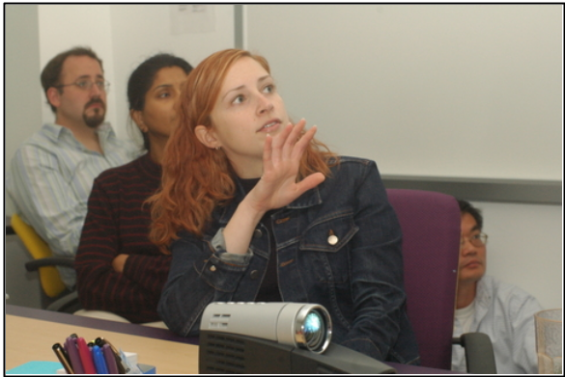
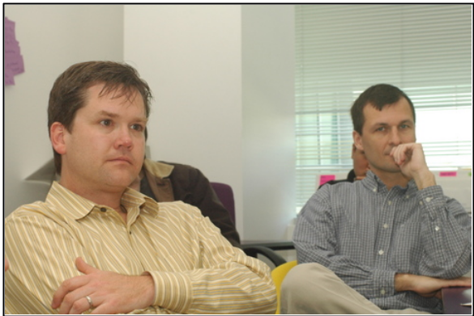
The sprint review
Team presents what it accomplished during the sprint
Typically takes the form of a demo of new features or underlying architecture
Informal
  2-hour prep time rule
  No slides
Whole team participates
Invite the world

Slide 24
Sprint retrospective
Periodically take a look at what is and is not working
Typically 15–30 minutes
Done after every sprint
Whole team participates
  ScrumMaster
  Product owner
  Team
  Possibly customers and others

Slide 25
Scrum framework
Roles
Product owner
ScrumMaster
Team
Ceremonies
Sprint planning
Sprint review
Sprint retrospective
Daily scrum meeting
Artifacts
Product backlog
Sprint backlog
Burndown charts

Slide 26

Product backlog
The requirements
A list of all desired work on the project
Ideally expressed such that each item has value to the users or customers of the product
Prioritized by the product owner
Reprioritized at the start of each sprint
This is the product backlog

Slide 27
A sample product backlog
Backlog item | Priority
Allow a guest to make a reservation | 1
As a guest, I want to cancel a reservation. | 1
As a guest, I want to change the dates of a reservation. | 2
As a hotel employee, I can run RevPAR reports (revenue-per-available-room) | 5
Improve exception handling | 4
...
...

Slide 28
Managing the sprint backlog
Individuals sign up for work of their own choosing
  Work is never assigned
Estimated work remaining is updated daily
Any team member can add, delete or change the sprint backlog
If work is unclear, define a sprint backlog item with a larger amount of time and break it down later
Update work remaining as more becomes known

Slide 29
A sprint backlog
Tasks
Mon
Tues
Wed
Thur
Fri
Code the user interface
8
4
8
Code the middle tier
16
12
10
4
Test the middle tier
8
16
16
11
8
Write online help
12
Write the foo class
8
8
8
8
8
Add error logging
8
4

Slide 30
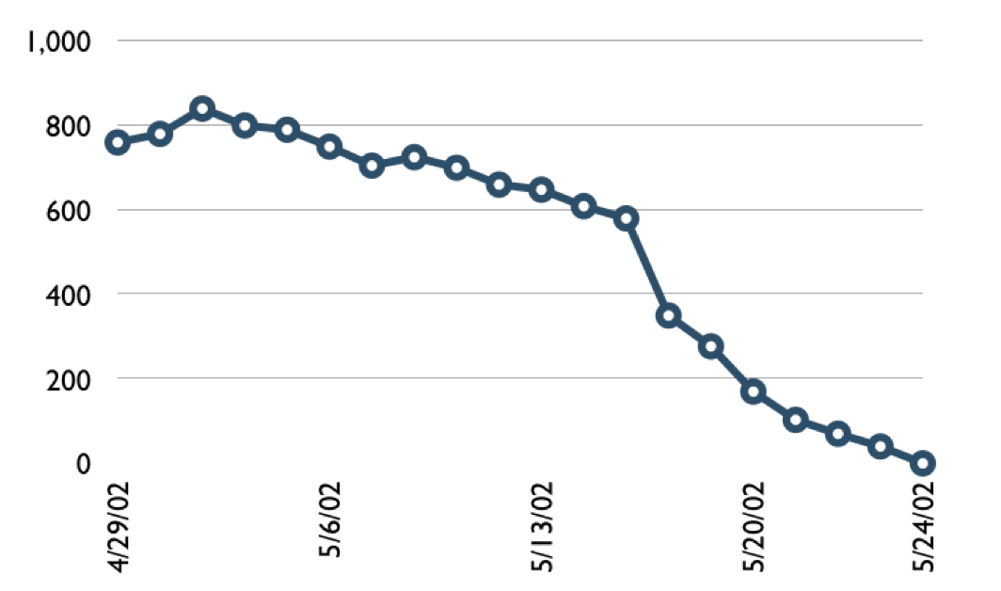

A sprint burndown chart
Hours

Slide 31
Tasks
Mon
Tues
Wed
Thur
Fri
Code the user interface
8
4
8
Code the middle tier
16
12
10
7
Test the middle tier
8
16
16
11
8
Write online help
12
50
40
30
Hours
20
10
0
Mon
Tue
Wed
Thu
Fri

Slide 32
Scalability
Typical individual team is 7 ± 2 people
  Scalability comes from teams of teams
Factors in scaling
  Type of application
  Team size
  Team dispersion
  Project duration
Scrum has been used on multiple 500+ person projects

Slide 33






Scaling through the Scrum of scrums

Slide 34
Scrum of scrums of scrums

Slide 35
Where to go next
www.agilemanifesto.org
www.mountaingoatsoftware.com/scrum
www.scrumalliance.org
www.agile.sk

Slide 36
Advantages – disadvantages
Questions

Slide 37

Thank you for your attention.

