Slide 1
Nimda Security
Cpp Algorithm Study Week5
Binary Search
2025.05.22 (Tue)

Slide 2
Linear Search 선형 탐색
Target Data : 6
1
2
3
4
5
6
7
Time Complexity : O(N)
총 6번 탐색

Slide 3
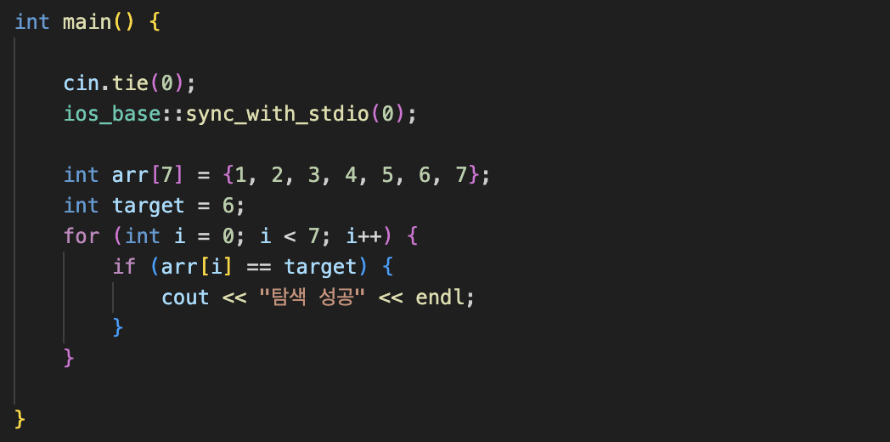

Slide 4
Up Down Game
Binary Search 이진 탐색
Target Data : 6
1
2
3
4
5
6
7
4 == Target(6) ? False
(1 + 7) / 2 = 4

Slide 5
Up Down Game
Binary Search 이진 탐색
Target Data : 6
1
2
3
4
5
6
7
6 == Target(6) ? True
(5 + 7) / 2 = 6

Slide 6
Up Down Game
Binary Search 이진 탐색
Target Data : 6
1
2
3
4
5
6
7
Time Complexity : O(NlogN)
총 2번 탐색

Slide 7
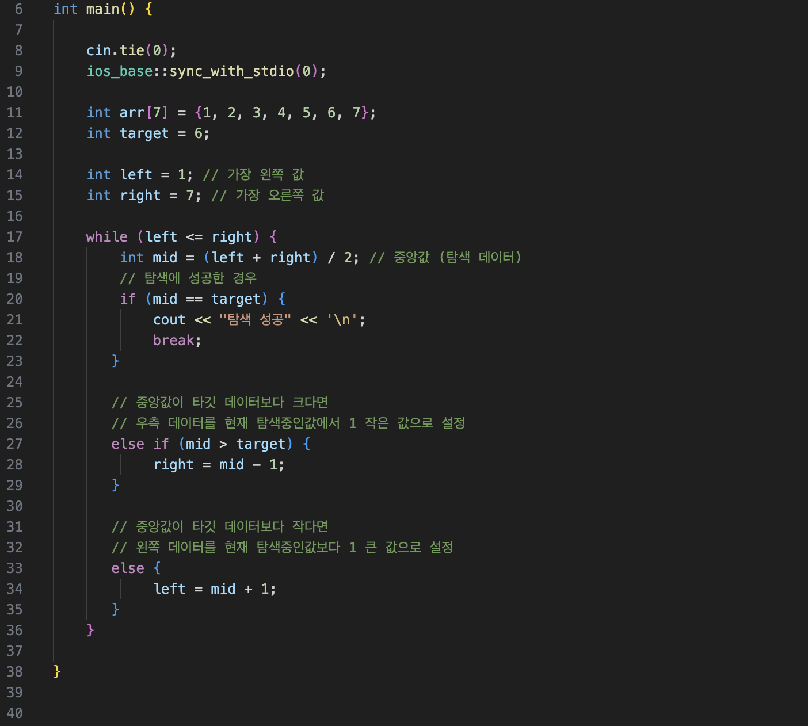
8
2
3
4
5
6
3
left
right
2
3
3
4
5
6
8
left = 2
Right = 8

Slide 8
target
1
2
3
4
5
6
7
left
right
mid

Slide 9
target
1
2
3
4
5
6
7
mid
left
right

Slide 10
target
1
2
3
4
5
6
7
mid
left
right

Slide 11
mid
target
1
2
3
4
5
6
7
left
right

Slide 12
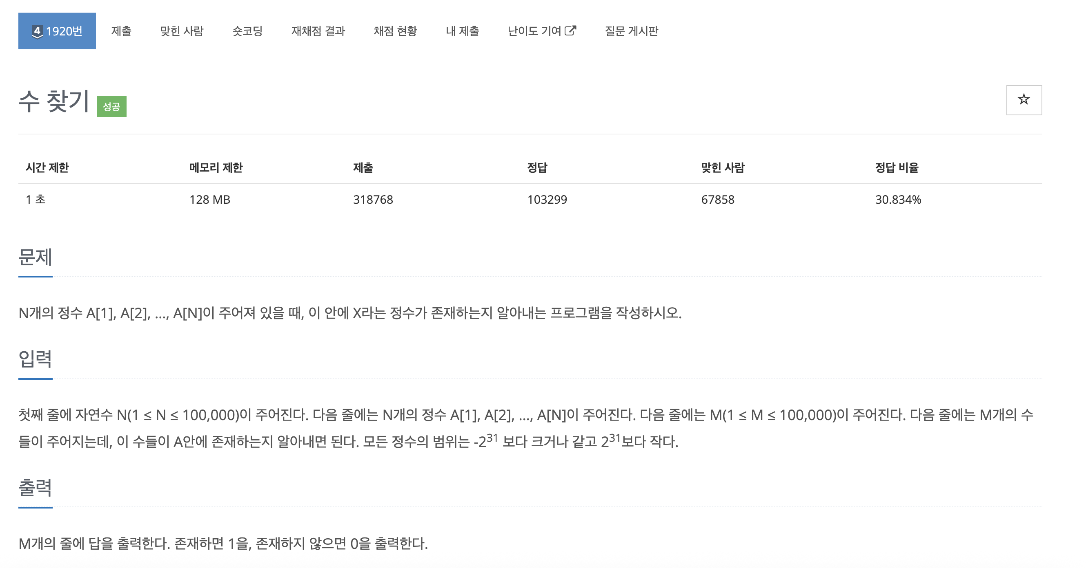

Slide 13
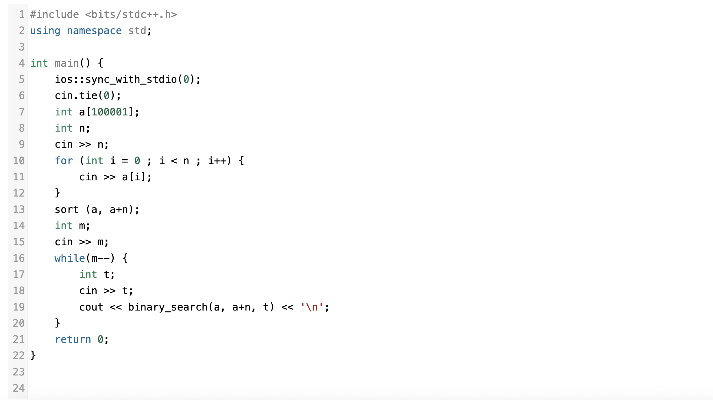

Slide 14
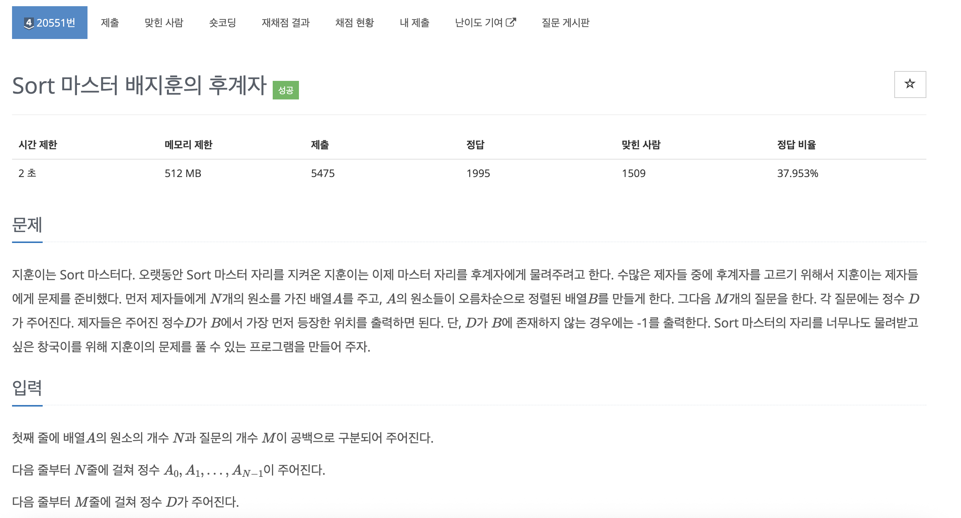

Slide 15
