Slide 1
Motorbike Fault Diagnosis Expert System
Group 2 · Introduction to Artificial Intelligence (261_72ITSE30303_01) · Lecturer: Dr. Nguyen Thanh Huy
Tăng Thoại Lâm · Kiều Bảo Giang · Nguyễn Nam Khoa
Notes:
Lâm: Good morning. We are Group 2, and our project is a rule-based expert system that diagnoses common motorbike faults.

Slide 2
Team and tasks
Tăng Thoại Lâm
Kiều Bảo Giang
Nguyễn Nam Khoa
Team leader · 2474802010210
Member · 2474802010095
Member · 2474802010194
Knowledge base: 79 symptoms, 40 faults, 88 rules with sources
Six bike models and owner's-manual specs
MotoLogic interface, CLI and .exe
Diagnosis assistant and rule-based chat
Forward chaining engine
Certainty factors (MYCIN)
Wang's algorithm prover
MotoLogic design and By-symptoms screen
Backward chaining engine
Why / how explanations
Step-by-step screen
Evaluation on 30 scenarios, charts
Report: Ch. 1, 2, 3.1, 3.5, 6; merged report and slides
Report: Ch. 3.2, 3.3, 5
Report: Ch. 3.4, 4
Notes:
Lâm: Our team has three members. I led the team and built the knowledge base, the bike-model data, the MotoLogic interface, the executable and the chat assistant. Giang built forward chaining, the certainty factors and Wang's prover, and designed the MotoLogic screens. Khoa built backward chaining with its explanations, the step-by-step screen and the evaluation.

Slide 3
Contents
01
Problem and architecture
02
Forward chaining, CF, Wang
Lâm · 2:00
Giang · 1:45
03
Backward chaining and evaluation
04
Diagnosis assistant and chat
Khoa · 1:45
Lâm · 0:45
05
Live demo
06
Conclusion and questions
All · 5:00
Lâm · 0:45
Notes:
Lâm: I start with the problem and the architecture. Giang then presents forward chaining, certainty factors and Wang's algorithm, and Khoa backward chaining and the evaluation. I present the diagnosis assistant, then we show the program live and conclude.

Slide 4
The problem: riders only see symptoms
74 million
79
40
motorbikes in Viet Nam, more than it has adults (WHO, 2024)
symptoms
faults
yes / no questions in Vietnamese and English
6 subsystems, each with a severity and an action
The same “it won't start” can be a flat battery or a fault for a mechanic.
88
6
Goals
Rank the likely faults by certainty factor (CF)
Say which faults need a mechanic
Explain every conclusion with its rules
rules
bike models
IF … THEN, each with a CF and a source
Vision, Air Blade, Lead, Wave, Future, Exciter
Notes:
Lâm: Viet Nam has about 74 million motorbikes, more than it has adults. When one breaks down, the rider only sees symptoms, and the same 'it won't start' can be a flat battery or a fault for a mechanic. Our system ranks the likely faults by certainty factor, says which ones need a mechanic, and explains every conclusion with its rules. The knowledge base has 79 symptoms, 40 faults in six subsystems and 88 rules, each with a CF and a source, plus specs for six popular models.

Slide 5
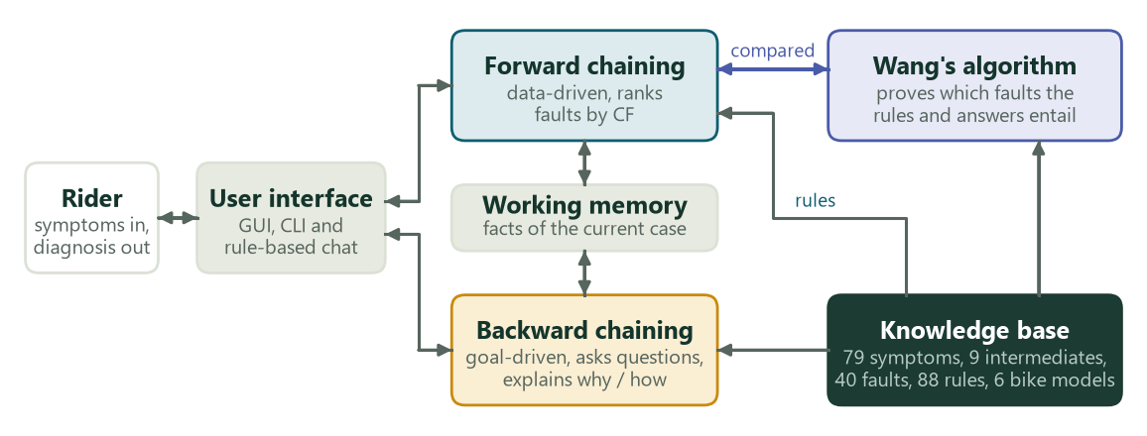
One knowledge base, three ways to reason
One JSON file per subsystem. The rule checker reports duplicate rules, unused symbols, missing sources and cycles: 0 errors, 0 warnings.
Notes:
Lâm: The knowledge base is one JSON file per subsystem, and a rule checker reports duplicate rules, unused symbols, missing sources and cycles; it reports none. The same rules drive forward chaining, backward chaining and the chat assistant, and Wang's algorithm proves the conclusions independently. The program is a desktop app, MotoLogic, that runs offline. Giang, please.

Slide 6
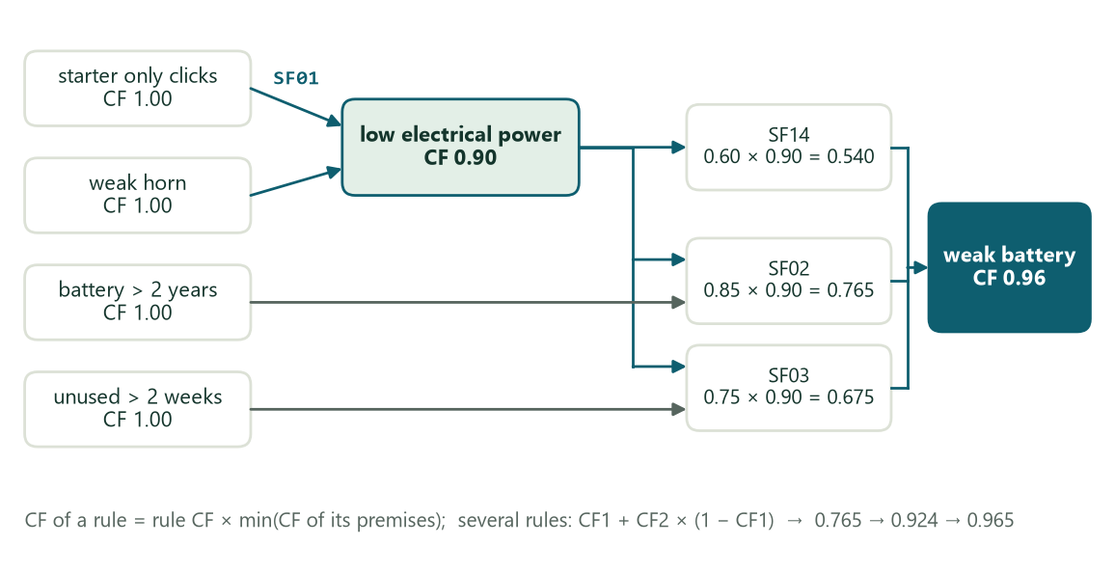
Forward chaining ranks faults by certainty
1
Facts in, rules fire
Each rule counts its unproved premises; at zero it fires (PL-FC-ENTAILS, AIMA ch. 7).
2
MYCIN certainty factors
AND: min CF of the premises. Rule: its CF × that. Same conclusion: CF1 + CF2 × (1 − CF1).
3
Report
Faults with CF ≥ 0.20, best first.
Scenario SE01: SF01, then SF02, SF03 and SF14 combined to CF 0.96.
Notes:
Giang: Forward chaining is data-driven. Each rule counts its unproved premises, and when the count reaches zero the rule fires and its conclusion joins the agenda, as in PL-FC-ENTAILS in the textbook. To rank faults we use MYCIN certainty factors: premises joined by AND take the minimum, a rule multiplies that by its own CF, and rules with the same conclusion combine as CF1 plus CF2 times one minus CF1. For a weak battery three rules give 0.765, 0.675 and 0.54, which combine to 0.96. Faults with a CF of at least 0.2 are reported, best first.

Slide 7
Wang's algorithm checks the reasoning
The question for Wang
0 disagreements
rules, answers ⇒ fault
between Wang and forward chaining on 30 scenarios and 500 random symptom sets (21,200 comparisons)
Each rule becomes (p1 ∧ … ∧ pk) → q; each “yes” is an atom.
Wang removes one connective at a time until every branch is an axiom.
Forward chaining is sound and complete for definite clauses, so both must find the same faults.
28/30 → 30/30
the two failures were missing rules, not engine bugs; four fallback rules for “dead-end” intermediate facts fixed them
Notes:
Giang: Our inference engine is our own code, so it could be wrong. We check it with Wang's algorithm, an independent theorem prover. Each rule becomes an implication, each yes answer an atom, and Wang removes one connective at a time until every branch has the same atom on both sides. Forward chaining is sound and complete for definite clauses, so both must find the same faults. On 30 scenarios and 500 random symptom sets, more than 21,000 comparisons, they never disagree. The first run failed two scenarios, and Wang failed them too, so rules were missing: four fallback rules fixed them. Khoa, please.

Slide 8
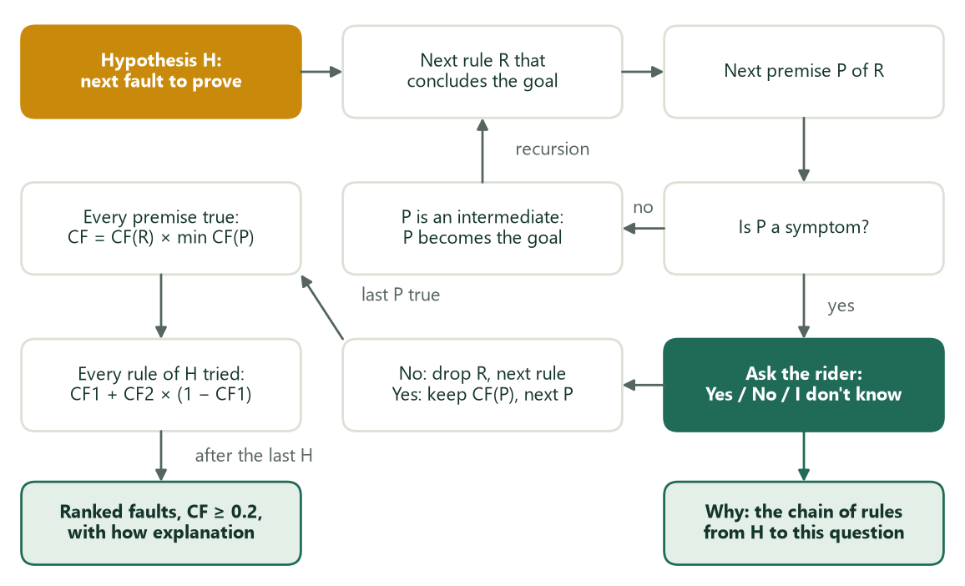
Backward chaining asks only what it needs
1
Pick a hypothesis
Each fault of the chosen part is a goal to prove.
2
Work back through the rules
Premises become sub-goals; intermediate facts are proved the same way.
3
Ask, remember, prune
A symptom is asked once; a false premise drops the rule.
Why: the rule chain to this question. How: the facts and rules behind a fault.
Notes:
Khoa: Backward chaining is goal-driven. Each fault of the part the rider chooses is a hypothesis. For every rule that concludes it, the premises become sub-goals; an intermediate fact is proved the same way, and a symptom is asked once and remembered. A rule is dropped at its first false premise, so questions that cannot change the result are never asked. All rules of a goal are combined with the same CF formulas, so the result equals forward chaining. 'Why' shows the rule chain to the current question, and 'how' shows the facts and rules behind a fault.

Slide 9
Evaluation on 30 scenarios
30/30
top-1 with forward and backward chaining, same CFs
9.0 questions
when the rider picks the part first: 4.4× fewer than 39.7
8/10 · 7/10
assistant on 10 new descriptions (Vietnamese / English)
Fair comparison: reading the same description, backward chaining still asks 36.3; stopping at the first proved fault gives 22.2 (28/30).
Notes:
Khoa: We tested 30 scenarios, ten per subsystem group, each written by a member who did not write the rules. Both engines rank the expected fault first in all 30, with the same CFs. Backward chaining over every part asks 39.7 questions; if the rider picks the part first it asks 9, four times fewer. The assistant asks 5.5, but those descriptions were used to write its phrase list; on ten new descriptions it is right 8 times in Vietnamese and 7 in English. Read the same description, backward chaining still asks 36.3, so the assistant is fast mostly because it picks good questions and stops early.

Slide 10
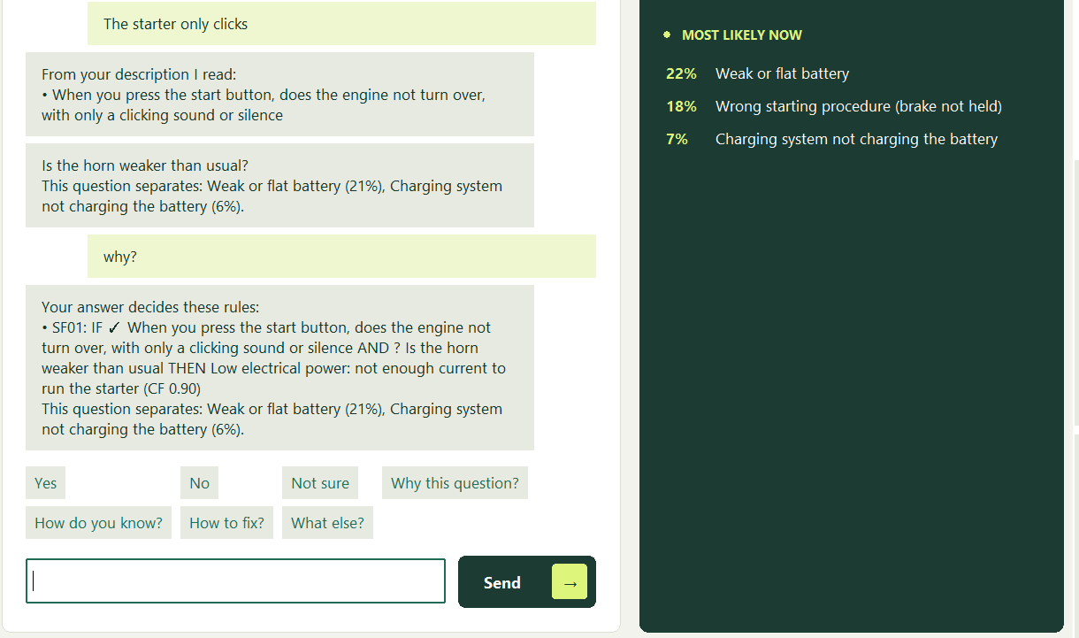
The assistant: words in, rule-based answers out
1
Read the description
Phrase matching without accents, with negation.
2
Ask the most informative question
Largest expected information gain; stop when the leader is proved.
3
Answer from the rules
why? how? how to fix? what else? Every reply quotes the rules.
The rider asks “why?” and gets the rule SF01 with each premise marked.
5.5 questions · 30/30 on the 30 scenarios
Notes:
Lâm: The third way is to describe the problem in words. A phrase matcher reads the symptoms, without accents and with negation. The assistant then asks the question with the largest expected information gain and stops when the leading fault is proved; the final ranking still comes from forward chaining. While it asks, the rider can ask back: why, how do you know, how to fix it, what else. There are no canned replies: every answer is built from the rules, the questions and the CFs. Its weak point is language: it only understands phrasings in its phrase list.

Slide 11
Live demo (5 minutes)
Lâm
Giang
Khoa
Describe it in words
I know my symptoms
Guide me with questions
Honda Vision → Describe it in words
“the starter only clicks, the horn is weak”
ask “why?”, answer “yes”
See the full result
Another bike → I know my symptoms
starter only clicks, weak horn, battery over 2 years
See the result
Click “Cross-check” (Wang)
Guide me with questions → Brakes
yes: soft lever, fluid below MIN
“Why this question?” at question 3
Answer to the end (9 questions)
Shows
Shows
Shows
Rule-based replies; the Vision's battery spec from its owner's manual
Weak or flat battery, confidence 89%; Wang proves it
Brake fluid leak, CF 0.96, take it to a mechanic
Backup: the classic screens (Ctrl+5 By symptoms, Ctrl+6 Step-by-step) with the same scenarios.
Notes:
Lâm: Now the live demo, about five minutes, in the English interface of MotoLogic. Each of us shows one way to diagnose. If MotoLogic fails, we use the classic screens, Control 5 and Control 6, with the same scenarios.

Slide 12
Conclusion
Achieved
Limits
Next
30/30 scenarios ranked first, forward and backward
Wang agrees with forward chaining: 0 disagreements
Part first: 9.0 questions instead of 39.7
Every answer traced to its rules
A “no” cannot lower a CF (positive premises only)
The chat knows only the phrasings in its list
CFs and scenarios written by the team
Negative evidence
Phrases from real repair logs
CFs measured on real repairs
Rules that explain themselves give riders a first diagnosis they can check.
Notes:
Lâm: To sum up, both chaining directions rank the expected fault first in all 30 scenarios, Wang agrees with forward chaining every time, choosing the part first cuts the questions from 39.7 to 9, and every answer can be traced to its rules. The limits: rules have only positive premises, so a 'no' cannot lower a CF; the chat only knows the phrasings in its list; and the CFs and scenarios were written by our team. Next we would add negative evidence, phrases from real repair logs and CFs measured on real repairs.

Slide 13
Thank you for listening
Questions are welcome
Tăng Thoại Lâm
Kiều Bảo Giang
Nguyễn Nam Khoa
Student ID 2474802010210
Student ID 2474802010095
Student ID 2474802010194
Group 2 · MotorbikeExpert.exe runs offline on Windows
Notes:
Lâm: Thank you for listening. We are happy to take your questions.

