Slide 1
Abstract class
Cannot be instantiated, but can be used as a base class
Contains at least one method – abstract method (in C++ terms is the pure virtual method)
Cannot use an abstract class as
a parameter type,
a function return type,
or the type of an explicit conversion, nor can you declare an object of an abstract class. You can, however, declare pointers and references to an abstract
More here - cppreference.com/abstract_class

Slide 2
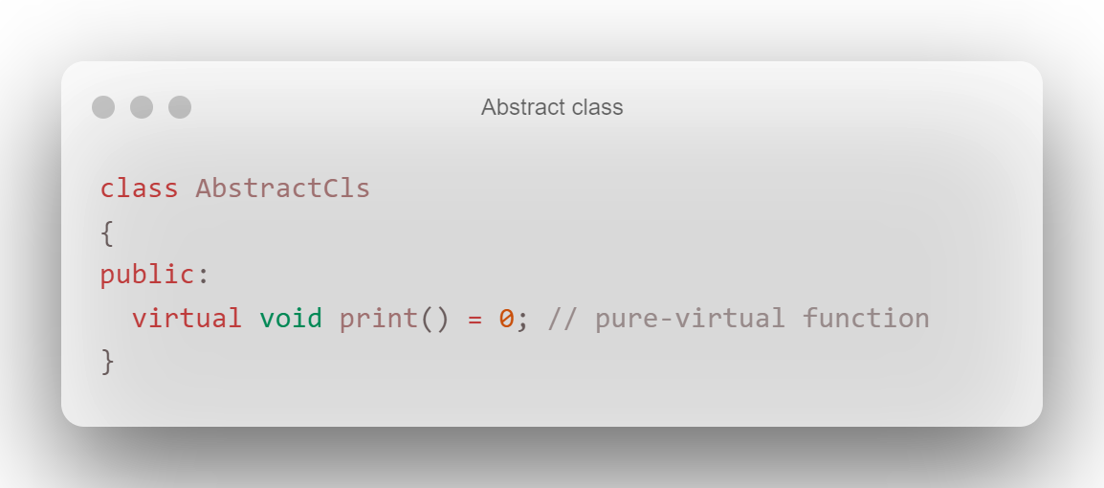
Examples

Slide 3
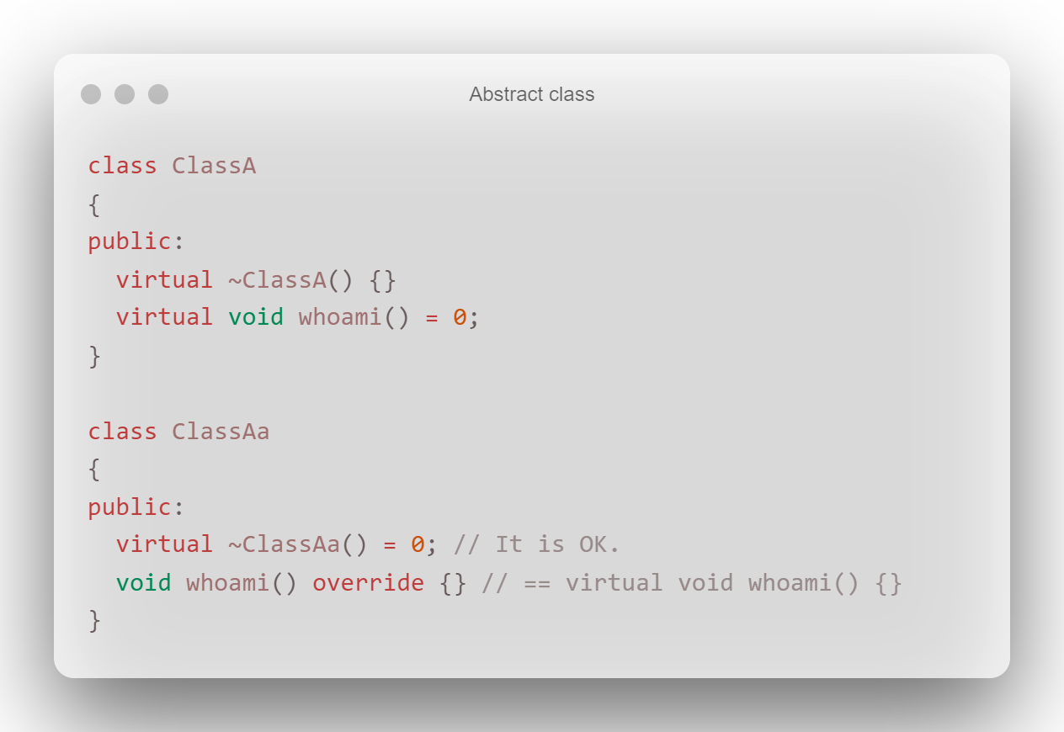
More examples

Slide 4
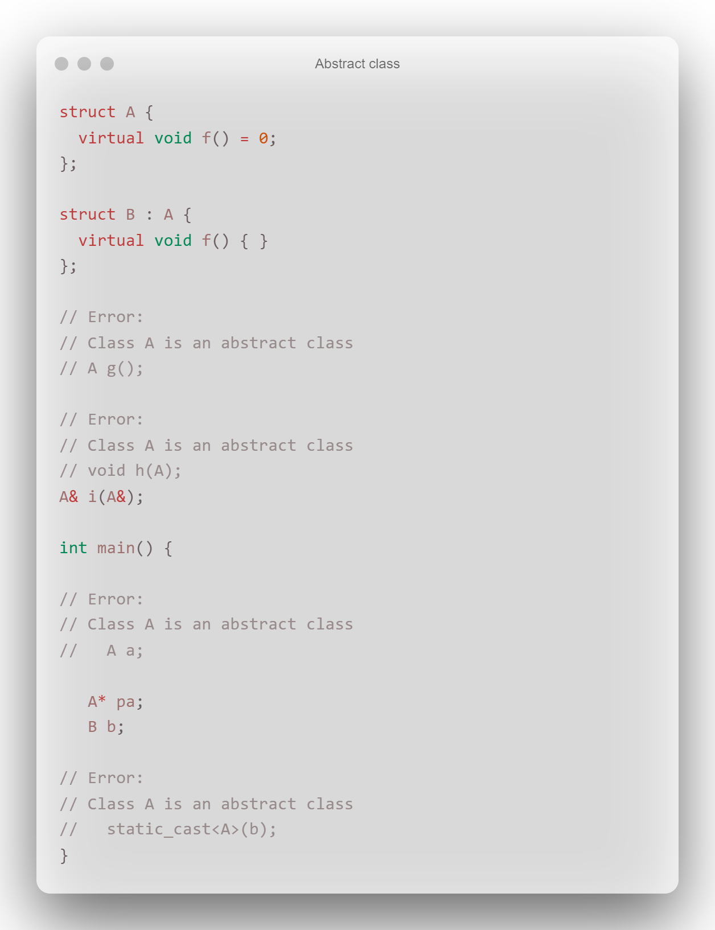
More examples

Slide 5
☕🍖

