Slide 1
A brief about classes
We need a title!
Michal Nowak

Slide 2
Agenda
First look into classes
Details about constructor and destructor
What is this?
Follow the Rule of 0
Copy constructor
Follow the Rule of 3
Move constructor
Follow the Rule of 5

Slide 3
First look into classes
Classes are fundamental block of OOP!
A class is a user-defined data type, which holds data members (fields) and member functions (methods).
A class may / should be interpreted as an equivalent object in the real world.
Remember!
An object is an instance of a class.

Slide 4
Details of constructor
Creation of an object relies on allocation a blocks memory for members and methods. Next it is invoke a method, which is the constructor of object.
In constructor all members are initialized. It depends which values – default or user-defined.
A constructor is defined like a function, but
have to has the same name like the class
doesn’t return any value, even void
may has parameters or no

Slide 5
Details of destructor
Special method which is invoked during deleting instance of the class:
object ends life i.e end of the scope
for the pointer, when was used delete operator
The compiler can define its own destructor if user doesn’t provide one.
The destructor doesn’t return any value, even void.
The destructor doesn’t have any parameters.
A class contains only one destructor.

Slide 6
Follow the Rule of 0
If we don’t define any constructor, then the compiler automatically creates its own default (without parameters) constructor.
This constructor doesn’t assign beginning values to members!
Defining only one own constructor breaks this rule.
From C++ Best Practices - No destructor is always better when it’s the correct thing to do. Empty destructors can destroy performance.

Slide 7
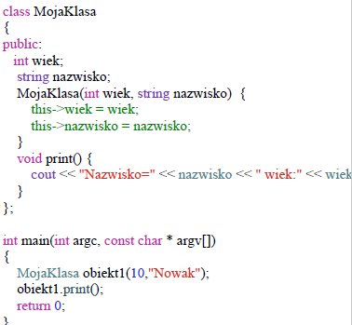
What is this?
This keyword is the pointer to the class

Slide 8
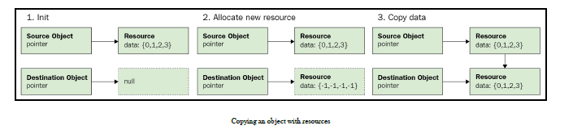
Copy constructor
A copy constructor is a member function that initializes an object using another object of the same class.
The members of newly created object are copied from the already existing object.

Slide 9
Follow of rule 3
Three refers to the special member functions:
copy-constructor,
copy-assignment,
destructor.
If you are handling resources in any of these three functions you most likely need to do it in all three of them.

Slide 10
Copy constructor
Copy Constructor may be called in the following cases:
when an object of the class is returned by value.
when an object of the class is passed (to a function) by value as an argument.
when an object is constructed based on another object of the same class.
when the compiler generates a temporary object.

Slide 11
Limitations of rule 3
Resources which cannot be copied.
Unnecessary copies

Slide 12
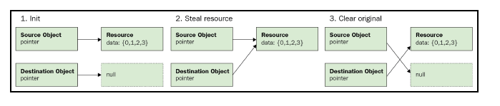
Move constructor (from C++11)
A move constructor is a member function in which the destination object steals the resource straight from the source object, and the source object is reset.

Slide 13
Follow of rule 5
In order to problems of the rule of three, we can get rid this by expanding it to the rule of 5.
Five refers to the special member functions:
copy-constructor,
copy-assignment,
move-constructor,
move-assignment,
destructor.

