Slide 1


Bear Talks
Encapsulation & private, public, protected (access specifiers) in C++

Slide 2
Agenda
Private
Public
Protected
Encapsulation

Slide 3
Private
private: member-declarations
The members declared after the access specifier have protected member access
A private member of a class is only accessible to the members and friends of that class, regardless of whether the members are on the same or different instances.
private base-class
Private inheritance: the public and protected members of the base class listed after the access specifier are private members of the derived class while the private members of the base class are inaccessible to the derived class

Slide 4
Public
public : member-declarations
The members declared after the access specifier have public member access
A public member of a class is accessible anywhere
public base-class
Public inheritance: the public and protected members of the base class listed after the access specifier keep their member access in the derived class while the private members of the base class are inaccessible to the derived class

Slide 5
Protected
protected : member-declarations
The members declared after the access specifier have protected member access
protected base-class
Protected inheritance: the public and protected members of the base class listed after the access specifier are protected members of the derived class while the private members of the base class are inaccessible to the derived class

Slide 6
Protected
A protected member of a class is only accessible:
1) to the members and friends of that class;
2) to the members of any derived class of that class, but only when the class of the object through which the protected member is accessed is that derived class or a derived class of that derived class

Slide 7
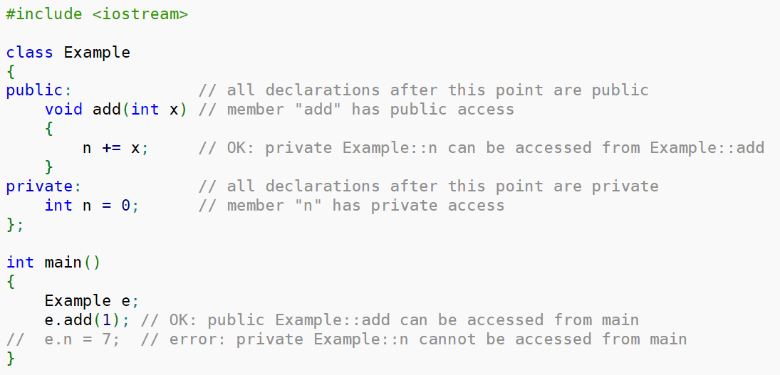
Examples

Slide 8
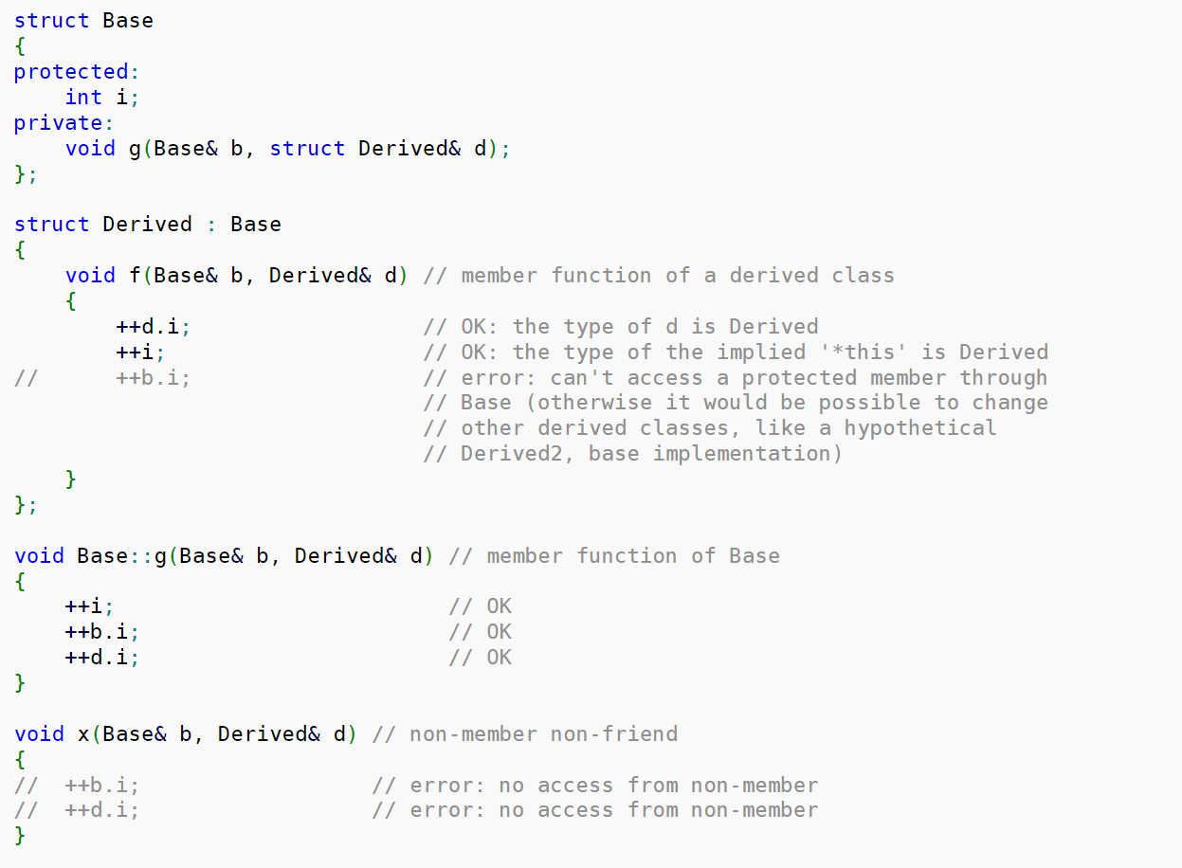
Examples

Slide 9
Encapsulation
The meaning of Encapsulation, is to make sure that "sensitive" data is hidden from users. To achieve this, you must declare class variables/attributes as private (cannot be accessed from outside the class). If you want others to read or modify the value of a private member, you can provide public get and set methods.

Slide 10
Why use encapsulation?
It is considered good practice to declare your class attributes as private (as often as you can). Encapsulation ensures better control of your data, because you (or others) can change one part of the code without affecting other parts
Increased security of data

Slide 11
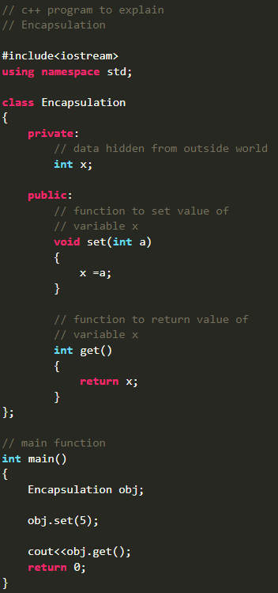
Example

Slide 12
☕🍖

