Slide 1


Bear Talks
Polymorphism

Slide 2
Agenda
What it is
How it works
Types

Slide 3
Polymorphism
Polymorphism in C++ means, the same entity (function or object) behaves differently in diffrent scenarios

Slide 4
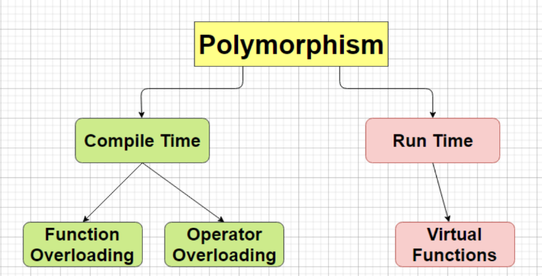
Types of polymorphism

Slide 5
Compile time polymorphism
Function is called at the time of program compilation a.k.a. early binding or static binding
There are two types of compile time polymorphism: function overloading and operator overloading

Slide 6
Function overloading
One function can perform many tasks
In C++, a single function is used to perform many tasks with the same name and different types of arguments. In the function overlo
Readability of the program increases by function overloading.

Slide 7
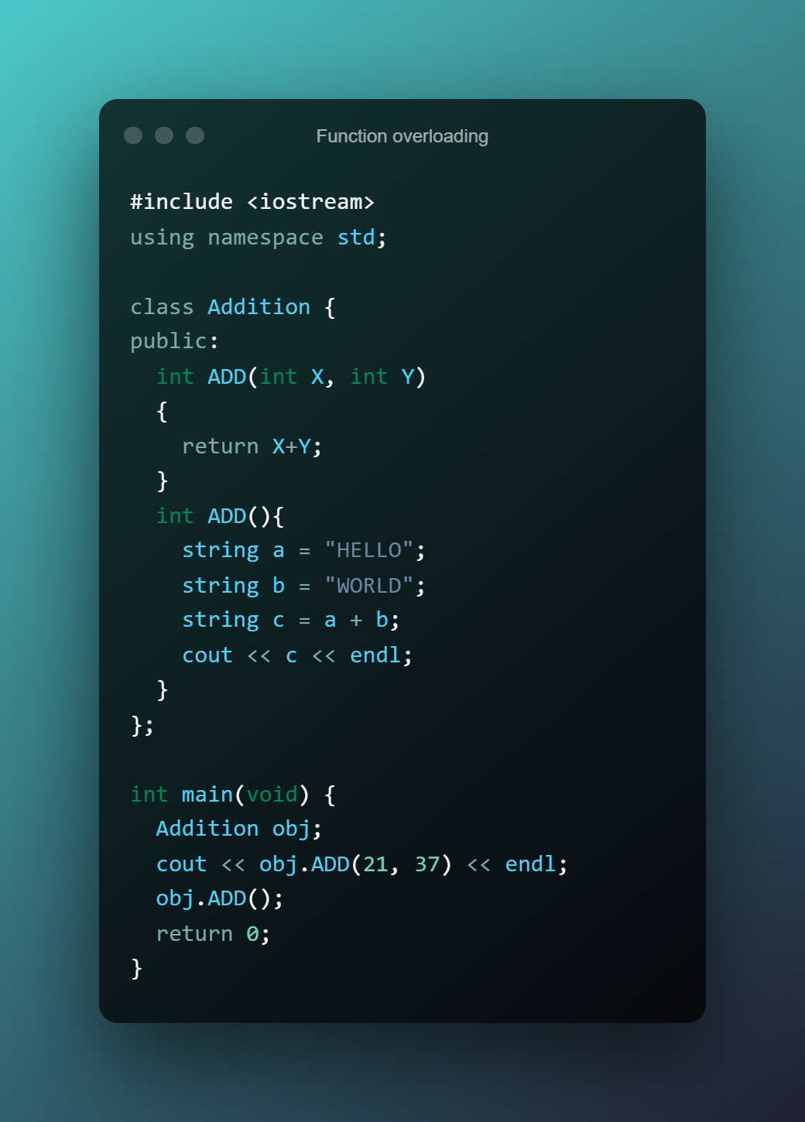
Function overloading

Slide 8
Operator overloading
Defining additional tasks to operators without changing its actual meaning
The purpose of operator overloaading is to provid a special meaning to the user-defined data types
The advantage of operators overloading is to perform different operations on the same operand

Slide 9
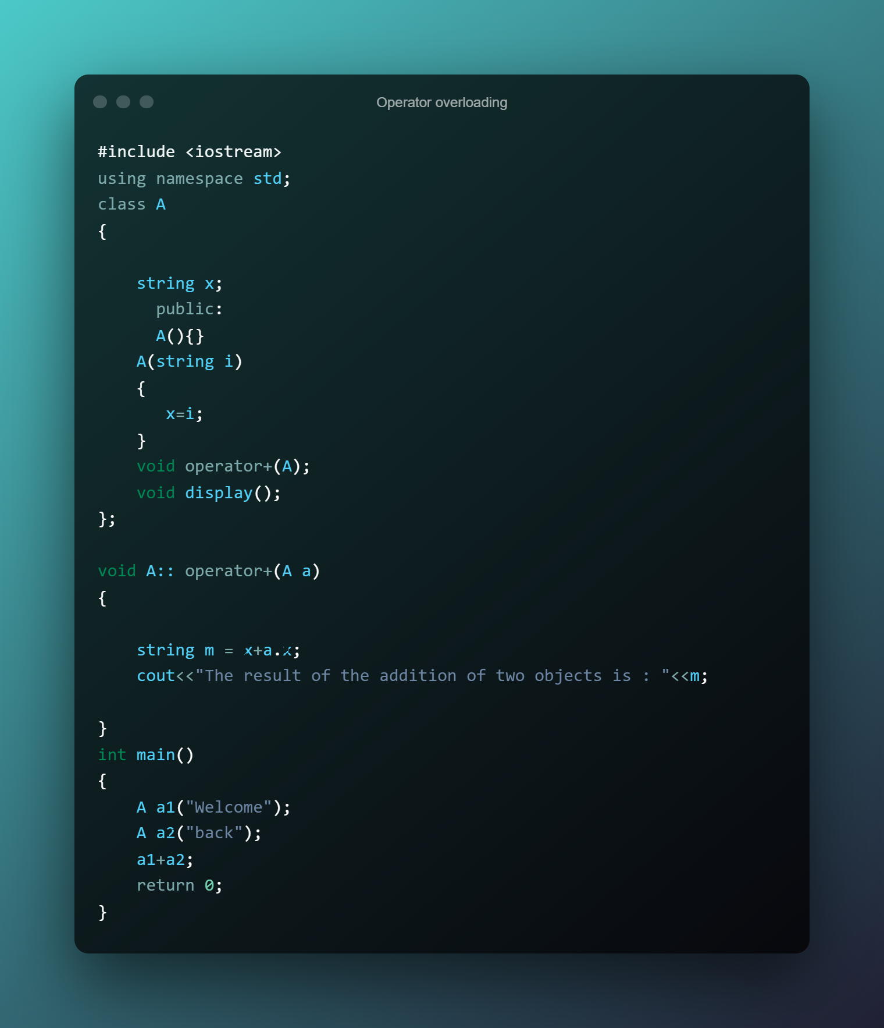
Operator overloading

Slide 10
Runtime polymorphism
Functions are called at the time the program execution. It is known as late binding or dynamic binding.
Function overriding is a part of runtime polymorhpsim. More than one method has the same name with different types of the parameter list.
It is achieved by using virtual functions and pointers. It provides slow execution as it is known at the run time but it’s more flexible as all the things executed are at the run time.

Slide 11
Function overriding
Give the new definition to base class function in the derived class
At that time the base function has been overriden
It is possible in the derived class
In function overriding we have two definitions of the same function, one in the superclass and one in the derived class
The decision about which function definition requires calling happens at runtime

Slide 12
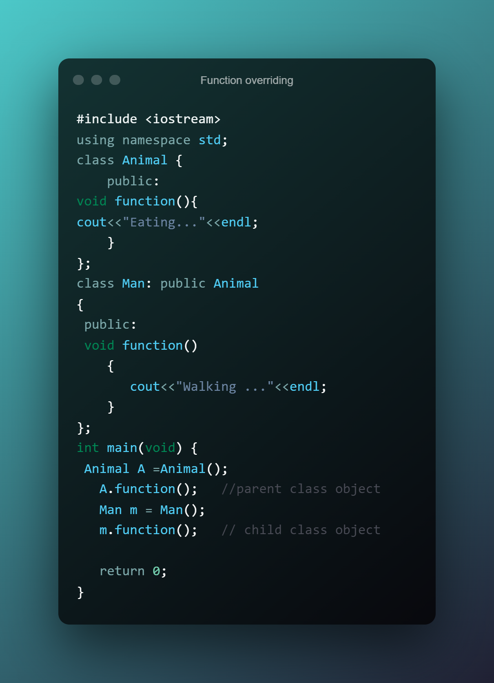
Function overriding

Slide 13
Virtual function
A virtual function is declared by keyword virtual
Virtual function is a member function in the base class. It is part of run time polymorphism. The declaration of the virtual function must be in the base class by using they keyword virtual. A virtual function is not static.
The virtual function helps to telll the compiler to perform dynamic binding or late binding in the function.

Slide 14
☕🍖

