Slide 1

Remote weather station
Michał Nowak • 28.02.2022

Slide 2

Devices and sensors
DFRobot: FireBeetle ESP32 IOT Microcontroller(V3.0)
DFRobot: FireBeetle Covers-Gravity IO Expansion Shield
Gravity BMP388 Barometric Pressure Sensor
Gravity: Analog SHT30 Temperature & Humidity Sensor
Gravity: Analog Ambient Light Sensor
Gravity: Analog Grayscale Sensor

Slide 3







Tech stack
Arduino
C++14
Python 3.10.2
Google Cloud IoT Core
MQTT
JSON
github.com/nowek7/remote_weather_station

Slide 4
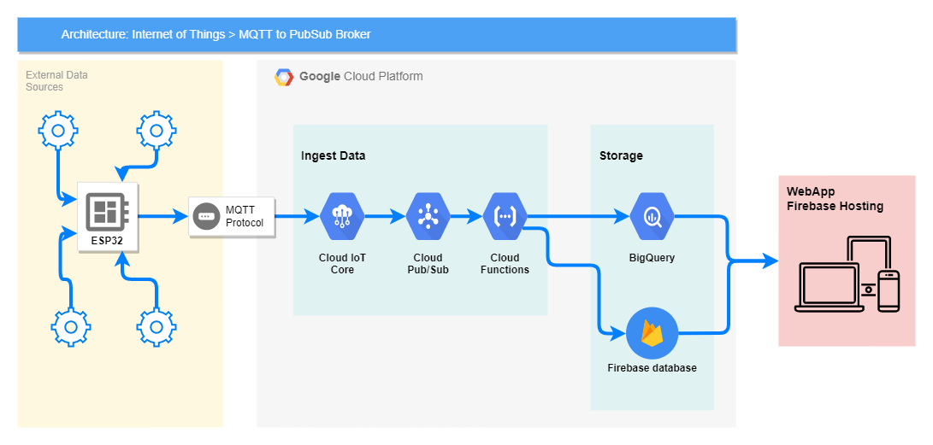

Slide 5
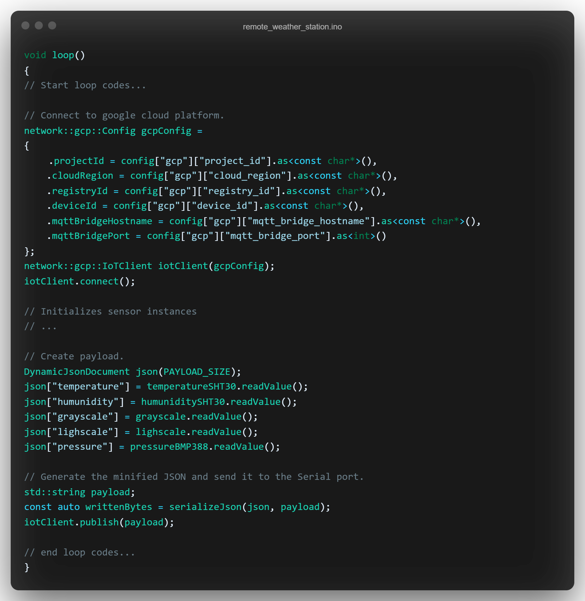
Main loop
github.com/nowek7/remote_weather_station

Slide 6
Retrospection
Limitations
Problems
Analog sensors
Lack of unit tests
Measurement quality
Arduino software
The first approach with Micropython
Flashing binary file into device on Linux
There was needed modify the Google Cloud IOT Core JWT library on Arduino

Slide 7
RTOS ( Zephyr, FreeRTOS)
Wind sensor
Air quality sensor
Visualization tool for iOS / Android
Next steps

Slide 8
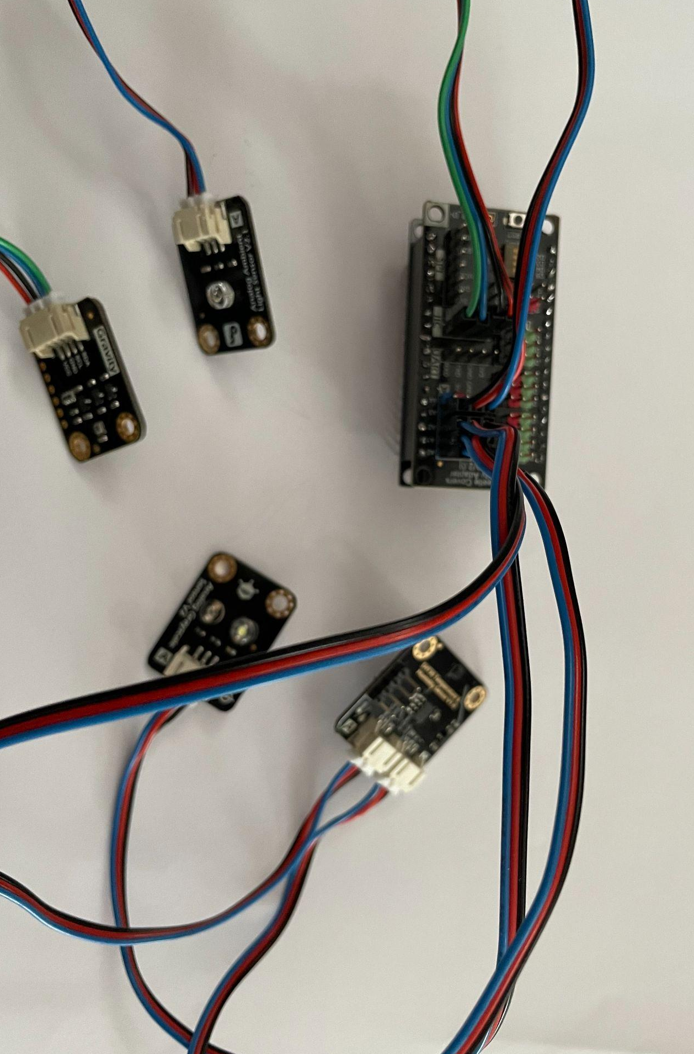
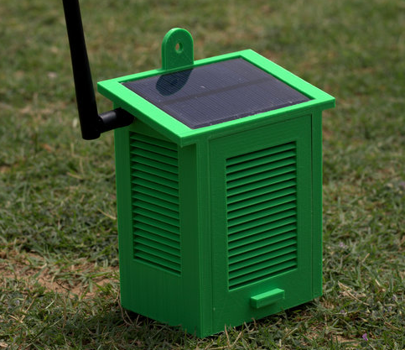

What with the case?

Slide 9


Thank you
Github
LinkedIn

