Slide 1
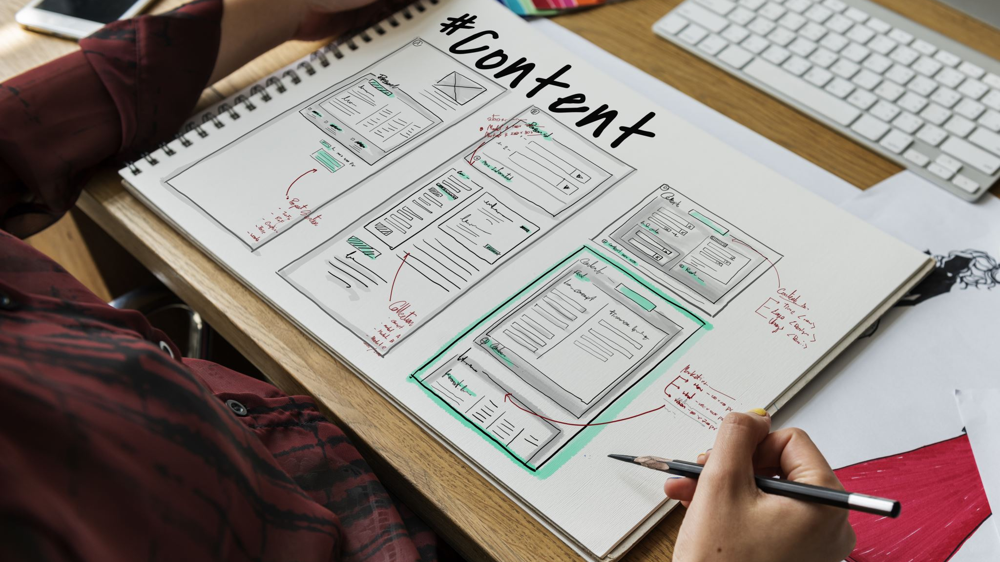
UI AND UX
R.NOWFEEQE MEERA
BSC AIML

Slide 2

WHAT IS UI:
USER INTERFACE
DEFINITION
. It is the visual part of an application or website
It includes buttons icons colour,font and menu
Goods UI makes an application attractive and easy
EXAMPLE:
The button icons and screens in mobile app

Slide 3

UI IMAGE

Slide 4
WHAT IS UX ?
USER EXPERIENCE
DEFINITION:
It describe how a user feels while using a product
UX focuses on easy to use satisfaction and efficiency
Goods UX helps user complete tasks easily
EXAMPLE
.Easy navigation
.Delivery app

Slide 5
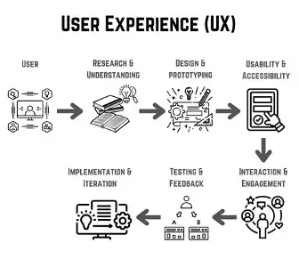
UX IMAGE

Slide 6
DIFFERENT BETWEEN UI AND UX
UI UX
User interface .User Experience
Visual appearance .Overall Experience
Colors .Navigation
Buttons .Easy to use
Icons .Users Satisfication
Fonts .Task Completion
Screen .Problem Solving
Design

Slide 7
UI AND UX IMAGE

Slide 8

UI AND UX CONCEPTS
UI and UX work together to create better a digital product
UI focuses on how the product looks
UX focuses on how the products works and feels
Goods UI and UX better experience

Slide 9
THANKYOU!

