Slide 1
Maximize the marketing effect
from the optimal bid strategy
Changhee Han cxh210037
Minhee Kim mxk210141
Jahnavi Billa jxb220011
Prakhar Soni pxs220025

Slide 2
BUSINESS GOAL
Optimally allocate this budget across three digital channels (search, programmatic, social)
and five audience types to maximize campaign returns
How?
By maximizing the marketing effect from the optimal bid strategy.

Slide 3

DATA EXPLANATION
Raw Data
Predictor Variable
Dependent Variable
Model Type
CTR=$\frac{Clicks}{Impressions}$
Logistic regression
Ad attributes
(Categorical)
VideoCompletes
SocialLikes
SocialShares
AdDigitialChannel (Panel)
AudienceType (Panel)
Conversion = WebVisit +
CollateralView +
ProductView +
FormComplete
Linear regression &
Panel data model
Auction payment
Marketing
result
SNS result
Conversion
Web visit: User visits the website
Collateral view: User browses through marketing materials or content
Product view: User looks at specific products or services
Form complete: User completes a form to request more information or make a purchase.
Total 339914 number of rows after removing duplicated and null data

Slide 4
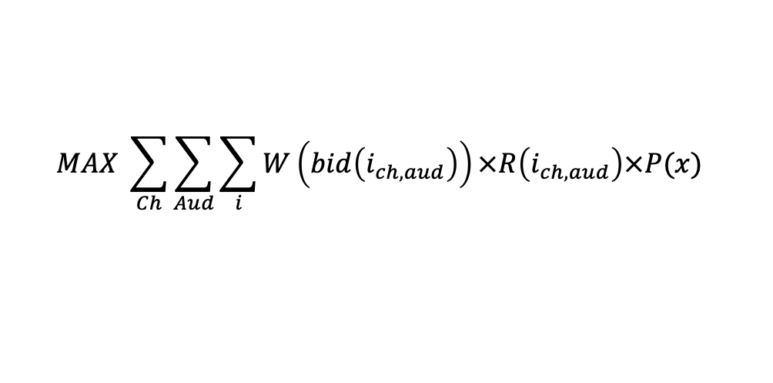
FORMULAR
$$MAX \sum_{Ch}{\sum_{Aud}{\sum_{i}{W\left(bid\left(i_{ch,aud}\right)\right)×R\left(i_{ch,aud}\right)×P(x)}}}$$

Slide 5
FORMULAR
$$MAX \sum_{Ch}{\sum_{Aud}{\sum_{i}{W\left(bid\left(i_{ch,aud}\right)\right)×R\left(i_{ch,aud}\right)×P(x)}}}$$

Slide 6
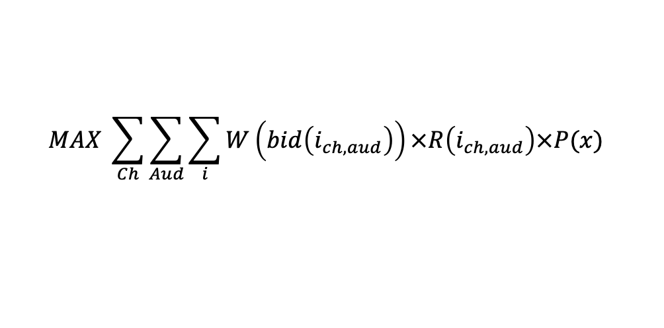
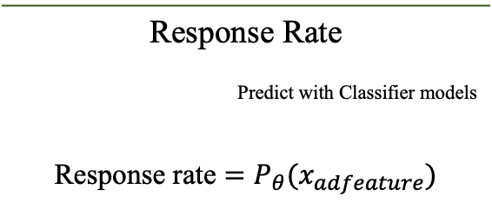
FORMULAR
$$MAX \sum_{Ch}{\sum_{Aud}{\sum_{i}{W\left(bid\left(i_{ch,aud}\right)\right)×R\left(i_{ch,aud}\right)×P(x)}}}$$
Response Rate
Predict with Classifier models
Response rate $=P_{θ}(x_{adfeature})$

Slide 7
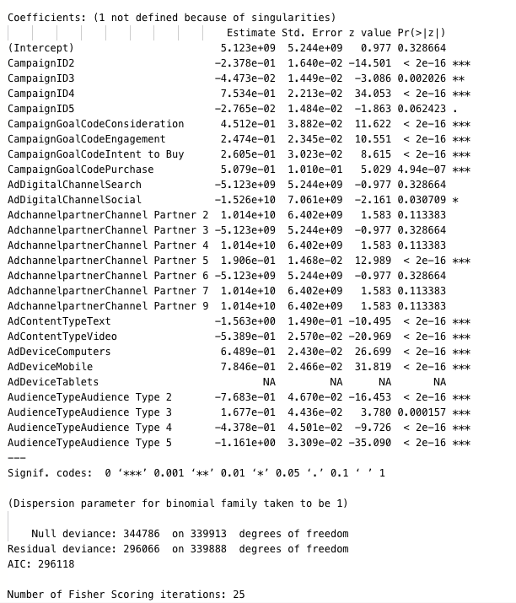
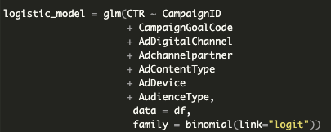
LOGISTIC MODEL
Result
Code
the following variables had a significant impact on click-through rate (CTR):
CampaignID4, CampaignGoalCodePurchase, AdDeviceComputers, and AdDeviceMobile.
These results suggest that optimizing ad campaigns for these devices and using effective CampaignIDs can improve CTR.

Slide 8
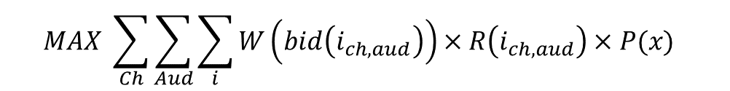
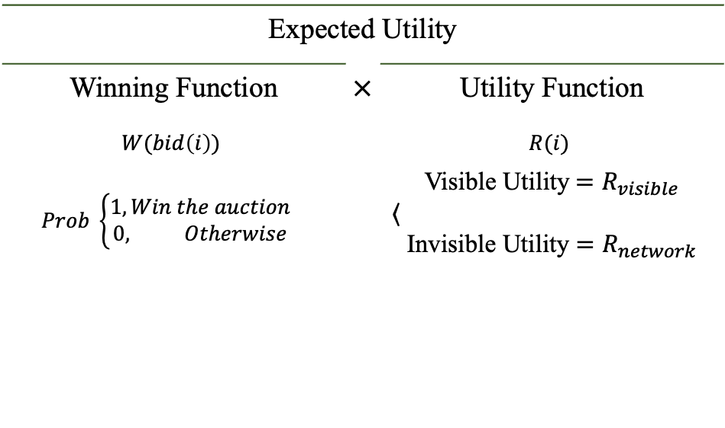
FORMULAR
$$MAX \sum_{Ch}{\sum_{Aud}{\sum_{i}{W\left(bid\left(i_{ch,aud}\right)\right)×R\left(i_{ch,aud}\right)×P(x)}}}$$
Expected Utility
Winning Function | $×$ | Utility Function
$$W(bid\left(i\right))$$ |  | $$R(i)$$
$$Prob \left\{\begin{aligned}1, Win the auction \\ 0, Otherwise\end{aligned}\right.$$ |  | Visible Utility${=R}_{visible}$ $\left\langle ,\right.$ Invisible Utility $=R_{network}$
Response Rate
Predict with Classifier models
Response rate $=P_{θ}(x_{adfeature})$

Slide 9
FORMULAR
$$MAX \sum_{Ch}{\sum_{Aud}{\sum_{i}{W\left(bid\left(i_{ch,aud}\right)\right)×R\left(i_{ch,aud}\right)×P(x)}}}$$
Expected Utility
Winning Function | $×$ | Utility Function
$$W(bid\left(i\right))$$ |  | $$R(i)$$
$$Prob \left\{\begin{aligned}1, Win the auction \\ 0, Otherwise\end{aligned}\right.$$ |  | Visible Utility${=R}_{visible}$ $\left\langle ,\right.$ Invisible Utility $=R_{network}$
Response Rate
Predict with Classifier models
Response rate $=P_{θ}(x_{adfeature})$

Slide 10
FORMULAR
$$MAX \sum_{Ch}{\sum_{Aud}{\sum_{i}{W\left(bid\left(i_{ch,aud}\right)\right)×R\left(i_{ch,aud}\right)×P(x)}}}$$
Expected Utility
Winning Function | $×$ | Utility Function
$$W(bid\left(i\right))$$ |  | $$R(i)$$
$$Prob \left\{\begin{aligned}1, Win the auction \\ 0, Otherwise\end{aligned}\right.$$ |  | Visible Utility${=R}_{visible}$ $\left\langle ,\right.$ Invisible Utility $=R_{network}$
Response Rate
Predict with Classifier models
Response rate $=P_{θ}(x_{adfeature})$

Slide 11
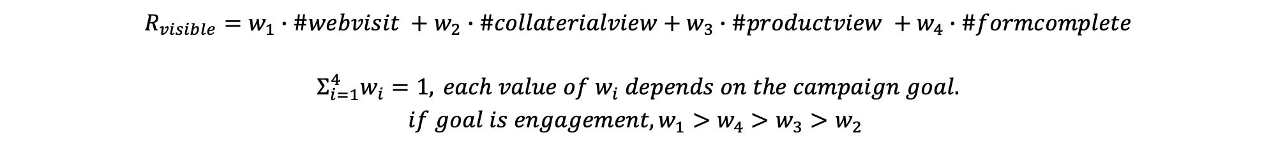
FORMULAR
$$MAX \sum_{Ch}{\sum_{Aud}{\sum_{i}{W\left(bid\left(i_{ch,aud}\right)\right)×R\left(i_{ch,aud}\right)×P(x)}}}$$
Expected Utility
Winning Function | $×$ | Utility Function
$$W(bid\left(i\right))$$ |  | $$R(i)$$
$$Prob \left\{\begin{aligned}1, Win the auction \\ 0, Otherwise\end{aligned}\right.$$ |  | Visible Utility${=R}_{visible}$ $\left\langle ,\right.$ Invisible Utility $=R_{network}$
Response Rate
Predict with Classifier models
Response rate $=P_{θ}(x_{adfeature})$
$R_{visible}=w_{1}∙\#webvisit +w_{2}∙\#collaterialview+w_{3}∙\#productview +w_{4}∙\#formcomplete$
$Σ_{i=1}^{4}w_{i}=1,$ $each value of w_{i} depends on the campaign goal.$ $$if goal is engagement, w_{1}>w_{4}>w_{3}>w_{2}$$

Slide 12
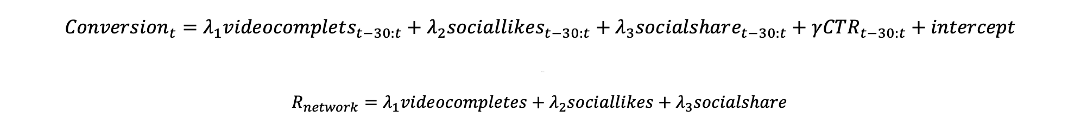
FORMULAR
$$MAX \sum_{Ch}{\sum_{Aud}{\sum_{i}{W\left(bid\left(i_{ch,aud}\right)\right)×R\left(i_{ch,aud}\right)×P(x)}}}$$
Expected Utility
Winning Function | $×$ | Utility Function
$$W(bid\left(i\right))$$ |  | $$R(i)$$
$$Prob \left\{\begin{aligned}1, Win the auction \\ 0, Otherwise\end{aligned}\right.$$ |  | Visible Utility${=R}_{visible}$ $\left\langle ,\right.$ Invisible Utility $=R_{network}$
Response Rate
Predict with Classifier models
Response rate $=P_{θ}(x_{adfeature})$
$$Conversion_{t}=λ_{1}videocomplets_{t−30:t}+λ_{2}sociallikes_{t−30:t}+λ_{3}socialshare_{t−30:t}+γCTR_{t−30:t}+intercept$$
dfasda
$$R_{network}=λ_{1}videocompletes+λ_{2}sociallikes+λ_{3}socialshare$$

Slide 13
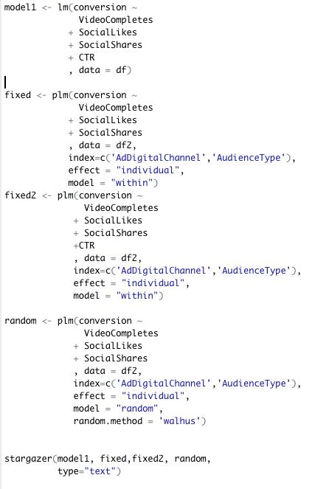
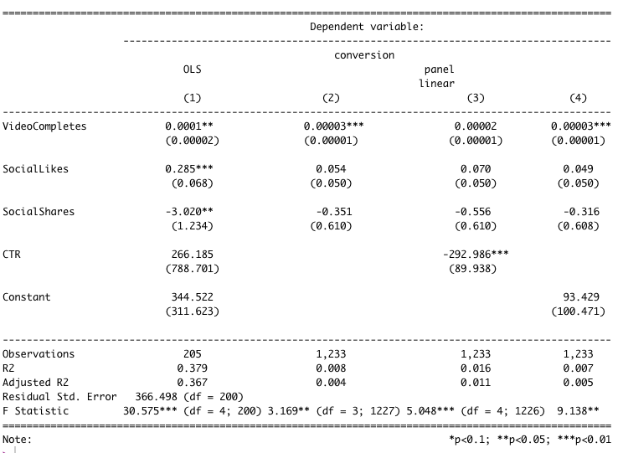
LINEAR MODEL
Code
Result

Slide 14

FORMULAR
$$MAX \sum_{Ch}{\sum_{Aud}{\sum_{i}{W\left(bid\left(i_{ch,aud}\right)\right)×R\left(i_{ch,aud}\right)×P(x)}}}$$
Expected Utility
Winning Function | $×$ | Utility Function
$$W(bid\left(i\right))$$ |  | $$R(i)$$
$$Prob \left\{\begin{aligned}1, Win the auction \\ 0, Otherwise\end{aligned}\right.$$ |  | Visible Utility${=R}_{visible}$ $\left\langle ,\right.$ Invisible Utility $=R_{network}$
Response Rate
Predict with Classifier models
Response rate $=P_{θ}(x_{adfeature})$
$$R=R_{visible}+R_{network}$$

Slide 15
FORMULAR
$$MAX \sum_{Ch}{\sum_{Aud}{\sum_{i}{W\left(bid\left(i_{ch,aud}\right)\right)×R\left(i_{ch,aud}\right)×P(x)}}}$$
Expected Utility
Winning Function | $×$ | Utility Function
$$W(bid\left(i\right))$$ |  | $$R(i)$$
$$Prob \left\{\begin{aligned}1, Win the auction \\ 0, Otherwise\end{aligned}\right.$$ |  | Visible Utility${=R}_{visible}$ $\left\langle ,\right.$ Invisible Utility $=R_{network}$
Response Rate
Predict with Classifier models
Response rate $=P_{θ}(x_{adfeature})$

Slide 16
MARKETING STRATEGY
We used Linear Programming to optimize our marketing budget and achieved the best result.
We were able to make data-driven decisions and allocate our budget effectively, resulting in the best outcome for our marketing campaign.

Slide 17
Thank you !

