Slide 1
Results
- Machine Learning

Slide 2
RESPONSE MODEL
$p\left(x_{i}\right)=CTR_{prediction}∈[0, 1]$
User response (CTR)
Converting CTR to 0 and 1
Target
Campaign ID, Campaign Goal Code, Ad Digital Channel,
Ad Channel Partner, Ad Device, Ad Content Type,
Target Audience Type
To predict the user response for new advertisement
Features

Slide 3
PREPROCESSING
Null & duplicated data
Categorical variable
Raw data : 379,139
After removal: 339,914
one-hot-encoding
for all feature variables

Slide 4
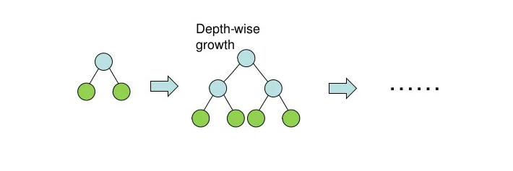
MACHINE LEARNING
Baseline: XGBoost
CatBoost
Predicted CTR
$p\left(x_{i}\right)=CTR_{prediction}∈[0,1]$

Slide 5
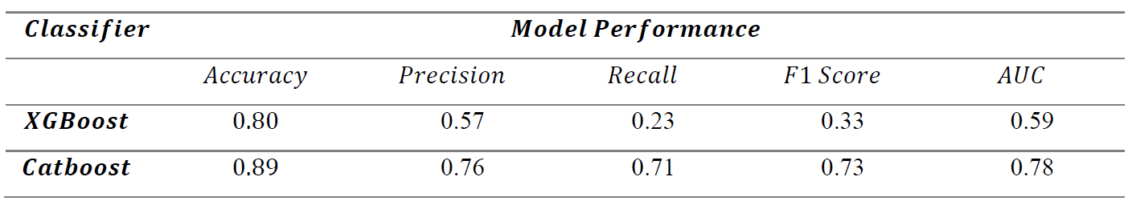
MODEL EVALUATION

Slide 6
Implications
- Optimization

Slide 7
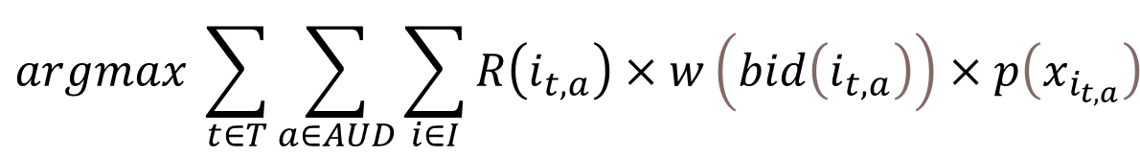
OPTIMIZATION
$$argmax \sum_{t∈T}{\sum_{a∈AUD}{\sum_{i∈I}{R\left(i_{t,a}\right)×w\left(bid\left(i_{t,a}\right)\right)×p\left(x_{i_{t,a}}\right)}}}$$
Our goal: Maximize this valuation
Method: Mixed Integer Linear Programming (MIP)
with GurobiPy
Budget Constraints : Max budget $ 1 Million
No more than 50% of budget
No less than 2% of the budget
on each channel and audience type

Slide 8
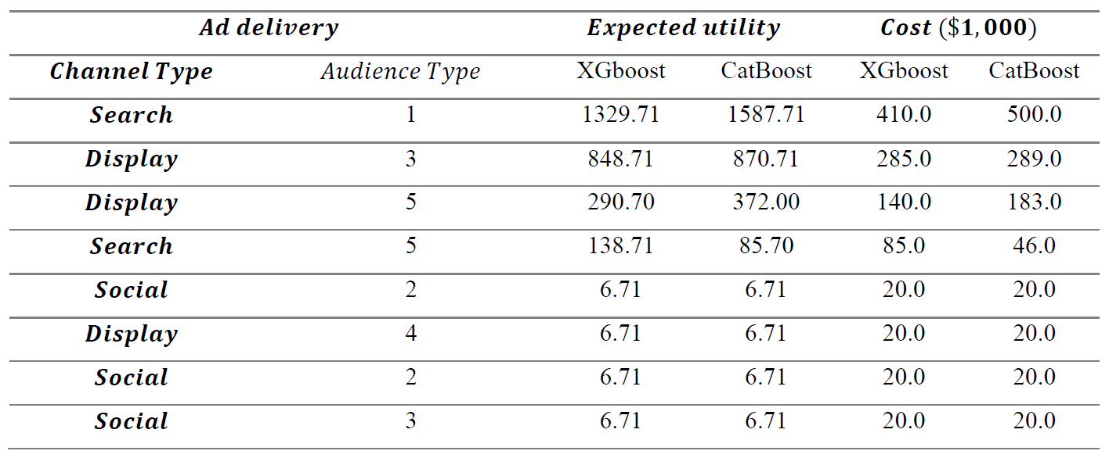
OPTIMIZATION

Slide 9
MODEL EVALUATION

Slide 10
OPTIMIZATION

Slide 11
Conclusion

Slide 12
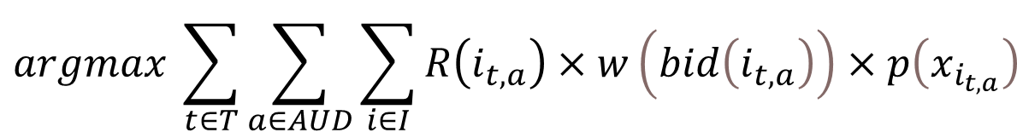
CONCLUSION
$$argmax \sum_{t∈T}{\sum_{a∈AUD}{\sum_{i∈I}{R\left(i_{t,a}\right)×w\left(bid\left(i_{t,a}\right)\right)×p\left(x_{i_{t,a}}\right)}}}$$
$p\left(x_{i}\right)=CTR_{prediction}∈[0, 1]$

Slide 13

LIMITATION
Network Effect
$$R_{visible}$$
ML & Optimization Process

Slide 14
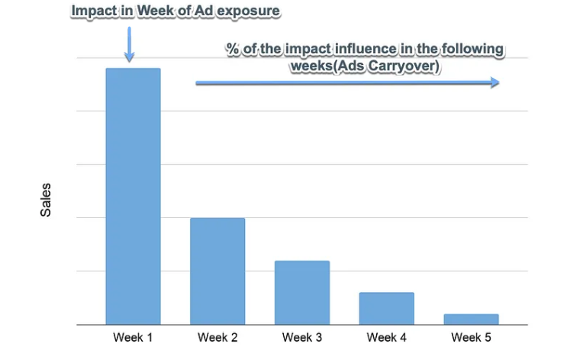
LIMITATION 1
Network Effect
$$R_{network}=λ_{1}videocompletes+λ_{2}sociallikes+λ_{3}socialshare+intercept$$

Slide 15
LIMITATION 2
Visible Return Effect
$R_{visible}=α∙webvisit +β∙collaterialview$ $+γ∙productview +δ∙formcomplete$
$$α<β<γ<δ$$

Slide 16
LIMITATION 3
Machine Learning
Optimization
Machine Learning
Optimization

Slide 17
Thank you !

