Slide 1
Absolute Parameter
Changhee Han
Minhee Kim
Yuna Seo

Slide 2
CONTENTS
Overview
Business goal
Solution - Base model
(1) winning function
(2) utility function
(3) response model
4. Results - Macahine Learning
5. Implication - Optimization
6. Conclusion

Slide 3
BUSINESS GOAL
Optimally allocate this budget across three digital channels (search, programmatic, social)
and five audience types to maximize campaign returns?
Maximize the marketing effect from the optimal bid strategy.

Slide 4

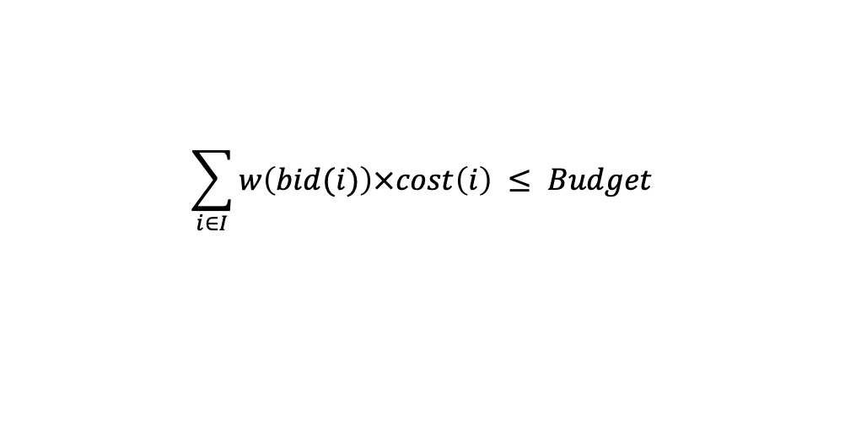
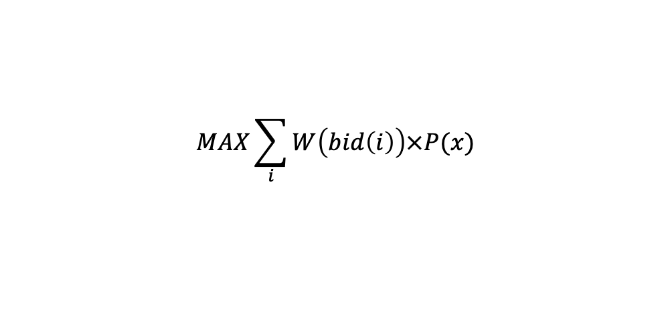
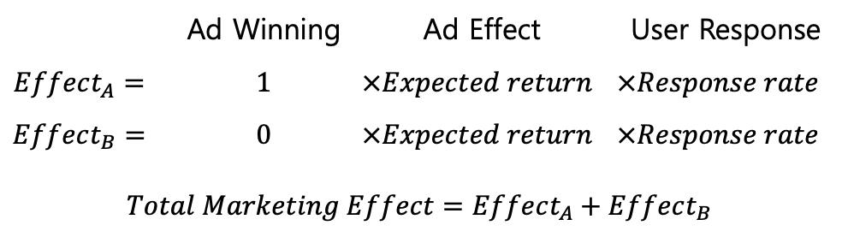
BUSINESS GOAL
Ad A
Ad | Channel | Audience | Strategy i
A | Search | 1 | $400
B | Display | 2 | $100
Budget Limit
Only Ad A won !!
Ad B
Budget Plan
 | Ad Winning | Ad Effect | User Response
$$Effect_{A}=$$ | $1$ | $$×Expected return$$ | $$×Response rate$$
$$Effect_{B}=$$ | $0$ | $$×Expected return$$ | $$×Response rate$$
$$Total Marketing Effect=Effect_{A}+Effect_{B}$$
$$\sum_{i∈I}{w\left(bid(i)\right)×cost\left(i\right)} ≤ Budget$$
$$MAX\sum_{i}{W\left(bid\left(i\right)\right)×P(x)}$$

Slide 5
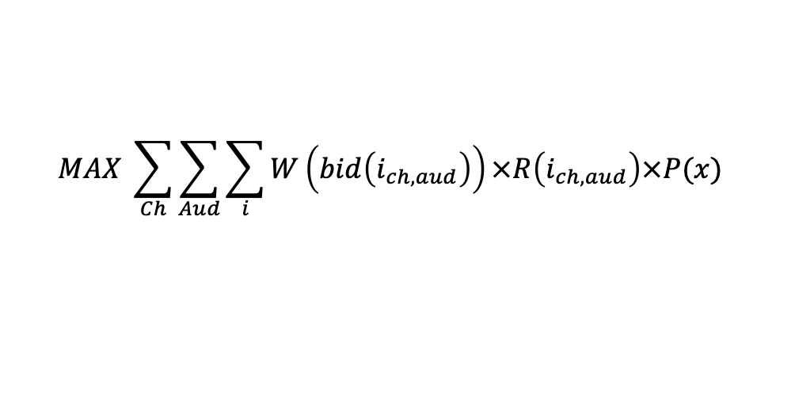
BUSINESS GOAL
Ad | Channel | Audience | Strategy i
A | Search | 1 | $400
B | Display | 2 | $100
Only Ad A won !!
 | Ad Winning | Ad Effect | User Response
$$Effect_{A}=$$ | $1$ | $$×Expected return$$ | $$×Response rate$$
$$Effect_{B}=$$ | $0$ | $$×Expected return$$ | $$×Response rate$$
$$Total Marketing Effect=Effect_{A}+Effect_{B}$$
$$MAX \sum_{Ch}{\sum_{Aud}{\sum_{i}{W\left(bid\left(i_{ch,aud}\right)\right)×R\left(i_{ch,aud}\right)×P(x)}}}$$

Slide 6
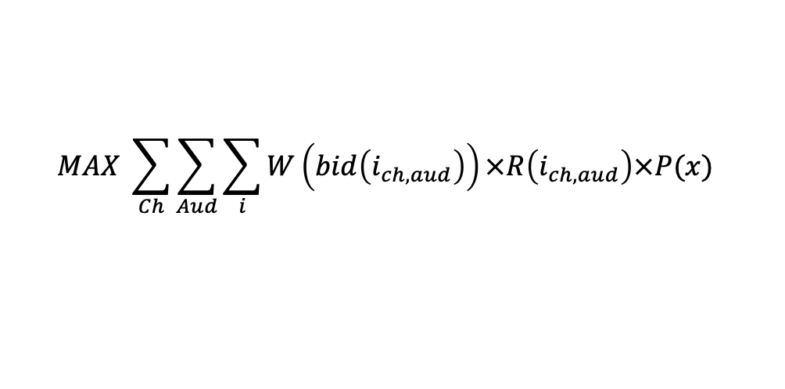
FORMULAR
$$MAX \sum_{Ch}{\sum_{Aud}{\sum_{i}{W\left(bid\left(i_{ch,aud}\right)\right)×R\left(i_{ch,aud}\right)×P(x)}}}$$

Slide 7
FORMULAR
$$MAX \sum_{Ch}{\sum_{Aud}{\sum_{i}{W\left(bid\left(i_{ch,aud}\right)\right)×R\left(i_{ch,aud}\right)×P(x)}}}$$

Slide 8
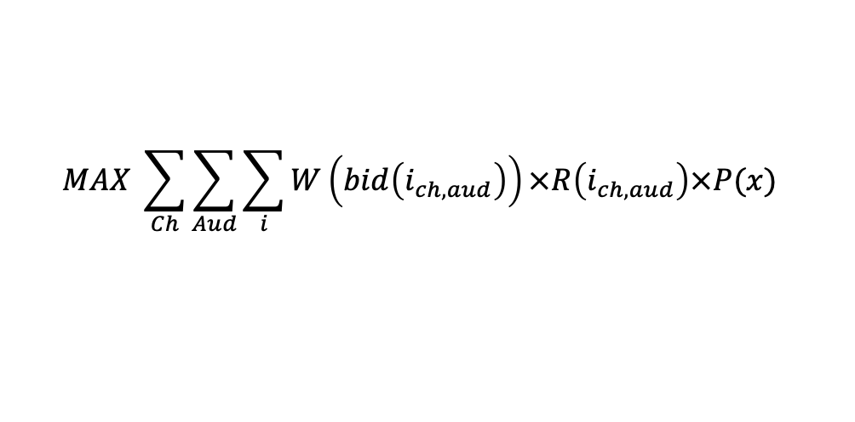
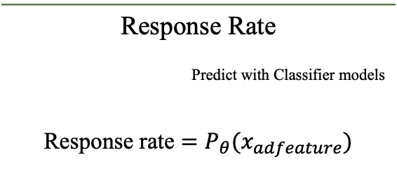
FORMULAR
$$MAX \sum_{Ch}{\sum_{Aud}{\sum_{i}{W\left(bid\left(i_{ch,aud}\right)\right)×R\left(i_{ch,aud}\right)×P(x)}}}$$
Response Rate
Predict with Classifier models
Response rate $=P_{θ}(x_{adfeature})$

Slide 9
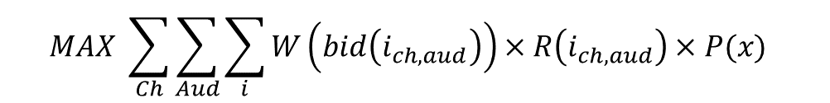
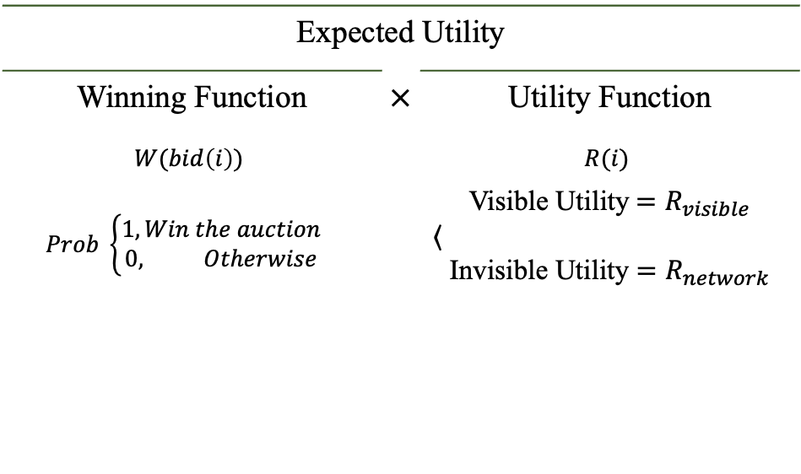
FORMULAR
$$MAX \sum_{Ch}{\sum_{Aud}{\sum_{i}{W\left(bid\left(i_{ch,aud}\right)\right)×R\left(i_{ch,aud}\right)×P(x)}}}$$
Expected Utility
Winning Function | $×$ | Utility Function
$$W(bid\left(i\right))$$ |  | $$R(i)$$
$$Prob \left\{\begin{aligned}1, Win the auction \\ 0, Otherwise\end{aligned}\right.$$ |  | Visible Utility${=R}_{visible}$ $\left\langle ,\right.$ Invisible Utility $=R_{network}$
Response Rate
Predict with Classifier models
Response rate $=P_{θ}(x_{adfeature})$

Slide 10
FORMULAR
$$MAX \sum_{Ch}{\sum_{Aud}{\sum_{i}{W\left(bid\left(i_{ch,aud}\right)\right)×R\left(i_{ch,aud}\right)×P(x)}}}$$
Expected Utility
Winning Function | $×$ | Utility Function
$$W(bid\left(i\right))$$ |  | $$R(i)$$
$$Prob \left\{\begin{aligned}1, Win the auction \\ 0, Otherwise\end{aligned}\right.$$ |  | Visible Utility${=R}_{visible}$ $\left\langle ,\right.$ Invisible Utility $=R_{network}$
Response Rate
Predict with Classifier models
Response rate $=P_{θ}(x_{adfeature})$

Slide 11
FORMULAR
$$MAX \sum_{Ch}{\sum_{Aud}{\sum_{i}{W\left(bid\left(i_{ch,aud}\right)\right)×R\left(i_{ch,aud}\right)×P(x)}}}$$
Expected Utility
Winning Function | $×$ | Utility Function
$$W(bid\left(i\right))$$ |  | $$R(i)$$
$$Prob \left\{\begin{aligned}1, Win the auction \\ 0, Otherwise\end{aligned}\right.$$ |  | Visible Utility${=R}_{visible}$ $\left\langle ,\right.$ Invisible Utility $=R_{network}$
Response Rate
Predict with Classifier models
Response rate $=P_{θ}(x_{adfeature})$

Slide 12
FORMULAR
$$MAX \sum_{Ch}{\sum_{Aud}{\sum_{i}{W\left(bid\left(i_{ch,aud}\right)\right)×R\left(i_{ch,aud}\right)×P(x)}}}$$
Expected Utility
Winning Function | $×$ | Utility Function
$$W(bid\left(i\right))$$ |  | $$R(i)$$
$$Prob \left\{\begin{aligned}1, Win the auction \\ 0, Otherwise\end{aligned}\right.$$ |  | Visible Utility${=R}_{visible}$ $\left\langle ,\right.$ Invisible Utility $=R_{network}$
Response Rate
Predict with Classifier models
Response rate $=P_{θ}(x_{adfeature})$
$R_{visible}=α∙\#webvisit +β∙\#collaterialview+γ∙\#productview +δ∙\#formcomplete$
$$α<β<γ<δ$$

Slide 13
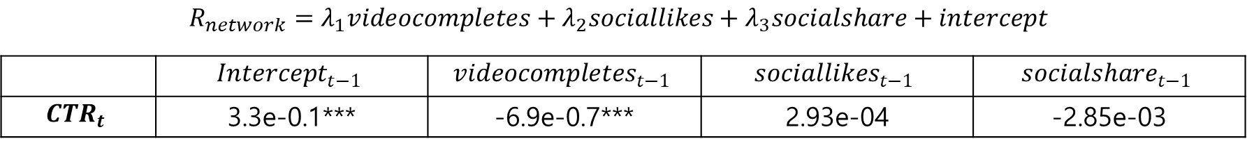
FORMULAR
$$MAX \sum_{Ch}{\sum_{Aud}{\sum_{i}{W\left(bid\left(i_{ch,aud}\right)\right)×R\left(i_{ch,aud}\right)×P(x)}}}$$
Expected Utility
Winning Function | $×$ | Utility Function
$$W(bid\left(i\right))$$ |  | $$R(i)$$
$$Prob \left\{\begin{aligned}1, Win the auction \\ 0, Otherwise\end{aligned}\right.$$ |  | Visible Utility${=R}_{visible}$ $\left\langle ,\right.$ Invisible Utility $=R_{network}$
Response Rate
Predict with Classifier models
Response rate $=P_{θ}(x_{adfeature})$
$$R_{network}=λ_{1}videocompletes+λ_{2}sociallikes+λ_{3}socialshare+intercept$$
 | $$Intercept_{t−1}$$ | $$videocompletes_{t−1}$$ | $$sociallikes_{t−1}$$ | $$socialshare_{t−1}$$
$$CTR_{t}$$ | 3.3e-0.1*** | -6.9e-0.7*** | 2.93e-04 | -2.85e-03

Slide 14

FORMULAR
$$MAX \sum_{Ch}{\sum_{Aud}{\sum_{i}{W\left(bid\left(i_{ch,aud}\right)\right)×R\left(i_{ch,aud}\right)×P(x)}}}$$
Expected Utility
Winning Function | $×$ | Utility Function
$$W(bid\left(i\right))$$ |  | $$R(i)$$
$$Prob \left\{\begin{aligned}1, Win the auction \\ 0, Otherwise\end{aligned}\right.$$ |  | Visible Utility${=R}_{visible}$ $\left\langle ,\right.$ Invisible Utility $=R_{network}$
Response Rate
Predict with Classifier models
Response rate $=P_{θ}(x_{adfeature})$
$$R=R_{visible}+R_{network}$$

Slide 15
FORMULAR
$$MAX \sum_{Ch}{\sum_{Aud}{\sum_{i}{W\left(bid\left(i_{ch,aud}\right)\right)×R\left(i_{ch,aud}\right)×P(x)}}}$$
Expected Utility
Winning Function | $×$ | Utility Function
$$W(bid\left(i\right))$$ |  | $$R(i)$$
$$Prob \left\{\begin{aligned}1, Win the auction \\ 0, Otherwise\end{aligned}\right.$$ |  | Visible Utility${=R}_{visible}$ $\left\langle ,\right.$ Invisible Utility $=R_{network}$
Response Rate
Predict with Classifier models
Response rate $=P_{θ}(x_{adfeature})$

Slide 16
Results
- Machine Learning

Slide 17
RESPONSE MODEL
$p\left(x_{i}\right)=CTR_{prediction}∈[0, 1]$
User response (CTR)
Converting CTR to 0 and 1
Target
Campaign ID, Campaign Goal Code, Ad Digital Channel,
Ad Channel Partner, Ad Device, Ad Content Type,
Target Audience Type
To predict the user response for new advertisement
Features

Slide 18
PREPROCESSING
Null & duplicated data
Categorical variable
Raw data : 379,139
After removal: 339,914
one-hot-encoding
for all feature variables

Slide 19
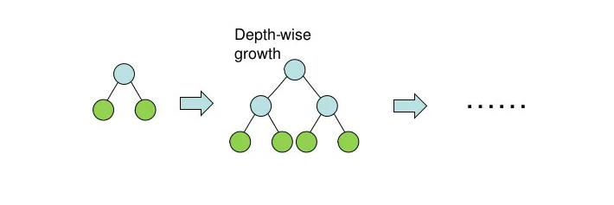
MACHINE LEARNING
Baseline: XGBoost
CatBoost
Predicted CTR
$p\left(x_{i}\right)=CTR_{prediction}∈[0,1]$

Slide 20
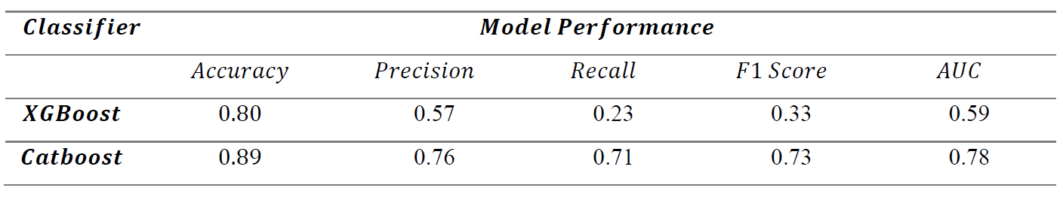
MODEL EVALUATION

Slide 21
Implications
- Optimization

Slide 22
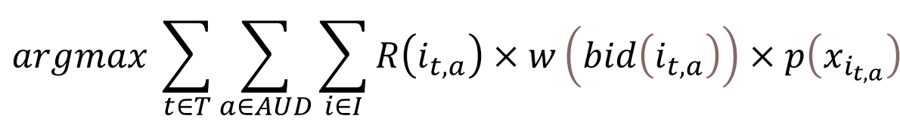
OPTIMIZATION
$$argmax \sum_{t∈T}{\sum_{a∈AUD}{\sum_{i∈I}{R\left(i_{t,a}\right)×w\left(bid\left(i_{t,a}\right)\right)×p\left(x_{i_{t,a}}\right)}}}$$
Our goal: Maximize this valuation
Method: Mixed Integer Linear Programming (MIP)
with GurobiPy
Budget Constraints : Max budget $ 1 Million
No more than 50% of budget
No less than 2% of the budget
on each channel and audience type

Slide 23
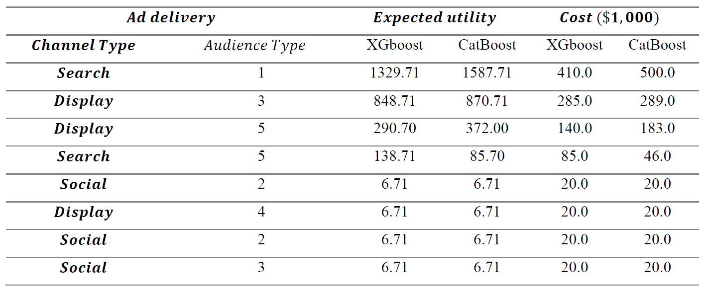
OPTIMIZATION

Slide 24
MODEL EVALUATION

Slide 25
OPTIMIZATION

Slide 26
Conclusion

Slide 27
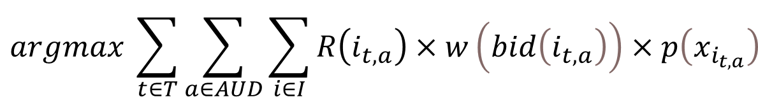
CONCLUSION
$$argmax \sum_{t∈T}{\sum_{a∈AUD}{\sum_{i∈I}{R\left(i_{t,a}\right)×w\left(bid\left(i_{t,a}\right)\right)×p\left(x_{i_{t,a}}\right)}}}$$
$p\left(x_{i}\right)=CTR_{prediction}∈[0, 1]$

Slide 28

LIMITATION
Network Effect
$$R_{visible}$$
ML & Optimization Process

Slide 29
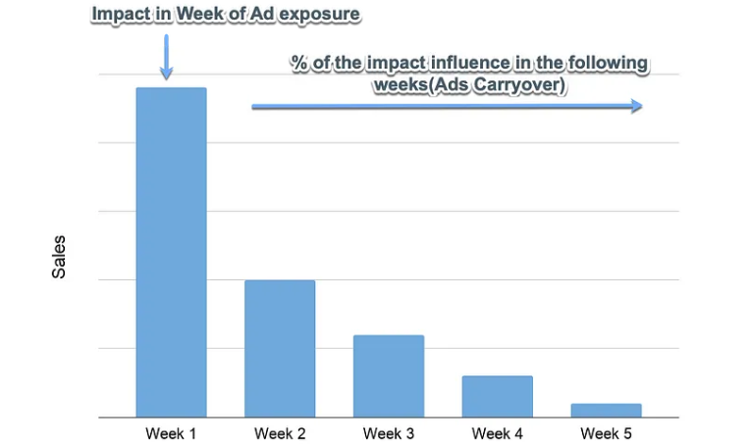
LIMITATION 1
Network Effect
$$R_{network}=λ_{1}videocompletes+λ_{2}sociallikes+λ_{3}socialshare+intercept$$

Slide 30
LIMITATION 2
Visible Return Effect
$R_{visible}=α∙webvisit +β∙collaterialview$ $+γ∙productview +δ∙formcomplete$
$$α<β<γ<δ$$

Slide 31
LIMITATION 3
Machine Learning
Optimization
Machine Learning
Optimization

Slide 32
Thank you !

