Slide 1
[INHERITANCE] Course Name: Object Oriented Programming Course Code: CSE 121 Intake – 50(06)

Slide 2

Presented By –
Name: ASIFUR RAHMAN [22234103353]
Name: Ferdouse Hassan Nowrin [22234103237]
Name: Tasnimul Haque nahin [22234103180]
Name: Mahajabin Kabir Arin [22234103213]
Name: Delwar Hossain Roman [22234103233]
Presented To –
Khan Md. Hasib
Assistant Professor
Department of CSE
Bangladesh University of Business and Technology (BUBT)
Email: khanmdhasib@bubt.edu.bd

Slide 3
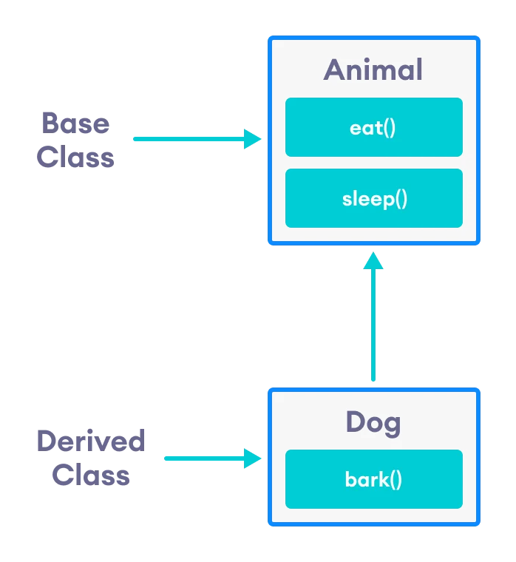
What is Inheritance?
Inheritance is a concept in object-oriented programming (OOP) that allows a new class to be based on an existing class, inheriting all of its properties and methods.
[1]

Slide 4
History of Inheritance

Slide 5
Ole-Johan Dahl and Kristen Nygaard first time included a form of inheritance called subclassing in Simula Programming Language. [2]
Early object-oriented programming language, Smalltalk introduced a more sophisticated form of inheritance called class inheritance. [3]
In C++, inheritance was first introduced in the 1980s as a way to extend the capabilities of C
Bjarne Stroustrup based the inheritance mechanism in C++ on the class inheritance mechanism in Smalltalk. [4]

Slide 6
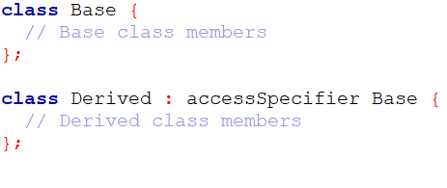
Syntax of Inheritance in C++

Slide 7
Modes of Inheritance
Public Mode : All public members of the base class are accessible in the derived class as public members.
Protected Mode : All public and protected members of the base class become private members of the derived class.
Private Mode : All public and protected members of the base class become protected members of the derived class.

Slide 8
Types of Inheritance
Single Inheritance
Multiple Inheritance
Hierarchical Inheritance
Multilevel Inheritance
Hybrid Inheritance

Slide 9
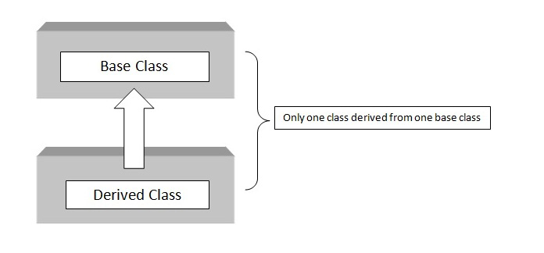
Single Inheritance
A derived class is derived from a single base class.
[5]

Slide 10
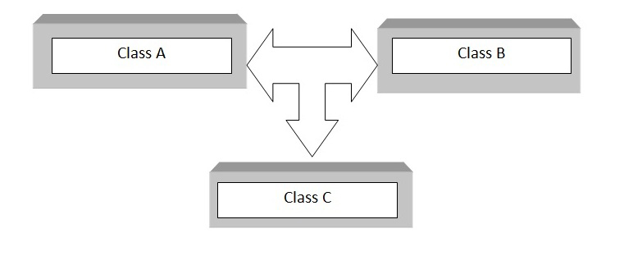
Multiple Inheritance
A derived class is derived from more than one base class.
[6]

Slide 11
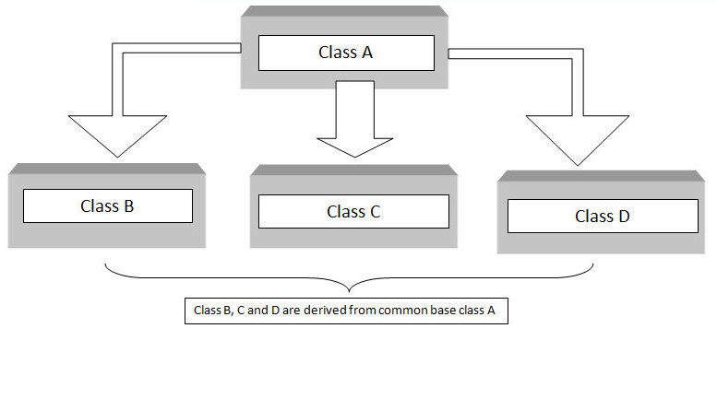
Hierarchical Inheritance
Multiple derived classes are created from a single base class.
[7]

Slide 12
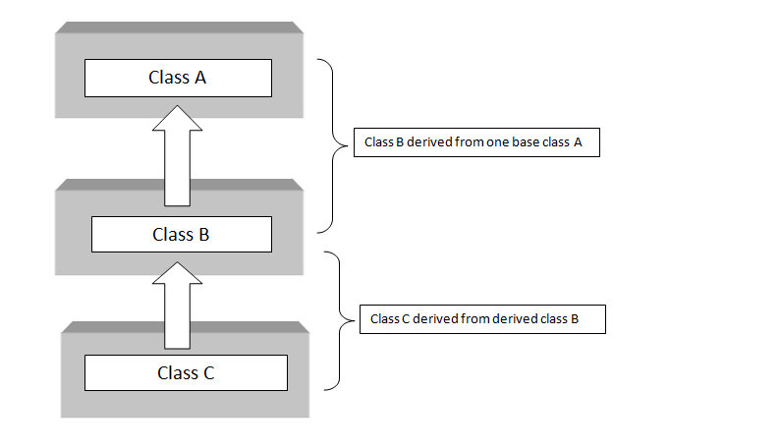
Multilevel Inheritance
A derived class is derived from another derived class.
[8]

Slide 13
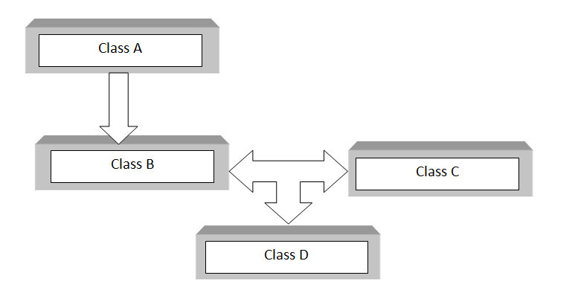
Hybrid Inheritance
A combination of multiple types of inheritance, such as a combination of Hierarchical and Multiple or Hierarchical and Multilevel.
[9]

Slide 14
Sample Code Featuring All types of Inheritance

Slide 15
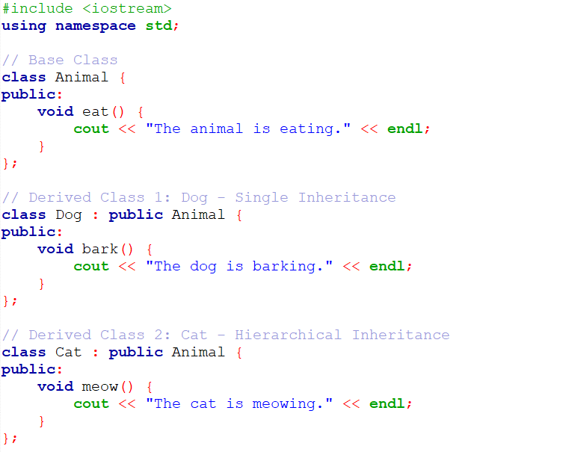

Slide 16
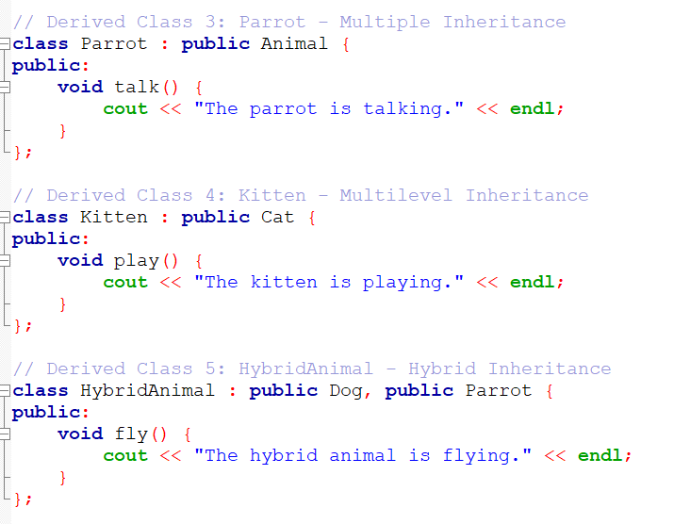

Slide 17
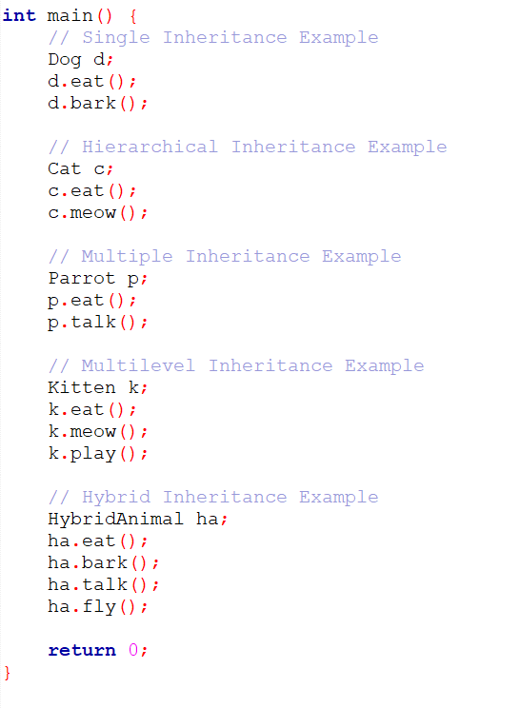

Slide 18
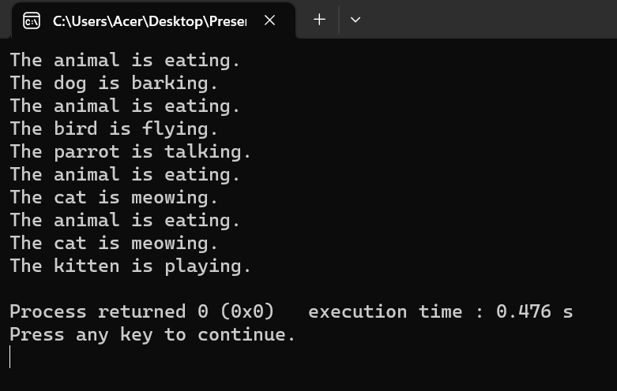
Output

Slide 19
Benefits of Inheritance
Reusability
Code Organization
Polymorphism
Code Flexibility

Slide 20
Drawbacks of Inheritance
Tight coupling
Complex hierarchies
Overuse

Slide 21
Reference
Programiz - C++ Inheritance
Wikipedia - Inheritance (object-oriented programming)
Wikipedia - Smalltalk
Wikipedia - C++
Trytoprogram - C++ Single Inheritance
Trytoprogram - C++ Multiple Inheritance
Trytoprogram - C++ Hierarchical Inheritance
Trytoprogram - C++ Multilevel Inheritance
Trytoprogram - C++ Hybrid Inheritance

Slide 22
Thank You All

