Slide 1
The Basics of Measurements
SE 611

Slide 2
Representation Theory of Measurement
The representational theory of measurement seeks to formalize our intuition about the way the world works.
The core of this theory is that measurement is a process of assigning numbers to attributes or characteristics of the empirical world in such a way that the relevant qualitative empirical relations among these attributes or characteristics are reflected in the numbers themselves.
According to representational theory, measurement is possible only because the empirical system represented and the numerical system representing it, possess the same mathematical structure.

Slide 3
Empirical Relations
We perceive the real world by comparing things. Not always by assigning number to them.
For example, taller than is a binary relation defined on the set of pairs of people. Given any two people, x and y, we can observe that
x is taller than y, or
y is taller than x
Therefore taller than is an empirical relation
We define measurement as the mapping from the empirical world to the formal, relational world. Consequently, a measure is the number or symbol assigned to an entity by this mapping in order to characterize an attribute.

Slide 4
Empirical Relations (cont..)
Sampling of 100 users to express preference among product A,B,C, and D (pairwise)

Slide 5
Subjective Rating Formats of E.R.
Likert Scale
Give the respondent a statement with which to agree or disagree.
Example: This software program is reliable

Slide 6
Subjective Rating Formats of E.R.
Forced Ranking
Give n alternatives, ordered from 1 (best) to n (worst).
Example: Rank the following five software modules in order of maintenance difficulty
with 1 = least complex, 5 = most complex:

Slide 7
Subjective Rating Formats of E.R.
Verbal Frequency Scale
Example: How often does this program fail?
Always Often Sometimes Seldom Never

Slide 8
Subjective Rating Formats of E.R.
Ordinal Scale
List several ordered alternatives and have respondent select one.
Example: How often the software fail?
1. Hourly
2. Daily
3. Weekly
4. Monthly
5. Several times a year
6. Once or twice a year
7. Never

Slide 9
Subjective Rating Formats of E.R.
Comparative Scale
Compare at least two entities and assign a numeric value

Slide 10
Subjective Rating Formats of E.R.
Numerical Scale

Slide 11
The Representation Condition of Measurement
The real world is the domain and the mathematical world is the range
Each relation in the empirical relational system corresponds via the measurement to an element in a number system
We want the mapping to preserve the relation. This rule is called the representation condition (see figure)
The mapping we call a measure is sometimes called a representation or homomorphism

Slide 12
Key Stages of Formal Measurement

Slide 13
Some Specific Measurements in Software
There is nothing wrong with using the same representation in different ways, or using several representation for the same attribute.

Slide 14
Measurement and Model
A model is an abstraction of reality. It can view an entity or concept from a particular perspective
Models come in many different forms: as equations, mapping, or diagram for instance
For example, to measure the length of a program using LOC, we need a model of a program which would specify how a program differs from a subroutine, whether or not to treat separate statements on the same line as distinct LOC, whether or not to count comment lines, data declaration, etc.

Slide 15
Direct and Derived Measurement
Direct measurement of an attribute of an entity involves no other attribute or entity. For example, length of a physical object can be measured without reference to any other object or attribute. Commonly user direct measure in SE:
E.g. Size of source code (measured by LOC)
Schedule of the testing process ( measured by elapsed time in hours)
Number of defects discovered
Time a programmer spends on a project (measure by months worked)
Derived Measures can be a combination of direct measures. It is often useful in making visible the interactions between direct measures.

Slide 16
Example of Derived Measures

Slide 17
Measurement Scale and Scale Types
Three important questions concerning representation and scales:
How do we determine when one numerical relation system is preferable to another? (The answer is pragmatic)
How do we know if a particular empirical relation system has a representation in a given numerical relation system? (A representation problem)
What do we do when we have several different possible representation in the same numerical relation system? (The uniqueness problem)

Slide 18
Measurement Scale and Scale Types
Five major types of measurement scale
Nominal
Ordinal
Interval
Ratio
Absolute

Slide 19
Nominal Scale Type
Nominal scale measurement places elements in a classification scheme. The classes are not ordered. It has two major characteristics:
1. The empirical relation system consists only of different classes; there is no notion of ordering among the classes.
2. Any distinct numbering or symbolic representation of the classes is an acceptable measure
Example: Suppose we are investigating the set of all known software faults.

Slide 20
Ordinal Scale Type
We can often augment the nominal scale with information about an ordering of the classes or categories creating an ordinal scale. The ordering leads to analysis not possible with nominal measures. The ordinal scale has the following characteristics:
The empirical relation system consists of classes that are ordered with respect to the attribute.
Any mapping that preserves the ordering (i.e., any monotonic function) is acceptable.
The numbers represent ranking only, so addition, subtraction, and other arithmetic operations have no meaning.

Slide 21
Ordinal Scale Type Example
Suppose we want to capture the attribute Complexity of a software X, quantitatively:

Slide 22
Interval Scale Type
The interval scale carries more information and it more powerful than nominal or ordinal. This scale captures information about the size of the intervals that separate the classes, so that we can in some sense understand the size of the jump from one class to another.
An interval scale preserves order, as with an ordinal scale.
An interval scale preserves differences but not ratios. That is, we know the difference between any two of the ordered classes in the range of the mapping, but computing the ratio of two classes in the range does not make sense.
Addition and subtraction are acceptable on the interval scale, but not multiplication and division
Example:

Slide 23
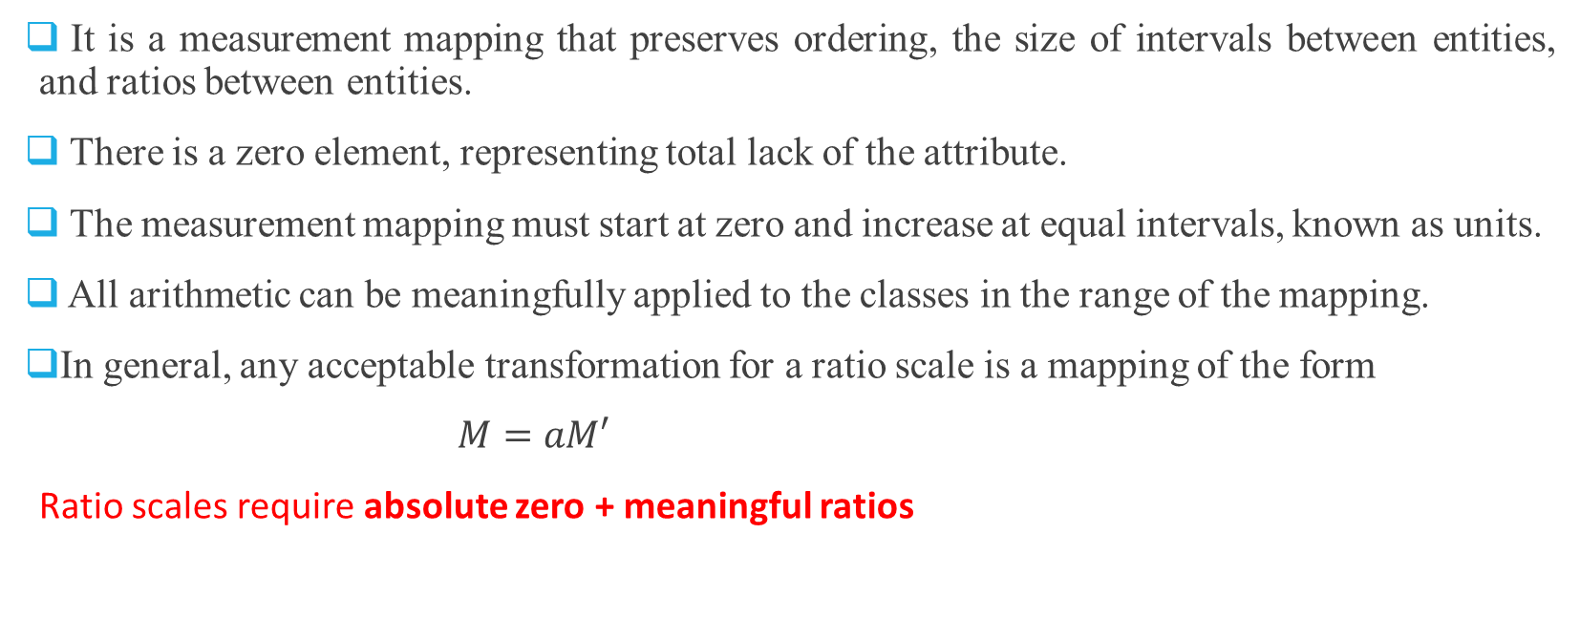
Ratio Scale Type
It is a measurement mapping that preserves ordering, the size of intervals between entities, and ratios between entities.
There is a zero element, representing total lack of the attribute.
The measurement mapping must start at zero and increase at equal intervals, known as units.
All arithmetic can be meaningfully applied to the classes in the range of the mapping.
In general, any acceptable transformation for a ratio scale is a mapping of the form
$M=aM′$
Ratio scales require absolute zero + meaningful ratios

Slide 24
Ratio Scale Type (cont..)
The ratio scale is the highest level of measurement in statistics, characterized by:
A true zero point (indicating the complete absence of the quantity being measured).
Equal intervals between units.
Meaningful ratios (e.g., "10 kg is twice as heavy as 5 kg").
Examples of Ratio Scale:
Weight (in kg) – 0 kg means no weight, and 20 kg is twice as heavy as 10 kg.
Height (in cm) – 0 cm means no height, and 180 cm is 1.5 times taller than 120 cm.
Age (in years) – 0 years means birth, and 30 years is three times older than 10 years.
Income (in dollars) – 0 means no income, and $100 is double $50.

Slide 25
Ratio Scale Type (cont..)
Some examples of variables that do not belong to the ratio scale because they lack a true zero point or meaningful ratios:
Temperature in Celsius or Fahrenheit
IQ Scores
Education Level (e.g., High School, Bachelor’s, PhD)

Slide 26
Absolute Scale Type
The absolute scale is the most restrictive of all scale types. For any two measures, M and M′, there is only one admissible transformation: the identity transformation.
That is, there is only one way in which the measurement can be made. The absolute scale has the following properties:
The measurement for an absolute scale is made simply by counting the number of elements in the entity set.
The attribute always takes the form “number of occurrences of x in the entity.”
There is only one possible measurement mapping, namely the actual count, and there is only one way to count elements.
All arithmetic analysis of the resulting count is meaningful.
Example:
Number of failures observed during integration testing can only measured in one way: by counting the failures
Number of people working in a project can be only measured by counting people

Slide 27
Summary of Scales

Slide 28
Meaningfulness in Measurement
The type of scale determine what kind of analysis we can perform on the measurements
Consider these statements:
The # of errors discovered during integration testing was 100.
The cost of fixing each error is at least 100.
A semantic error takes twice as long to fix than an syntactic error.
A semantic error is twice as complex as a syntactic error.
A measurement statement is meaningful if its truth value is invariant of admissible transformations of the scale
What about this following statement?
“The President of the United States is 125 years old “

Slide 29
Statistical Operations on Measures
The scale type of a measure affects the types of operations and statistical analyses
Consider we have measured an attribute for 13 entities, and the resulting data points in ranked order are:
2, 2, 4, 5, 5, 8, 8, 10,11, 11, 11, 15, 16
The mean of this set of data (i.e., the sum divided by the number of items) is 8.3.
The median (i.e., the value of the middle-ranked item) is 8.
The mode (i.e., the value of the most commonly occurring item) is 11.

Slide 30
End of Chapter 2

