Slide 1
Event Planner
Submitted by
ROBIUL HASAN NOWSHAD(16.01.04.061)
MUNA SAHA(16.01.04.060)
SADIA AREFIN SMRITY(16.01.04.068)

Slide 2
Project Introduction
Our project is Event Planner Website, by which people will know about Event planning & Book Consultation for an Event.
Here we discuss about our project’s
Entity Relationship Diagram
Relational Model
SQL Commands
Inserting some dummy data to justify the multiplicities

Slide 3
Entities
Event_Manager ( EManagerID, Name, Email, Phone, Password )
Director ( DirectorID, Name, Email, Phone, Password )
Client ( ClientID, Name, Email, Address, Phone, Password )
Venue ( VenueID, Name, Address, VenueFee, DecorationCost )
Photographer ( PhotographerID, Name, Phone, Fee )
EventOrder ( EventID, ClientID(FK), EventType, VenueID(FK), PhotographerID(FK), GuestNO, DateofEvent, CateringCost, EventManagerFee, TotalCost )
Event ( EventID(FK), EMangerID(FK), DirectorID(FK), EventStatus, PaymentStatus )

Slide 4
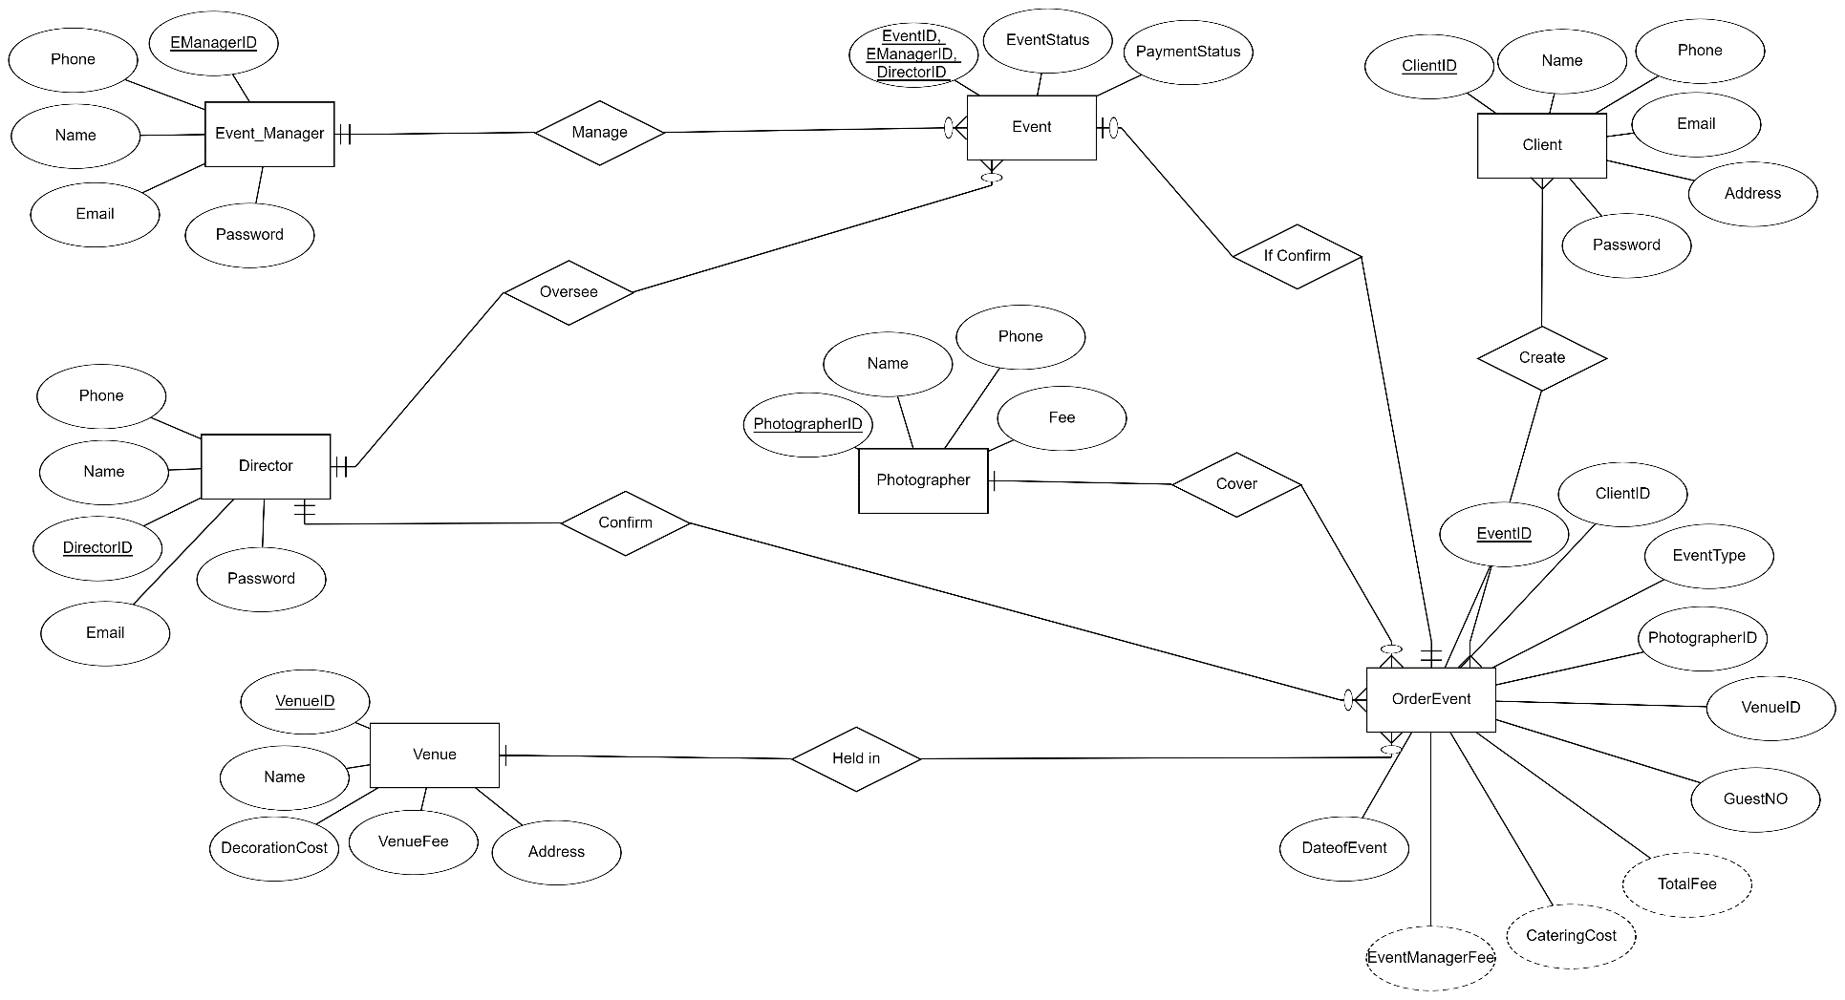
Entity Relationship (ER) diagram

Slide 5
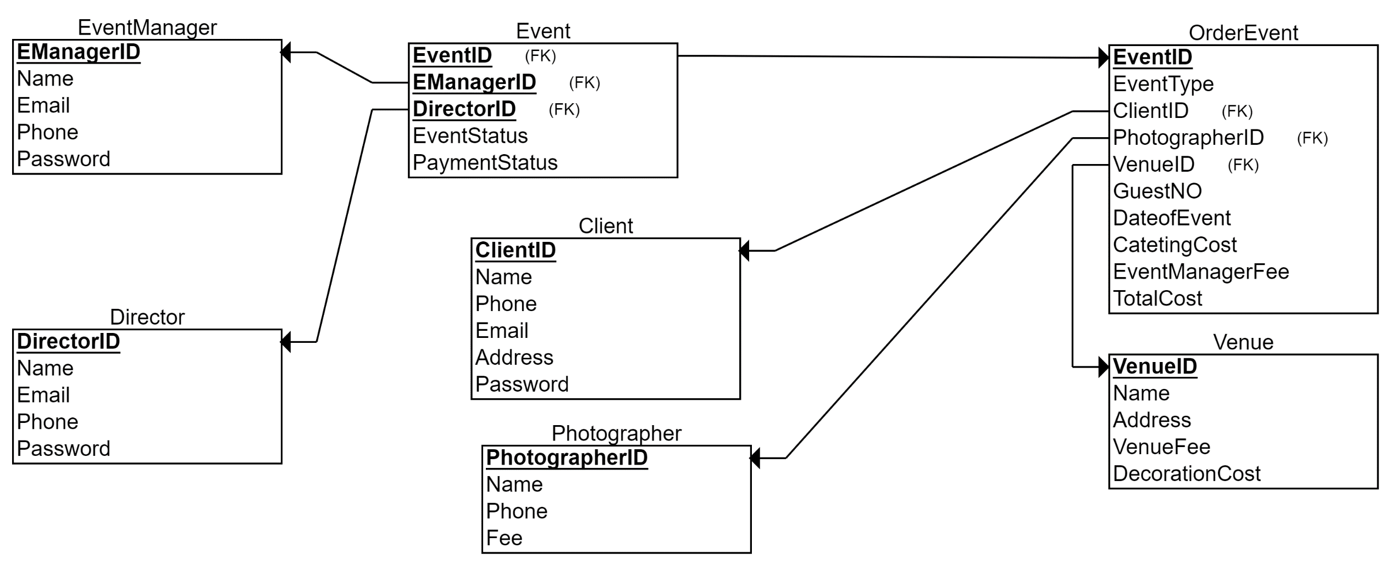
Relational Model

Slide 6
SQL Commands
CREATE TABLE EventManager
(
EManagerID INT NOT NULL,
Name VARCHAR(100) NOT NULL,
Email VARCHAR(100) NOT NULL,
Phone VARCHAR(30) NOT NULL,
Password VARCHAR(30) NOT NULL,
PRIMARY KEY (EManagerID)
);
CREATE TABLE Director
(
DirectorID INT NOT NULL,
Name VARCHAR(100) NOT NULL,
Email VARCHAR(100) NOT NULL,
Phone VARCHAR(30) NOT NULL,
Password VARCHAR(30) NOT NULL,
PRIMARY KEY (DirectorID)
);

Slide 7
SQL Commands
CREATE TABLE Venue
(
VenueID INT NOT NULL,
Name VARCHAR(100) NOT NULL,
Address VARCHAR(100) NOT NULL,
VenueFee INT NOT NULL,
DecorationCost INT NOT NULL,
PRIMARY KEY (VenueID)
);
CREATE TABLE Photographer
(
PhotographerID INT NOT NULL,
Name VARCHAR(100) NOT NULL,
Phone VARCHAR(30) NOT NULL,
Fee INT NOT NULL,
PRIMARY KEY (PhotographerID)
);

Slide 8
SQL Commands
CREATE TABLE Client
(
ClientID INT NOT NULL,
Name VARCHAR(100) NOT NULL,
Phone VARCHAR(30) NOT NULL,
Email VARCHAR(100) NOT NULL,
Address INT NOT NULL,
Password VARCHAR(100) NOT NULL,
PRIMARY KEY (ClientID)
);

Slide 9
SQL Commands
CREATE TABLE OrderEvent
(
EventID INT NOT NULL,
EventType VARCHAR(100) NOT NULL,
GuestNO INT NOT NULL,
DateofEvent DATE NOT NULL,
CatetingCost INT NOT NULL,
EventManagerFee INT NOT NULL,
TotalCost INT NOT NULL,
ClientID INT NOT NULL,
PhotographerID INT NOT NULL,
VenueID INT NOT NULL,
PRIMARY KEY (EventID),
FOREIGN KEY (ClientID) REFERENCES Client(ClientID),
FOREIGN KEY (PhotographerID) REFERENCES Photographer(PhotographerID),
FOREIGN KEY (VenueID) REFERENCES Venue(VenueID)
);

Slide 10
SQL Commands
CREATE TABLE Event
(
EventStatus VARCHAR(100) NOT NULL,
PaymentStatus VARCHAR(100) NOT NULL,
EManagerID INT NOT NULL,
DirectorID INT NOT NULL,
EventID INT NOT NULL,
PRIMARY KEY (EManagerID, DirectorID, EventID),
FOREIGN KEY (EManagerID) REFERENCES EventManager(EManagerID),
FOREIGN KEY (DirectorID) REFERENCES Director(DirectorID),
FOREIGN KEY (EventID) REFERENCES OrderEvent(EventID)
);

Slide 11
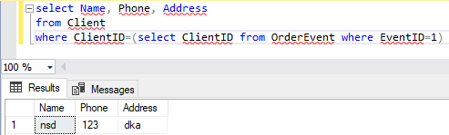
justify the multiplicities

Slide 12
Thank you

