Slide 1
Event Planner Website
Submitted By –
Robiul Hasan Nowshad(16.01.04.061)
Sadia Arefin Smrity(16.01.04.068)
Muna Saha(16.01.04.060)

Slide 2
Questionnaire will help us to know people’s opinion on this website. From their opinion we will try our best to stand up on their expection. Beside of all this, we will be able to advertise our site to the potential clients.
Sampling Decisions
We have undertaken target-oriented method for sampling. Our target research included Facebook, Twitter, Direct E-mail, messages, colleges, universities, and public places in Dhaka city.

Slide 3
Sample Design
1. Sample Size: The sample size selected for the research is 40.
2. Parameters of Interests: The major parameter of interest is the subgroup of people having an experience in hiring event planners for celebration.
3. Sampling Technique: Any probabilistic sampling technique described in the class.
Data Collection Tool Used
The data collection tool used for the research is “Questionnaires” to get the primary data for the empirical research on clients preference on event planner website.

Slide 4
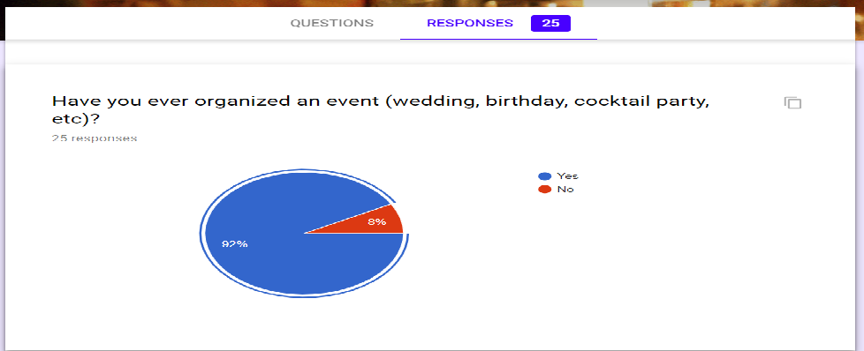
Data Analysis: Have you ever organized an event (wedding, birthday, cocktail party, etc)?
The above diagram depicts that out of total 40 respondent 92% in the affairmative form. At present attractive design and other delighted decoration can be organized through the help of planner. That’s why the response is in positive.

Slide 5
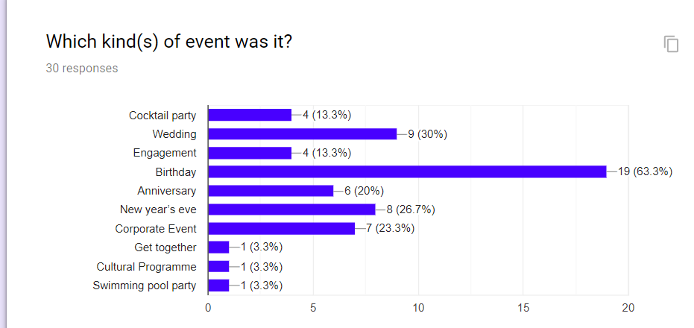
Which kind(s) of event was it?
In this chart, there is a view of events which was organized by the event management. 63.3% respondent was for birthday organization. Then 2nd respondent was for the wedding . The corporate events are also planned by the event planner. Because everything needs to be handled professionally. According to the percentage of response the other events were also managed by event planner.

Slide 6
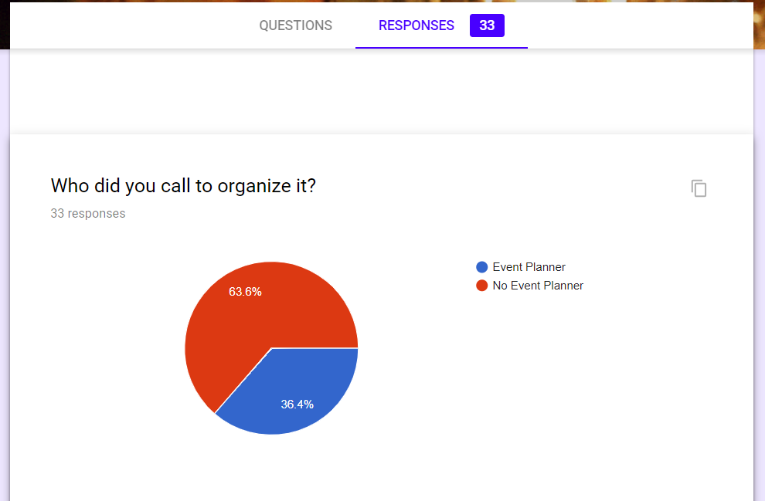
Who did you call to organize it?
People now a days want a perfection in any kind of party. That’s why they are inneed of event organizer. 63.6% respondent was for not hiring event planner in this chart. Because before this modern era people were not concerned about this planning management system.

Slide 7
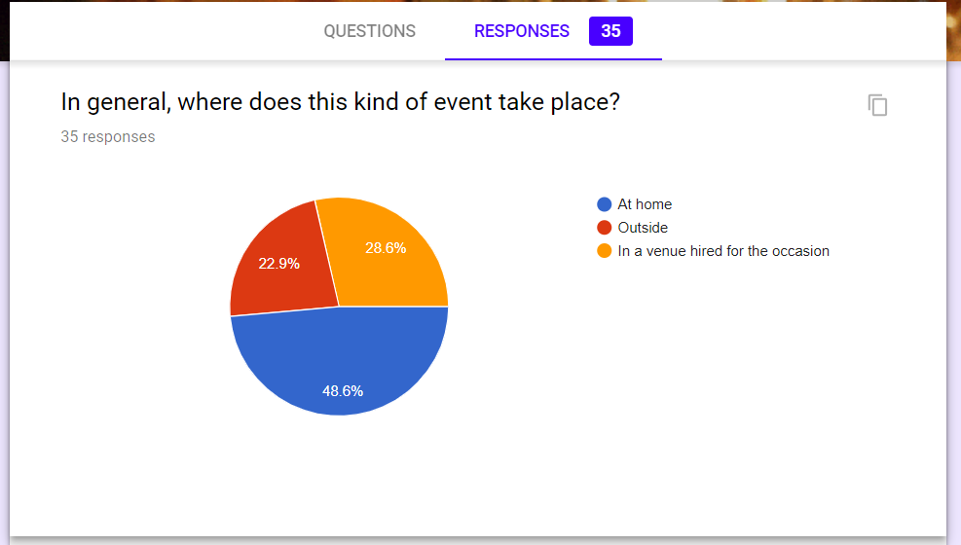
In general, where does this kind of event take place?
It is a kind of trend in our country to celebrate any occasion with family members at home. Though there are also some corporate events which are organized outside of the house. So from this chart it can be said that people are now-a-days are interested to celebrate any function with their loved ones, inside the home. $48,6% represents that.

Slide 8
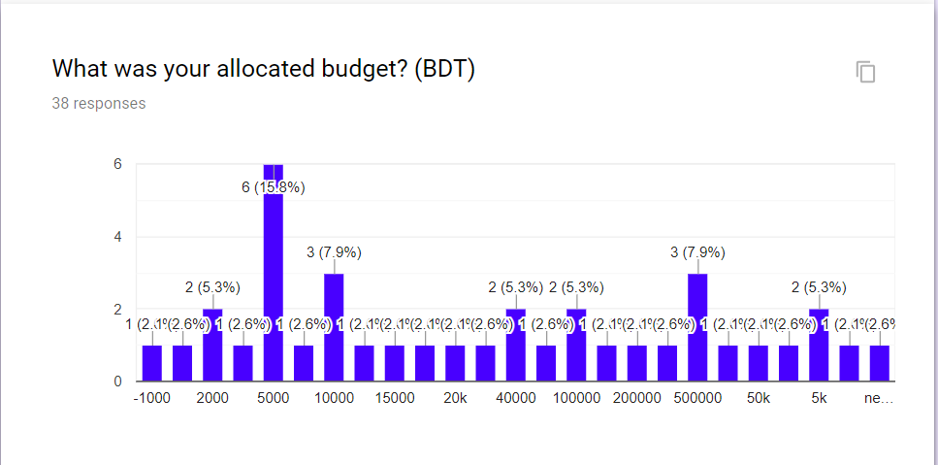
What was your allocated budget? (BDT)
What was your allocated budget? (BDT)
In general, everyone wants to organize party or occasion with limited budget. For this reason the 1st respondent are from 5k. When the affluent people organize their party in grand way, they contribute kind of huge fund. According the budget of every client event planner try to give their best.

Slide 9
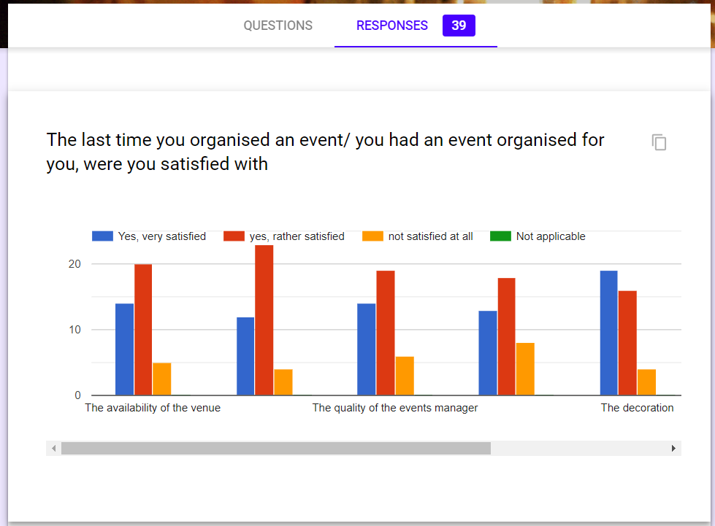
Illustration on organized party
As in these days, the businessmen & other general people are getting interested in this event management , the planners are also doing their work enthusiasmly. They try to afford best value for grang celebration, they also provide nice decoration with the help of other vendor likedecor manager,photographer and so on. So that the client will be happy and this will update planners image to other people or organization.

Slide 10
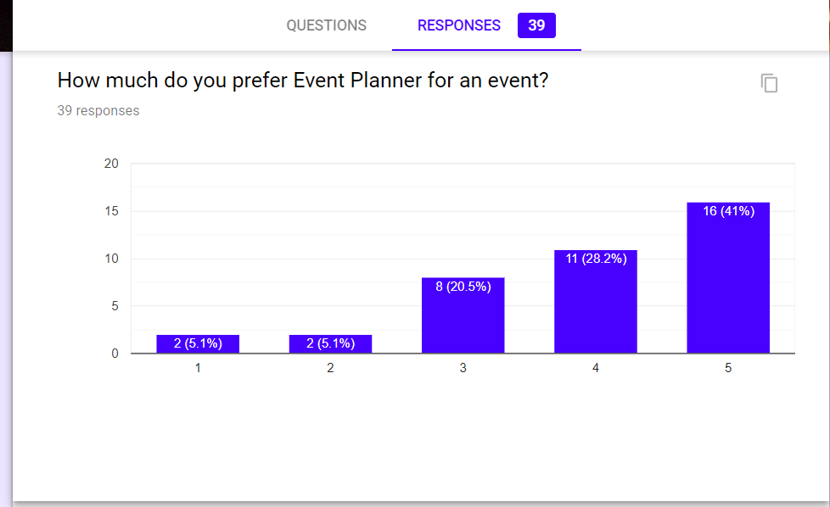
How much do you prefer Event Planner for an event?
In earlier, the event management system was not so much renonwned. But day by day this management is getting familiar to educated people. They know that in this century planners are much preferable than organizing it by themselves. Because the planners know in which way work should be done properly. From this chart, this things is getting cleared.

Slide 11
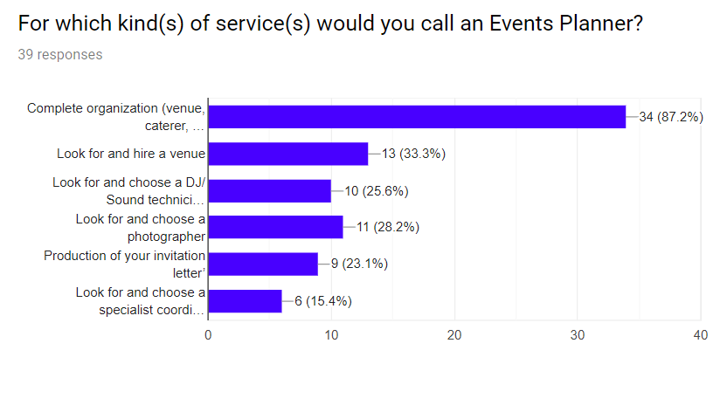
For which kind(s) of service(s) would you call an Events Planner?
In this chart, 87.2% percentage is representing that the responsibility should be given to event planner for a hosing a complete occasion. Like, in a celebration we need to communicate with various kind of vendor, like photographer, catering, decor and so on. This is not so easy to handle all these by all alone. That’s why we need to hire planners. Not only for this, if anybody wants to communicate with any single vendor like sound system handlers, djs , then client can consult with the event planners.

Slide 12
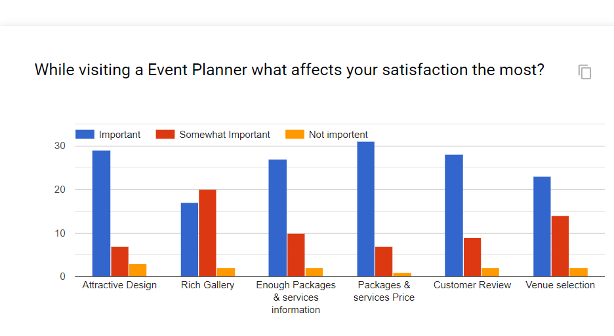
While visiting a Event Planner Website what affects your satisfaction the most?
Event planner usually advertise their site or their professional work on social networking site. So it is compulsory that the internal design of page should be attractive. After that people will be interested to visit that site and they will also provide work to the planners. The admin of this management should give some valuable pictures on their gallery side. So that these will give an acknowledgement to the people who visit this planners site. It will be also benefited for the clients who want to deal with event planners for arranging party.

Slide 13
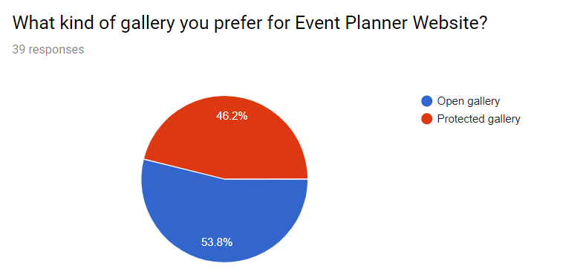
What kind of gallery you prefer for Event Planner Website?
In this chart we can see that protected gallery for any event management system is more preferable. Sometimes the corrupted sites try to steal some efficient work of other hosts, as a result of this, the actual planners can not publish their worthy tasks to other. So it is needed to open a protected gallery for any event management site.

Slide 14
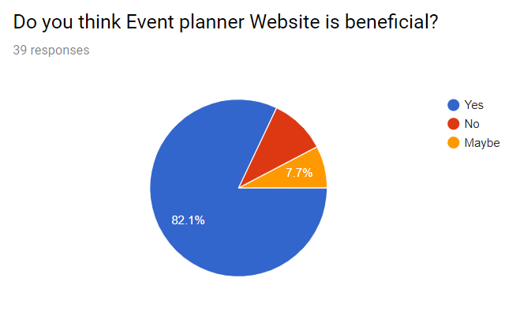
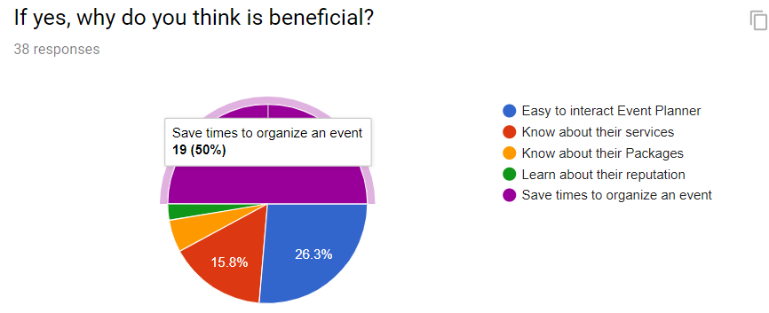
Do you think Event planner Website is beneficial? If yes, why do you think it is beneficial?
Yes, Event planner website is beneficial.
The following reasons are:
This site gives a general knowledge for total management.
People need not to go in search of different vendors, like, sound technician, catering, photographers and so on. It conquers the time of the client.
The professional event planners give a overview of their packages through the site. So client can choose affordable package within their budget. By consulting with planners in details, client can be assured to some extends about the efficient work of planners.

Slide 15
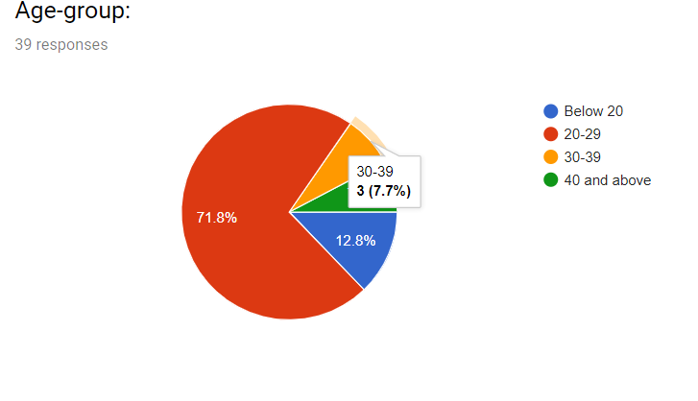
Demongraphics Information:
Here, 71.8% respondents are between 20-29. Because they are either corporate workers or businessmen. They know how to deal with outside of the world. The people of this age also work as event planners. So there can be good reations among them for hosting a party.

Slide 16
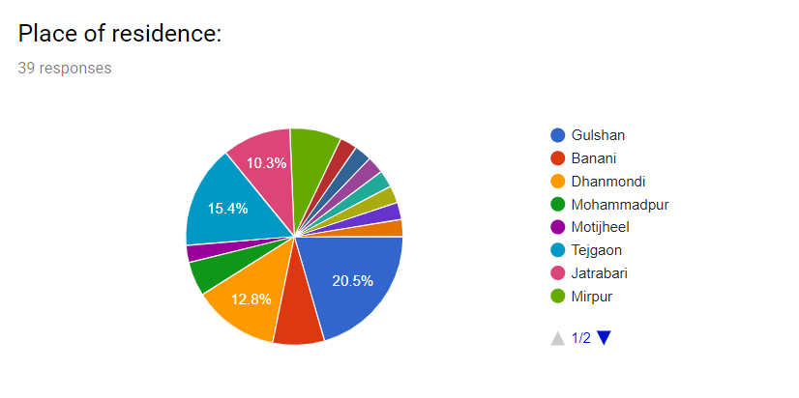
Place of Residience
Through this chart we can see that in area of Dhaka almost all people consult with a planner for hosting party. They know that it’s a easier way to arrange an occasion.

Slide 17
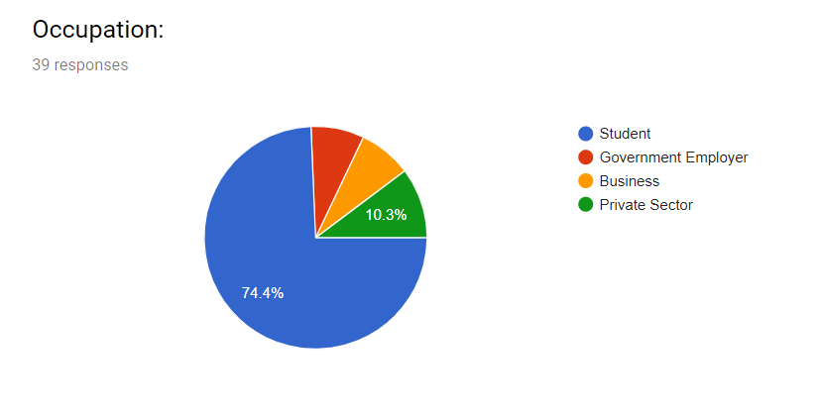
Occupation
Most of the people who are now a days communicating with the planners are student. They know that a grand party with a limited budget can be done by the event planners.

Slide 18
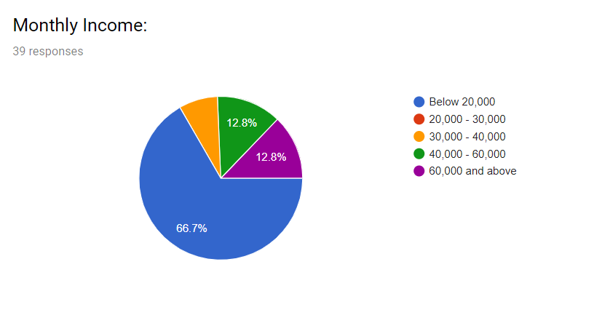
Monthly Income
The respondent of monthly income is 66.7%. It is clear that it is not possible for all general people to organize party with pomp and grandeur. That’s why the helping hand of planners are needed.

Slide 19
Conclusion
Through the whole illustration, many aspects of event planners have been tried to show up. At the end it will be an recommendation for all to communicate with event planners for celebration.

