Slide 1
Event Planning Website
Use Case Diagram & Class Diagram
Submitted by-
Robiul Hasan Nowshad(16.01.04.061)
Sadia Arefin Smrity(16.01.04.068)
Muna Saha(16.01.04.060)

Slide 2
Motivation
Make easy to throw an Event
Organize Event on budget
Help to find right Venue & Photographer
Easy to choose Design, Decoration, Catering

Slide 3
List of Events
Wedding
Anniversary
Birthday
Corporate Event
Get Together
New year’s eve

Slide 4
Actors
Primary Actors
Secondary Actors
Visitors
Clients
Event Manager
Director
System

Slide 5
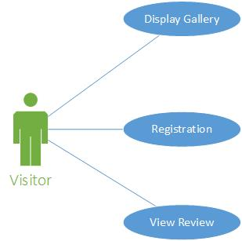
Use Case diagram of Visitors

Slide 6
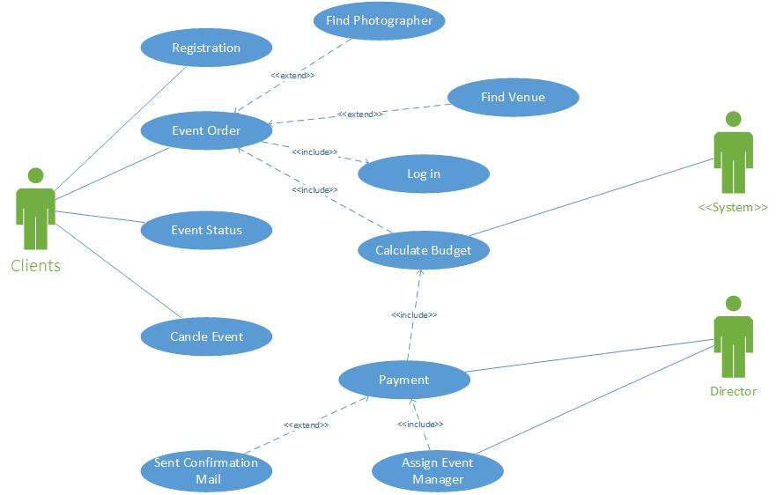
Use Case diagram of Clients

Slide 7
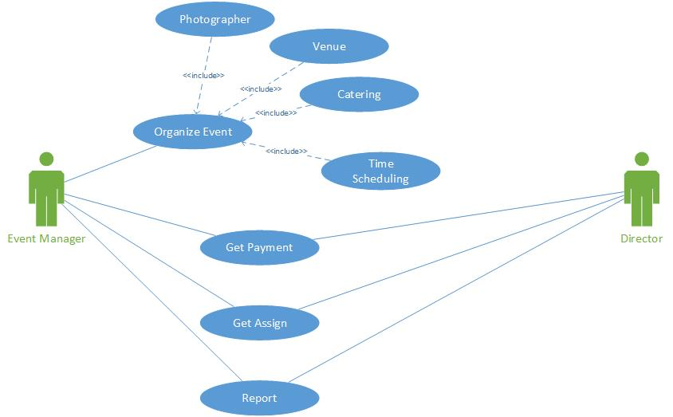
Use Case diagram of Event Manager

Slide 8
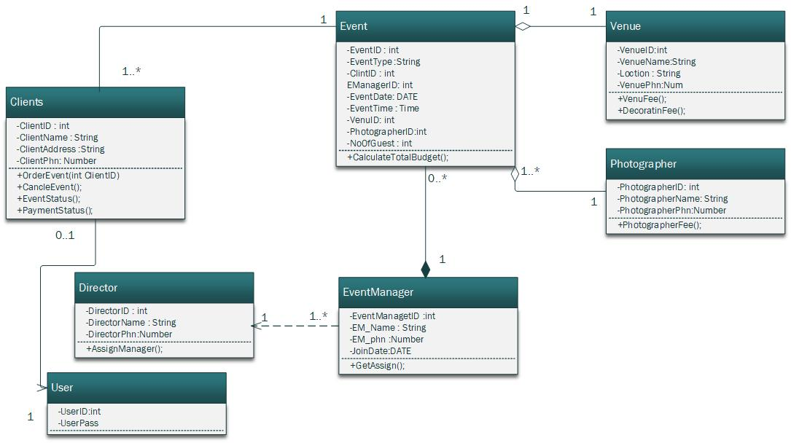
Class Diagram

Slide 9
Conclusion
We use Class Diagram and User case diagram to implement our Project more efficient as requirement. It make easy to implement our project.

Slide 10
Thank You

