Slide 1


Central Bank of India
Bank
Analysis

Slide 2


Central Bank of India
Group 1 members :-
Abhaysingh Rathod
Amarnath
Dharmi Somaiya
Malikarjun Reddy
Nowshad
Pooja Tavaskar
Rohan Barse

Slide 3
Central Bank of India
INDEX :-
Introduction
KPI’s
Year Wise Loan Amount Statistics
Grade & Sub-Grade Wise Revolving Balance
Total Payment For Verified Status Vs Total Payment For Non-Verified Status
State Wise And Month Wise Loan Status
Home Ownership Vs Last Payment Date Statistics
Dashboard’s

Slide 4
Central Bank of India
Introduction :-
In an ever-evolving financial landscape, it is significant to understand the intricacies of bank performance for stakeholders, investors, and regulators alike. This presentation gives us a comprehensive analysis of a bank, delving into its financial health, operational efficiency, risk management practices, and market positioning.
Through this analysis, we seek to provide a holistic view of the bank's strengths, weaknesses, opportunities, and threats, offering valuable perspectives to navigate through the dynamics of banking.

Slide 5
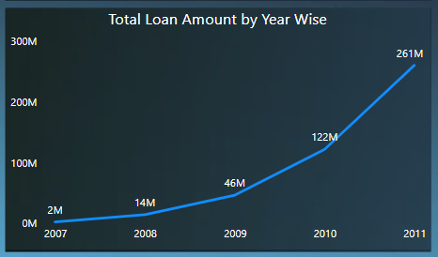
Central Bank of India
1. Year wise loan amount statistics :-
Understanding the year-wise loan amount status of bank loan customers is imperative for financial institutions to assess risk, optimize lending practices and regulatory compliance.

Slide 6
Central Bank of India
Observation :-
The year wise stats indicate a huge inclination towards people lending loans year-on-year. This showing an increment of 300%. This goes to show that people are willing and showing bigger risk appetites year-on-year when purchasing houses.
Key Suggestions :-
If there is a consistent increase or decrease in loan amounts over the years, consider adjusting lending policies or marketing strategies accordingly.
Conclusion:-
By concluding 1st KPI, it can be detected that the increase in loan amounts has been influenced by various economic factors. Thus, it is important to monitor this trend and ensure that it aligns with sustainable financial practices.

Slide 7
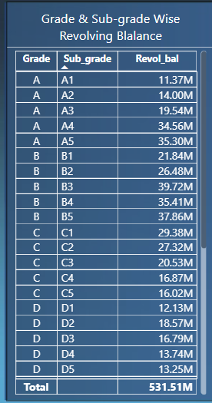
Central Bank of India
2. Grade and sub grade wise revol _ bal:-
The banking and financial management, comprehending the grade and sub-grade wise distribution of revolving balance (revol _ bal) among bank loan customers is paramount for risk assessment and portfolio management.
To explore the intricate relationship between credit grades, sub-grades, and revolving balances to discern underlying trends and patterns that influence borrower behavior and credit risk profiles.

Slide 8
Central Bank of India
Observation:-
Analyze the distribution of revolving balances across different loan grades and subgrades to identify any trends or patterns. As you see the highest grade and subgrade is B and B3 of 39.72M that determine if there are any significant differences in revolving balances between different grades and subgrades.
Key Suggestions :-
If there are significant variations in revolving balances, consider adjusting lending criteria or risk assessment methods to better account for these differences.
Conclusion:-
By concluding 2nd kpi, revolving balance data about the creditworthiness of borrowers within each category, identify any correlations between revolving balances and other borrower characteristics, such as income level, employment status or history.

Slide 9
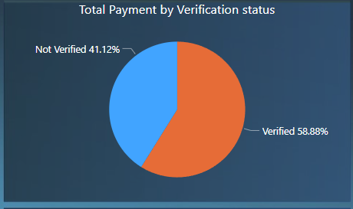
Central Bank of India
3. Total Payment for verified status vs Non verified status:-
The banking and financial services, discerning the disparities in total payments between verified and non-verified statuses among bank loan customers holds significant implications for risk management and customer verification processes.
To investigate the variations in total payments made by borrowers categorized by their verification status, shedding light on the efficacy of verification procedures in influencing repayment behavior and loan performance.

Slide 10
Central Bank of India
Observation:-
Total payment for verified status is approximately 50% more than the payment for un verified status. But if you look at the bigger picture approximately 2/3rd of the payment is done to the non verified accounts, which shows that the loan disbursement institutions are approving loans at a very high rate.
Key Suggestions :-
Review loan approval processes and credit policies to ensure that they suitable account for regional economic conditions or seasonal factors that may influence borrower repayment behavior.
Conclusion:-
By concluding 3rd kpi, verified accounts have advantages in terms of trust and less risk. Meanwhile, the unverified accounts have to face risk and may impose the higher rate of interest to compensate for the uncertainty.

Slide 11
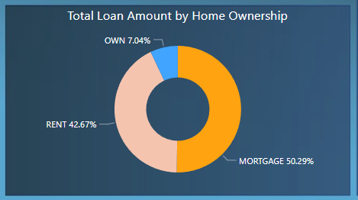
Central Bank of India
4. Home ownership VS last payment date status:-
The home ownership status and the last payment date holds pivotal importance for risk assessment and loan portfolio management of home ownership status and its correlation with the timing of last payments among bank loan customers.

Slide 12
Central Bank of India
Observation:-
Analyze the distribution of last payment date statuses across different categories of home ownership. As we see the own is 7.04% same as rent is of 42.67% and mortgage is of 50.29%. Determine if there are any differences in last payment date statuses based on home ownership status
Key Suggestions :-
If there are disparities in last payment date statuses between different categories of home ownership. consider implementing targeted financial education or counseling programs to assist borrowers in managing their mortgage or rental obligations effectively
Conclusion:-
By concluding 4th kpi, the home ownership status and last payment date status, the relationship between housing tenure and loan repayment behavior

Slide 13
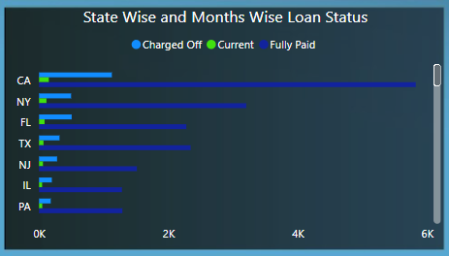
Central Bank of India
5. State wise and month wise loan status :-
Understanding the state-wise and month-wise loan status of bank loan customers is crucial for strategic decision-making and risk assessment. This aims to delivered into the dynamic interplay between geographic location, temporal trends, and loan repayment behaviors.
By analyzing loan data categorized by state and month, we seek to uncover insights into regional variations in loan performance, default rates, and repayment patterns over time.

Slide 14
Central Bank of India
Observation:-
Analyze the distribution of loan statuses, across different states and months to identify any trends or patterns, investigate any seasonal variations in loan statuses and assess their potential impact on portfolio performance
Key Suggestions :-
Review loan approval processes and credit policies to ensure that there suitable account for regional economic conditions or seasonal factors that may influence borrower repayment behavior.
Conclusion:-
By concluding 5th kpi, Identify any geographic or temporal trends in loan performance that may warrant adjustments to lending policies, portfolio allocation, or customer engagement approaches.

Slide 15
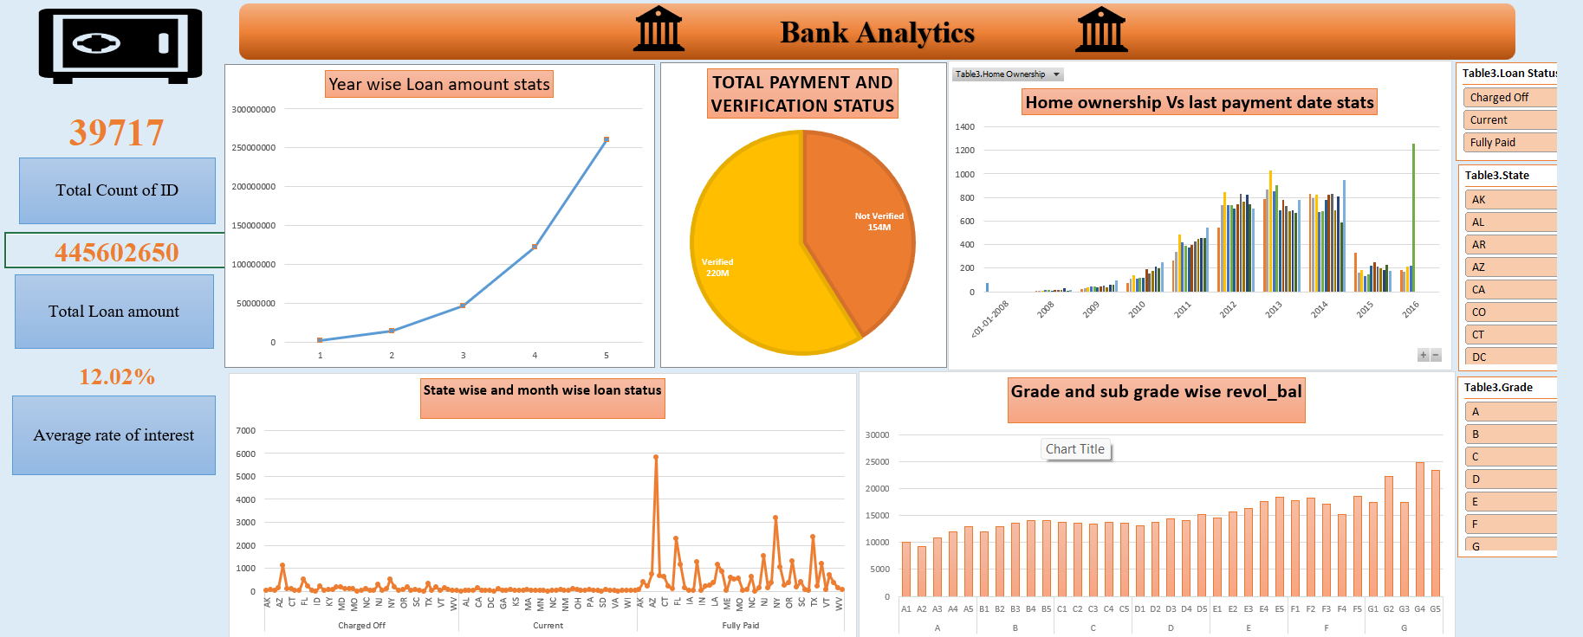
Central Bank of India
EXCEL DASHBOARD:-

Slide 16
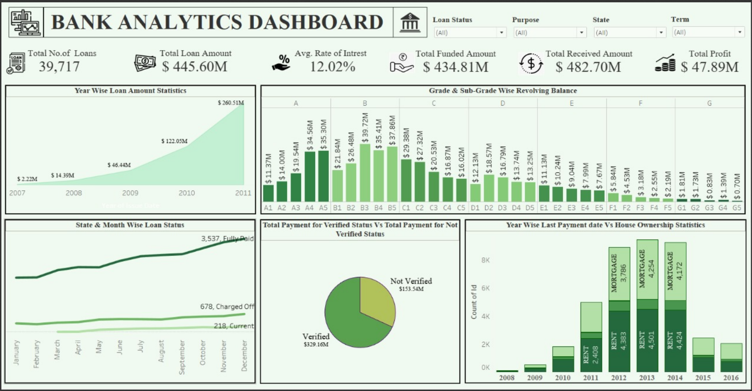
Central Bank of India
TABLEAU DASHBOARD:-

Slide 17
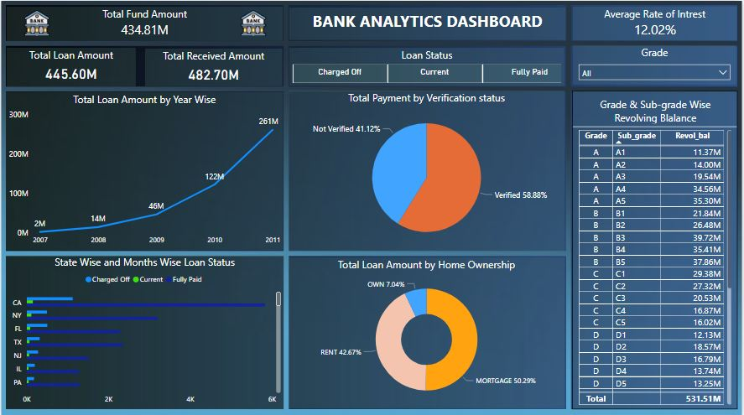
Central Bank of India
POWER BI DASHBOARD:-

Slide 18
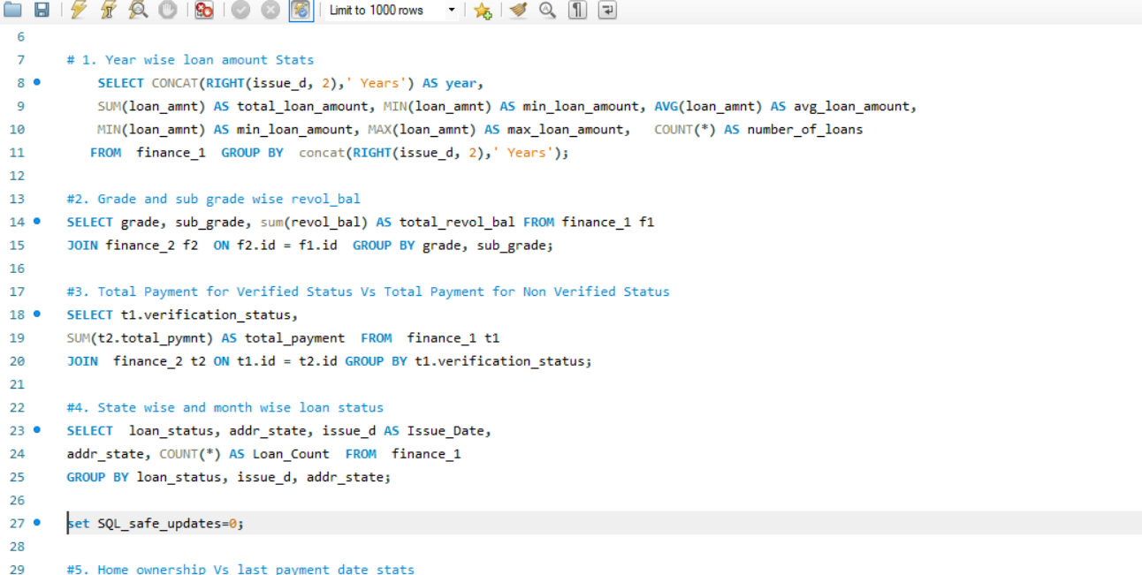
Central Bank of India
SQL QUERIES:-

Slide 19
Central Bank of India
THANK YOU!

