Slide 1
HIKEAWAY
Alex, Connor, Garrett, Todd

Slide 2
PROBLEM
New hikers are often discouraged
Too many hikes to choose from
WTA rating information inadequate
No hiking progression

Slide 3
SOLUTION
An app that gives trail suggestions
Based on:
Hiker skill level
Complex algorithm
Trail difficulty
Length
Elevation gain
Steepness
Sentient AI suggestions will improve over time

Slide 4
DEMO
Big data gathered from WTA database

Slide 5
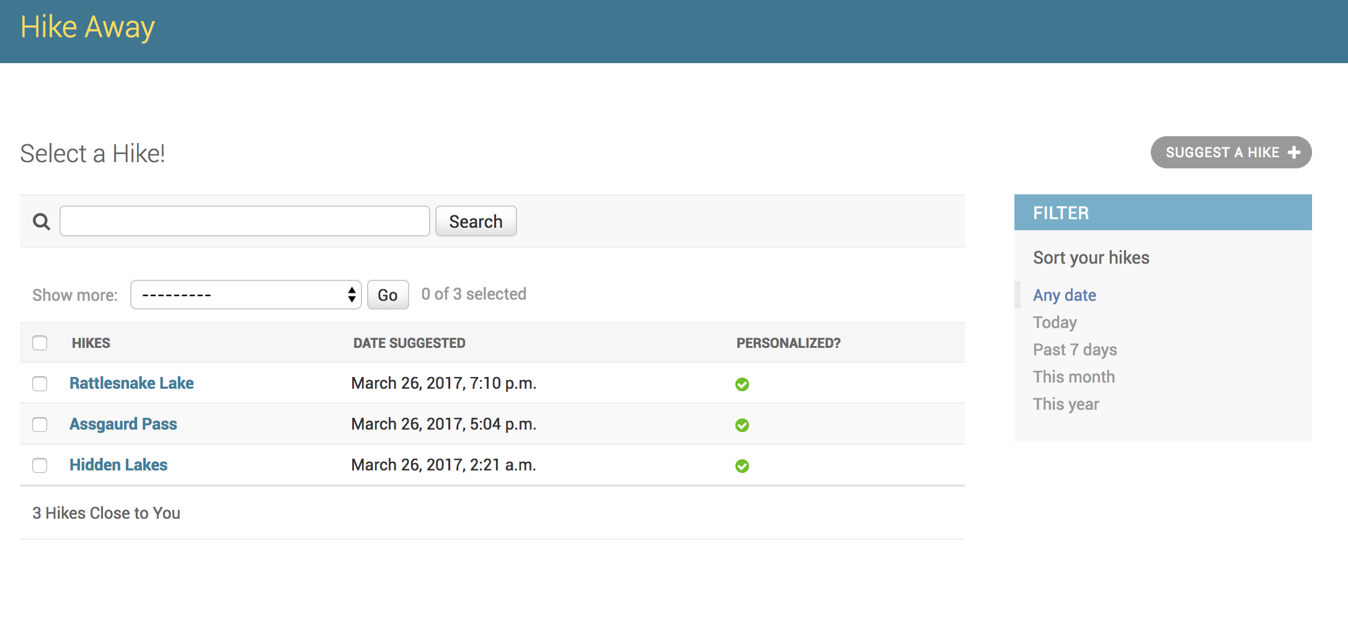
WEB APP

Slide 6
T-MOBILE
Promote healthy and active lifestyle
Increases outdoor exposure
Positive impact on communities
Relevant advertising opportunities
Partnership with Washington State

Slide 7
TECHNOLOGY
Python
MySQL
Django
Sentient AI
Machine Learning
Big Data
Probabilistic Model

Slide 8
FUTURE
Mobile and web apps integration
Pull data from health apps for more accurate skill level
Pair users of similar skill levels
Hiking in groups averages skill levels

Slide 9

HIKEAWAY

