Slide 1

GRIMOIRE
LOCAL-FIRST MARKDOWN
Notes that stay yours.
A focused desktop workspace built on ordinary folders, Markdown files, and links.
01

Slide 2
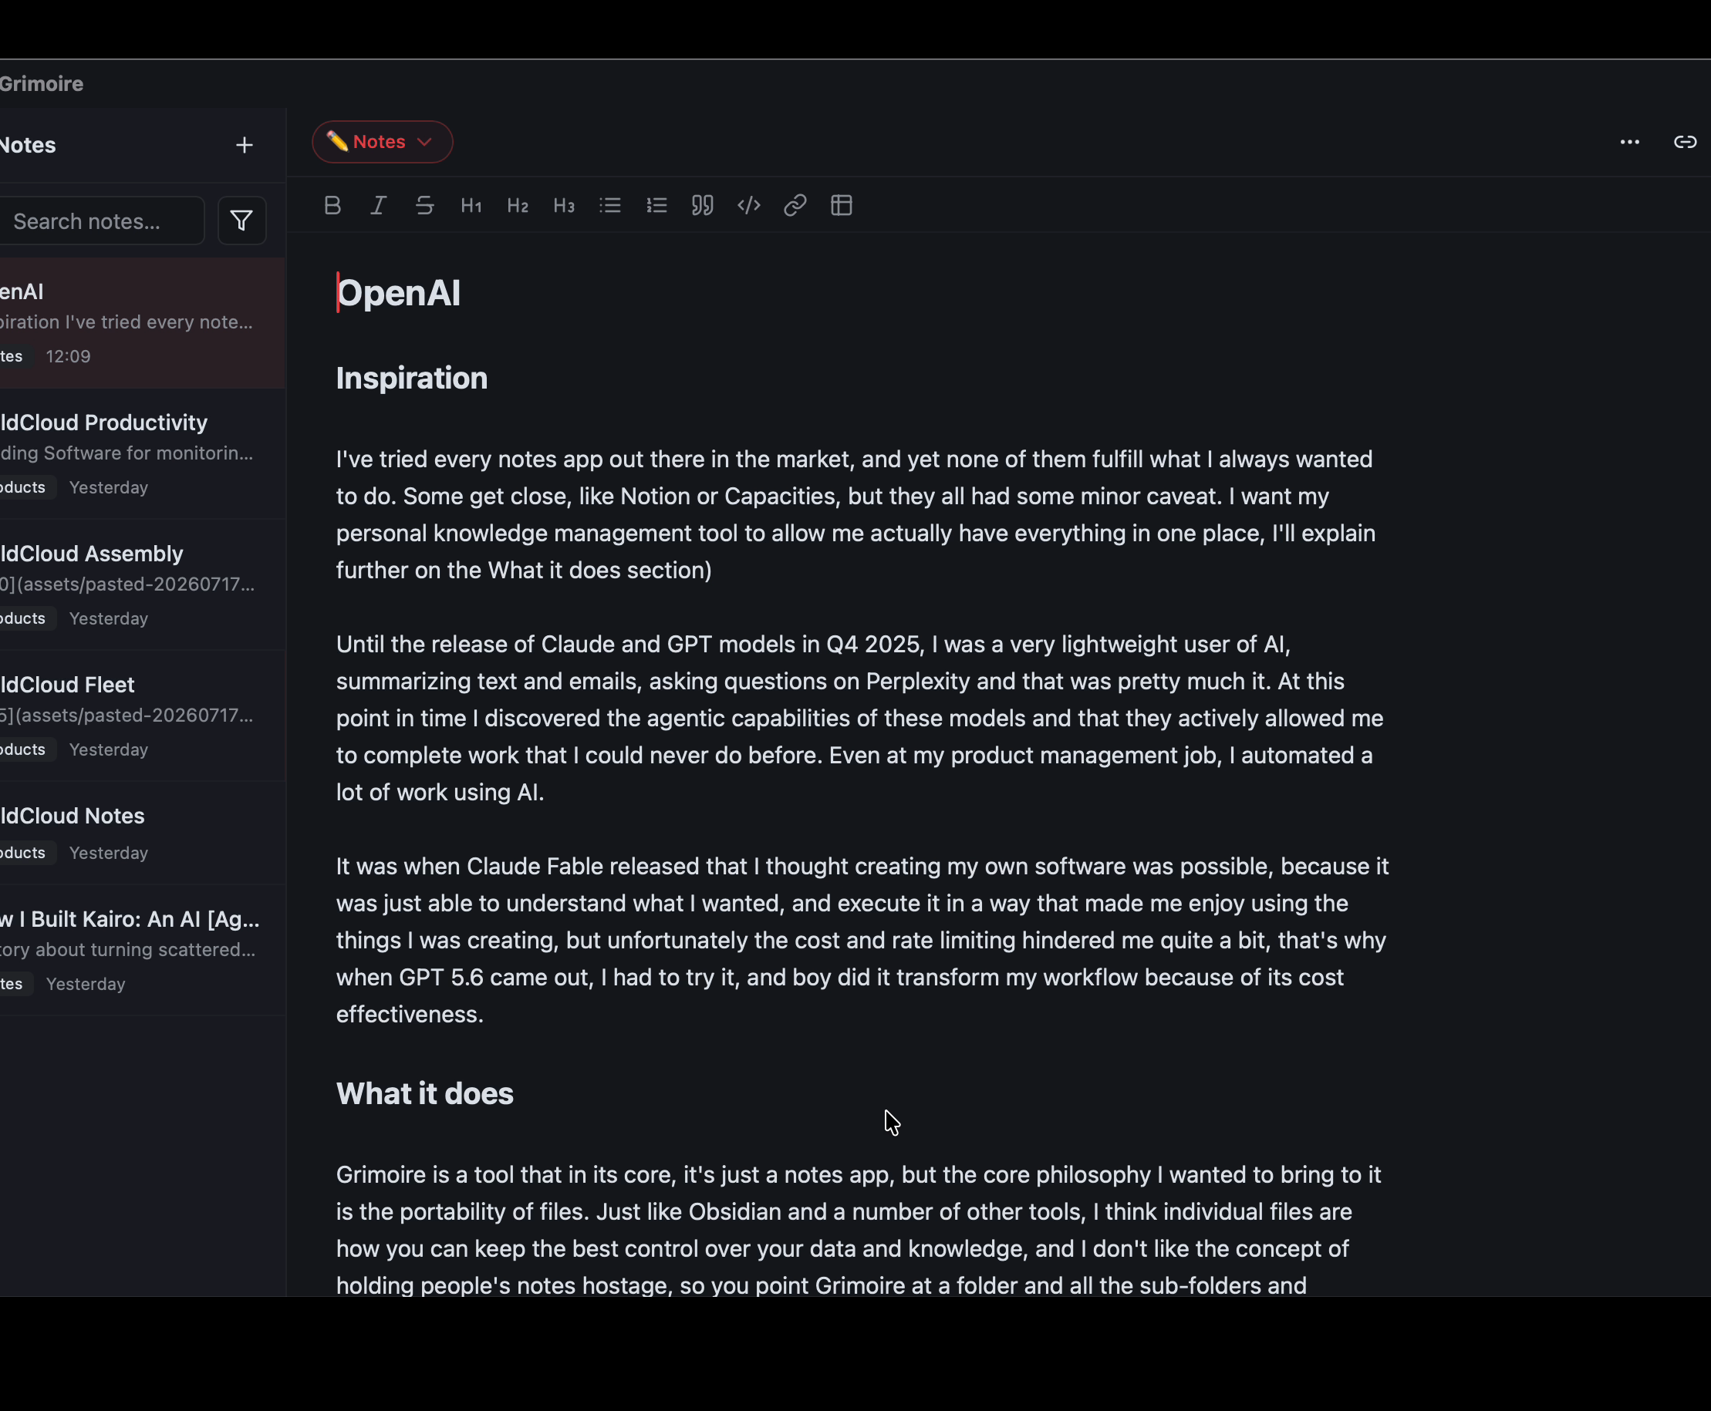
Your vault is a folder—not a database
POINT GRIMOIRE AT ANY FOLDER
Files stay as Markdown. Folders become note types. YAML properties remain readable everywhere.
Edit in Grimoire · sync with your cloud · version with Git
02

Slide 3
Structure and connection—without lock-in
01
02
03
WRITE Focused Markdown editing with live formatting, tables, links, and pasted images.
CONNECT Wikilinks, backlinks, and note relations turn separate files into a knowledge network.
ORGANIZE Nested note types, property filters, pinning, archives, and recoverable trash keep work navigable.
Choose a folder. Keep every Markdown tool you already trust.
03

