Slide 1
Deep Learning
Homework 1
Noy Rahmani
Gideon Shachar

Slide 2
Problem Definition
Image classification on CIFAR-10
Chosen due to clear benchmarks and manageable scale
10 classes: airplane, automobile, bird, cat, deer, dog, frog, horse, ship, truck

Slide 3
Data Collection Process
CIFAR-10 dataset
60,000 labeled RGB images (32×32)
50,000 training / 10,000 test samples
Balanced class distribution
Main difficulty: low resolution images

Slide 4
Model Pipeline
Fastai training framework
Pretrained ResNet (e.g., ResNet18/34)
Transfer learning with fine-tuning
Data augmentation and normalization
Cross-entropy loss, Adam optimizer

Slide 5
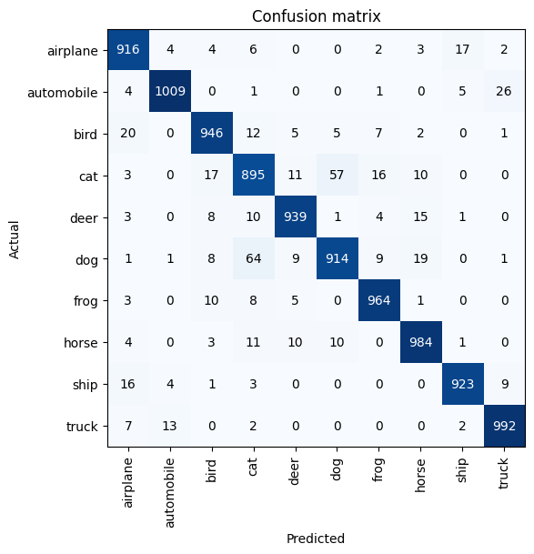
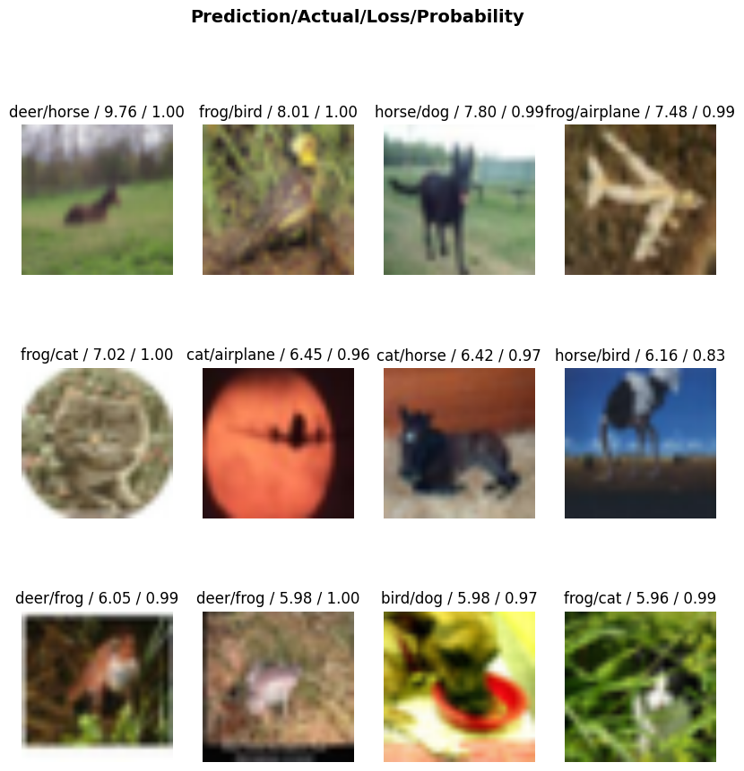
Results
Achieved high test accuracy: 94.3%
Achieved great confusion matrix stats:
Most errors are between visually similar classes

Slide 6
Challenges Encountered
Confusion between similar classes (cat vs dog, deer vs horse)
Limited image resolution
Overfitting without sufficient augmentation

