Slide 1
PT Helper
Workout Experience
Redesign
Making exercises easier to understand and complete

Slide 2
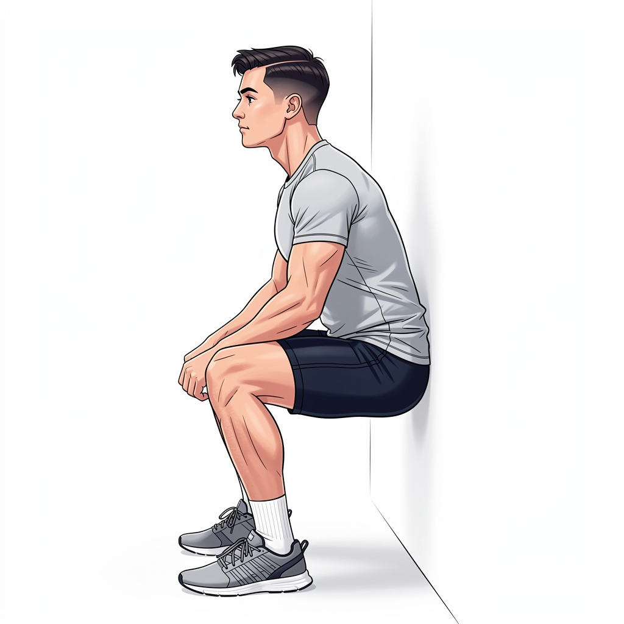
Current Pain Points
Static images don't teach movement
3 instruction paragraphs shown at once
"Complete Set" button buried below the fold
4 equal-weight buttons create decision fatigue
No adaptation to user familiarity
No visual form cues on images
Text-heavy layout with
buried action button

Slide 3
Show, Don't Tell
Before: Read → Do → Hope
After: See → Understand → Do → Confirm
1
Visual Annotations
2
Phase-Based Steps
3
Progressive Learning
Form cues overlaid directly on exercise images
Setup → Move → Return instead of paragraphs
Adapts display to user familiarity
The same exercise data, expressed visually instead of textually

Slide 4
New Exercise Screen
🎯
Annotated Image
Form cues, angles, and arrows overlaid on the exercise photo
✓ Flat back
📋
Phase Stepper
90°
Setup → Move → Return replaces three text paragraphs
⚡
Compact Actions
✕ Knees behind toes
Form / Swap / Skip as small icon buttons, not full-width
📌
Sticky Bottom Bar
"Complete Set" always visible with set dot indicators
📖
How-To Toggle
Instructions expand on demand, collapse for familiar exercises

Slide 5
Annotated Exercise Images
Visual cues overlay the exercise image to show correct form at a glance
✓ Correct Form
✕ Common Mistakes
"Back flat", "Core engaged"
"Don't cave knees"
📐 Angle Indicators
↕ Movement Arrows
90° markers on key joints
Direction and alignment lines
Form Checkpoints Card
Structured list below the image: what to do right (green) and what to avoid (red), with concise explanations

Slide 6
Smart Rest Timer
Color-Coded Ring
Green → Amber → Red as time decreases
0:32
+/- 15s Buttons
Adjust rest duration on the fly
Rest
Up Next Preview
See the next exercise with image thumbnail
Plenty of time
Haptic Feedback
Halfway
Buzz at 5 seconds, notification at zero
Almost up

Slide 7
Adapts to Your Experience
0
First Encounter
Full demo, all annotations expanded, tips visible
1-3
Learning
Annotations visible, phases collapsed, tap to expand
4-9
Familiar
Minimal view, audio tempo toggle, review link
10+
Mastered
Ultra-compact, "Last time" context, audio cues only
⚠ Form regression trigger: If pain increases, auto-expand back to full instructions

Slide 8
Know Before You Go
New exercises show a form preview before the first set
▶
Animated Demo
1→3
Phase Breakdown
Looping animation showing the full movement cycle
Setup → Movement → Return with key cues per step
⚠
Common Mistakes
♫
Tempo Preview
2-3 exercise-specific errors to avoid (AI-generated)
Shows the audio counting pattern before you start
💪 Ready — Start Exercise

Slide 9
Voice-Guided Tempo
PT exercises require controlled tempo — the app counts with you
"Down... 2... 3... 4... Hold... Up... 2... 3..."
Eccentric
Hold
Concentric
Voice cues count through each rep
Breathing reminders: "Exhale as you lift"
Toggle on/off per exercise
Especially valuable for eccentric rehab movements

Slide 10
Build Order
High Impact
1
Phase-based visual instruction
Immediate clarity improvement
2
Sticky bottom bar + set dots
Primary action always visible
3
Annotated exercise images
Biggest comprehension jump
4
Progressive learning
Adapts to returning users
5
Animated demos
Activate existing infrastructure
6
Pre-exercise form preview
Common mistakes awareness
7
Audio tempo cues
Voice-guided movements

Slide 11
The Net Effect
"Read everything, then find the button" → "See the exercise, tap complete, move on"
👁
⏱
🎯
Faster Understanding
Respects Your Time
Correct PT Form
Visual annotations teach form at a glance
Progressive learning adapts to familiarity
Audio tempo ensures proper recovery movements
PT Helper — Workout Experience Redesign

