Slide 1
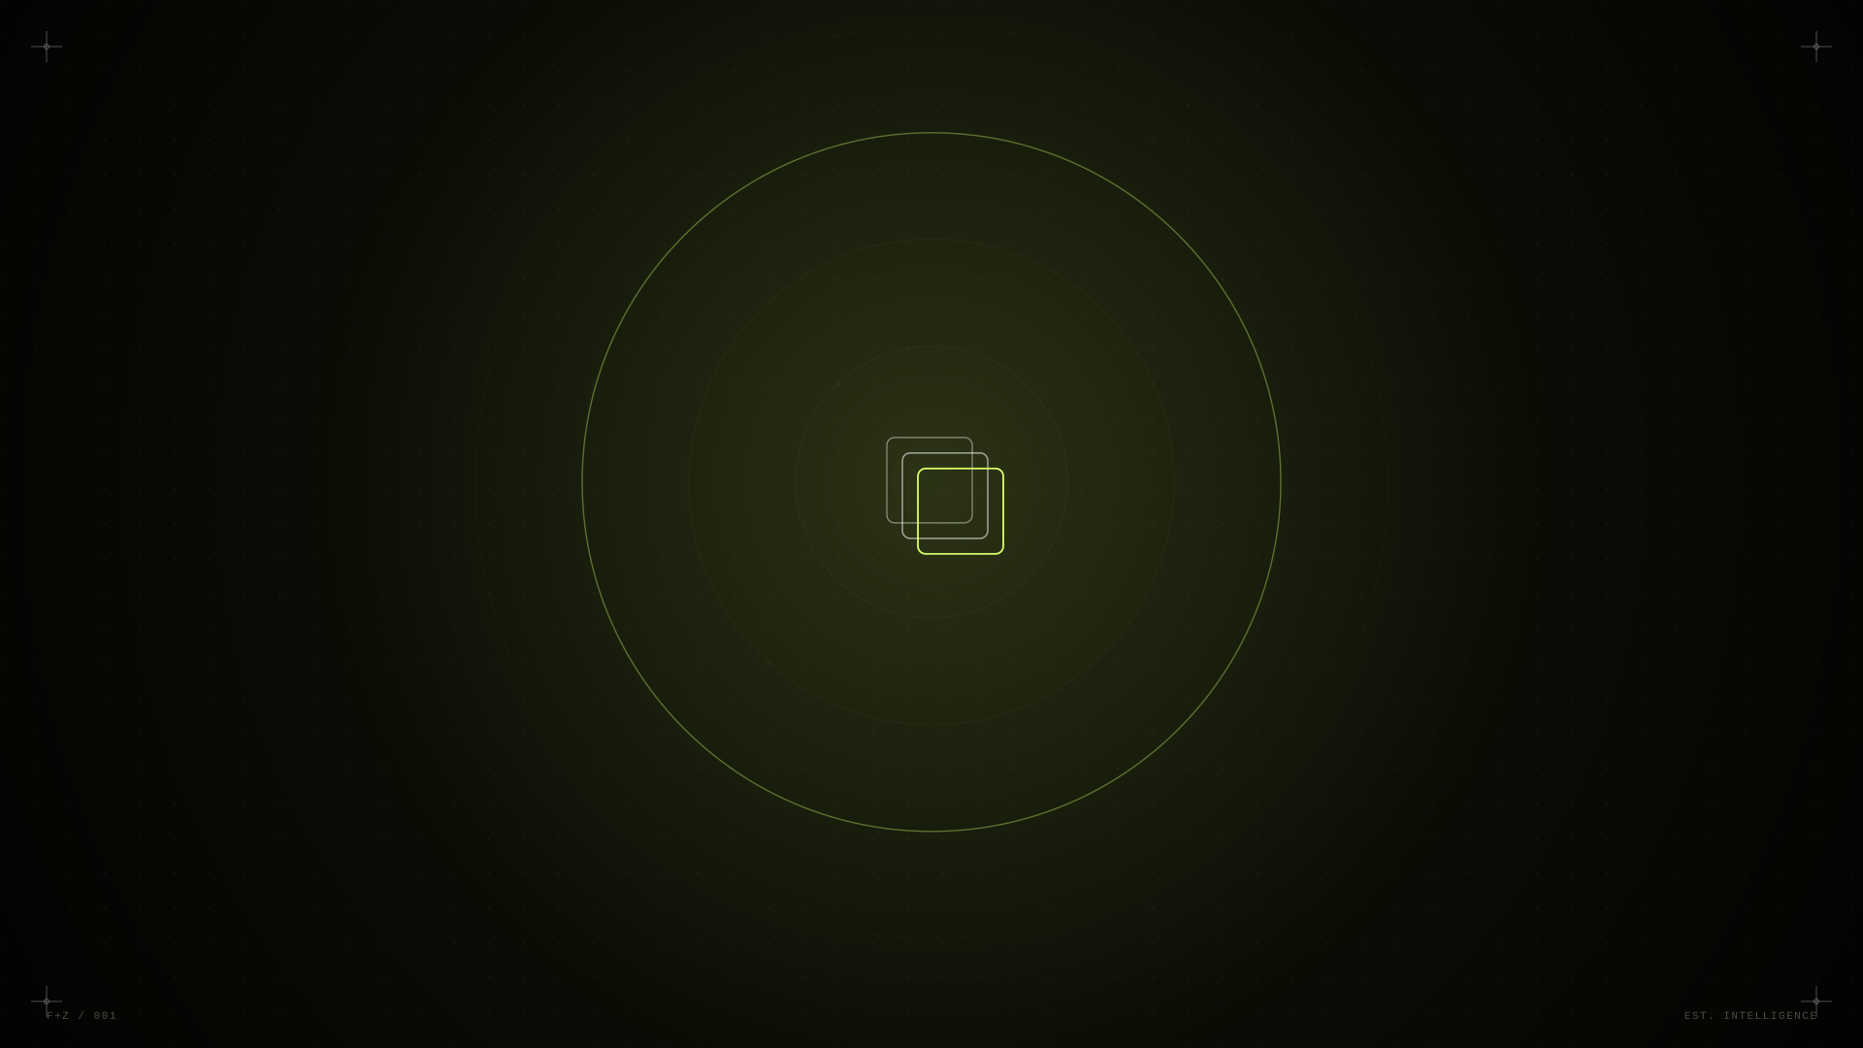
01 / 26
FIFTH & ZERO
Creative Intelligence. Built to move brands.
CREATIVE · MOTION · FILM · EXPERIENCES · AI

Slide 2
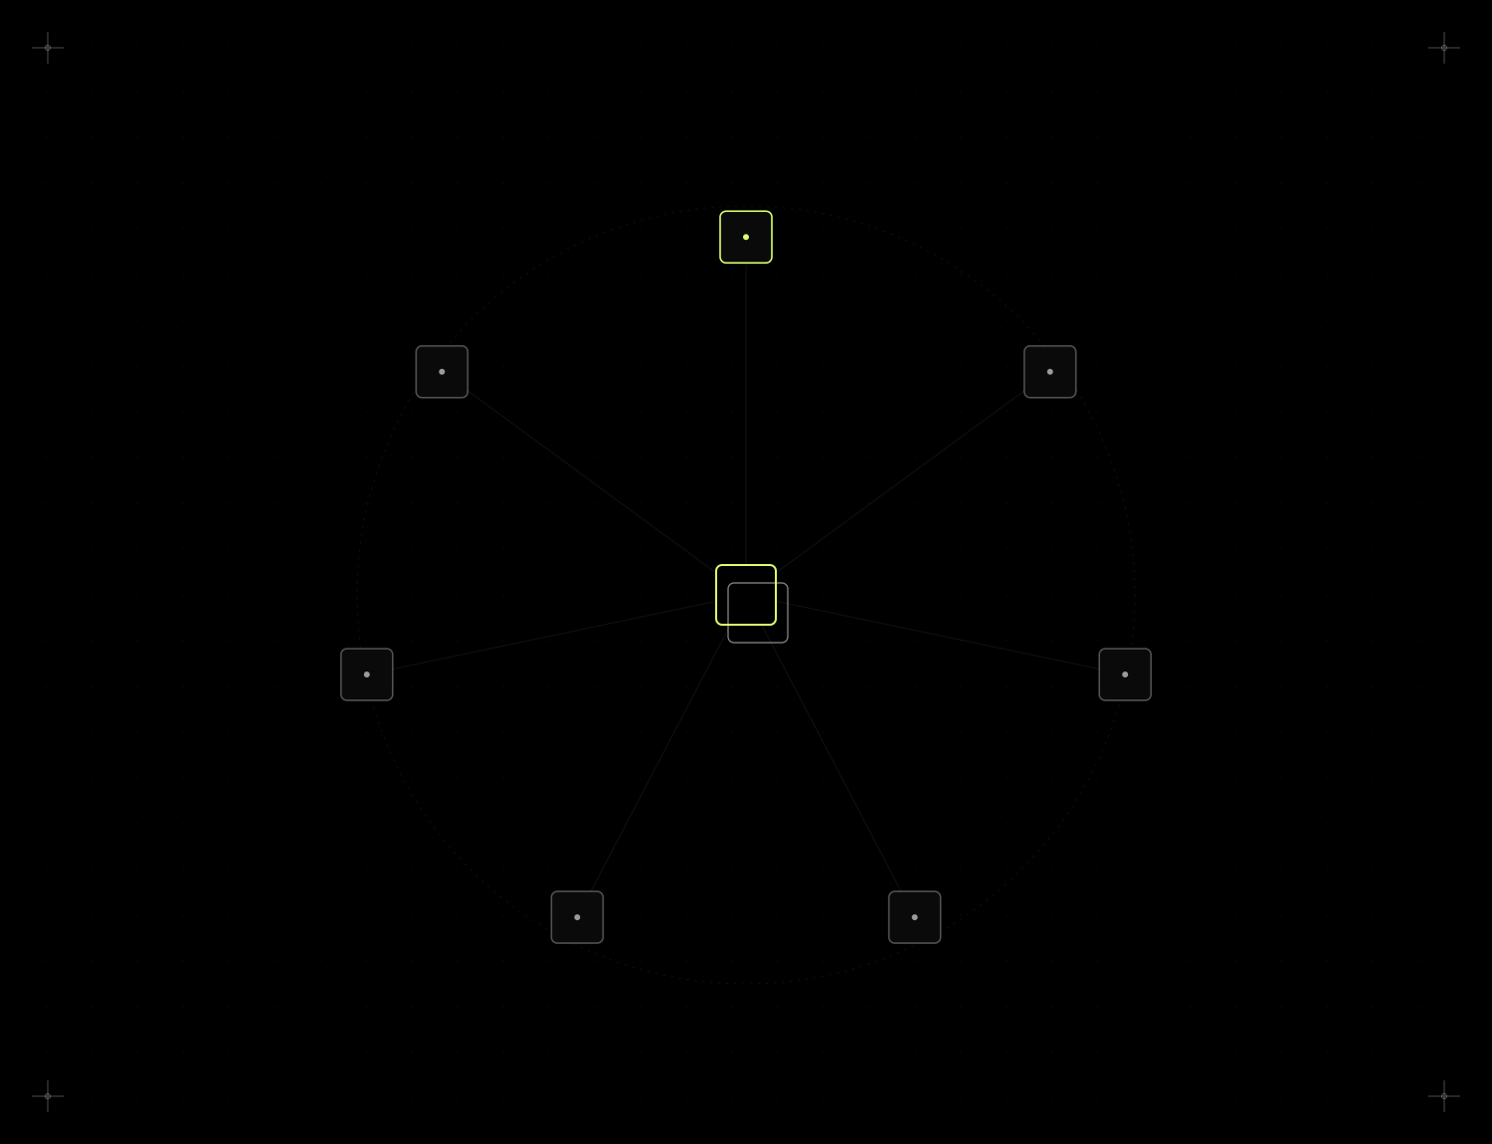
FIFTH & ZERO
02 / 26
WHAT WE DO
One creative direction.
Every screen. Every format.
A single idea, art-directed once and engineered to hold its shape everywhere it lands — from a five-second story to a forty-metre stage.
KEY VISUAL
DIGITAL
PRINT
EVENT
MOTION
FILM
AI
THE SYSTEM

Slide 3
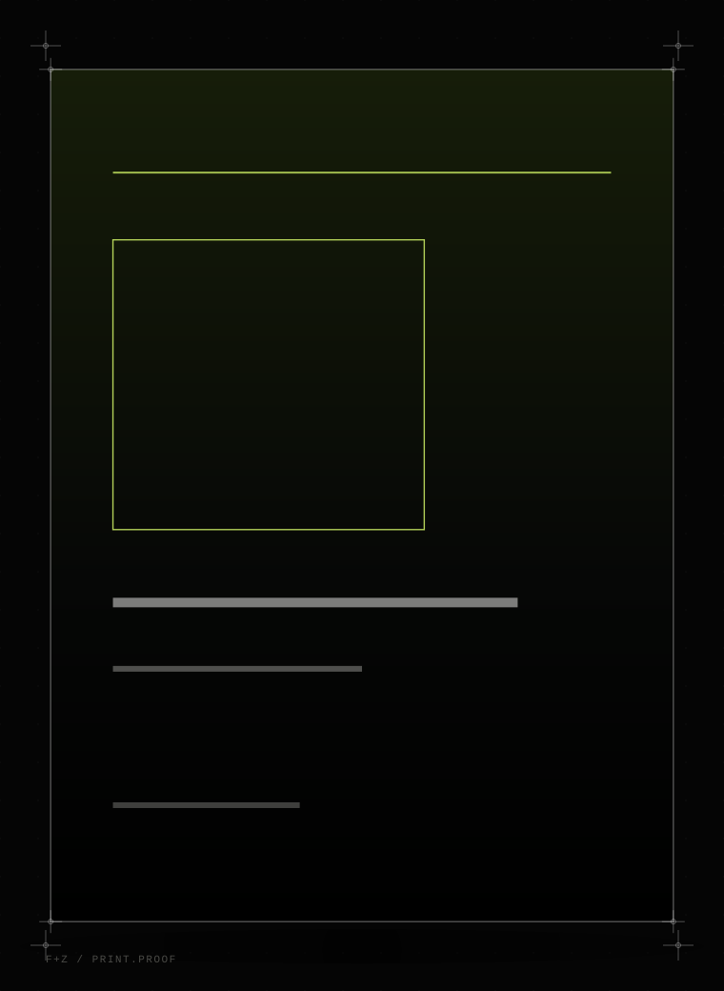
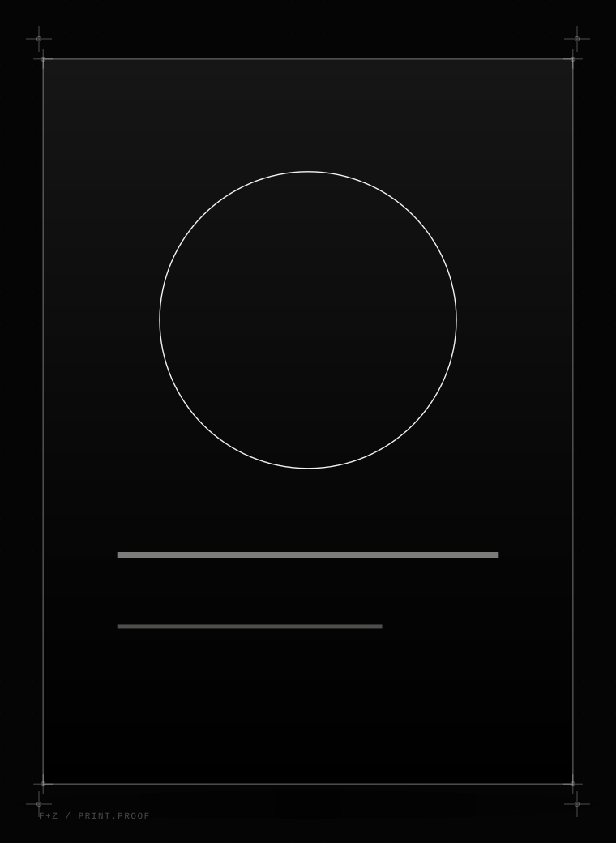
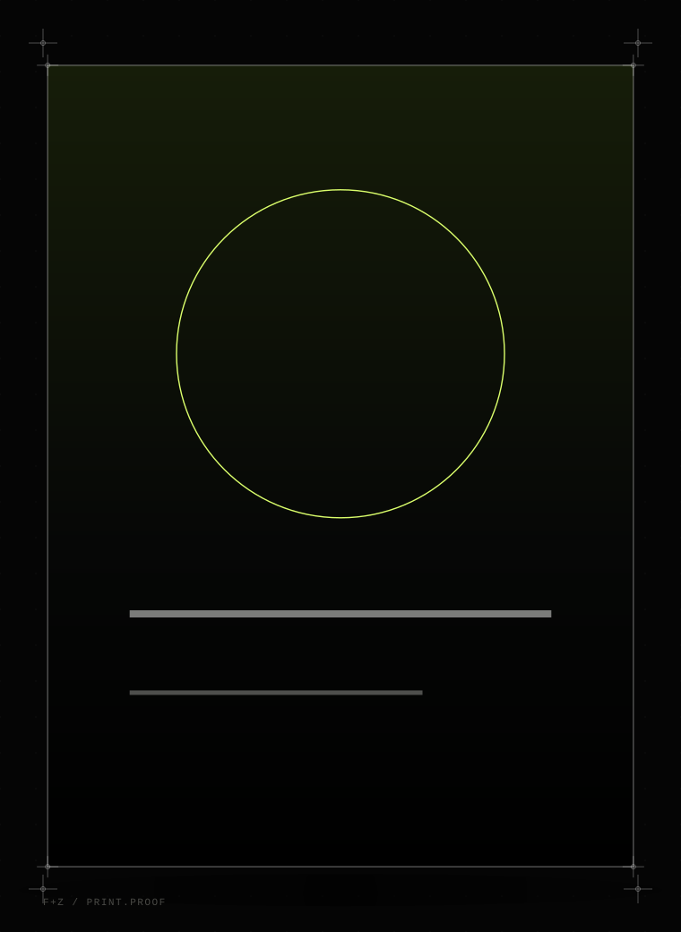
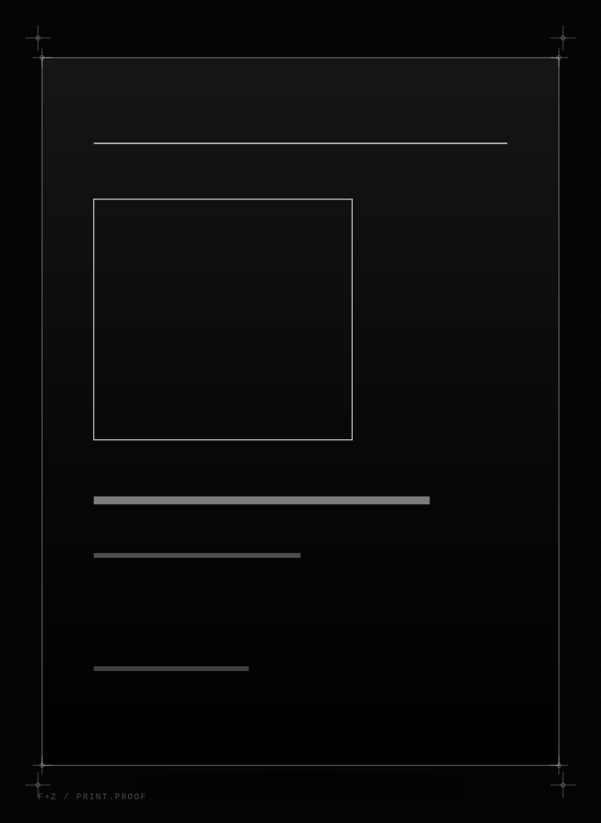
FIFTH & ZERO
03 / 26
KEY VISUALS
Big idea. Every format.
NOCTURNE
AERO
MERIDIAN
ORBIT CAPITAL
Hero Campaign KV
Product KV
Event KV
Corporate KV
CONCEPT WORK FOR FICTIONAL BRANDS, NOT PRIOR CLIENT WORK.

Slide 4
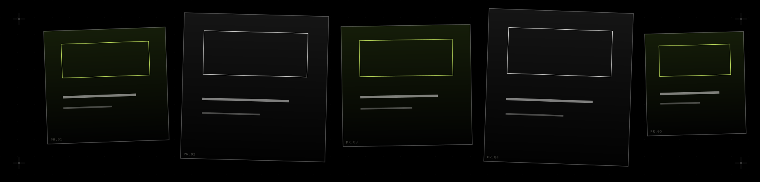
FIFTH & ZERO
04 / 26
FLYERS · POSTERS · PRINT
Static when it needs
to stop you.
— Event flyer — MERIDIAN
— Promotional poster — AFTERGLOW
— Corporate comms — ORBIT CAPITAL
— Launch artwork — AERO 2
— Invitation — NOCTURNE
BRAND & CAMPAIGN CREATIVES · 02

Slide 5
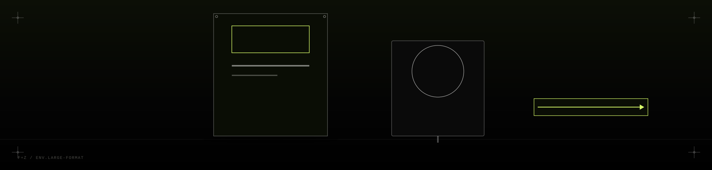
FIFTH & ZERO
05 / 26
BANNERS & LARGE FORMAT
Built for every screen
in the room.
— Event banners
— Venue branding
— Backdrops
— Hoardings
— Standee systems
— Directional signage
BRAND & CAMPAIGN CREATIVES · 03

Slide 6
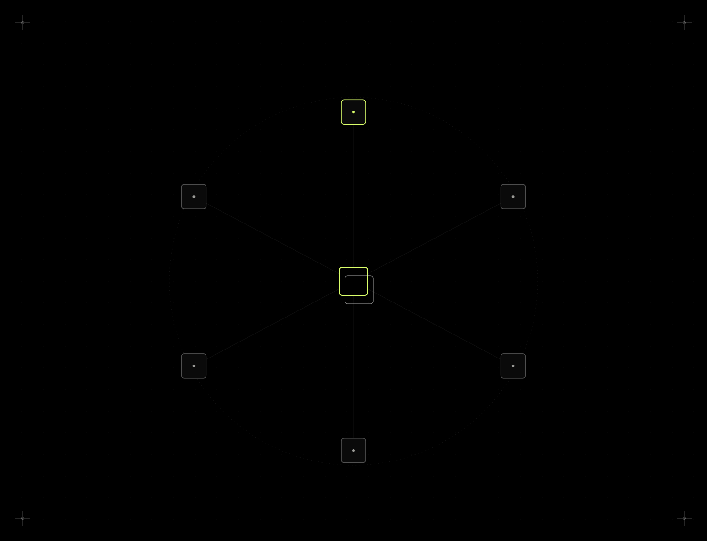
FIFTH & ZERO
06 / 26
EVENT VISUAL IDENTITY
From KV to curtain call.
MERIDIAN — an annual industry summit — built once as a visual language, then carried across every surface an attendee will stand in front of.
KV → STAGE → SCREENS → SIGNAGE → DIGITAL → PRINT
Every touchpoint below reads at a glance as the same event — same mark, same grid, same restraint.
EVENT CREATIVE ECOSYSTEM · 01

Slide 7
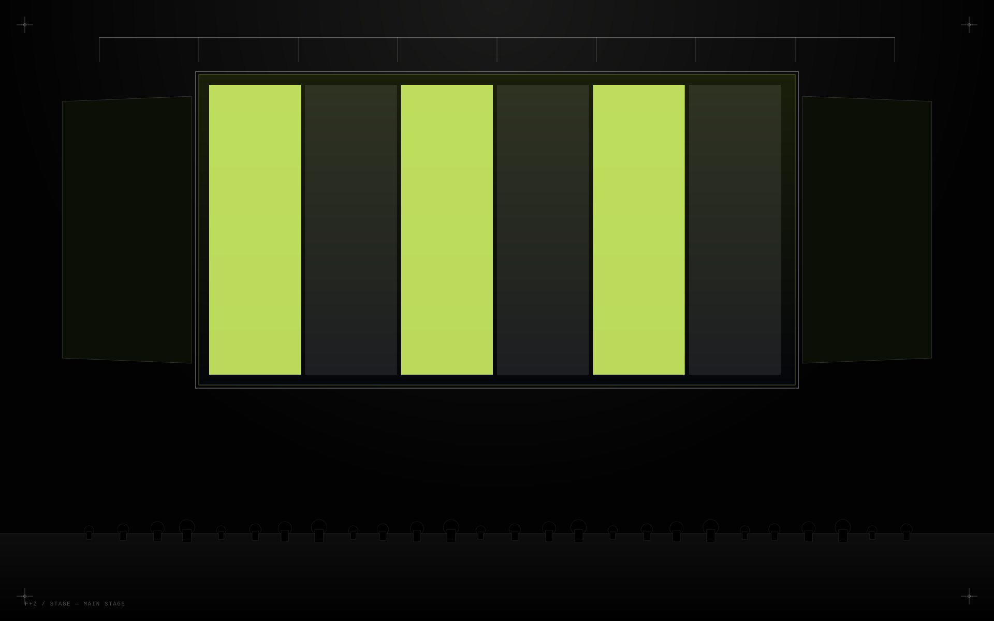
FIFTH & ZERO
07 / 26
MERIDIAN
Main Stage LED Content
CENTRAL LED · SIDE SCREENS · TRUSS GRAPHICS

Slide 8

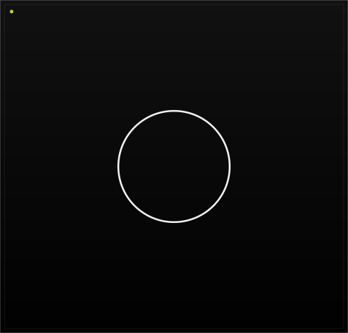
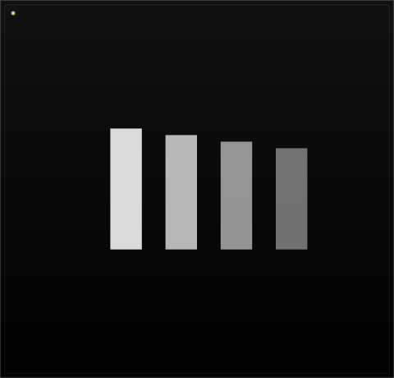
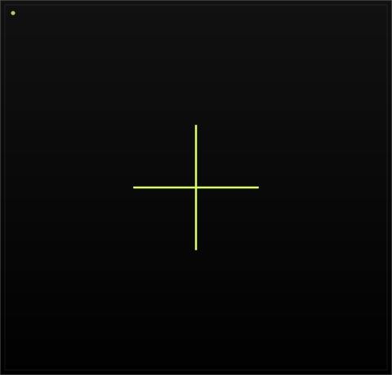
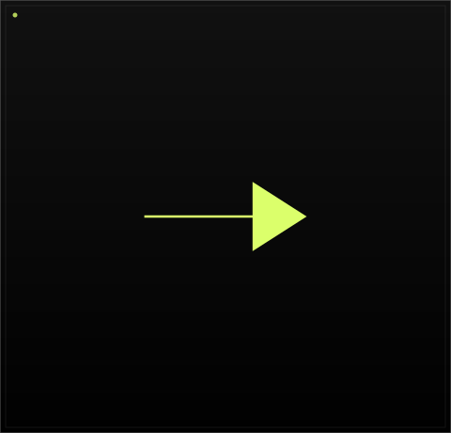
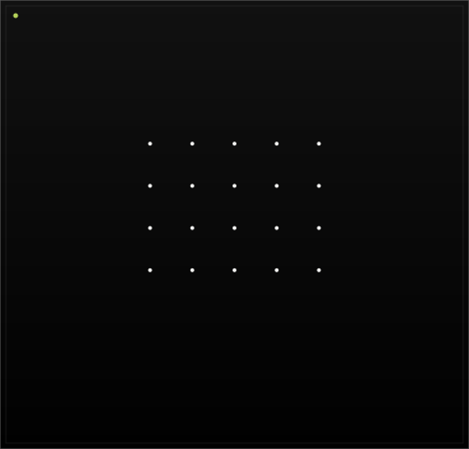
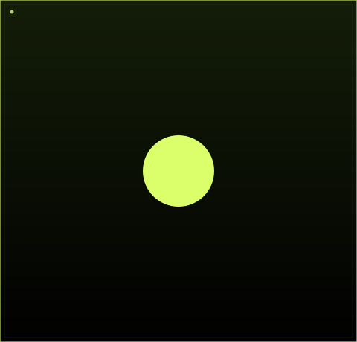
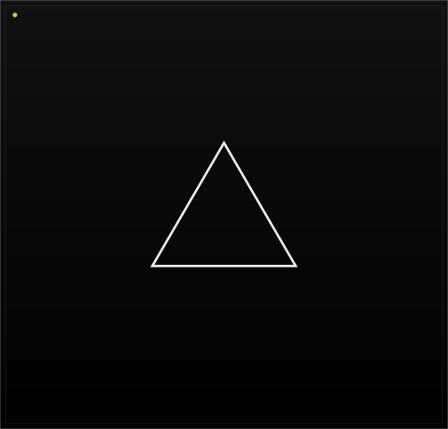
FIFTH & ZERO
08 / 26
LED SCREEN CONTENT SYSTEMS
One system. Every state on screen.
Welcome
Speaker Intro
Agenda
Session Title
Transition
Sponsor
Holding
Closing
EVENT CREATIVE ECOSYSTEM · 03

Slide 9
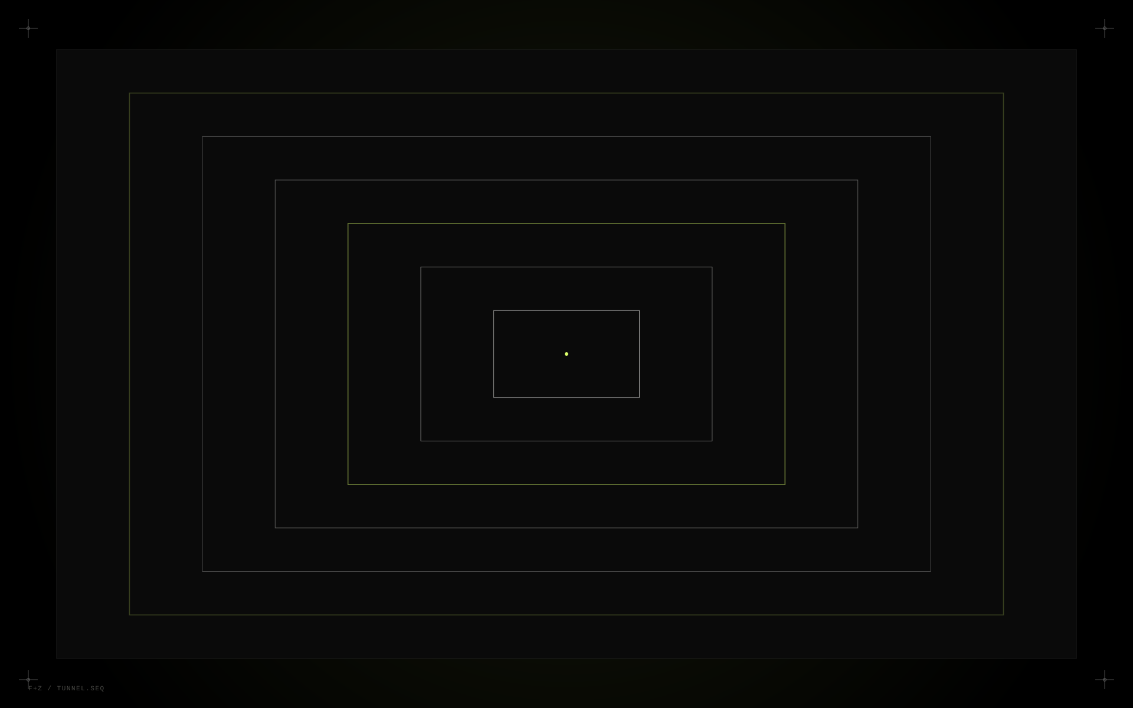
FIFTH & ZERO
09 / 26
WALK-THROUGH · TUNNEL SCREENS
A KV becomes a place you walk through.

Slide 10
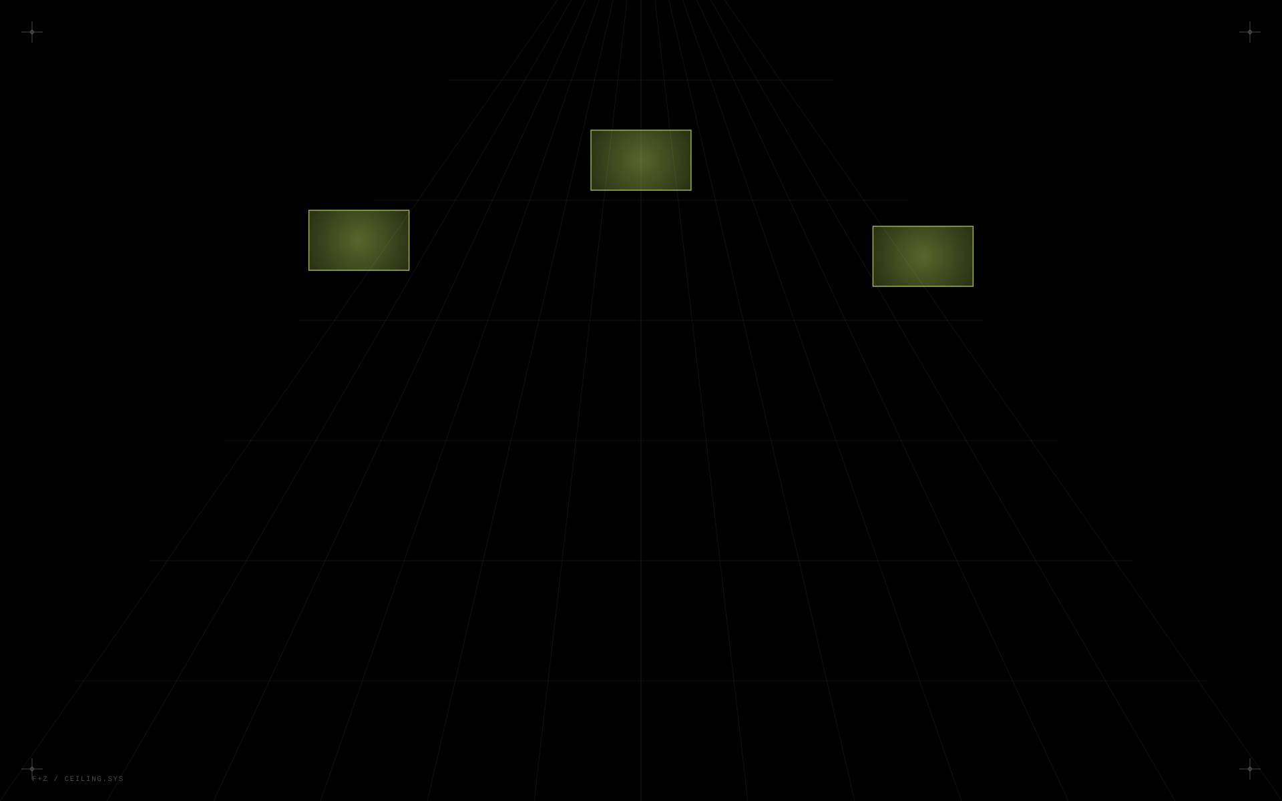
FIFTH & ZERO
10 / 26
SKYLIGHT · CEILING SCREENS
The brand extends into the architecture.

Slide 11
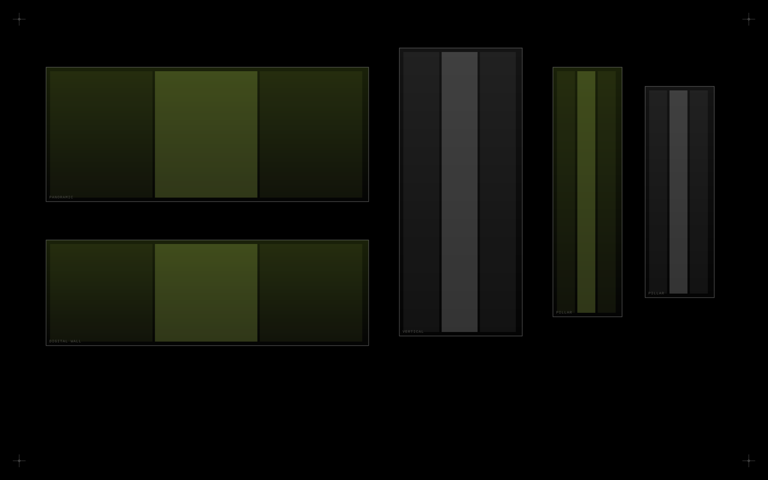
FIFTH & ZERO
11 / 26
MULTI-SCREEN EXPERIENCES
One story. Any canvas.
Panoramic LED, vertical drops, pillar wraps, digital walls — the same content system re-cut intelligently for whatever aspect ratio the venue gives us.
EVENT CREATIVE ECOSYSTEM · 06

Slide 12
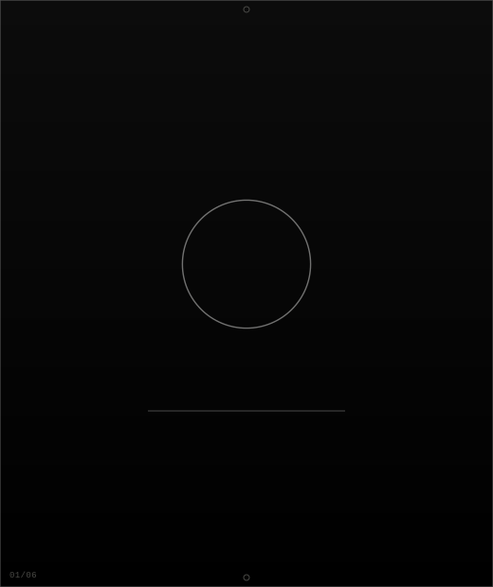

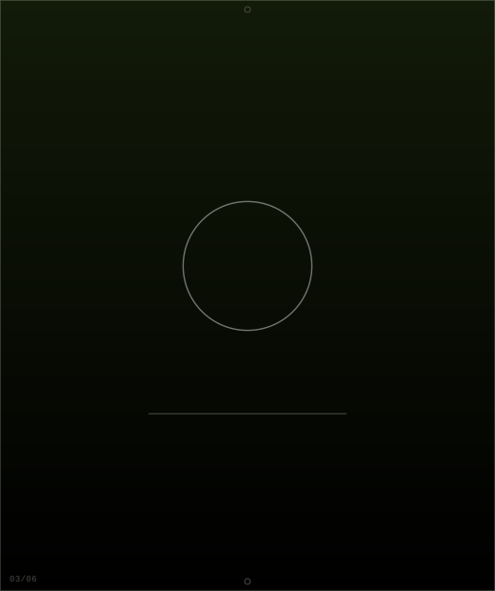

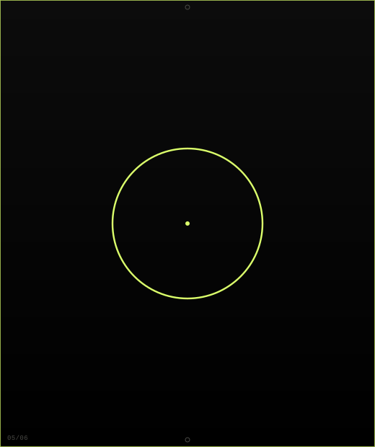

FIFTH & ZERO
12 / 26
MOTION GRAPHICS
Static, evolved.
Type Animation
Logo Animation
Transitions
Data Animation
Event Motion
Brand Film
MOTION + VIDEO · 01

Slide 13
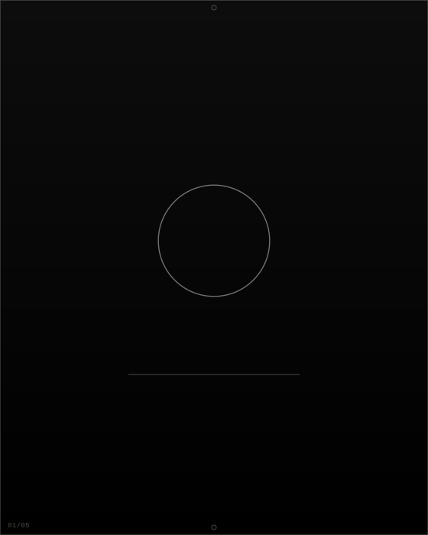



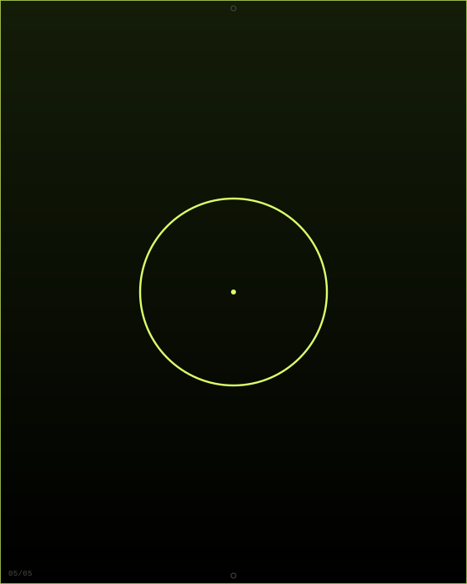
FIFTH & ZERO
13 / 26
EVENT TEASER FILMS
From first tease
to final frame.
A five-beat teaser campaign for MERIDIAN, built to run identically across social and the venue's own screens.
SOMETHING
IS COMING
72 HOURS
48 HOURS
TO GO
THE NEXT
CHAPTER BEGINS
SEE YOU
AT MERIDIAN
MOTION + VIDEO · 02

Slide 14



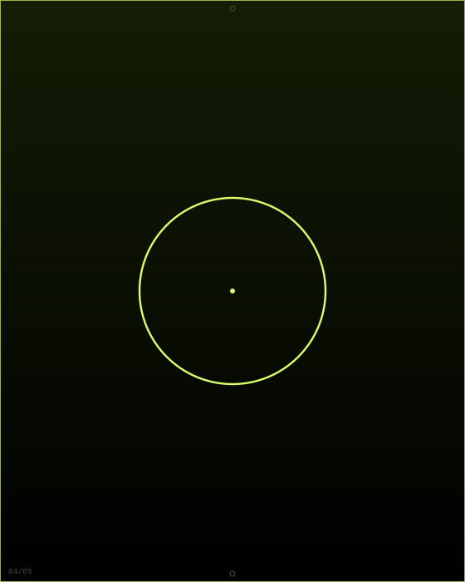

FIFTH & ZERO
14 / 26
COUNTDOWN FILMS
Motion when it needs
to move you.
One connected countdown, five drops, built once and scheduled to run across social and every screen in the building.
5 DAYS
3 DAYS
24 HOURS
TONIGHT
WE'RE LIVE
MOTION + VIDEO · 03

Slide 15





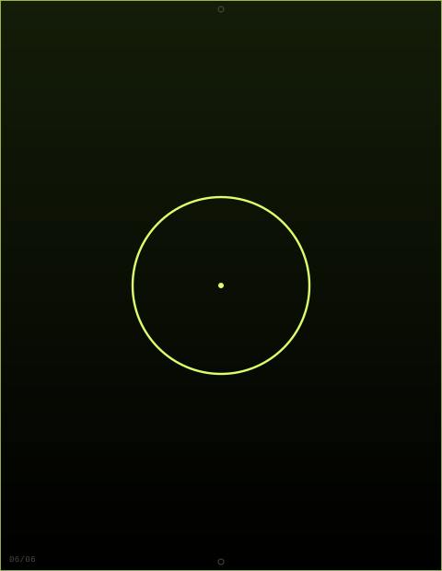
FIFTH & ZERO
15 / 26
EVENT OPENING FILMS
Brand storytelling,
built to a reveal.
Tension, build, reveal — the final frame flows straight into the physical main-stage LED, so the film and the room feel like one continuous shot.
BLACK
A SIGNAL
THE WORLD
RESPONDS
TENSION
BUILDS
REVEAL
LIVE ON
MAIN STAGE
MOTION + VIDEO · 04

Slide 16
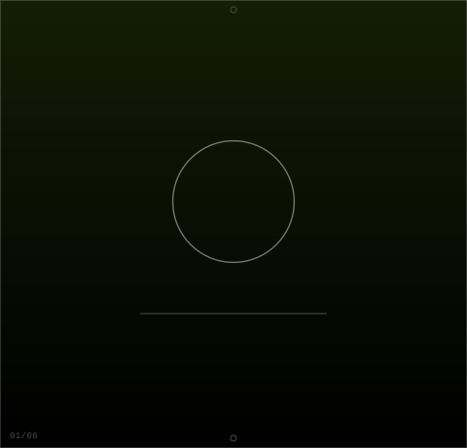
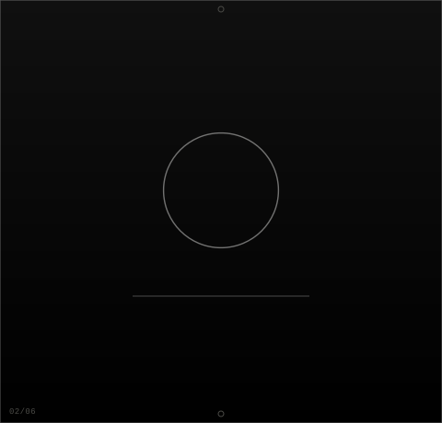



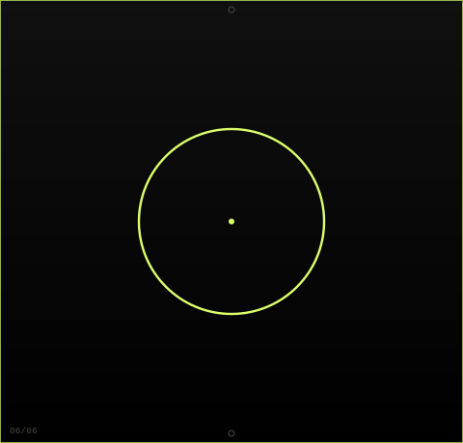
FIFTH & ZERO
16 / 26
HIGHLIGHT · AFTERMOVIES
Every moment worth keeping, in ninety seconds.
Arrival
Crowd
Take the Stage
Performance
Brand Moments
Finale
Energetic, premium, cut to the room's own soundtrack — an aftermovie that gets forwarded, not just archived.
MOTION + VIDEO · 05

Slide 17
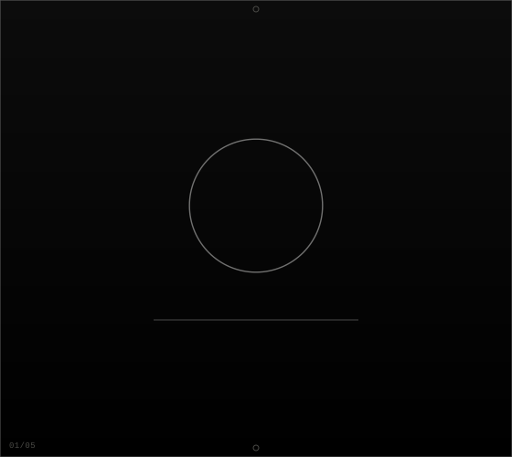

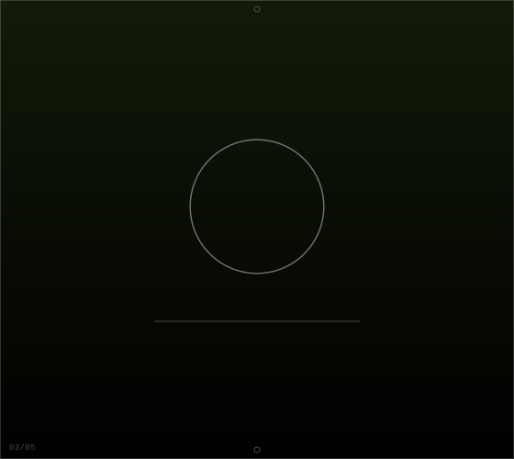

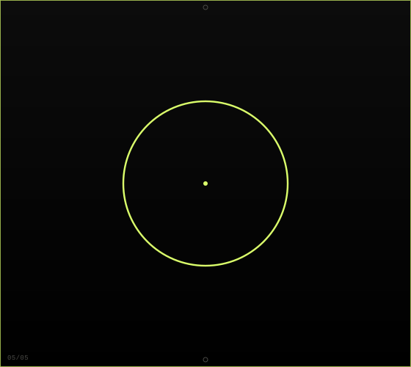
FIFTH & ZERO
17 / 26
EXPLAINER FILMS
Complicated ideas,
made obvious.
A fictional fintech product, AERO PAY, explained end to end — the pipeline stays sophisticated, never cartoonish.
SCRIPT
STORYBOARD
DESIGN
ANIMATION
FINAL FRAME
MOTION + VIDEO · 06

Slide 18
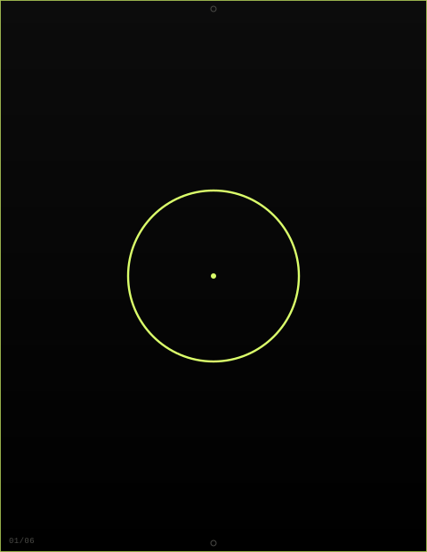

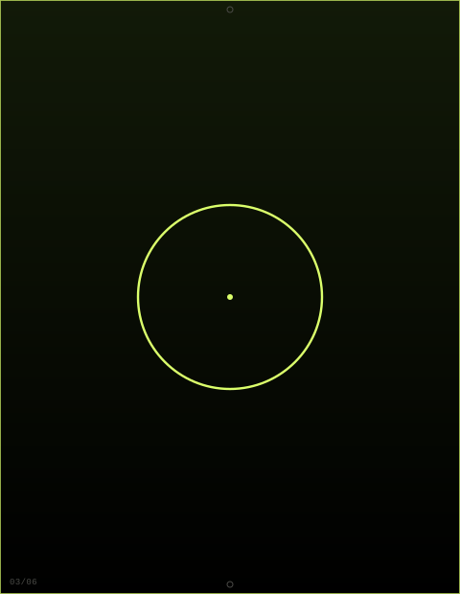



FIFTH & ZERO
18 / 26
BRAND · STORY FILMS
Every brand has a story worth thirty minutes of ours.
Founder Story
FERRO COFFEE
Corporate Film
ORBIT CAPITAL
Brand Manifesto
NOCTURNE
Product Story
AERO
Human Story
Culture Film
MOTION + VIDEO · 07

Slide 19
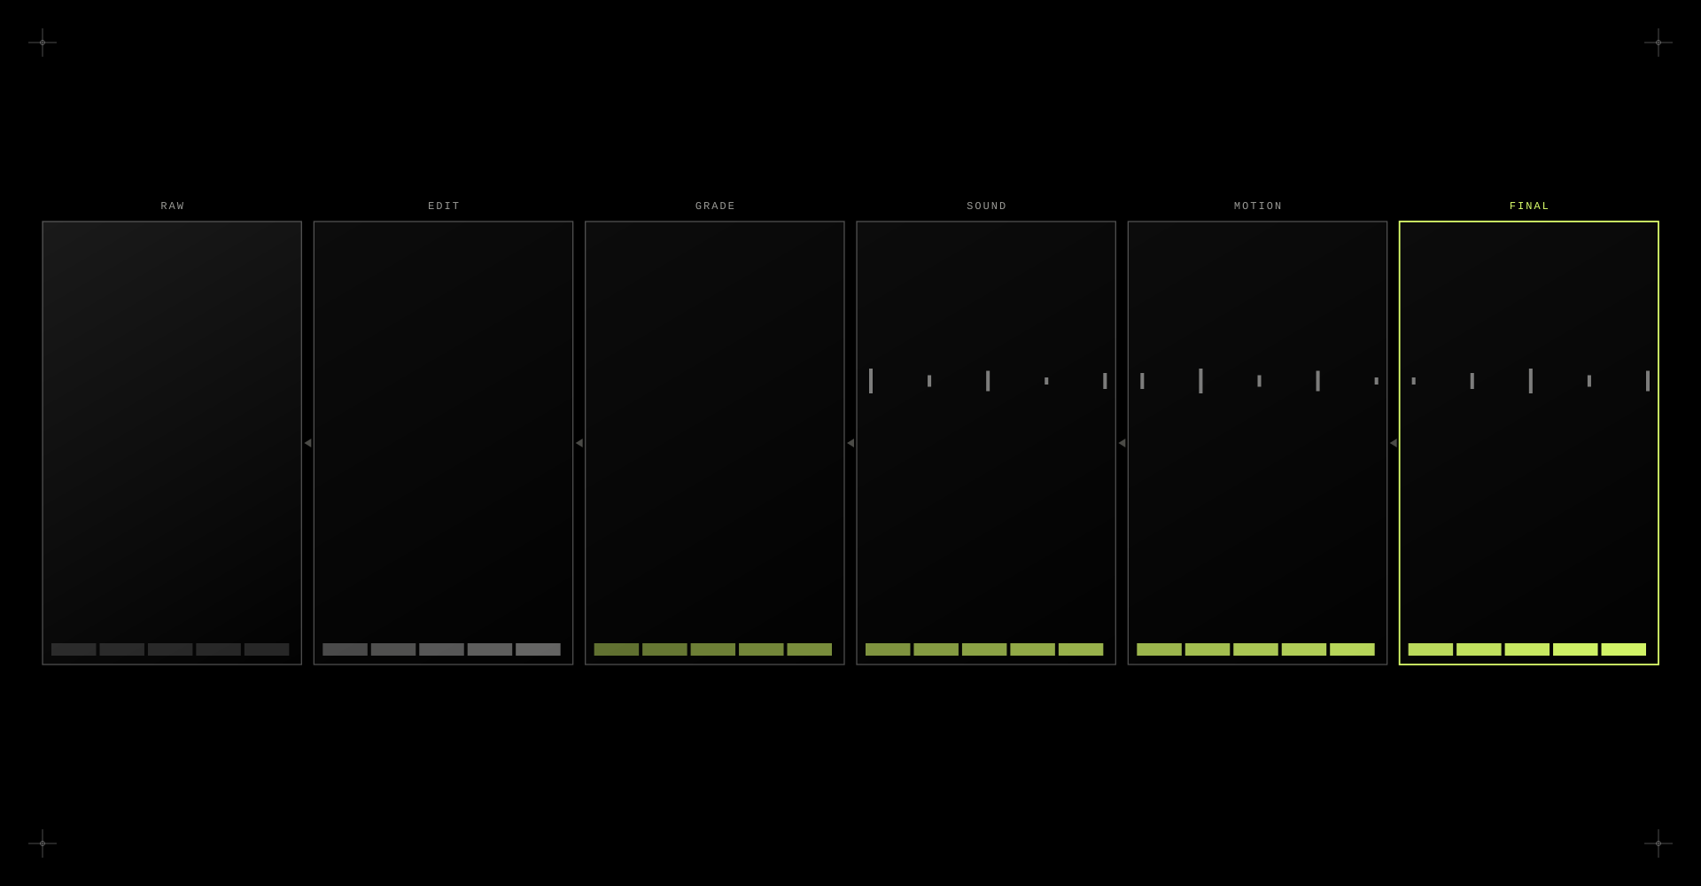
FIFTH & ZERO
19 / 26
VIDEO EDITING & POST-PRODUCTION
Raw becomes final — six disciplines, one pipeline.
Editing · colour grading · sound design · motion graphics · compositing · cleanup — finished to broadcast and social spec alike.
MOTION + VIDEO · 08

Slide 20


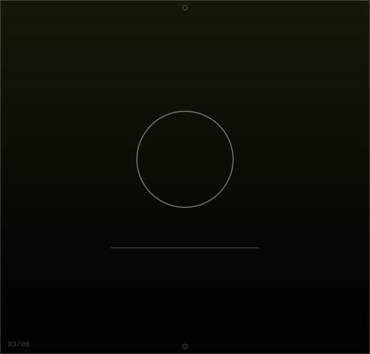
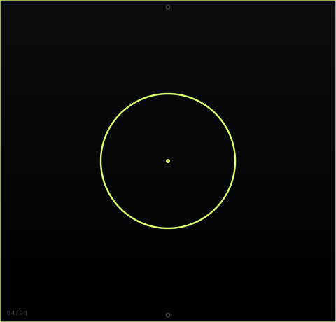


FIFTH & ZERO
20 / 26
ANIMATION
Drawn to move.
2D Animation
Typography
Product Animation
Logo Animation
UI Animation
Event Screens
MOTION + VIDEO · 09

Slide 21
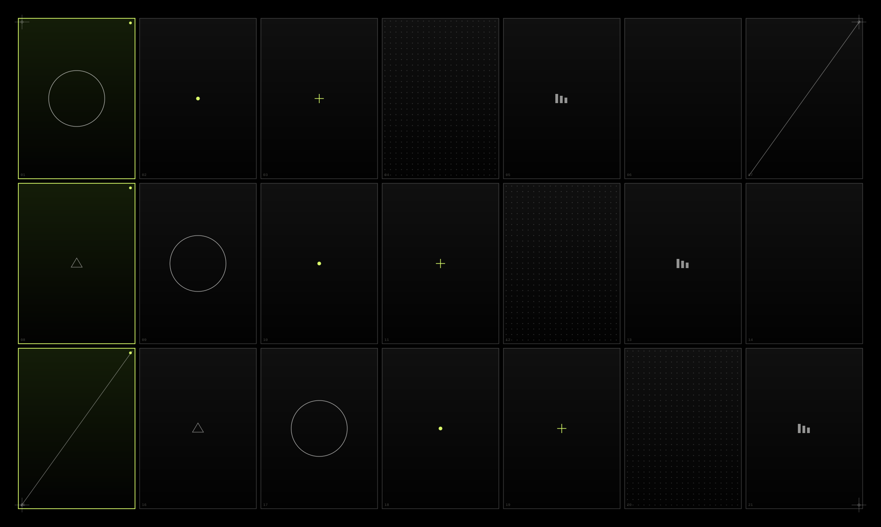
FIFTH & ZERO
21 / 26
PHOTOGRAPHY
Shot to be used, not just admired.
— Products
— Food
— Corporate
— People
— Events
— Lifestyle
— Detail Shots
PHOTOGRAPHY

Slide 22
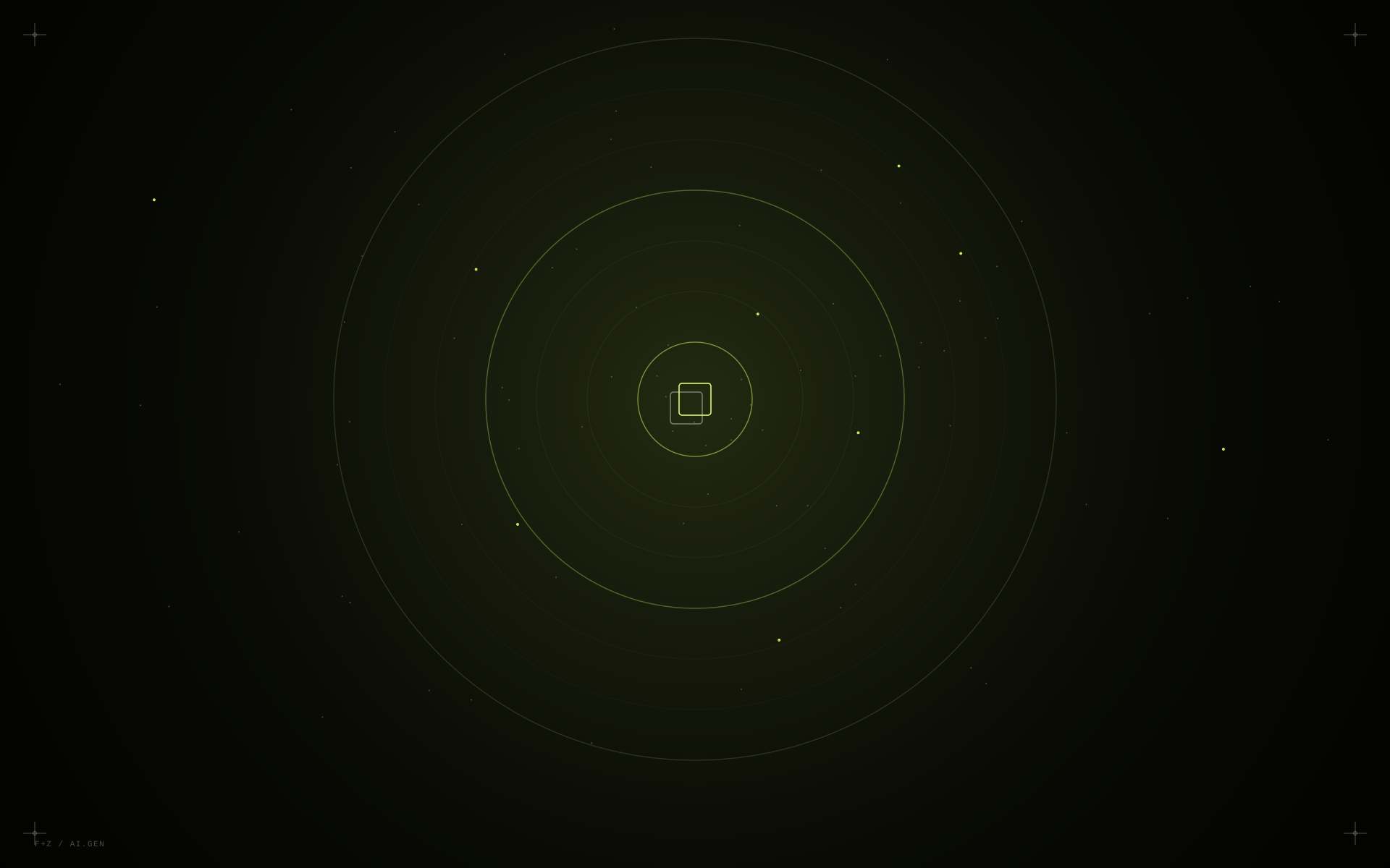
FIFTH & ZERO
22 / 26
AI-GENERATED CONTENT
Imagination without
production limits.
IMPOSSIBLE LOCATIONS · VIRTUAL SETS · HYPER-REAL PRODUCT WORLDS.

Slide 23




FIFTH & ZERO
23 / 26
AI VIDEO
Cinematic visuals,
without the shoot.
A storyboard from an AI-generated commercial for AERO — full cinematic craft without a traditional-scale production.
→
→
→
CONCEPT
FRAME
MOTION
FILM
AI CREATIVE STUDIO · 02

Slide 24
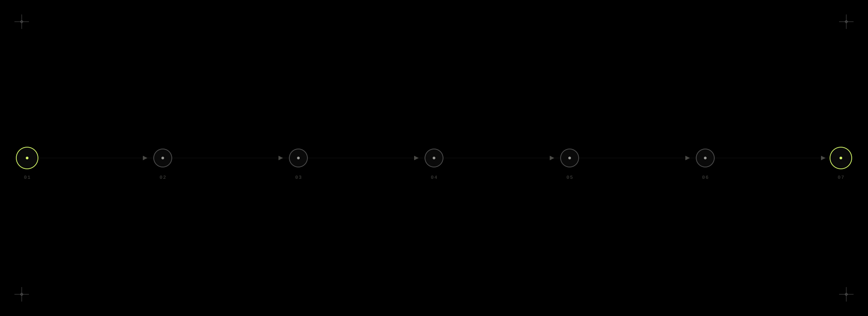
FIFTH & ZERO
24 / 26
AI + TRADITIONAL CREATIVE
AI accelerates production.
Creative direction keeps it human.
IDEA
AI
CONCEPTING
ART
DIRECTION
DESIGN
MOTION
EDIT
FINAL
CAMPAIGN
AI CREATIVE STUDIO · 03

Slide 25
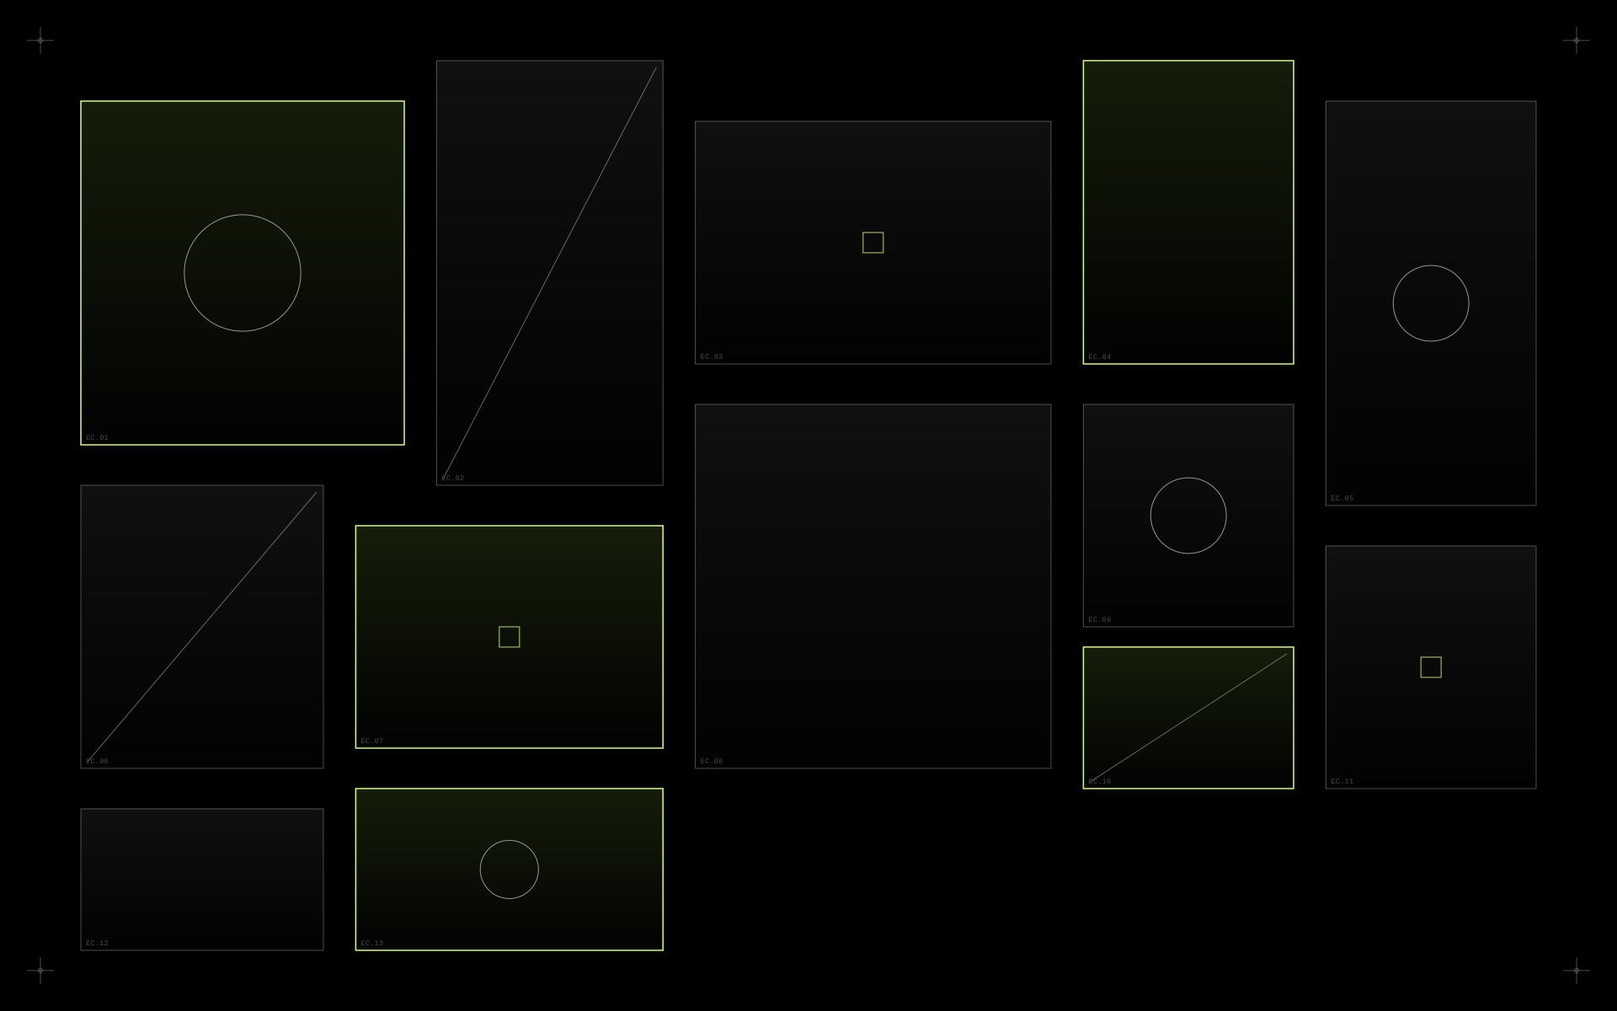
FIFTH & ZERO
25 / 26
THE FULL ECOSYSTEM
One creative partner. The entire visual journey.
— KV
— Teaser
— Poster
— Countdown
— Social
— Opening Film
— Stage LED
— Aftermovie
— Walk-through Screen
— Photography
— Skylight
— AI Content
— Motion Graphics
MERIDIAN, one campaign — every deliverable in this deck, produced from a single creative direction.
ONE CAMPAIGN — EVERYTHING CONNECTED

Slide 26
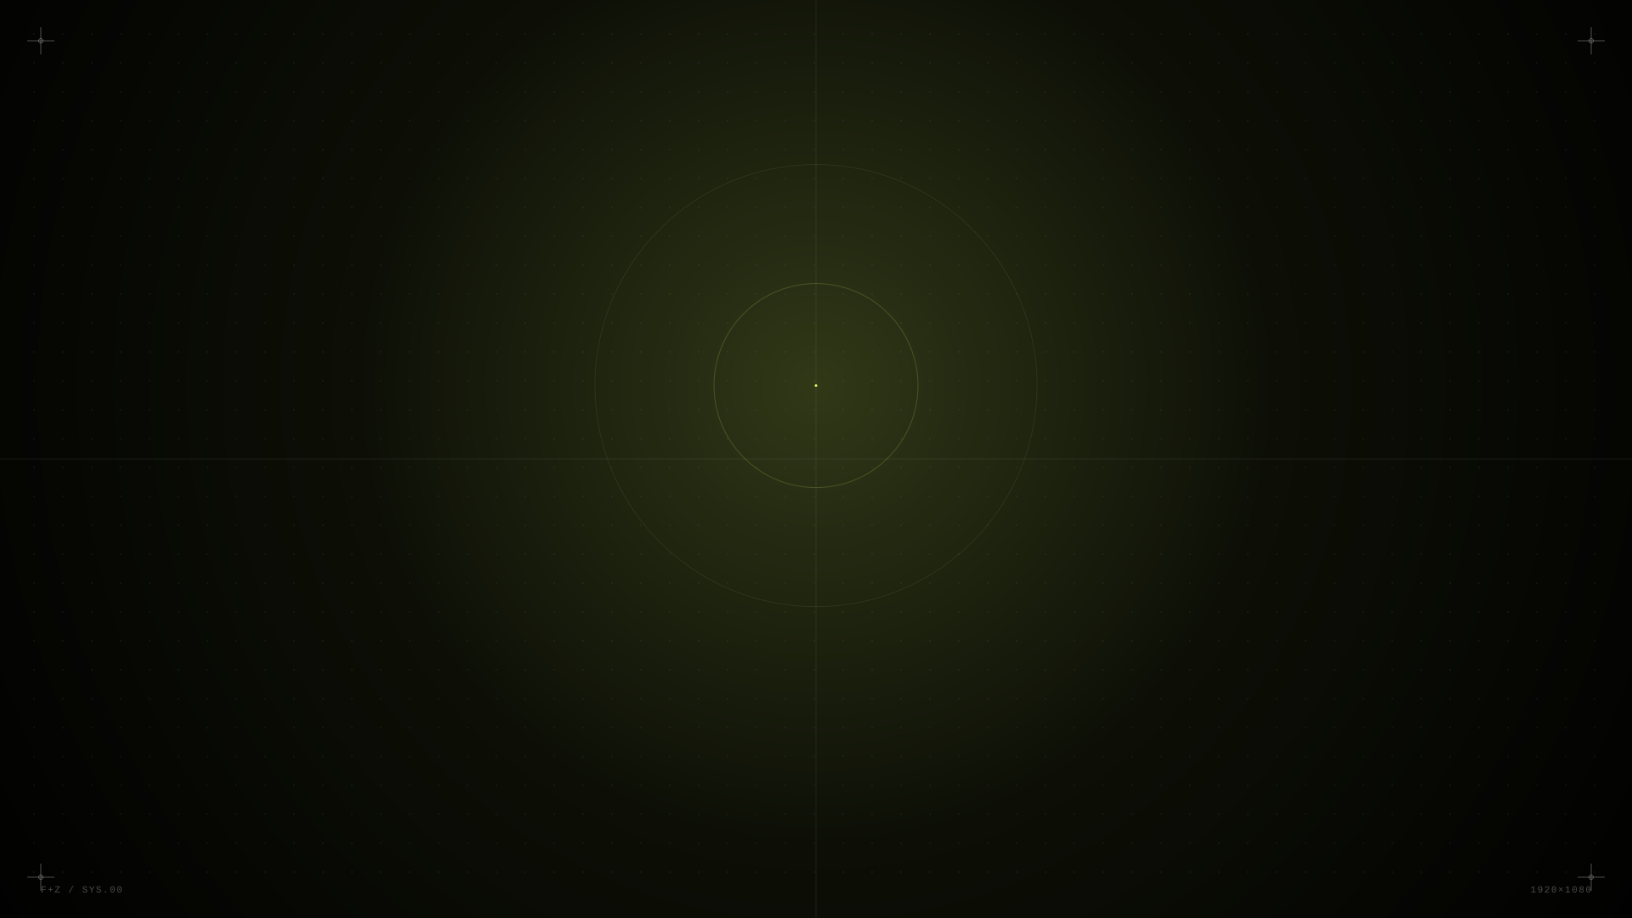
26 / 26
Let's make something
worth remembering.
FIFTH & ZERO

