Slide 1
Java
With NOYON
CodeMaster Noyon

Slide 2
JAVA: Data Types
In Java Programming language, there are two types of variables: 1. primitive & 2. Non-primitive
Primitive: byte, short, char, Boolean, int, long, float, double.
Non-Primitive: String, Array, Class, Object, Interface.
String Name = “Noyon Sarker”;
int age = 24;
int x = 10, y = 20;
float num1 = 39.46f;
double num2 = 50.25d;
Note: After every line, you must use ; sign, otherwise you get error. For float must use f and for double must use d.

Slide 3
JAVA: Type Conversion & output
For getting output, you can follow two processes:
System.out.print(“Hello world”); [It doesn’t give next-line statement]
System.out.println(“Hello world”); [It gives next-line statement]
Type Conversion:
int num1 = 10;
float num2 = 20.50f;
Convert int to float and float to int. That means short to long and long to short.
System.out.println( (float) num1); [Returns 10.0]
System.out.println( (int) num2); [Returns 20]

Slide 4
JAVA: Input
For taking input from user, we must import one package. Import above the class.
Import java.util.*;
Into the class, there is some steps;
First make a scanner object from scanner class: Scanner sc = new Scanner(System.in);
Take input and store into the variable: String name = sc.next();
Display the input variable: System.out.println(name);
Note: next() method just take first word. If you want to take a whole sentence as a input then you should use nextLine() method.
Scanner sc = new Scanner(System.in);
String name = sc.nextLine();
System.out.println(name);

Slide 5
JAVA: Conditional Statement
Conditional statement, check the condition and return output according to the condition.
if
else
else if
Switch case is also use for checking the conditions:
int num = 2; switch (num){
case 1: System.out.println("This is one"); case 2: System.out.println("this is two");
case 3: System.out.println("this is three"); }

Slide 6
JAVA: Conditional Statement
Switch case is also use for checking the conditions: break & default
int num = 2; switch (num){
case 1: System.out.println("This is one"); break;
case 2: System.out.println("this is two"); break;
case 3: System.out.println("this is three"); break;
default: System.out.println("Not match");
}

Slide 7
JAVA: Loops
In Java, there are three types of loops:
For loop [initial state, condition check, update] Initial state is execute just one time
While loop
Do while loop
For loop:
for (int num = 0; num < 10; num++){ System.out.println(num); }
While loop:
int num = 0; while (num < 5){ System.out.println(num); num++; }
Do while loop:
int num = -1; do{ System.out.println(num); num++; }while (num > 5);

Slide 8
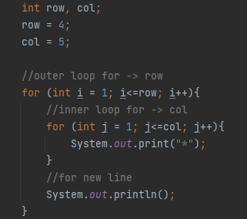
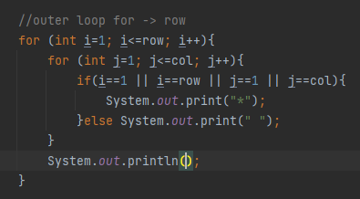
JAVA: Pattern
Pattern 01: Solid Rectangle
Pattern 02:Hollow Rectangle
***** ***** ***** *****
***** * * * * *****

Slide 9
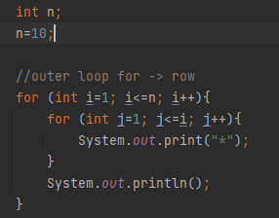
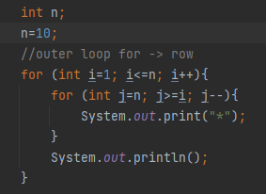
JAVA: Pattern
Pattern 03: Half pyramid
Pattern 04: Inverted half pyramid
*
**
***
****
*****
*****
****
***
**
*

Slide 10
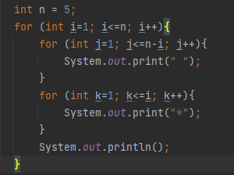
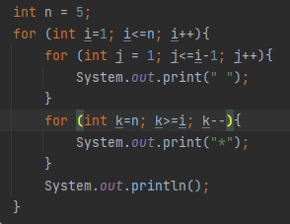
JAVA: Pattern
Pattern 05: inverted half pyramid (rotated 180 deg)
Pattern 06:
*
**
*** **** *****
*****
****
***
**
*

Slide 11
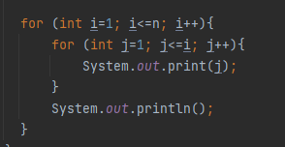
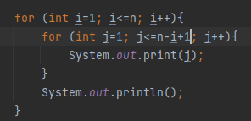
JAVA: Pattern
Pattern 07: Half pyramid with number
Pattern 08:inverted half pyramid with numbers
1
12
123
1234
12345
12345
1234
123
12
1

Slide 12
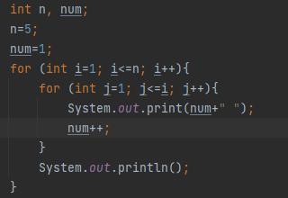
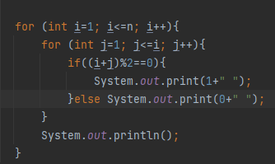
JAVA: Pattern
Pattern 09: Floyd’s tringle
Pattern 10: 0-1 triangle (calculate the sum of every element’s position)
If sum even then 1 printed, if sum odd then 0 printed
1
2 3
4 5 6
7 8 9 10
11 12 13 14 15
1
0 1
1 0 1
0 1 0 1
1 0 1 0 1

Slide 13
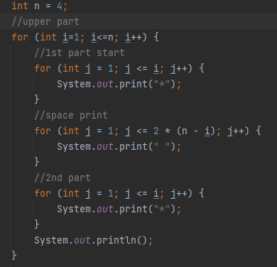
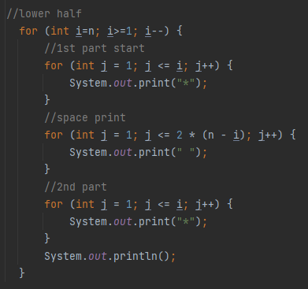
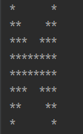
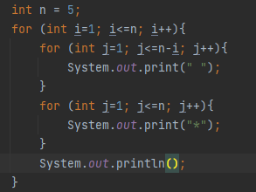
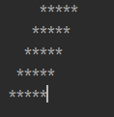
JAVA: Complex Pattern
Pattern 11: Butterfly Pattern
Pattern 12: Solid Rhombus

Slide 14
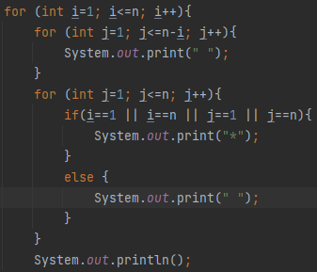
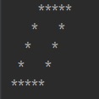
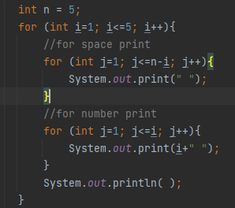
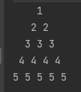
JAVA: Complex Pattern
Pattern 13:Holo Rhombus
Pattern 14: Number pyramid

Slide 15
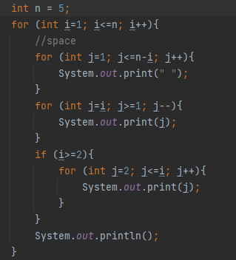

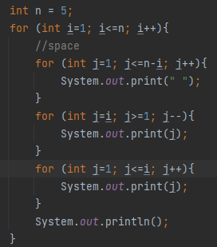
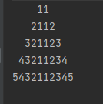
JAVA: Complex Pattern
Pattern 15: Palindromic
Pattern 16: palindromic -2

Slide 16
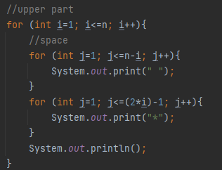
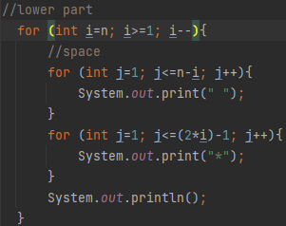
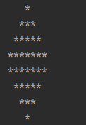
JAVA: Complex Pattern
Pattern 15: Diamond pattern

Slide 17
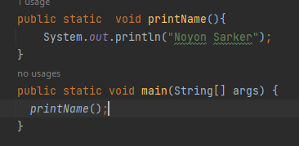
JAVA: Function
Function is a block of code. That can be re-use multiple times. Syntax of function:
returnType function_name (type para1, type para2) {
// code
}
In Java, all the functions are stored into a stack in the memory.

Slide 18
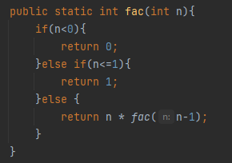
JAVA: Factorial
Factorial is a mathematical solution. Here,
0! = 1
1! = 1
5! = 5*4*3*2*1
n! = n*(n-1)*(n-2)…..1

Slide 19
JAVA: Function
In Java, functions can define the outer of the main function. Some functions return value, some are not:
Return types: int, String, Boolean;
Void type means this function does not return anything.
// return the value
public static int addTowNumber(int a, int b){ return a + b; }
// does not return value
public static void printName(String name){ System.out.println(name); }

Slide 20
JAVA: Array
There are types of array, one dimension and two dimension or 2D array;
// One dimension array
int[] arrayName = new int[size];
Or
int[] arrayName = {2,3,4,5,6,6};
Push the value to the array using loop
int[]arr = new int[5]; for (int i=0; i<5; i++){ arr[i] = i; }

Slide 21
JAVA: 2D Array
The syntax of 2D array is:
int[][] arr = new int[row][col];
Take input from the user for 2D array
int[][] arr = new int[2][3]; for (int i=0; i<2; i++){ for (int j=0; j<3; j++){ arr[i][j] = sc.nextInt(); } }

Slide 22
JAVA: String
In Java, a String is a special data type. The string is an object.
// add two string
String firstName = "Noyon"; String lastName = "Sarker"; System.out.println(firstName+" "+lastName); System.out.println(firstName.concat(lastName));
// find string length
System.out.println("Noyon".length());
// compareTo() function, compares between two string
String a = "Tony"; String b = "Tony"; System.out.println(a.compareTo(b) == 0);
compareTo() method return:
Positive, 0, negative
S1 > S2: positive
S1 == S2: 0
S1 < S2: negative

