Slide 1
MongoDB
With NOYON
CodeMaster Noyon

Slide 2
DB: Database
MongoDB is a database management system.
Show all Databases:
show dbs + Enter
For create and Enter into the database:
use database_name + Enter
For delete the database:
db.dropDatabase() + Enter

Slide 3
DB: Collection
In MongoDB, tables are called collections. Collection store the records. Each record called document.
First of all enter the database where you want to make the tables or collections. use database_name + Enter
For see all the collections:
show collections + Enter
For create new collection:
db.createCollection(“collection_name”)

Slide 4
DB: Insert Documents
In MongoDB, every record is called document. There can be two ways to insert the documents:
insertOne
insertMany
Add one document:
db.collection_name.insertOne({name: “Noyon”, age: 24}) + Enter
Add more than one documents:
db.collection_name.insertMany([{name: “Pritim”, age: 21}, {name: “Purna”, age: 23}]) + Enter

Slide 5
DB: Read Documents
For read the documents, there is a function, which is find().
Read all the documents:
db.collection_name.find() + Enter
Read document with condition:
db.collection_name.find({age: 23}) + Enter
Read document with shown limit:
db.collection_name.find().limit(2) + Enter
findOne() method return the first one.

Slide 6
DB: Read Documents
Less than: lt
Less than equal: lte
Greater than: gt
Greater than equal: gte
Find the records, age equal 23;
db.user.find({age: 23}) + Enter
Find the records, age less than 23;
db.user.find({age: {$lt: 23}}) + Enter
Find the records, age less than equal 23;
db.user.find({age: {$lte: 23}}) + Enter
Find the records, age greater than 23;
db.user.find({age: {$gt: 23}}) + Enter
Find the records, age less than equal 23;
db.user.find({age: {$gte: 23}}) + Enter
Find the records, age less than 25 & greater than 21:
db.user.find({age: {$gt: 21, $lt: 25}})

Slide 7
DB: Different between find() and findOne()
find() method, returns the array list. We can use more method after find(). Array list called cursor
findOne() method, just returns one value, if not found then returns NULL.
db.user.find().forEach(x=>printjson(x))
or
db.user.find().count()
db.user.findOne.count() // It returns an Error

Slide 8
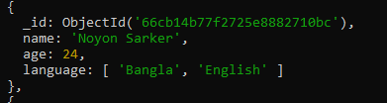
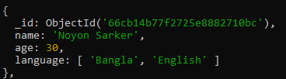
DB: Update Documents
For update the documents, there is a function, which is update({which document you want to update}, {$set: {which one will be updated}}).
For update the value:
db.collection_name.updateOne({name: “puran”}, {$set: {age: 35}}) + Enter
Previous:
Updated:

Slide 9
DB: Update Documents
There is another method which is updateMany(). This method update all the documents which are matched the condition.
For update multiple documents:
db.collection_name.updateMany({age: 22}, {$set: {age: 40}}) + Enter
Here, updateOne() also update the first one

Slide 10
DB: Delete Documents
For delete the records there are two methods.
Delete one record:
db.user.deleteOne({name: “Noyon”}) + Enter
Delete many records:
db.user.deleteMany({age: {$gt: 25}}) + Enter
Delete all the records:
db.user.deleteMany({}) + Enter

Slide 11
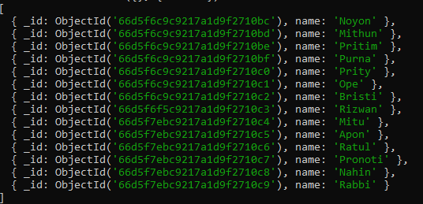
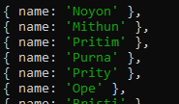
DB: Projections
Projection means, just showing specific fields. Like, we want to show just name.
db.user.find({}, {name: 1}) + Enter
Remove also id:
db.user.find({}, {name:1, _id:0}) + Enter

Slide 12
DB: Validation Schema
db.createCollection('nobel', {
validator:{
$jsonSchema: {
required: ['name', 'price'],
properties:{
name:{
bsonType: 'string',
description: 'must be string and required'
},
price:{
bsonType: 'number',
description: 'must be number and required'
}
}
}
},
validationAction: 'error'
})

Slide 13
DB: Update Schema validation
authors:{
bsonType: 'array',
description: 'must be an array and required',
items:{
bsonType: 'object',
required: ['name', 'email'],
properties: {
name: {
bsonType: 'string',
},
email: {
bsonType: 'string'
}
}
}
}
}
}
},
validationAction: 'error'
})
db.runCommand({
collMod: 'nobel',
validator:{
$jsonSchema:{
required: ['name', 'price', 'authors'],
properties: {
name: {
bsonType: 'string',
description: 'must be string and required'
},
price: {
bsonType: 'number',
description: 'must be number and required'
},

