Slide 1
New updated cancer traits
26-05-21

Slide 2
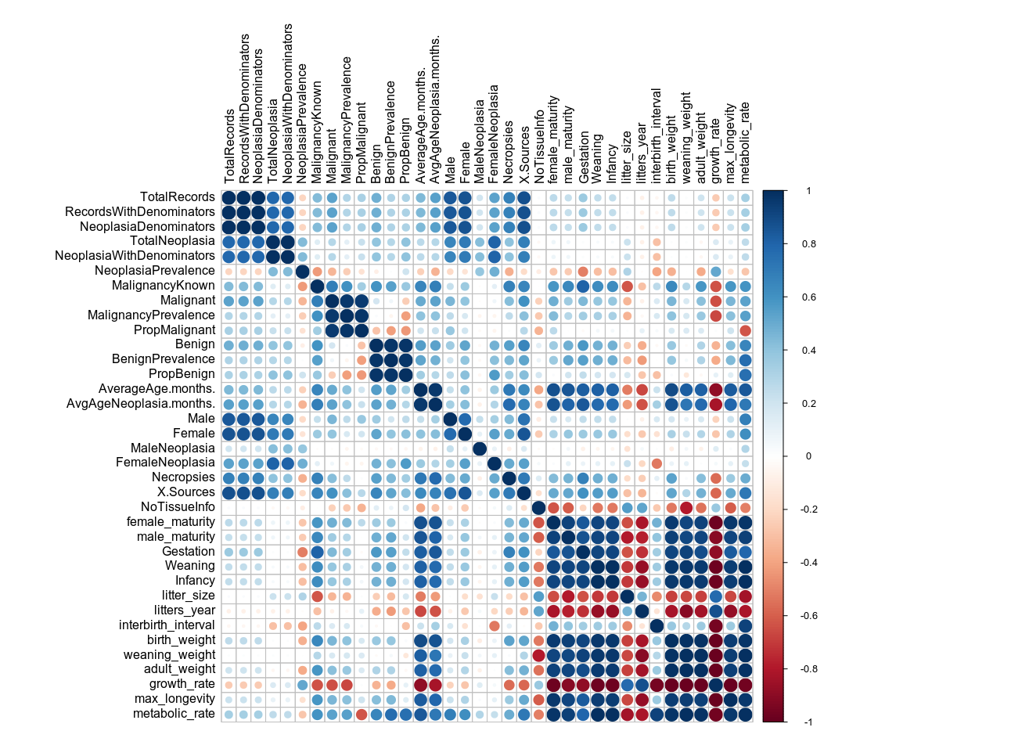
Correlation of scaled new neoplasm variables

Slide 3
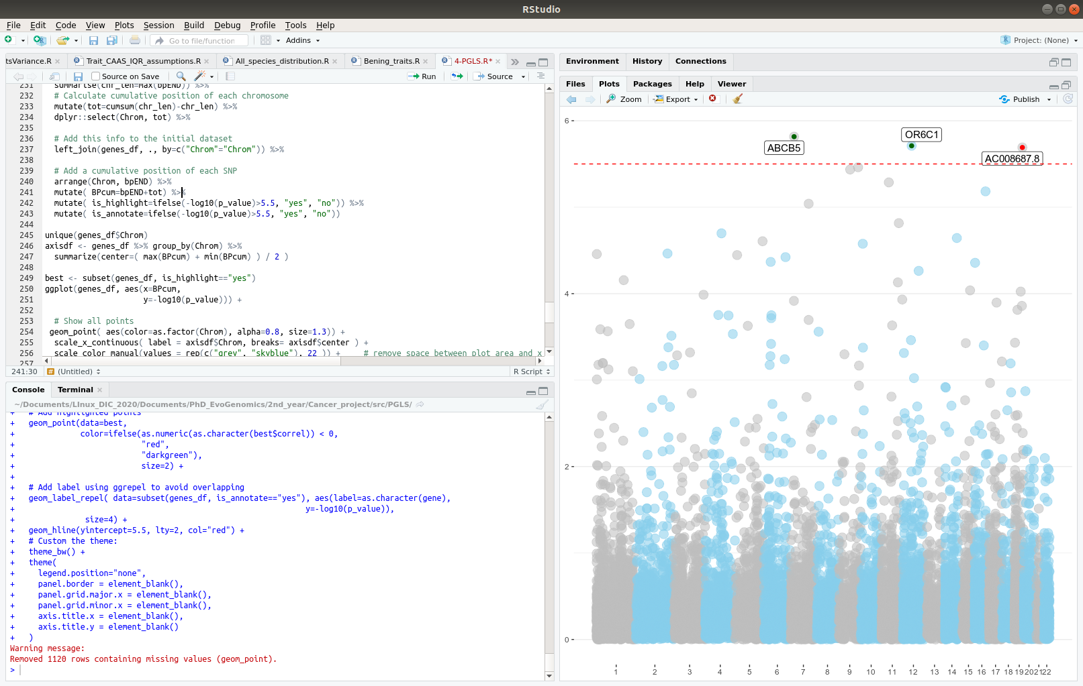
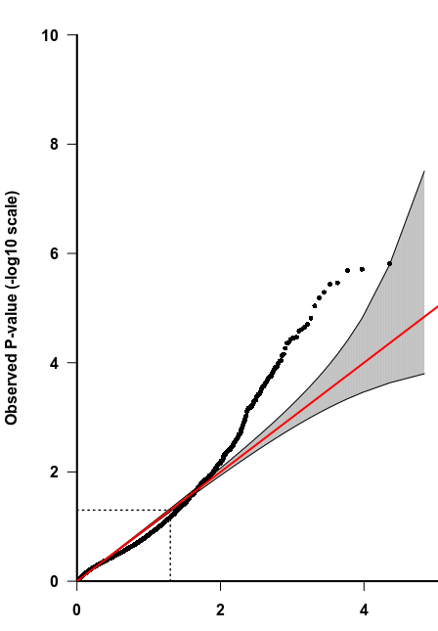
Malignancy prevalence

Slide 4
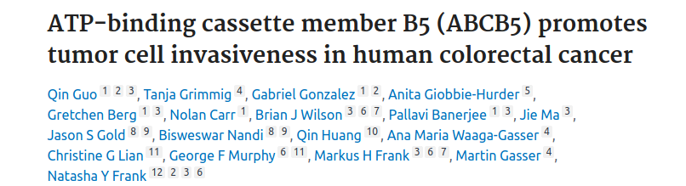
Malignancy prevalence

Slide 5
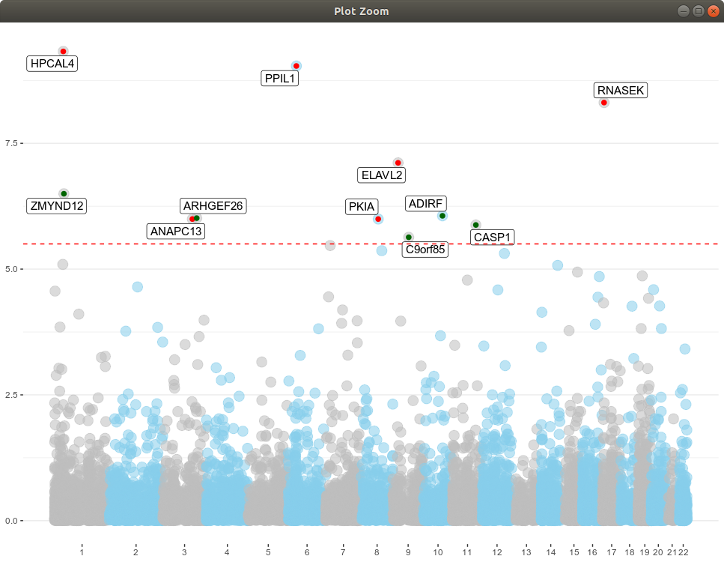
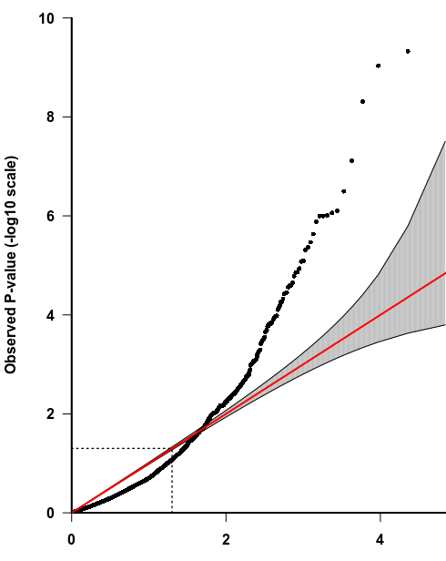
Malignancy proportion

Slide 6
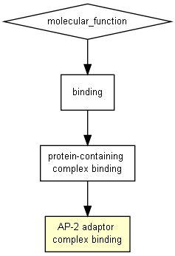
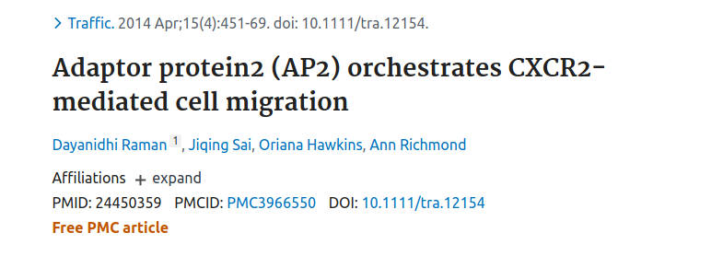
Malignancy proportion - malignant cases over neoplasic cases
Target genes enrichment - Molecular function
Top 50-100 genes ranked by p-value
> Link with AP2-Adaptor
(pval < 10-3)
tumor cell proliferation and invasion

Slide 7
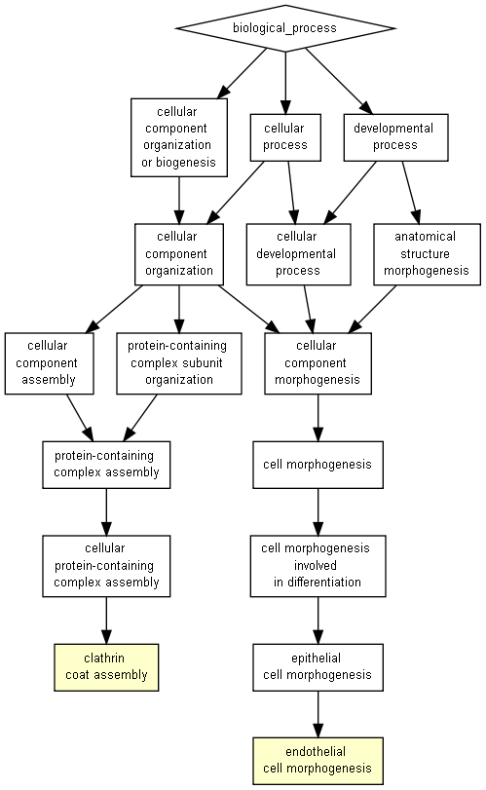
Malignancy proportion - malignant cases over neoplasic cases
Target genes enrichment - Biological processes
Top 50-100 genes ranked by p-value
> Link with clathrin and endothelial morphogenesis
(pval < 10-3)

Slide 8
PGLS slope (ß) statistic
~16,000 genes (with sets of root-to-tip dN/dS) x 200 traits (in primates project) x
>1,000 permulations
Computatonally intensive!!

Slide 9
PGLS slope (ß) statistic
~16,000 genes (with sets of root-to-tip dN/dS) x 200 traits (in primates project) x
>1,000 permulations
Computatonally intensive!!
Here, we discussed permulating only genes retrieveing significant association signals (p-value <0.05) in the discovery phase of PGLS

Slide 10
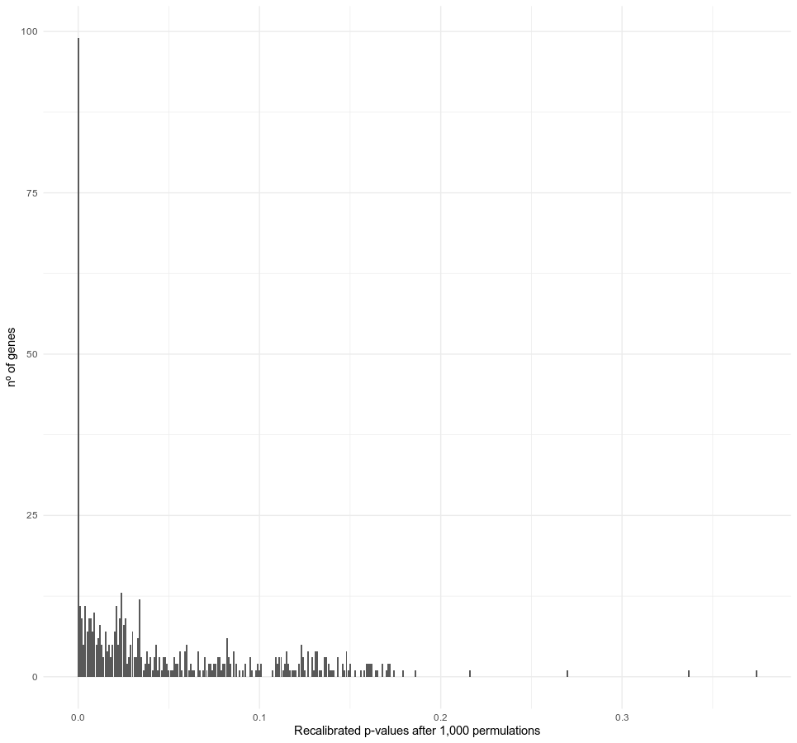
PGLS slope (ß) statistic
p-value = 0.05
From 1000 tested permulations
+ slope/correlations →
p-value = nº of times permulations above observed / total nº of permulations
- slope/correlations →
p-value = nº of times permulations under observed / total nº of permulations

Slide 11
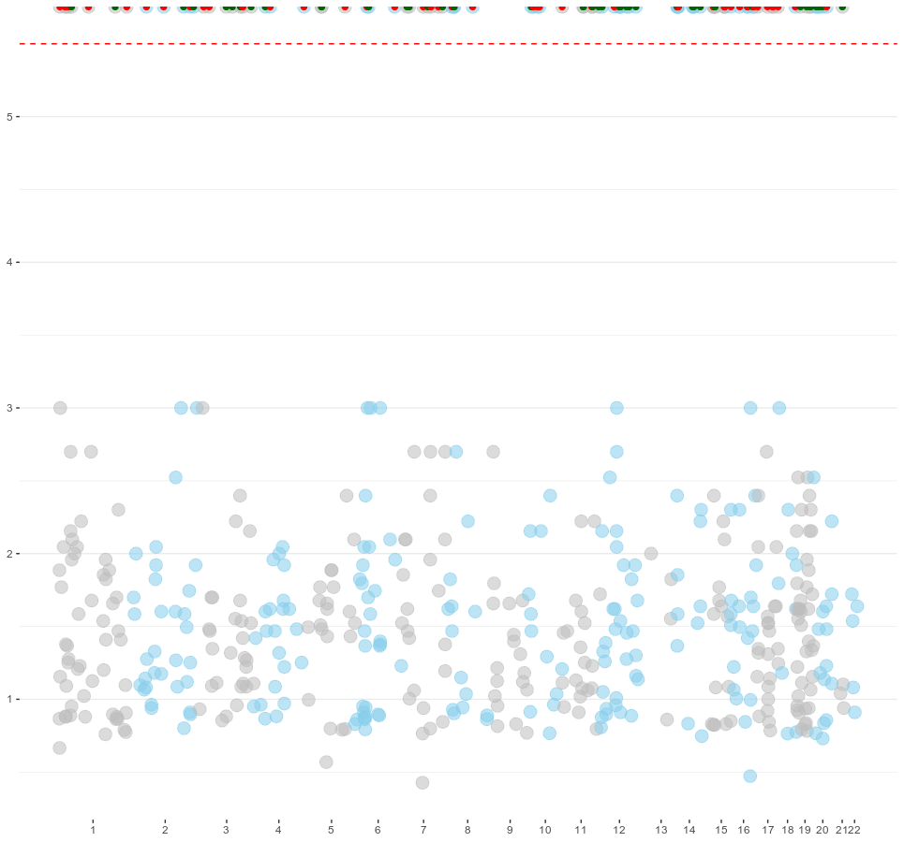
Recalibration with permuLations →
inflated set of correlated genes with strong significant p-values
-log10(p-value)

Slide 12
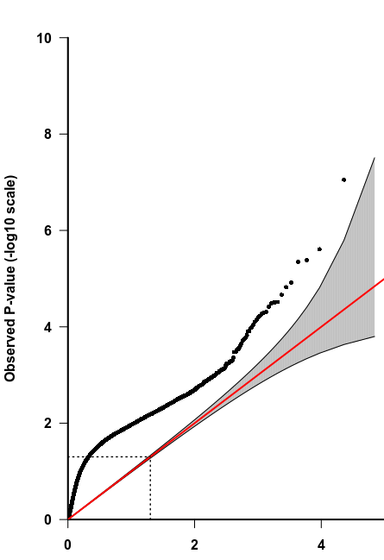
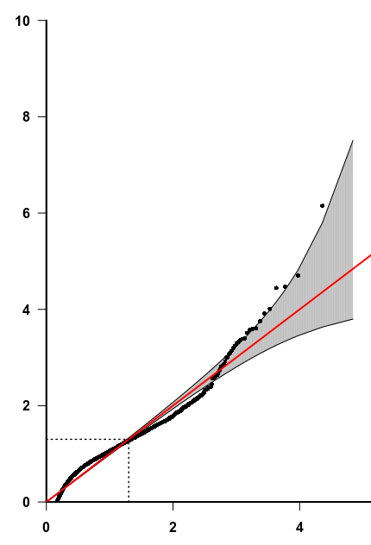
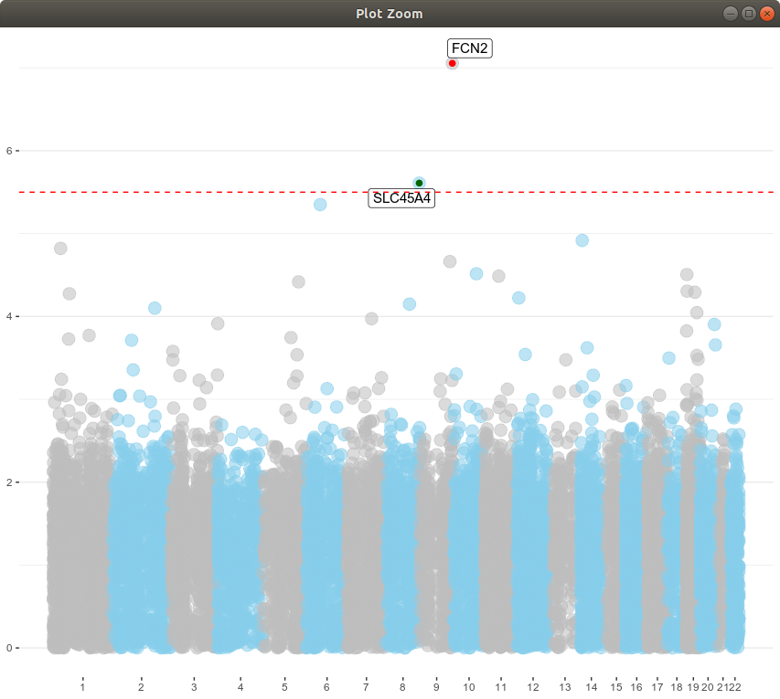
Benignancy prevalence
lambda non-corrected
lambda corrected

Slide 13
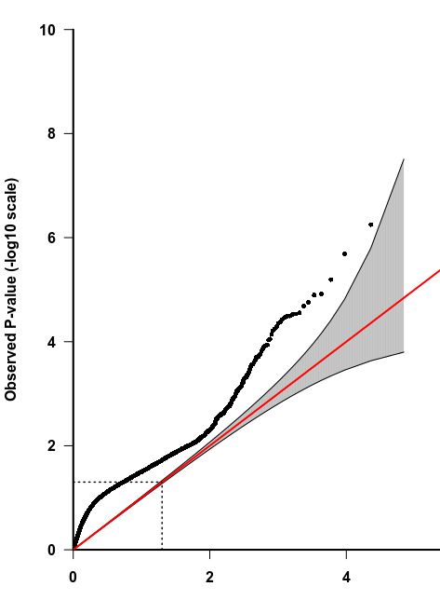
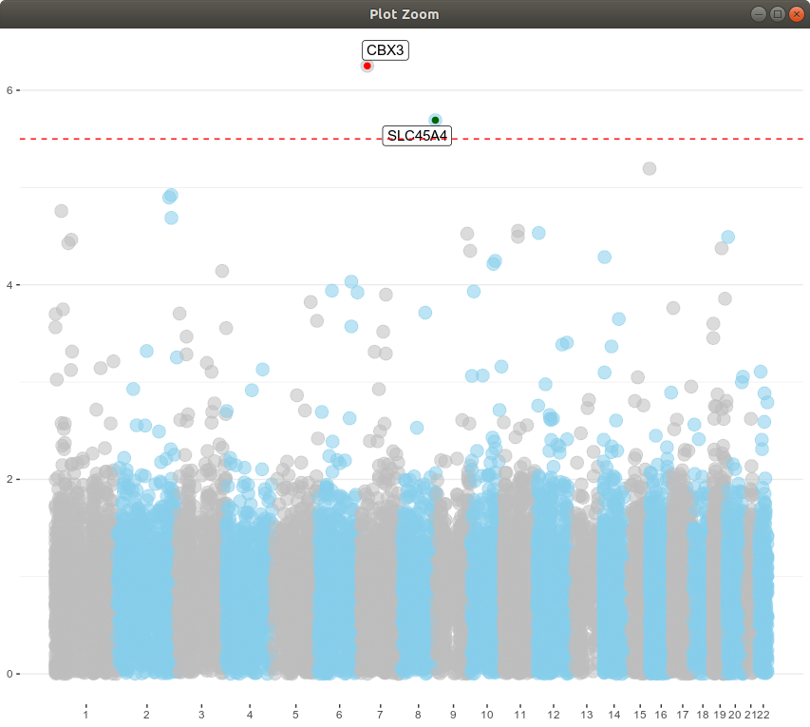
Benignancy proportion
lambda non-corrected
lambda corrected

Slide 14
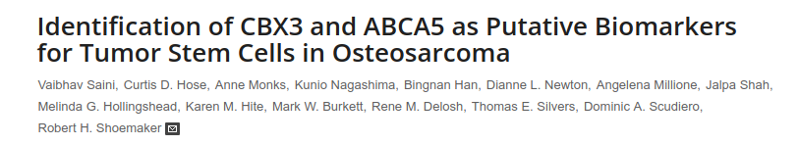
Benignancy proportion

Slide 15
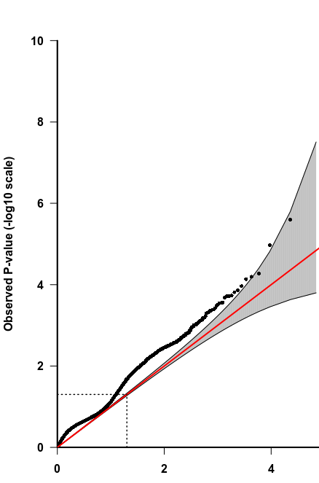
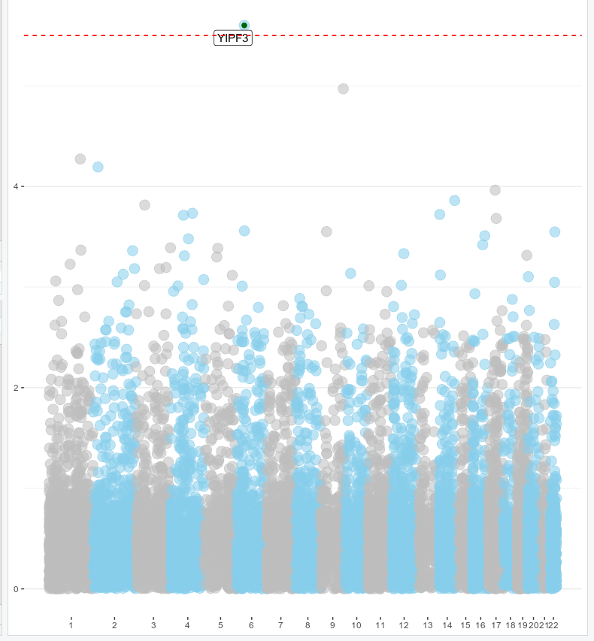
Neoplasy prevalence

