Slide 1
Updated CAAS analysis
12/09/2021

Slide 2
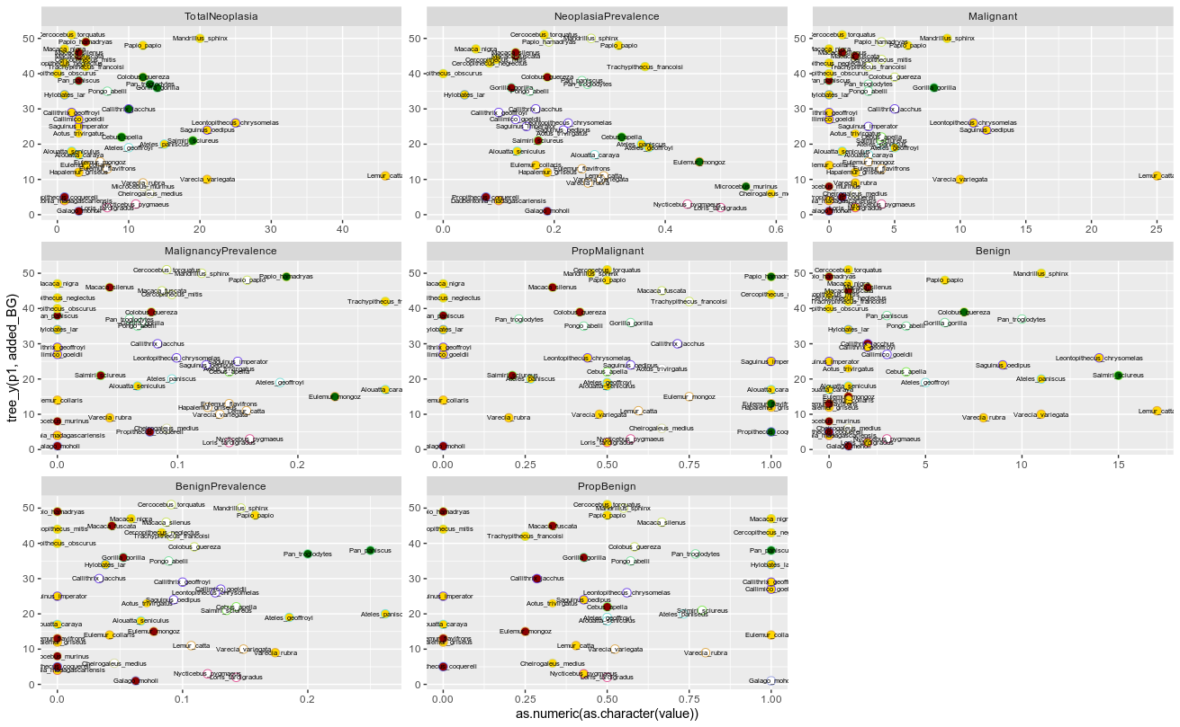
Phylogeny tip order
FG/BG selection
Total nº AA

Slide 3
Illumina extreme species
UCSC lowextreme/topextreme
1 MAD

Slide 4
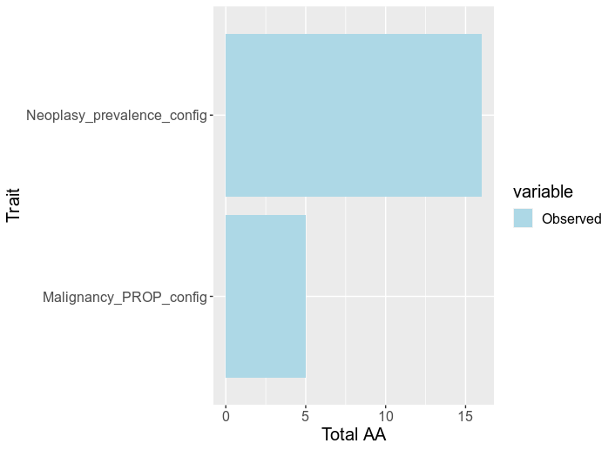
Scenario 1
Phylogeny-guided
validation

Slide 5
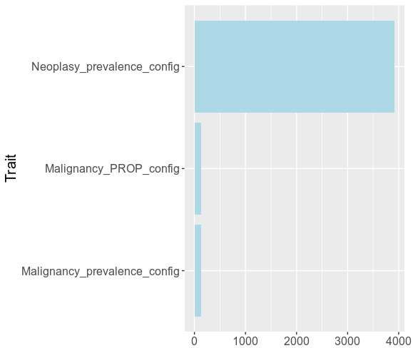
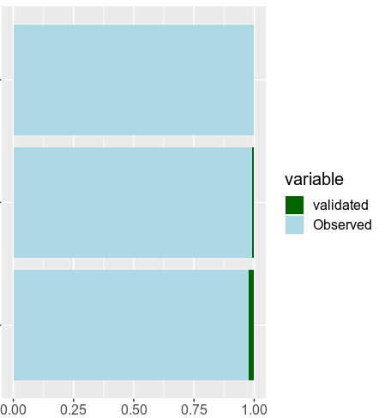
Scenario 2
Total nº AA
Proportion aa

Slide 6
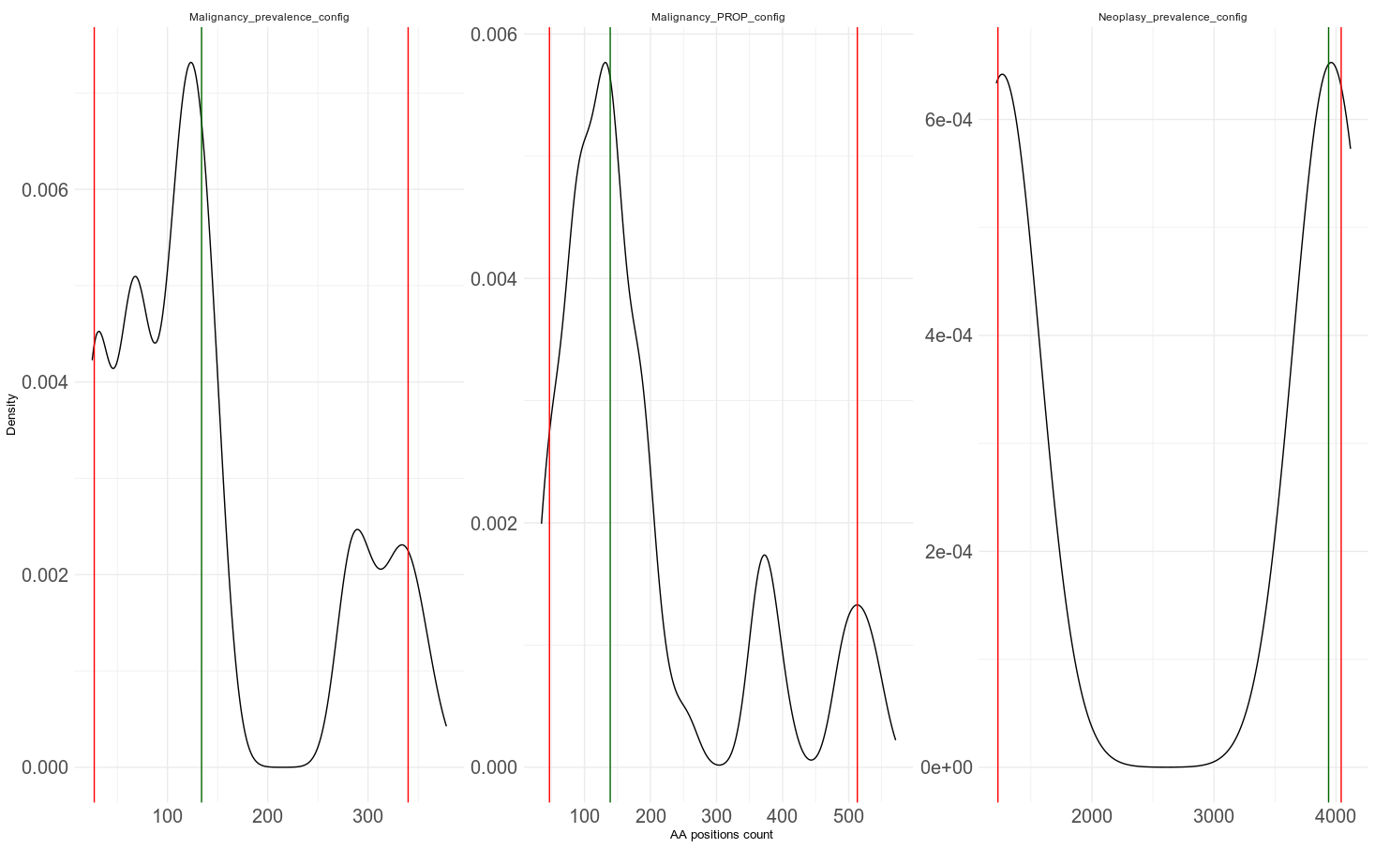
Malignancy prevalence
Malignancy proportion
Neoplasy prevalence
Total nº AA

