Slide 1
Summary

Slide 2
Bagging
Stands for bootstrap aggregation
It combines multiple learners in a way to reduce the variance of estimates. For example, random forest trains M Decision Tree, you can train M different trees on different random subsets of the data and perform voting for final prediction. Bagging ensembles methods are Random Forest and Extra Trees.

Slide 3
Boosting algorithms
are a set of the low accurate classifier to create a highly accurate classifier. Low accuracy classifier (or weak classifier) offers the accuracy better than the flipping of a coin. Highly accurate classifier( or strong classifier) offer error rate close to 0. Boosting algorithm can track the model who failed the accurate prediction. Boosting algorithms are less affected by the overfitting problem.

Slide 4
Boosting algorithms
The following three algorithms have gained massive popularity in data science competitions.
  AdaBoost (Adaptive Boosting)
  Gradient Tree Boosting
  XGBoost

Slide 5
Stacking(or stacked generalization)
is an ensemble learning technique that combines multiple base classification models predictions into a new data set. This new data are treated as the input data for another classifier. This classifier employed to solve this problem. Stacking is often referred to as blending.

Slide 6
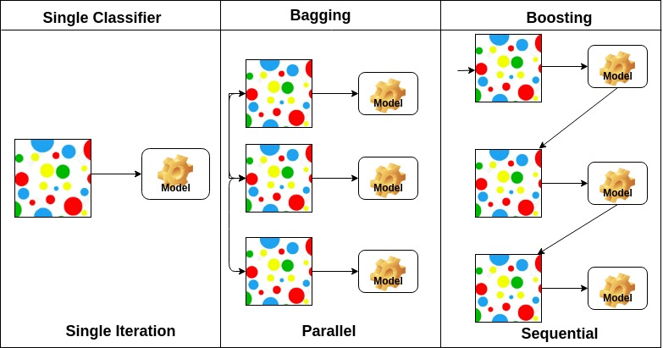
https://www.datacamp.com/community/tutorials/adaboost-classifier-python

Slide 7
AdaBoost Classifier
It combines multiple classifiers to increase the accuracy of classifiers. AdaBoost is an iterative ensemble method. AdaBoost classifier builds a strong classifier by combining multiple poorly performing classifiers so that you will get high accuracy strong classifier.

Slide 8
AdaBoost Classifier
The basic concept behind Adaboost is to set the weights of classifiers and training the data sample in each iteration such that it ensures the accurate predictions of unusual observations. Any machine learning algorithm can be used as base classifier if it accepts weights on the training set.

Slide 9
AdaBoost Classifier
Adaboost should meet two conditions:
  The classifier should be trained interactively on various weighed training examples.
  In each iteration, it tries to provide an excellent fit for these examples by minimizing training error.

Slide 10
How does the AdaBoost algorithm work?
Initially, Adaboost selects a training subset randomly.
It iteratively trains the AdaBoost machine learning model by selecting the training set based on the accurate prediction of the last training.
It assigns the higher weight to wrong classified observations so that in the next iteration these observations will get the high probability for classification.
Also, It assigns the weight to the trained classifier in each iteration according to the accuracy of the classifier. The more accurate classifier will get high weight.
This process iterate until the complete training data fits without any error or until reached to the specified maximum number of estimators.

Slide 11
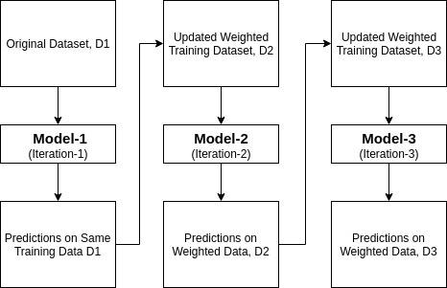
How does the AdaBoost algorithm work?

Slide 12
Bootstrap Method
The bootstrap method is a resampling technique used to estimate statistics on a population by sampling a dataset with replacement.
The bootstrap method is a statistical technique for estimating quantities about a population by averaging estimates from multiple small data samples.
Importantly, samples are constructed by drawing observations from a large data sample one at a time and returning them to the data sample after they have been chosen. This allows a given observation to be included in a given small sample more than once. This approach to sampling is called sampling with replacement.

Slide 13
Configuration of the Bootstrap
There are two parameters that must be chosen when performing the bootstrap: the size of the sample and the number of repetitions of the procedure to perform.
The bootstrap sample is the same size as the original dataset. As a result, some samples will be represented multiple times in the bootstrap sample while others will not be selected at all.
If the dataset is enormous and computational efficiency is an issue, smaller samples can be used, such as 50% or 80% of the size of the dataset.

Slide 14
Configuration of the Bootstrap
The number of repetitions must be large enough to ensure that meaningful statistics, such as the mean, standard deviation, and standard error can be calculated on the sample.
A minimum might be 20 or 30 repetitions. Smaller values can be used will further add variance to the statistics calculated on the sample of estimated values.
Ideally, the sample of estimates would be as large as possible given the time resources, with hundreds or thousands of repeats.

Slide 15
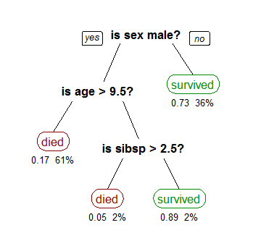
Decision Trees in Machine Learning
the bold text in black represents a condition/internal node, based on which the tree splits into branches/ edges. The end of the branch that doesn’t split anymore is the decision/leaf

Slide 16
Decision Trees in Machine Learning
This methodology is more commonly known as learning decision tree from data and above tree is called Classification tree as the target is to classify passenger as survived or died.
Regression trees are represented in the same manner, just they predict continuous values like price of a house.
In general, Decision Tree algorithms are referred to as CART or Classification and Regression Trees.

Slide 17
Decision Trees in Machine Learning
Growing a tree involves deciding on which features to choose and what conditions to use for splitting, along with knowing when to stop
As a tree generally grows arbitrarily, you will need to trim it down for it to look beautiful. Lets start with a common technique used for splitting.
  Recursive Binary Splitting: In this procedure all the features are considered and different split points are tried and tested using a cost function. The split with the best cost (or lowest cost) is selected.

Slide 18
Decision Trees in Machine Learning
In the first split or the root, all attributes/features are considered and the training data is divided into groups based on this split.
Now we will calculate how much accuracy each split will cost us, using a function. The split that costs least is chosen, which in our example is sex of the passenger.
Due to this procedure, this algorithm is also known as the greedy algorithm, as we have an excessive desire of lowering the cost. This makes the root node as best predictor/classifier.

Slide 19
Cost of a split
cost functions try to find most homogeneous branches, or branches having groups with similar responses.

Slide 20
When to stop splitting?
As a problem usually has a large set of features, it results in large number of split, which in turn gives a huge tree. Such trees are complex and can lead to overfitting. So, we need to know when to stop?
One way of doing this is to set a minimum number of training inputs to use on each leaf. For example we can use a minimum of 10 passengers to reach a decision(died or survived), and ignore any leaf that takes less than 10 passengers.
Another way is to set maximum depth of your model. Maximum depth refers to the the length of the longest path from a root to a leaf.

Slide 21
Pruning
The performance of a tree can be further increased by pruning. It involves removing the branches that make use of features having low importance. This way, we reduce the complexity of tree, and thus increasing its predictive power by reducing overfitting.
Pruning can start at either root or the leaves. The simplest method of pruning starts at leaves and removes each node with most popular class in that leaf, this change is kept if it doesn't deteriorate accuracy. Its also called reduced error pruning.

Slide 22
Pruning
More sophisticated pruning methods can be used such as cost complexity pruning where a learning parameter (alpha) is used to weigh whether nodes can be removed based on the size of the sub-tree. This is also known as weakest link pruning.

