Slide 1

“Time spent effectively with a high quality.”
Goals
Take care about the health
Have quick and high quality coffee and food service
Minimal disruption at meetings
Time spent effectively
Frustrations
“I often order at busy hours and sometimes it takes too long to deliver my order.”
“Sometimes the coffee gets cold, when ordering at busy hours.”
“It is hard to find information about allergens”
“Sometimes it is hard to find my favourite sandwich, the way is too long.”
Jakub Veselý
Jakub is a young man, who spends a lot of time at work and he is always busy. He is a vegetarian and has a lactose intolerance. He wears a suit all day long, he spends a lot of time in the office or on business meetings. After work he goes to the gym or he has a fun with his friends. He takes care of his health and healthy lifestyle, he lives alone and has no time to cook or take care about the food. He uses App and online food ordering every day. For his working hours, he requires a high quality food and coffee, perfect and quick service.
Age:
Education:
Hometown:
Family:
Occupation:
34
Engineer (University of Economy)
Brno
Single, lives alone
Manager in a large international
company

Slide 2
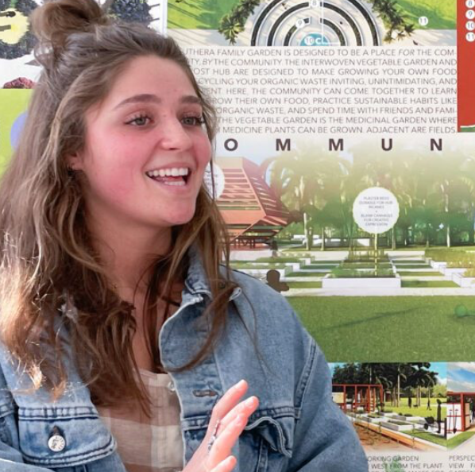
“Let's try this café, let's try something new. Is there some special offer for this season of the year?”
Goals
Have a freedom in life
Explore new things
After graduation at Uni continue to work in an art studio
Participate in (special) events - concerts, picnics
Create home with Adam and Charlie
Frustrations
“I usually use the order App on weekends mornings and menu is other than on working days.”
“Deliveries at weekends are not so often than on working days.”
“I would like to order Friday evening to get my offer on Saturday or Sunday morning.”
“Sometimes the vegetable in food is not fresh at all.”
Add image that represents this persona
Monika Studničková
Monika lives student's life. She lives with her boyfriend Adam and their dog Charlie. She attends university as well as internship in an art studio. She loves good coffee and sweet cakes. She likes to try new things. She goes to a café with her friends. On weekends she loves brunches with Adam and as they live in suburban area they like to order coffee and food from their favorites cafes.
Age:
Education:
Hometown:
Family:
Occupation:
28
Student of a Garden Architecture
Brno (suburban area)
Lives with a boyfriend, 1 dog
Internship in an art studio

