Slide 2
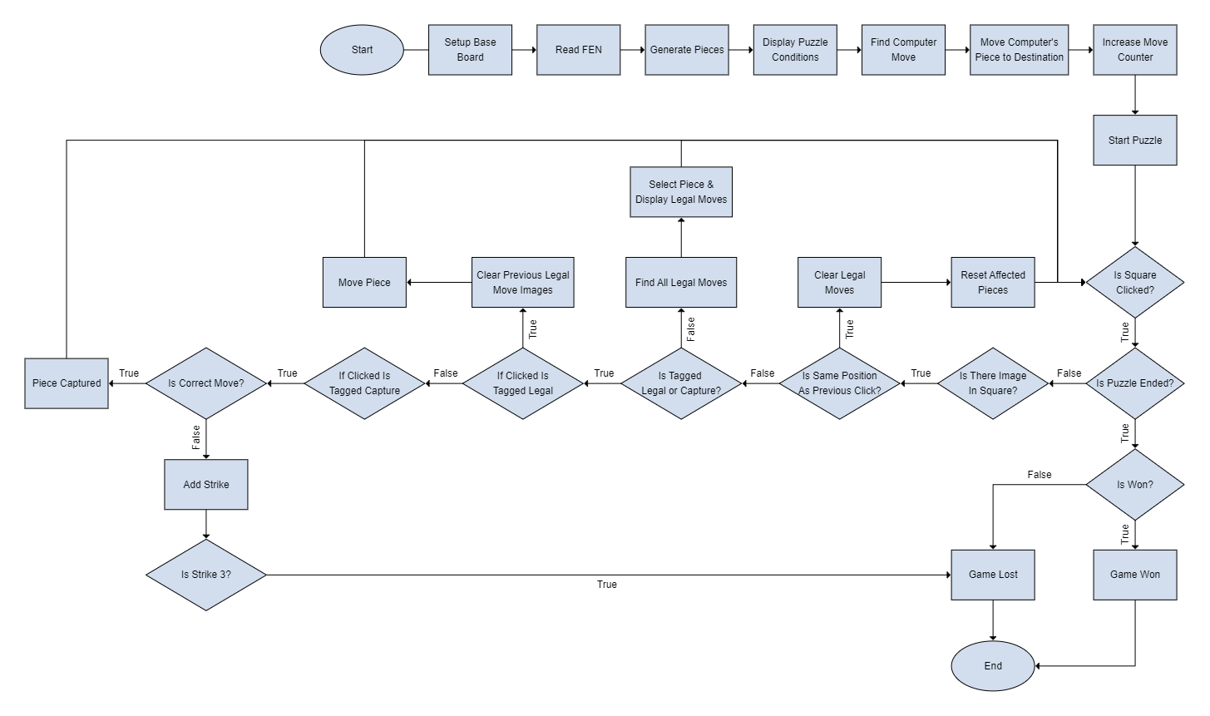
Flowchart

Slide 3
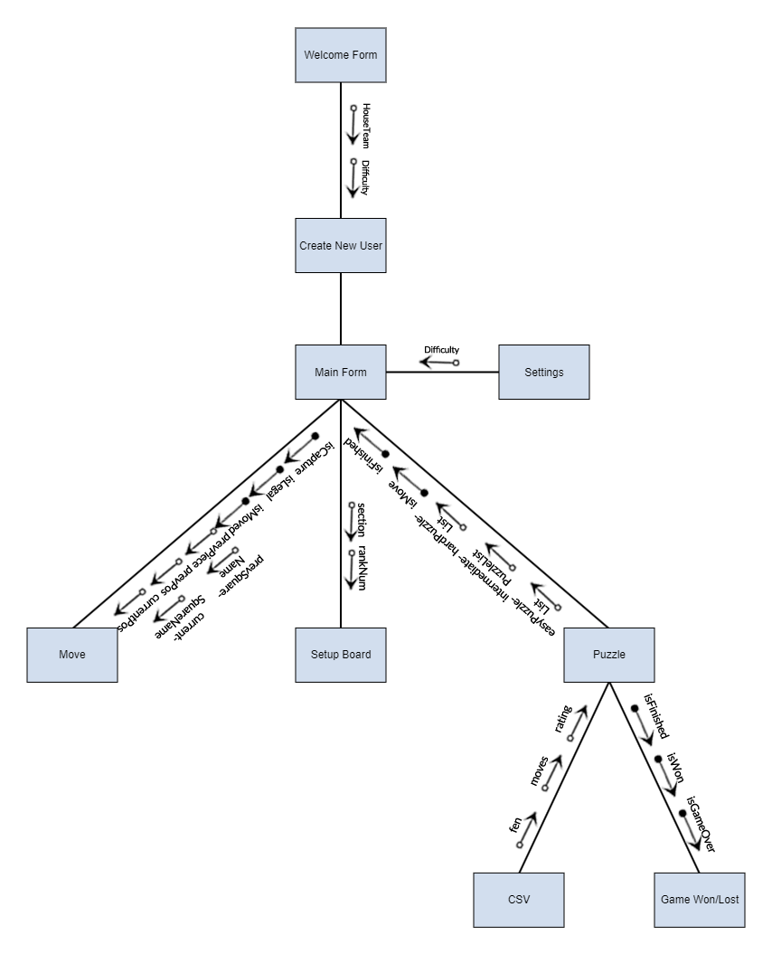
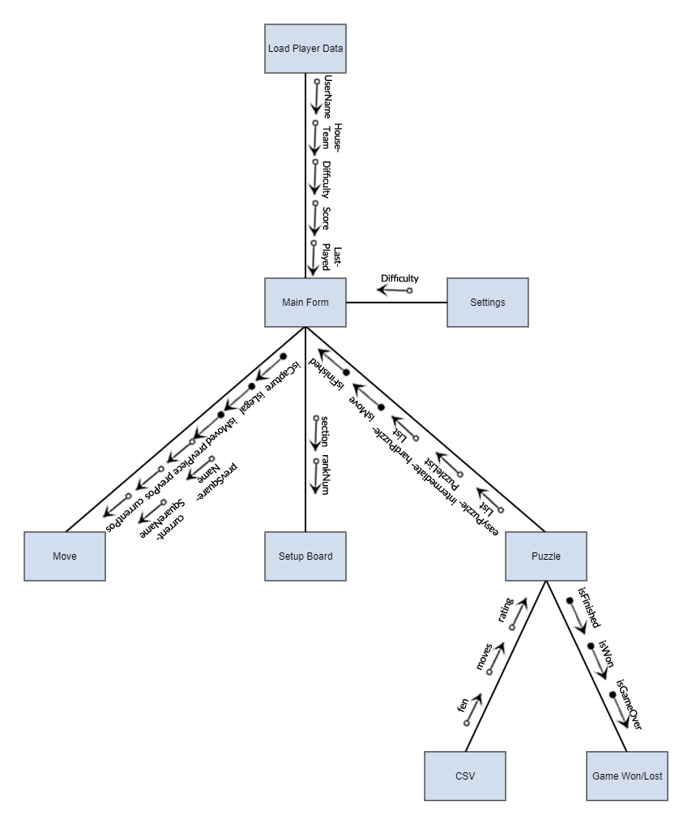
Structure Chart
New User
Previous User

Slide 4
Iteration 1: Overview
In the first build of the application, the most part of the application was created, with the puzzle being updated each day manually by changing the constant values of “fen” and “moves” to the correct values in accordance with each day.

Slide 5
Iteration 1: Reading FEN
<Piece Placement> = <rank8>/<rank7>/<rank6>/<rank5>/<rank4>/<rank3>/<rank2>/rank1>
<rank i> = [<digit 1-7>]<piece>
<piece> = <white piece> | <black piece>
<Piece Placement> = <rank8>/<rank7>/<rank6>/<rank5>/<rank4>/<rank3>/<rank2>/rank1>
<rank i> = [<digit 1-7>]<piece>
<piece> = <white piece> | <black piece>
4r1k1/5ppp/r1p5/p1n1RP2/8/2P2N1P/2P3P1/3R2K1 b - - 0 21

Slide 6
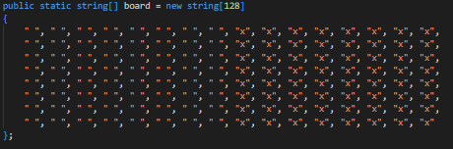
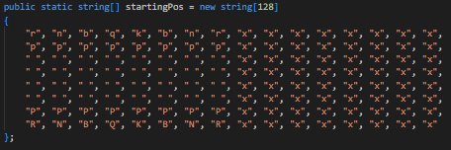
Iteration 1: Board Representation (0x88)

Slide 7
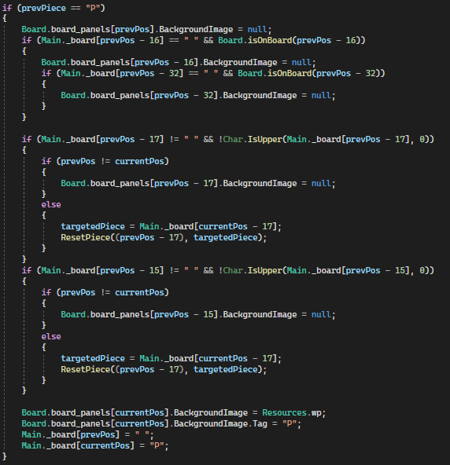
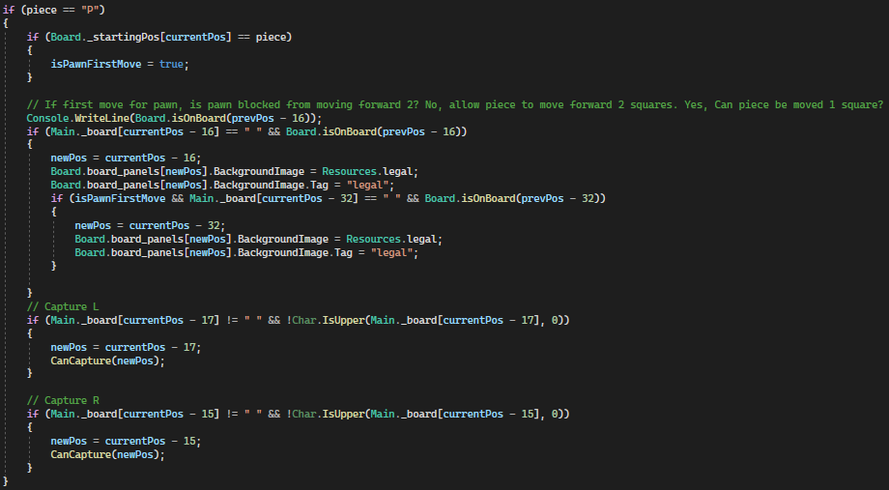

Iteration 1: Move Generation

