Slide 2
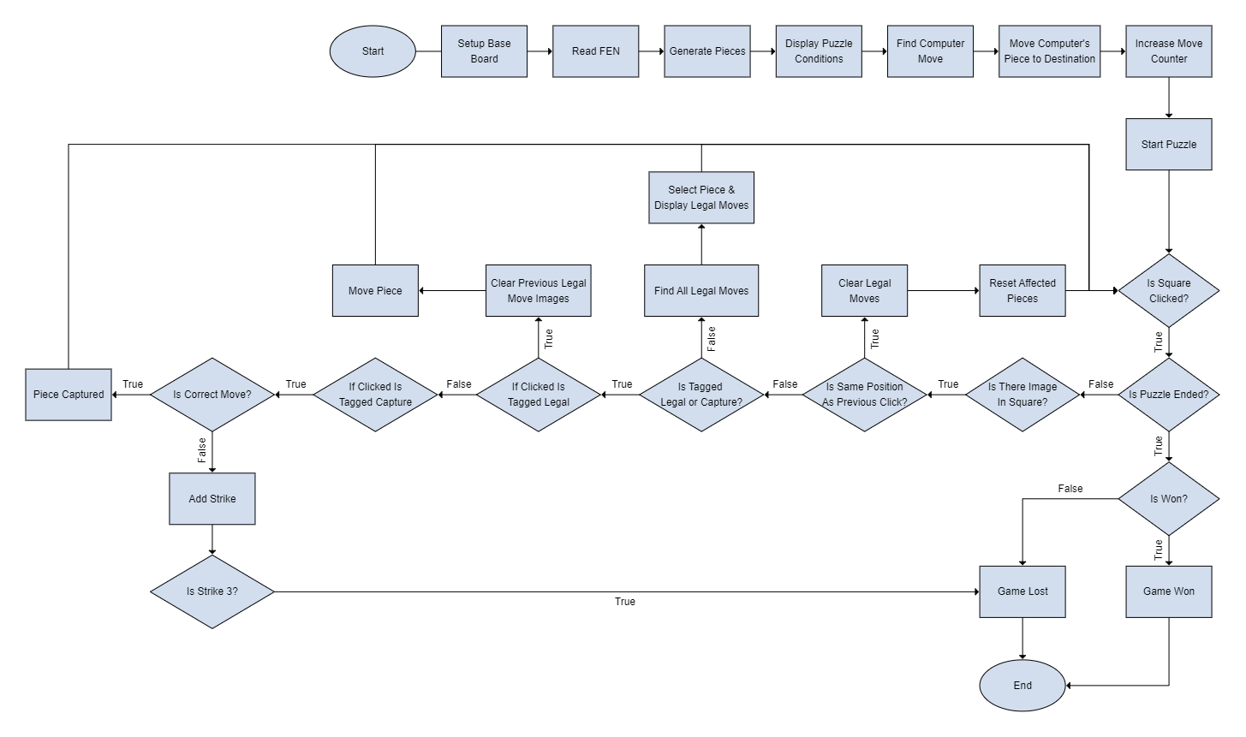
Flowchart

Slide 3
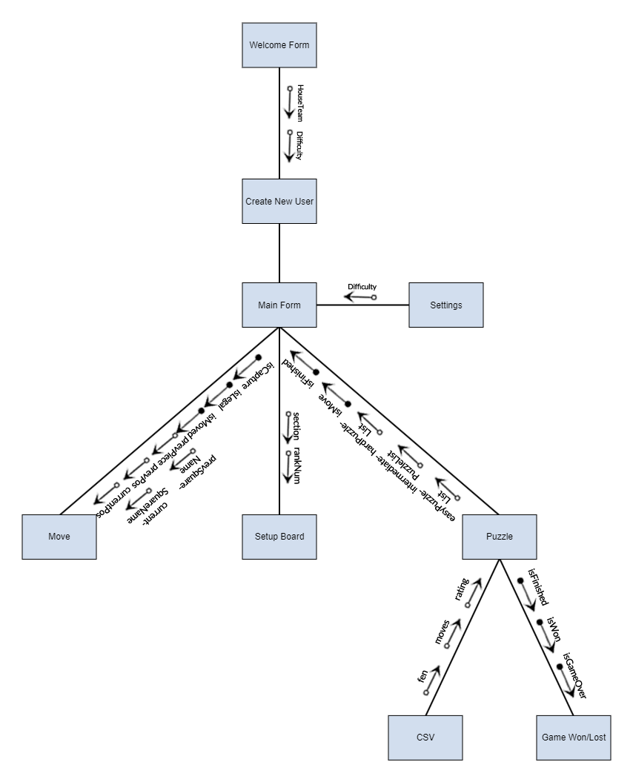
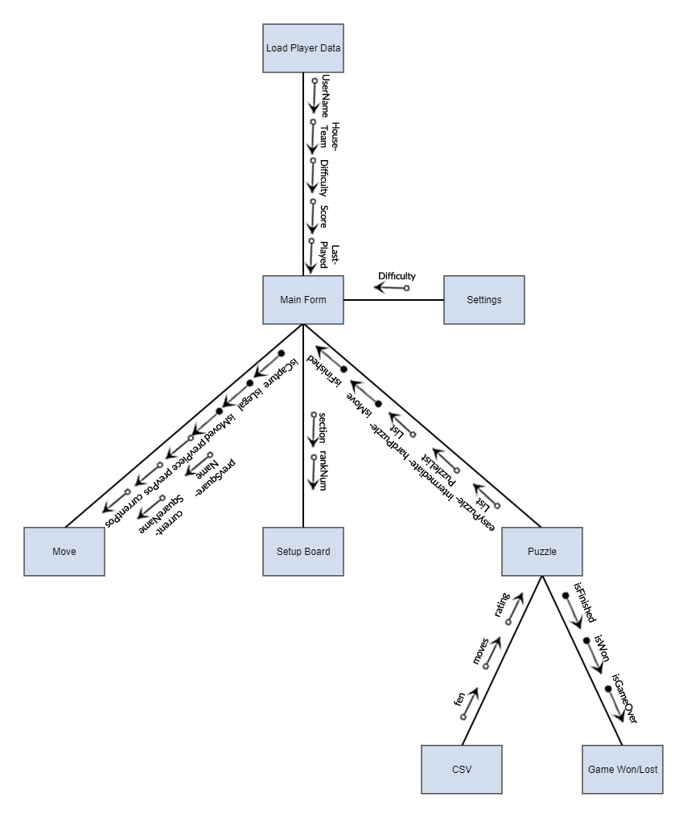
Structure Chart
New User
Previous User

Slide 4
Iteration 1: Overview

Slide 5
Iteration 1: Reading FEN
<FEN> ::= <Piece Placement>
' ' <Side to move>
' ' <Castling ability>
' ' <En passant target square>
' ' <Halfmove clock>
' ' <Fullmove counter>

Slide 6
Iteration 1: Board Representation (0x88)

Slide 7
Iteration 1: Move Generation

