Slide 2
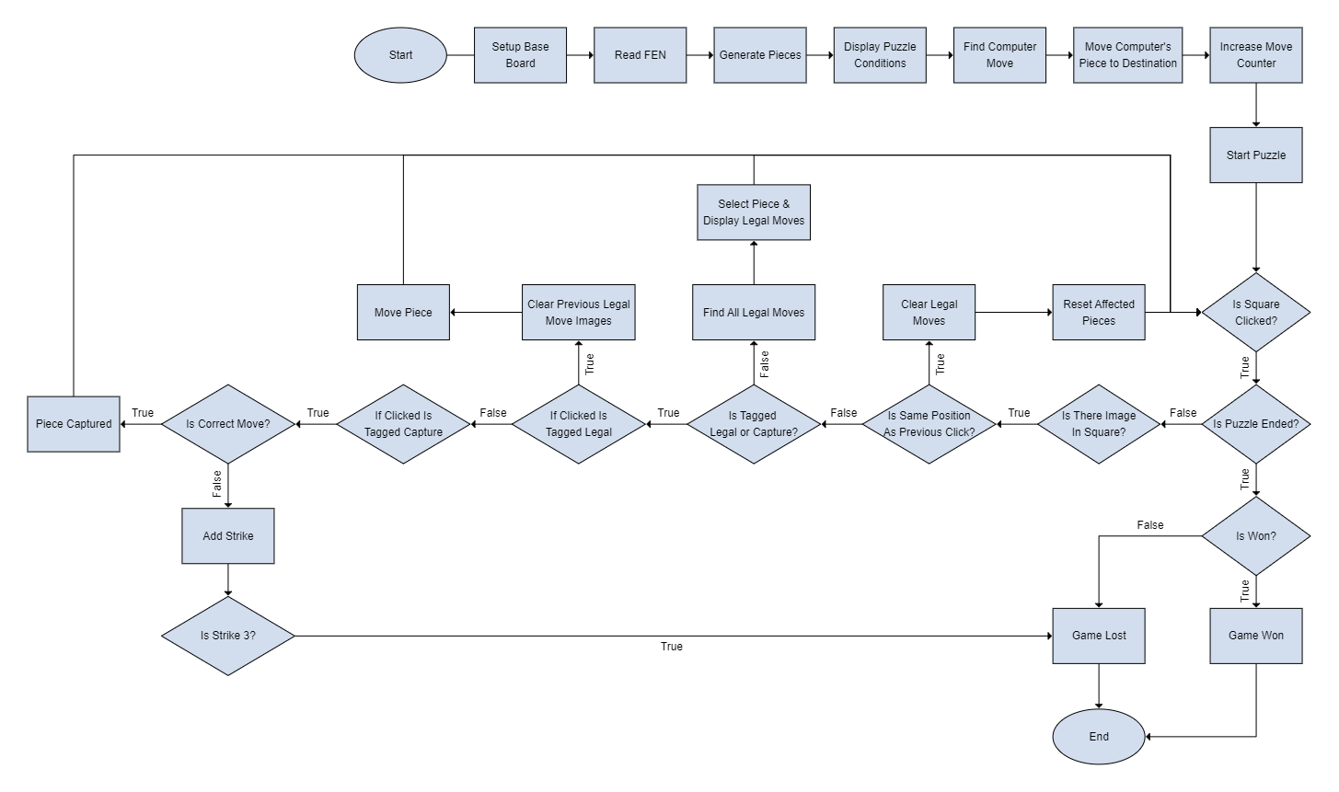
Flowchart

Slide 3
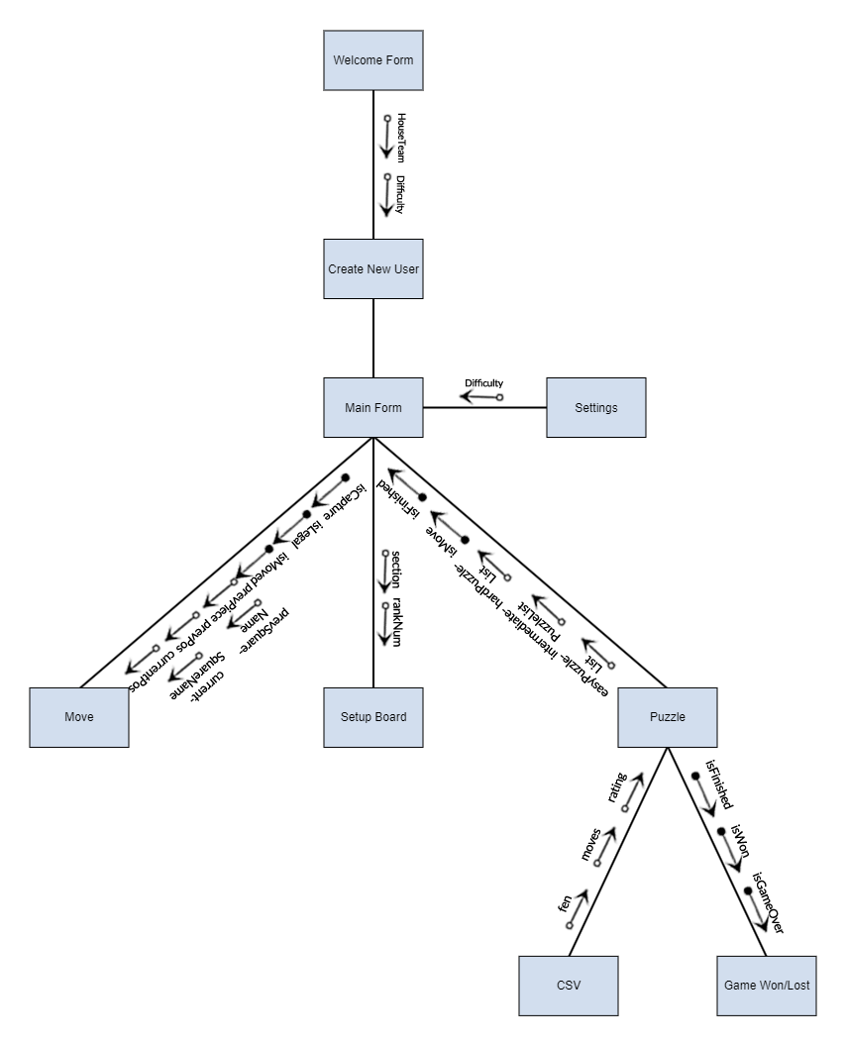
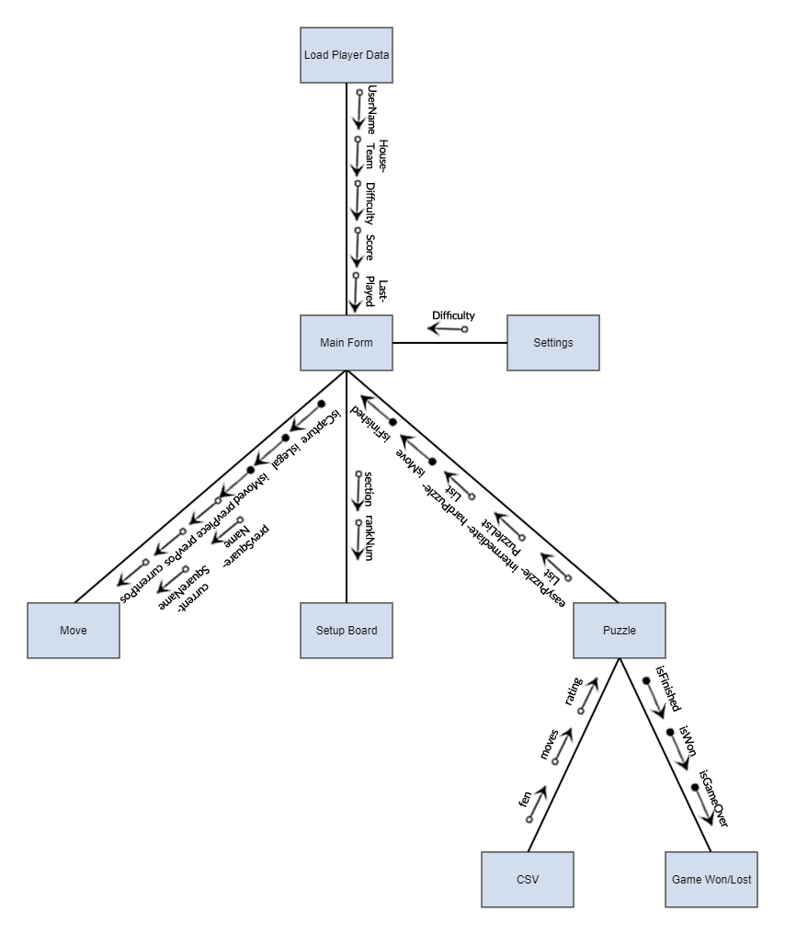
Structure Chart
New User
Previous User

Slide 4
Iteration 1: Overview
In the first build of the application, the most part of the application was created, with the puzzle being updated each day manually by changing the constant values of “fen” and “moves” to the correct values in accordance with each day.

Slide 5
Iteration 1: Reading FEN
<Piece Placement> = <rank8>/<rank7>/<rank6>/<rank5>/<rank4>/<rank3>/<rank2>/rank1>
<rank i> = [<digit 1-7>]<piece>
<piece> = <white piece> | <black piece>
<Piece Placement> = <rank8>/<rank7>/<rank6>/<rank5>/<rank4>/<rank3>/<rank2>/rank1>
<rank i> = [<digit 1-7>]<piece>
<piece> = <white piece> | <black piece>
4r1k1/5ppp/r1p5/p1n1RP2/8/2P2N1P/2P3P1/3R2K1 b - - 0 21

Slide 6
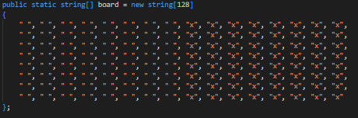
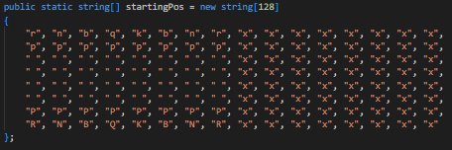
Iteration 1: Board Representation (0x88)
When initialising the Chart System, it was necessary to dynamically program the LoadChart event so that each form would be able to call the event to create their charts. Within the set of code, the LoadChart event creates a series for each of the categories, then adds the 2D array’s data to the chart’s points. Meanwhile, within the Unit form, the 2D array’s size is set by the amount of X and Y filters the user selects. In this chart the X coordinates correspond to the Unit Number, and the Y coordinates correspond to the Licence Type.
As I initially planned to allow for the user to dynamically select their X and Y coordinates from all the filters, I implemented a PropertyInfo method to utilise strings in order to call objects located in the UnitClass. This is effective as it allows any of the possible X or Y coordinates to be programmed within just a couple lines of code, rather than utilising several if statements. As the X coordinates were linked to the series, I used the Series List to check if the crash met the filters set by checking for the index of the property, which is now set to the Unit Number property. In turn, this means that the Y coordinates were linked to the data being collected, using a similar method to X. It was then checked if either the X or Y lists didn’t contain the object property, and if they both contained the correct property values, then the X and Y coordinates were to be added to the 2D array.

Slide 7
Iteration 1: Board Representation (0x88)
In the background of this application, the representation of the board is important as it is the array of the board behind the visible board, which is utilised in move generation and move checking to determine if a move is legal or not. When programming the board representation, there are two main ways that it can be addressed. This can be through implementing Bitboards, which is a set of 64 elements, which are all squares of the board, with one bit associated with each square. However, I did not find this as useful to me as using the square centric method of 0x88 to illustrate the board. 0x88 represents the board in 128-byte array, with only half of the array representing valid squares on the board. Within the initial board representation, it can be seen that half of the array elements consist of a blank entry, with the other half containing x’s. Another example of this in implementation is in the starting position array, which illustrates where each piece starts on the board in a standard game. It can be seen that as usual, the lower and upper two ranks contain the pieces are regularly seen, however being surrounded by both open strings and x’s.

Slide 8
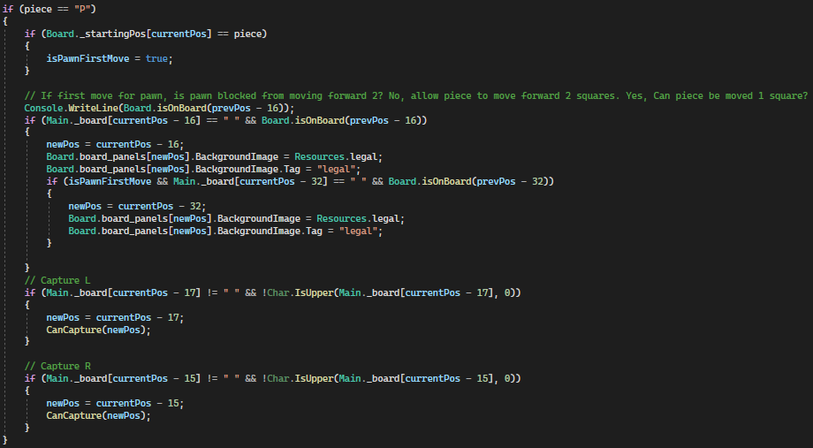
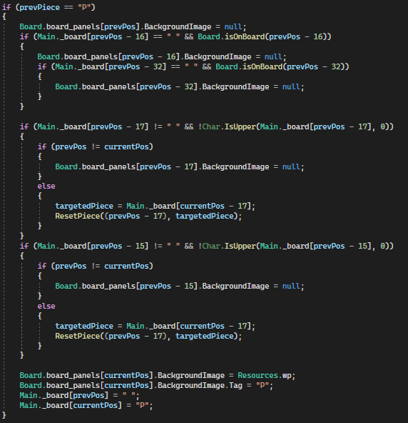

Iteration 1: Move Generation
Within this project, one of the most major parts of the program is move generation. This is because to make any move on the chess board, the legal moves must be checked. As this Daily Chess Puzzle application has been designed to only consist of “White to Move and Mate in x number of moves”, the pseudo-legal move generation method is used. This where the moves made by the piece isn’t checked if it leaves the king in check, as this would mean that more resources would be used to check for more possible lines, when it isn’t required to be present as the move will be returned as incorrect anyway. In the line displayed image, which reads “if Main dot board, previous position minus 16 is equal to blank string and Board dot is on board, previous position minus 16”, the isOnBoard method is called to return a Boolean. This is to utilise the 0x88 board representation, through checking if the piece is on the board through the line, “if destination and 0x88, then square is invalid”.

Slide 9
Iteration 1: Move Generation

Slide 10
Writer’s Statement: Array Implementation

Slide 11
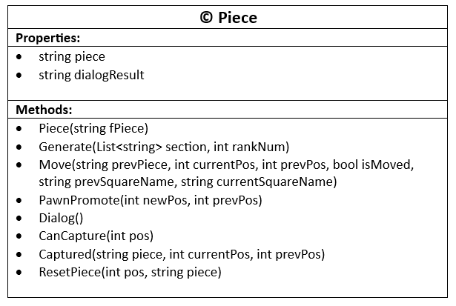
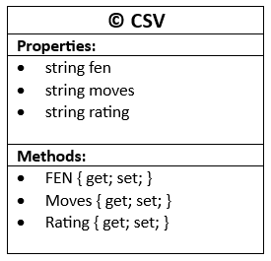
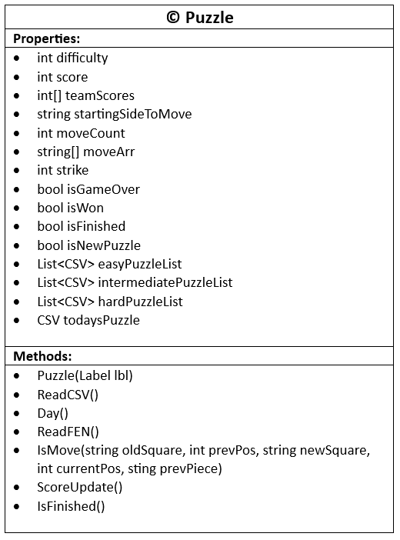
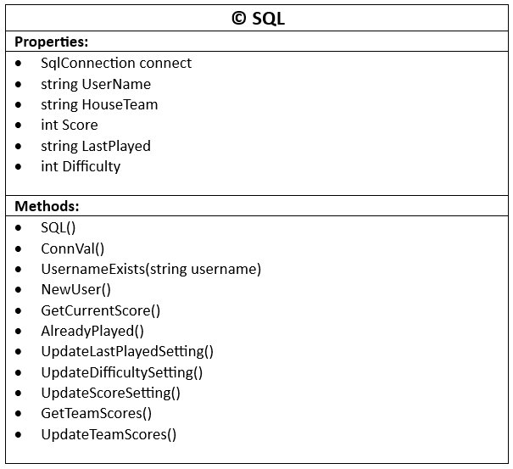
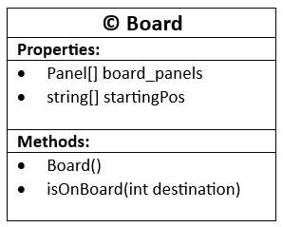
Writer’s Statement: Classes

