Slide 1
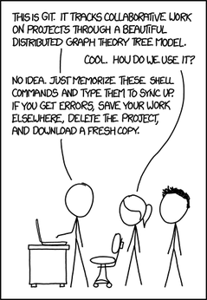
Introduction to version control with Git

Slide 2
Outline
Intro to version control systems – why you should want to use them (and not just for your code)
General concepts with Git, structure and workflow
Start playing…

Slide 3
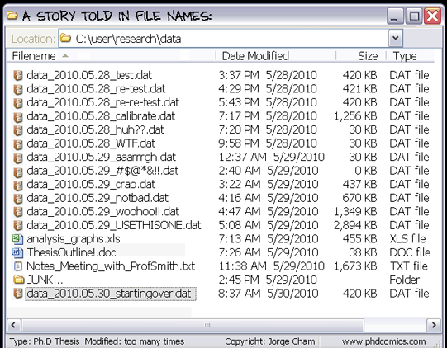
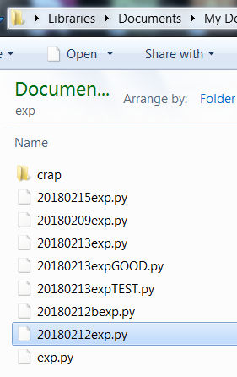
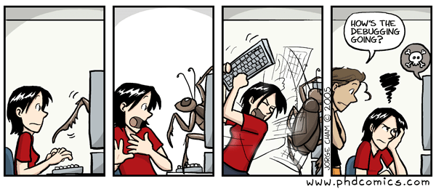
Why we need version control
We often need to work incrementally on a project: code, manuscript, thesis… It’s like playing Legos.
Best case scenario: you give your files incremental names
= DIY version control
Your folders look like this:
A Fictitious Experiment:
Record activity from a mouse exp.py
Play various tones 20180209exp.py
Give mouse a reward for learning dance steps 20180212exp.py
Add online dance steps analysis 20180212expb.py
Add disco ball to setup 20180213exp.py
Change algorithm for dance steps analysis 20180215exp.py
Worst case scenario: you keep overwriting the same file

Slide 4
We need better than a DIY file naming system
It is hard to stick to a consistent nomenclature scheme (even if you are a very organised person)
Which version is what?

Slide 5
Version control systems and benefits
Tracks history of changes in your code :
Centralized backups
Easily roll back to older versions
Bring back that bit you accidentally changed/deleted yesterday at midnight
help debugging: “it was working on Tuesday / what did I break between v.12 and v.13?”
What version of the code was I using before I upgraded the camera?
Work with multiple versions in parallel (re-run some analysis using the code used in the paper while you keep working on the new version)
Tag different versions of your code
In scientific research:
Reproducibility:
Share your code (and a specific version of it) with others
Know what version you used for your experiment in January 2018 – and to make the plot in Figure 3B
Citability
You can assign a DOI to a version of your code

Slide 6
Distributed Version Control Systems for collaboration
Your main collaborator is yourself:
Will it all make sense in 6 months?
Documenting the changes in your code helps document the way your project evolves
Collaborating with others:
Split the work and resync later on
Projects evolve in parallel
Run your collaborator’s version while you keep working on your own

Slide 7
Git is a distributed version control system
Track changes in computer files (Main application : code management for software development)
Code is text! Use it for code and text documents, not for data
You can only add stuff
Supports distributed, non-linear workflow (collaborative development)
Each person has its own copy of the project and can work on them locally (you have local access to project history)
Fast and lightweight
GitHub is the repository hosting service for Git
Web-based collaboration interface: repositories, wikis, issues pages
https://github.com/
Desktop tool
https://desktop.github.com/

Slide 8
Git concepts
This is a description of general concepts + git commands on virtual examples
Not an exhaustive description of commands : use the documentation https://git-scm.com/doc, ask your friends, ask Google or Stackoverflow
It is not compulsory to use the command line interface – GitHub Desktop does the job, too
Many actions can be done locally (via the GUI or command line interface) or on the cloud on github.com

Slide 9




Git repository = All the files related to a project
Local
Remote
Your computer
Git server
.git
My_repo
https://github.com/My_git_account/My_repo
Your_files

Slide 10
Clone a Cool_repo from a Git repository (git clone)
Local
Remote
git clone
Your computer
Git server
A_cool_repo
https://github.com/some_cool_kid/Cool_repo
$ git clone https://github.com/some_cool_kid/Cool_repo.git A_cool_repo

Slide 11
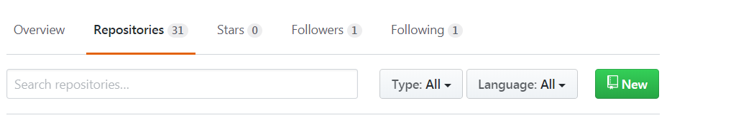
Create a repo (git init)
Local
Remote
Your computer
Git server
If you have existing files: create the repo on github.com
$ cd ~/My_repo
$ git init
$ git add Your_files % add a file
$ git remote add origin https://github.com/username/new_repo.git
$ git push-u origin master
.git
My_repo
Your_files
git init
My_repo
Your_files
OR if you start from scratch:
create the repo on github.com, then clone on your local

Slide 12
Commit changes to a repo and push to remote
Local
Remote
git push
https://github.com/My_git_account/My_repo
Your computer
Git server
.git
git commit
Staging area
My_repo
Your_new_file
Your_files
Your_new_file
git add
$ git add Your_new_file
$ git commit –m “short description”
$ git push
My_repo
Your_files
Your_new_file

Slide 13
Pull changes from a repo to update your local repo
Local
Remote
git pull
https://github.com/My_git_account/My_repo
Your lab computer
Git server
.git
My_repo
Your_files
Your_new_file
$ git pull

Slide 14

Create a new branch in your repo (e.g. for a test version)
Local
Remote
git push origin newbranch
https://github.com/My_git_account/My_repo
Your computer
Git server
.git
My_repo
Your_files
Your_new_file
$ git status %on which branch am I
$ git add Your_new_file
$ git commit –m “commit message”
$ git push origin newbranch
$ git branch newbranch
$ git checkout newbranch %like cd for branches
$ git push origin newbranch

Slide 15
Branch merging (e.g. add your test files to your master branch)
$ git checkout master
$ git branch % list all branches
newbranch
*master
$ git merge newbranch
Merge conflict: e.g. when 2 files in each branch to merge are too similar git does not know what to keep
Open the file in text editor, git has added merge conflict signs:
<<<<<<<HEAD % stuff below code in your current branch (here master)
======= % stuff below is code in the incoming branch
>>>>>>> % where the conflict finishes
Manually try to resolve the conflict then try to commit again

Slide 16
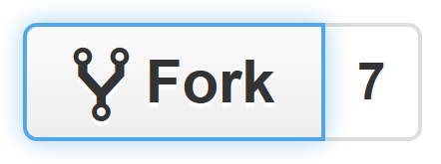
Fork somebody else’s repo
Local
Remote
git clone
My fork of the repo
push
pull
https://github.com/My_git_account/A_repo
Your computer
.git
A_repo
pull
files
Remote
Somebody else’s repo
https://github.com/Another_account/A_repo

Slide 17
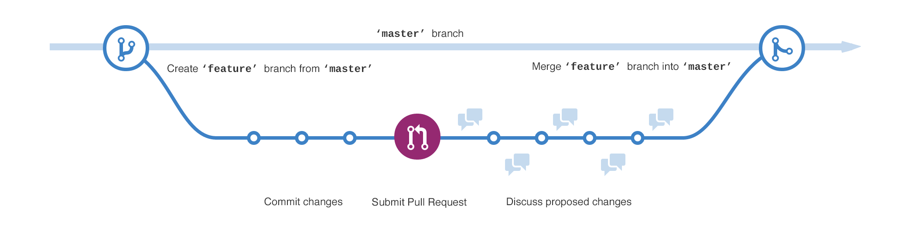
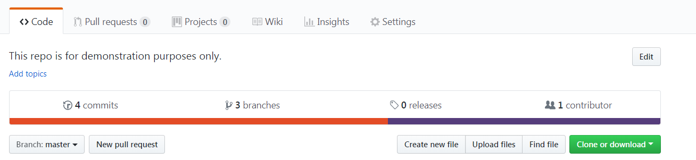
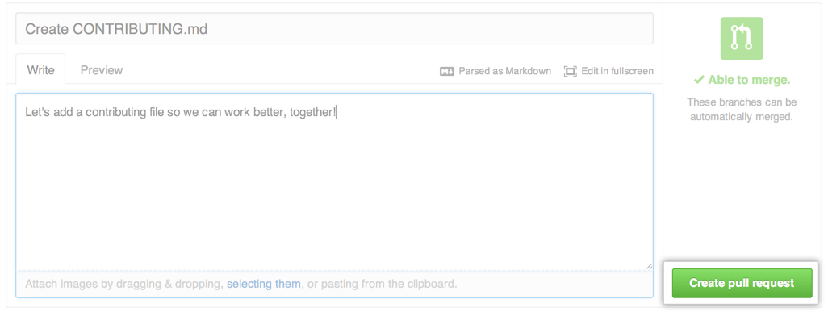
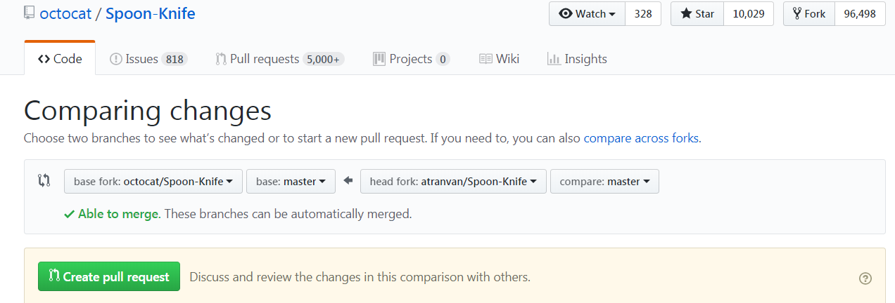
Create a pull request : You want to share your additions (e.g. a bug fix, new features)
The original poster may or may not merge the pull request

Slide 18
Useful docs
https://services.github.com/on-demand/downloads/github-git-cheat-sheet/
https://services.github.com/on-demand/resources/
https://git-scm.com
https://learngitbranching.js.org/

Slide 19
Install Git and set up and account
Create an account: https://github.com
Download Github Desktop: https://desktop.github.com/ includes GUI and CLI

