Slide 1

Shift-left Automatic Generation of Network Policies
Speakers: Ziv Nevo, Shripad Nadgowda
Contributors: Adi Sosnovich, Fabio Oliveira, Gil Shurek, Karen Yorav, Shai Doron, Tanya Veksler, Shireen Falah
https://shift-left-netconfig.github.io

Slide 2
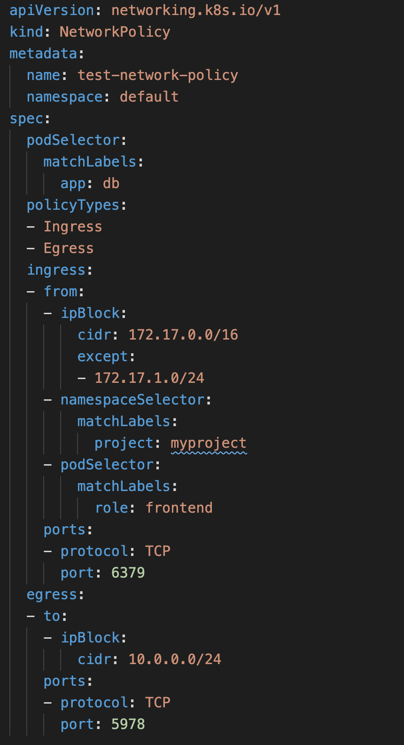
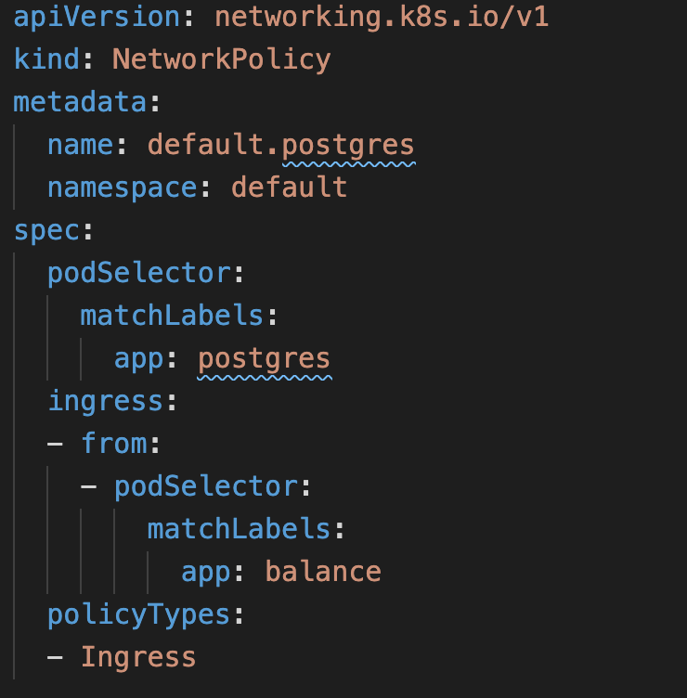
User problem
It is hard to manually craft network policies
error prone
tedious
“How do I automatically generate network policies that
(1) enable only the required cross-application connectivity,
(2) do not break the apps, and
(3) comply with organizational security requirements,
before running my organization’s code in production?”

Slide 3
Technical challenges
Generate network policies from static artifacts
Generate as much as possible “on the left”
K8s Deployments/Services/ConfigMaps → NetworkPolicies
YAMLs + openAPI specs + … → YAMLs
Get the network policies right
Tricky K8s NetworkPolicy YAML syntax
Must secure both egress and ingress
Ensure only required connectivity is allowed
Zero trust
How to identify connectivity without running the apps?
Adapt to evolution
New apps or versions are created
Possible changes
connectivity needs; labels;
organizational security requirements
Opportunity: Create an ecosystem of tools to solve the above problems

Slide 4
Project goals
Minimize human effort required to manipulate network policies
Analyze K8s YAML artifacts to generate K8s NetworkPolicies “on the left”
Give users peace of mind by keeping them in the loop
Provide a set of tools for users to review the connectivity impact
A textual/graphical summary of the connectivity graph
A connectivity diff between a proposed network policy and a previous version of this policy
Verifying connectivity against corporate policies and baseline rules
Ultimately, raise the level of abstraction beyond NetworkPolicy YAMLs

Slide 5


Our approach
Actual Traffic (Optional)
Static Artifacts & Code
Build
Deploy, Run
DevOps
Net-Config v_{i}
(Optional)
Analyze & Synthesize
Net-Config v_{i+1} Proposal
Review, Modify,
Re-synthesize
Net-Config v_{i+1}
Org Security Requirements (Org-Pol)
Connectivity Analysis + Change-impact-Analysis
Org Security Requirements Check
DevSecOps
Triggers:
Initial setup
Code/config changes
Change in org-pol
Change in actual traffic
Periodic audits
Report + Visualization Connectivity,
Connectivity-change
Org Security Requirements (Org-Pol)

Slide 6


Integration into CI/CD flow (auto synthesis)
DevOps
Repo
CI/CD pipeline
Makes changes, opens PR
…
Analyze & Synthesize
PR
…
Updated netpols
Connectivity mapper
Connectivity map
Connectivity differ
Connectivity diff
Org-pol checker
Org-pol validity
…
…

Slide 7
Integration into CI/CD (synthesis on demand)
DevOps
Repo
Makes changes, opens PR
CI/CD pipeline
Initiates
PR
…
…
Analyze & Synthesize
Updated netpols
Connectivity mapper
Connectivity map
Connectivity differ
Connectivity diff
Org-pol checker
Org-pol validity
…
…

Slide 8
Demo

Slide 9
Future and community
Potential short-term future directions
GitOps integration
Generate network policies for service meshes
We want to build a community
Join the party! ☺
Questions and feedback
Are there similar/complementary projects that we can leverage or can capitalize on our approach?
Have you heard about users’ problems that this approach can help with? In what context?
What are the most promising integration points for us?
CI/CD tools (e.g. GH Actions, Tekton, Jenkins, etc.)
GitOps technologies
CLIs
IDEs
Where to find us:
GitHub org: https://github.com/shift-left-netconfig
Landing page: https://shift-left-netconfig.github.io

