Slide 1

B.Tech CSE · Manipal University Jaipur
Adaptive driver drowsiness detection using personalized baseline modeling
A real-time, explainable, and deployment-aware driver monitoring framework
Nishtha Pandey

Slide 2





Problem context
Driver drowsiness is a major safety risk
Fatigue impairs driving
Vision-based monitoring
Camera-based detection is non-invasive and cost-effective, requiring no physical contact with the driver. It captures natural behavioral cues like eye closure and yawning in real time.
Static thresholds fall short
Fatigue reduces reaction time, focus, and decision quality
Mostlow-cost systems apply ﬁxed
detection rules to every driver. Individual differences in eye shape, blinking habits, and baseline behavior mean these thresholds miss real fatigue or raise false alarms.

Slide 3



What existing systems get wrong
Blink rate varies
Human blink frequency differs signiﬁcantly between individuals - no single baseline applies universally.
Eye openness differs
Natural eye aperture variesby person -
anatomy alone changes what an "open" or "drowsy" eye looks like.
One-size-ﬁts-all thresholding is scientiﬁcally weak for human fatigue detection.
Fatigue looks different
Fixed EAR thresholds fail
Mouthmovementand fatigue expression vary widely - yawning patterns alone cannot be read uniformly.
Rigid thresholdscause both false
positives and false negatives - ﬂagging alert drivers or missing genuinely drowsy ones.

Slide 4


Research gap
The gap in current research
Isolated thresholds
No personalization
Deployment gap
Mostsystemsdetectfatigue using ﬁxed, one-size-ﬁts-all thresholds. They measure signals in isolation without accounting for how each driver naturally behaves when alert.
Fewpracticalsystemsbuilda driver- speciﬁc baseline before making decisions. Without a personal proﬁle, detection is reactive rather than individualized.
Hosteddemos exist, butreal-time edge-
like execution is rarely addressed. Practical deployment with explainability built in remains largely absent from existing work.

Slide 5

Proposed solution
Detection should be
personal
Learns each driver's normal EAR, MAR, and head pose as a
Flags drowsiness through deviation from that individual
Delivers explainable fatigue
scores and real-time alerts
personal baseline
baseline

Slide 6





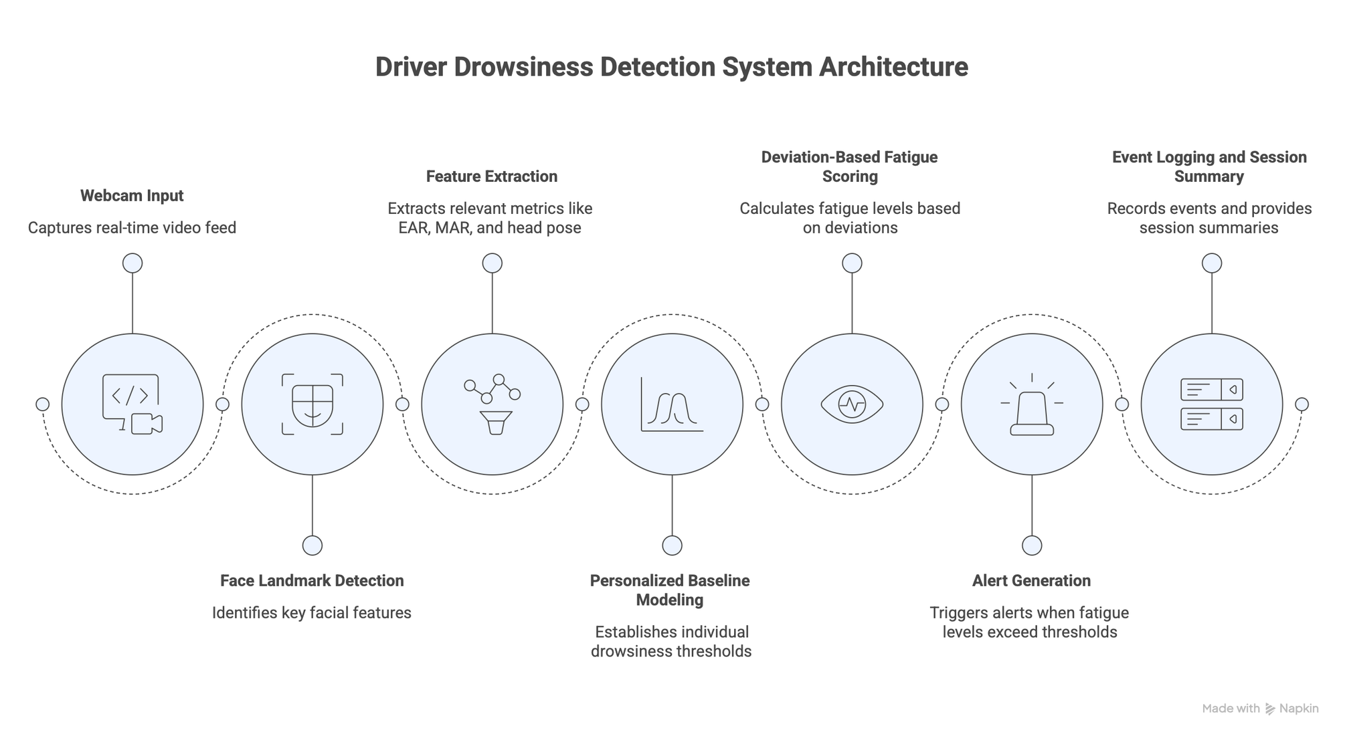
Project objectives
What the system is built to do

Slide 7

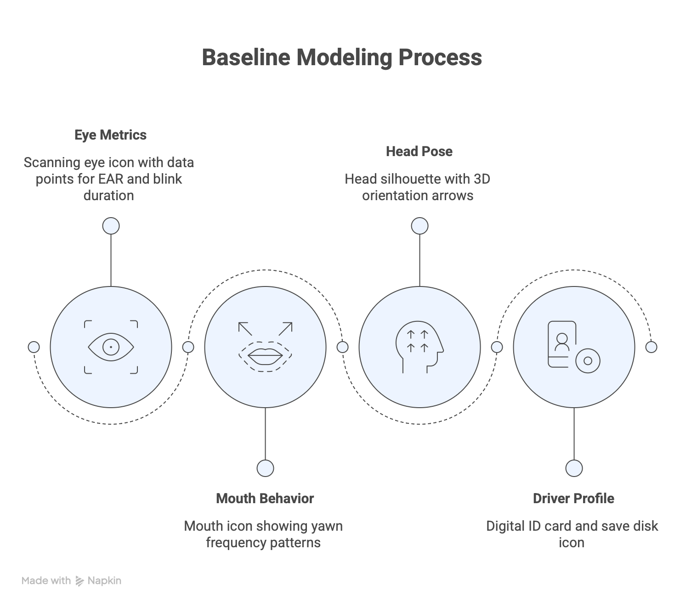
Baseline modeling

Slide 8
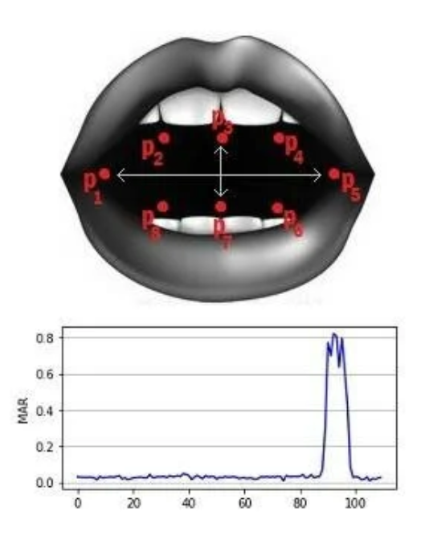
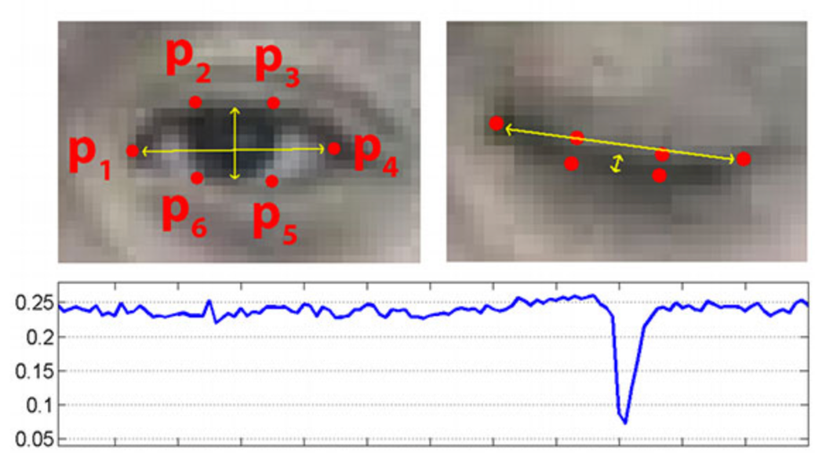
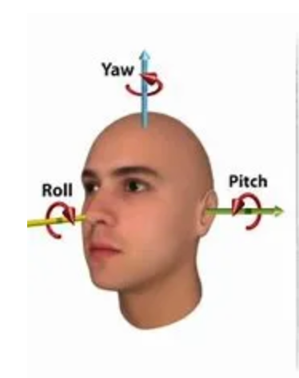
Visual features
EAR - Eye Aspect Ratio
MAR - Mouth Aspect Ratio
Head pose estimation
Tracks eyelid separation over time to detect sustained closure, slow blinks, and drowsy blink patterns in real time.
Captures yaw, pitch, and roll to ﬂag nodding, head drooping, and off-road gaze - orientation cues linked to fatigue.
Measures mouth opening width to identify sustained yawns - a reliable involuntary indicator of fatigue onset.

Slide 9

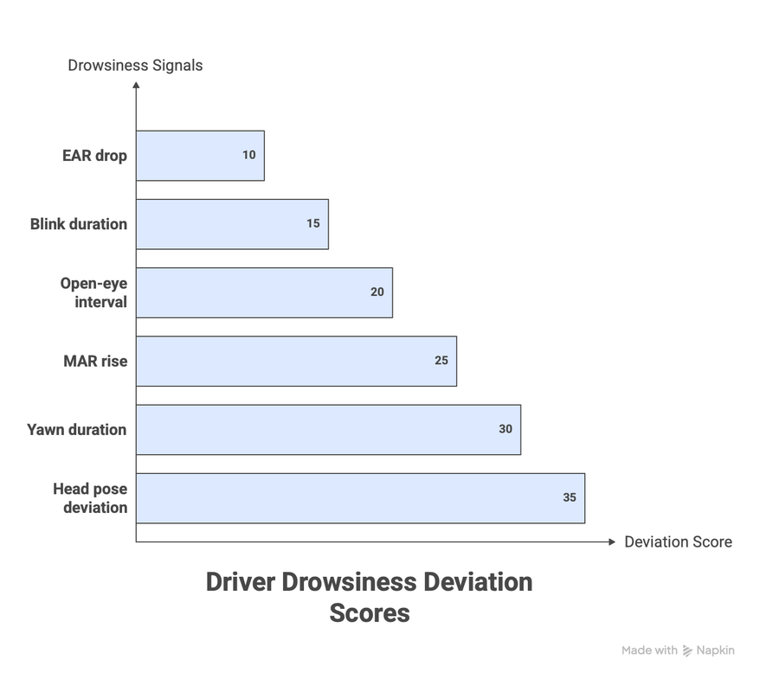
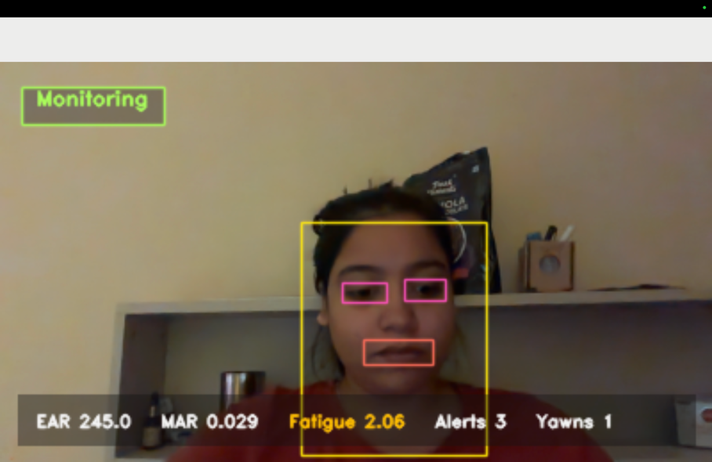
Six signals scored against your personal baseline
Deviation scoring
How far from normal
is this driver right
now?
EAR drop
92
MAR rise
78
Blink duration
85
Open-eye interval
70
Head-pose devi…
74
Yawn events
88
Each signal is compared against the driver's personal baseline. Fatigue is ﬂagged when deviation scores exceed individual thresholds - not ﬁxed population norms.
0
20
40
60
80
100

Slide 10
Technologies used for Lightweight and modern Implementation.
Python
OpenCV
MediaPipe
Face landmarker model for precise eye and mouth landmark extraction
Primarylanguage for all detection, calibration, and scoring logic
Real-timevideo capture, frame processing, and visual output rendering
NumPy + Matplotlib
Gradio
Interactive web interface for live demo and rapid research prototyping
Git / GitHub / HF Spaces
Numericalscoring computations and research reporting ﬁgures
Versioncontrolandpublicdeployment
via Hugging Face Spaces

Slide 11

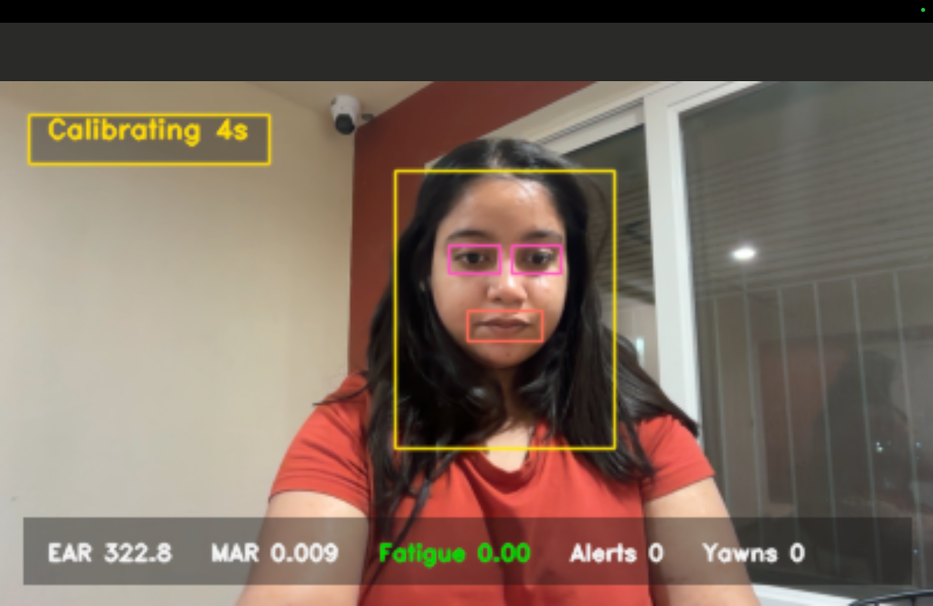
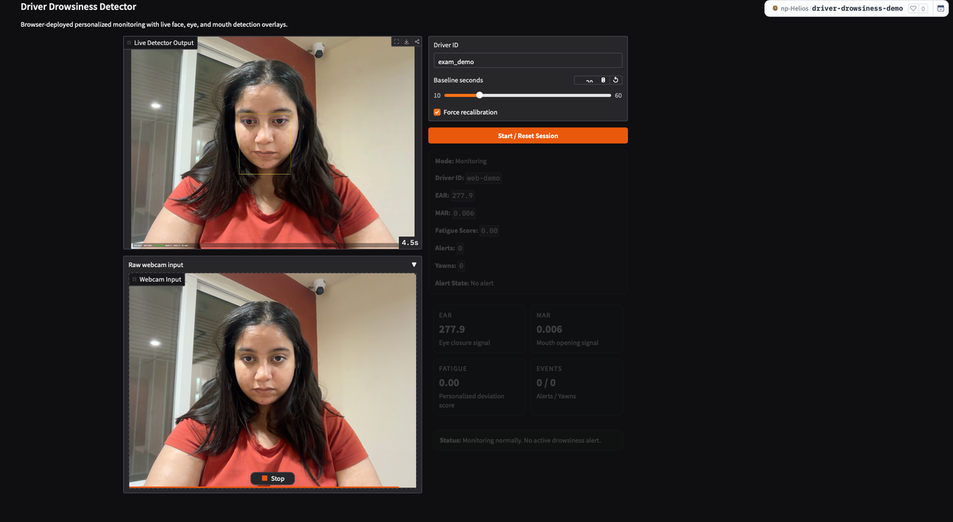
Local
Local edge runtime
Hosted
Hosted on Hugging Face Spaces
Runs fully on-device with real-time, low-latency processing. Closest to a practical automotive deployment scenario.
Accessible via any browser for sharing and demonstration. Slower than local due to browser-server video streaming.

Slide 12





Current outcomes
Live monitoring
Feature detection
Driver proﬁle
Personalized baselinecreated and
Real-timelocalsystemisfully functional
Face,eye,andmouthregionsdetected live
reused across sessions
Fatigue scoring
Yawn logic
Deployment
Scoreupdatesdynamically via personal deviation
Morerobustthansimple mouth- threshold systems
Hostedversionconﬁrms accessible
deployment
Results based on local system testing and hosted deployment validation

Slide 13
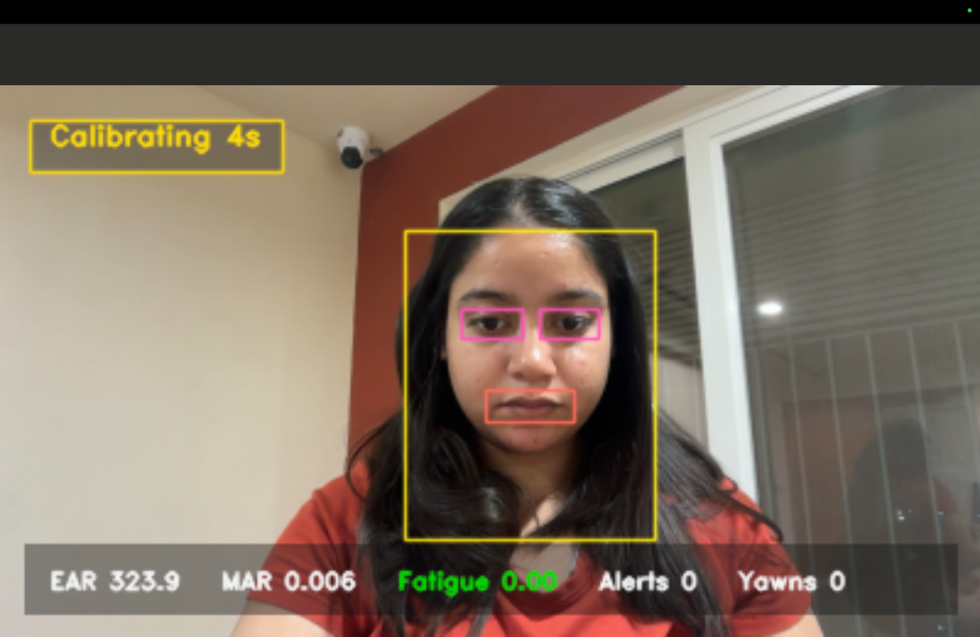
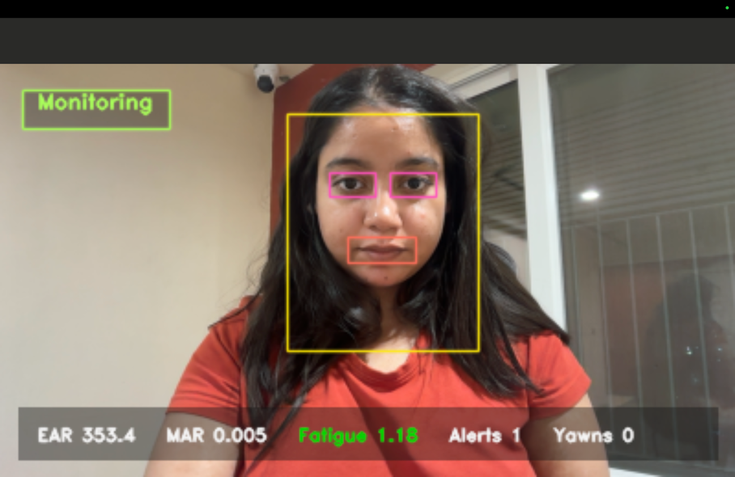
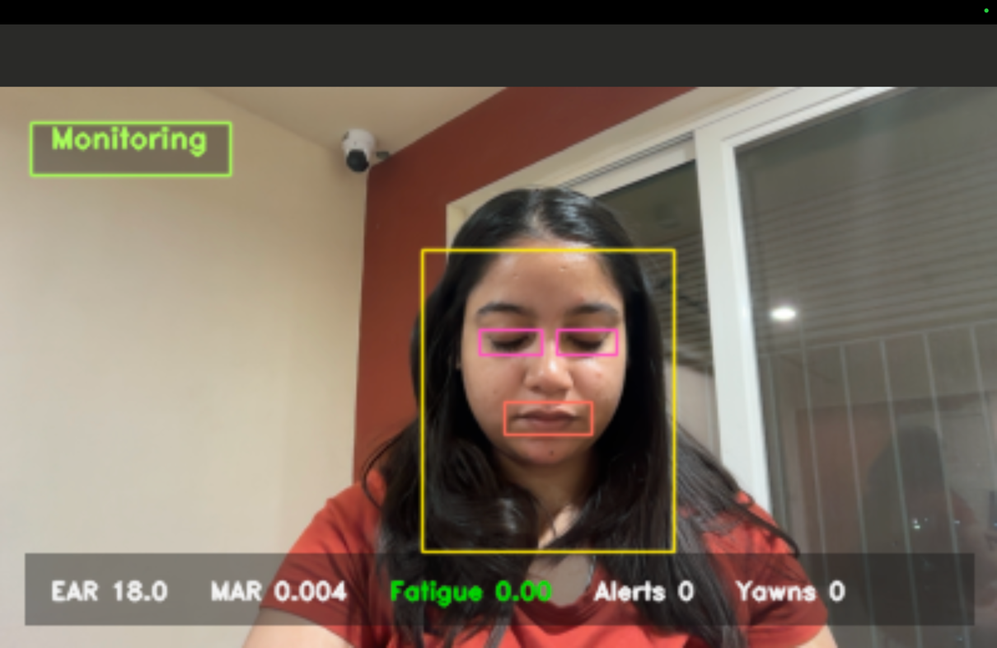
Live system output

Slide 14
Why this matters
Personalized to each driver - not
Explainable and real-time - not a
Modular and deployable - built for
a one-size-ﬁts-all threshold
cloud-only black box
real edge environments

Slide 15
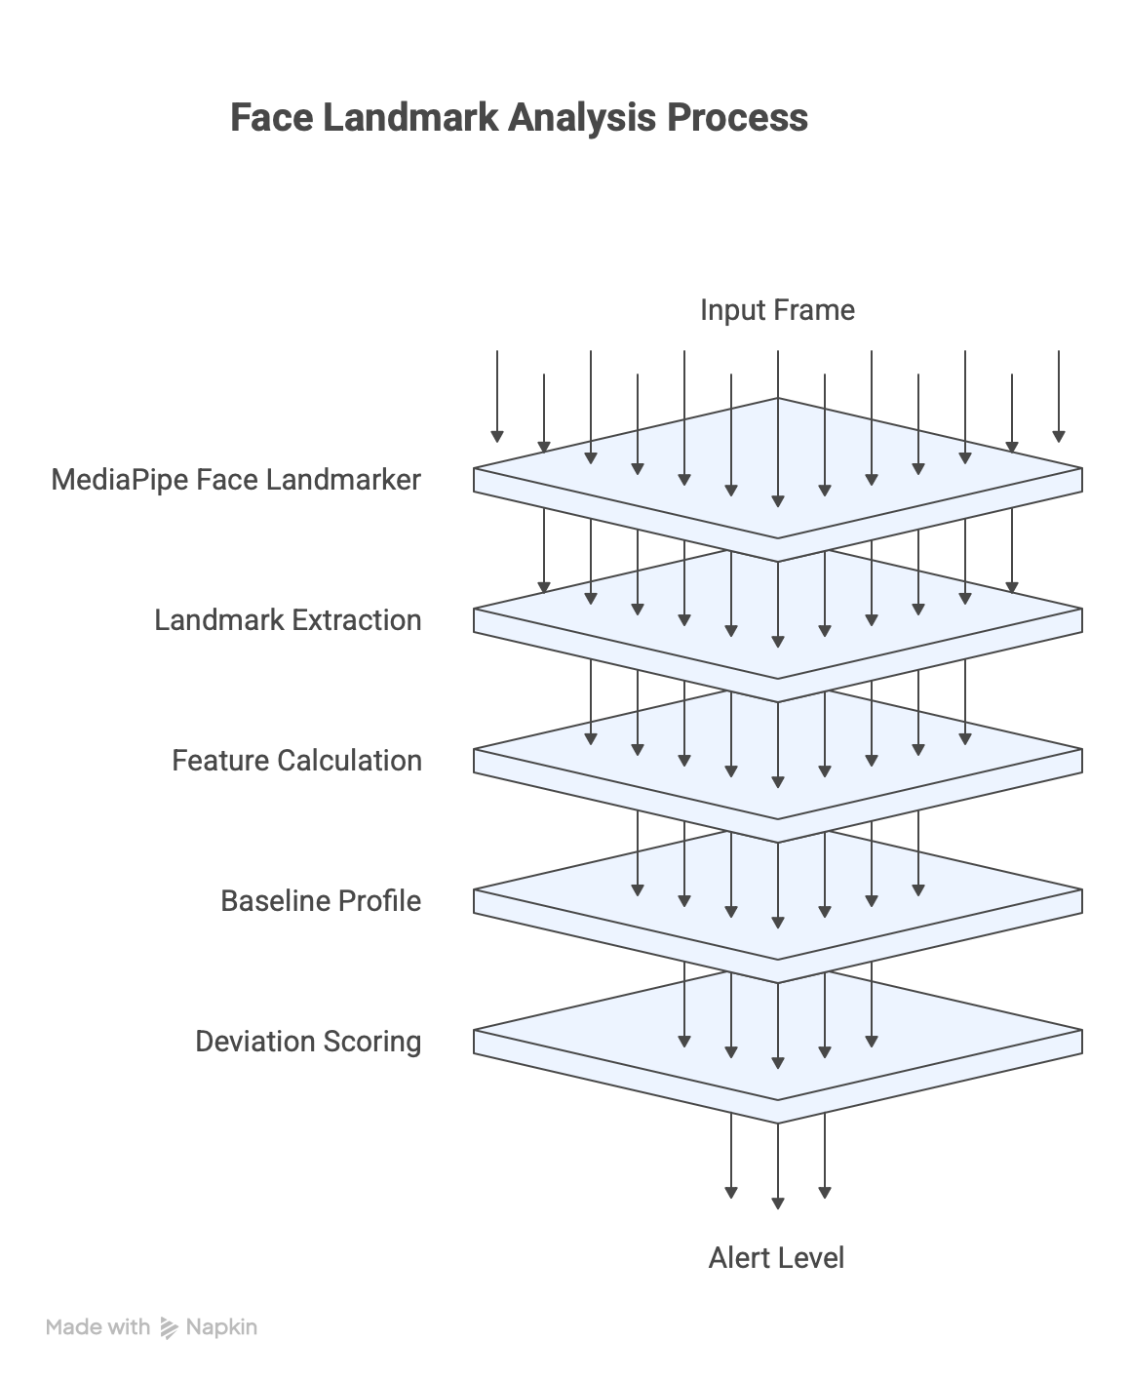
Contributions
Personalized framework: Baseline-based drowsiness detection calibrated to each individual driver
Multi-signal scoring: Fatigue scoring that combines
eye, blink, and yawn signals into a uniﬁed metric
Real-time prototype: A deployable system validated
under live driving conditions
Concept to practice: A bridge from academic
drowsiness research to practical driver monitoring
Adaptive personalization outperforms universal thresholding as a foundation for drowsiness detection.

Slide 16
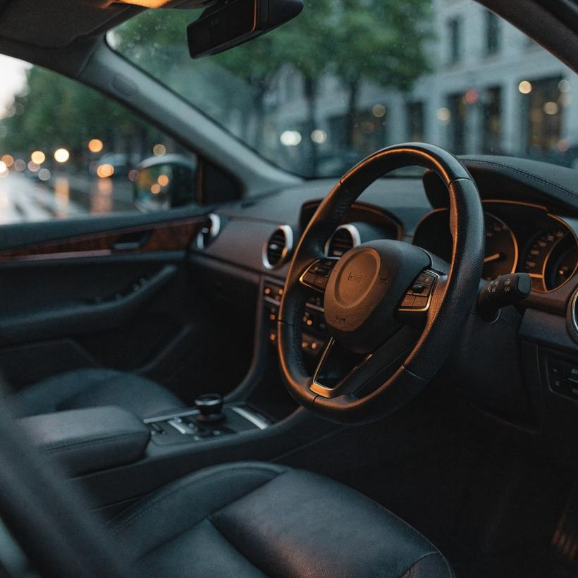
Conclusion
Detection should not rely on universal blink rules. Every driver has a different resting baseline, and ﬁxed thresholds produce false positives that erode trust. Personalized calibration improves both realism and interpretability — the system explains deviations relative to the individual, not a population average. EAR, MAR, and head pose work together to produce a multi-signal deviation score that is more robust than any single metric alone.
Local deployment behaves like a practical edge system — low- latency, offline-capable, and suitable for in-vehicle integration. Hosted deployment demonstrates public accessibility, enabling remote testing and broader evaluation without hardware constraints. The project is a strong foundation for future research and product- grade development in personalized driver safety systems.

Slide 17
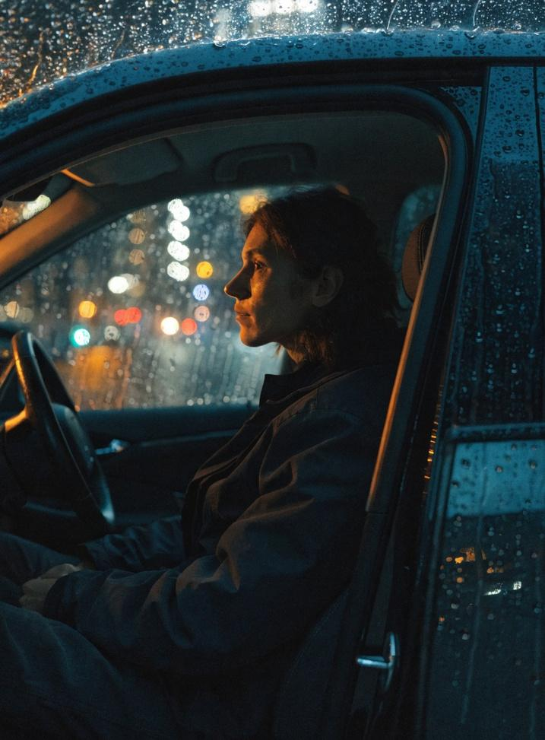
Adaptive Drowsiness Detection
Learns the driver ﬁrst.
Detects fatigue from
deviation, not assumption.

Slide 18
Thank you
Happy to walk through any part of the system in more detail.
Adaptive Driver Drowsiness Detection

