Slide 1
RESEARCH PITCH DECK
Most drowsiness systems assume a universal blink rule.
This project replaces that assumption with personalized baseline modeling.
Adaptive Driver Drowsiness Detection Using Personalized Baseline Modeling
A real-time, explainable, and deployment-aware driver monitoring framework
Nishtha Pandey
B.Tech CSE | Manipal University Jaipur

Slide 2
Problem Context
Driver drowsiness is a major safety risk that reduces reaction time and concentration.
Vision-based monitoring is non-invasive, low-cost, and suitable for continuous observation.
Most existing low-cost systems still rely on static thresholds shared by all users.
PITCH TAKEAWAY
Key issue: generic thresholds do not reflect natural differences between drivers.

Slide 3
Research Gap
Natural blink rate, eye openness, and fatigue expression vary from person to person.
Fixed EAR thresholds often create false positives and false negatives.
Few practical systems combine personalization, explainability, and deployment awareness.
PITCH TAKEAWAY
We need a personalized, real-time, and deployable drowsiness detection framework.

Slide 4
Proposed Solution
Learn the driver’s normal behavior during an initial calibration period.
Track EAR, MAR, and 3D head pose continuously in real time.
Compute fatigue through deviation from the driver’s own baseline instead of universal rules.
Generate alerts, break recommendations, and runtime logs.
PITCH TAKEAWAY
Core idea: drowsiness is personal, so detection should be personal too.

Slide 5
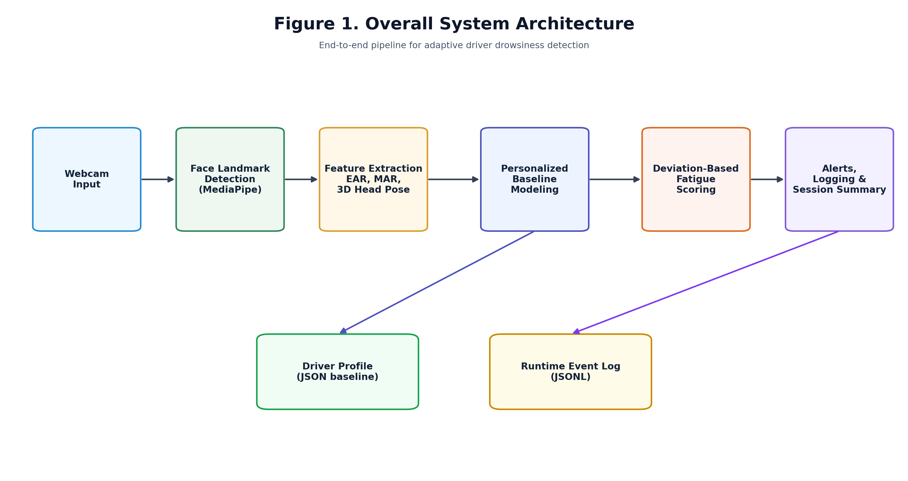
System Pipeline
End-to-end architecture of the adaptive monitoring framework.
Research-pitch visual
KEY DIAGRAM

Slide 6
Feature Extraction
EAR measures eye openness and sustained eye closure.
MAR captures mouth opening and yawn-like behavior.
3D head pose adds yaw, pitch, and roll as additional fatigue cues.
Multi-signal monitoring is more robust than single-feature systems.
PITCH TAKEAWAY
The detector combines eye, mouth, and head behavior into one interpretable pipeline.

Slide 7
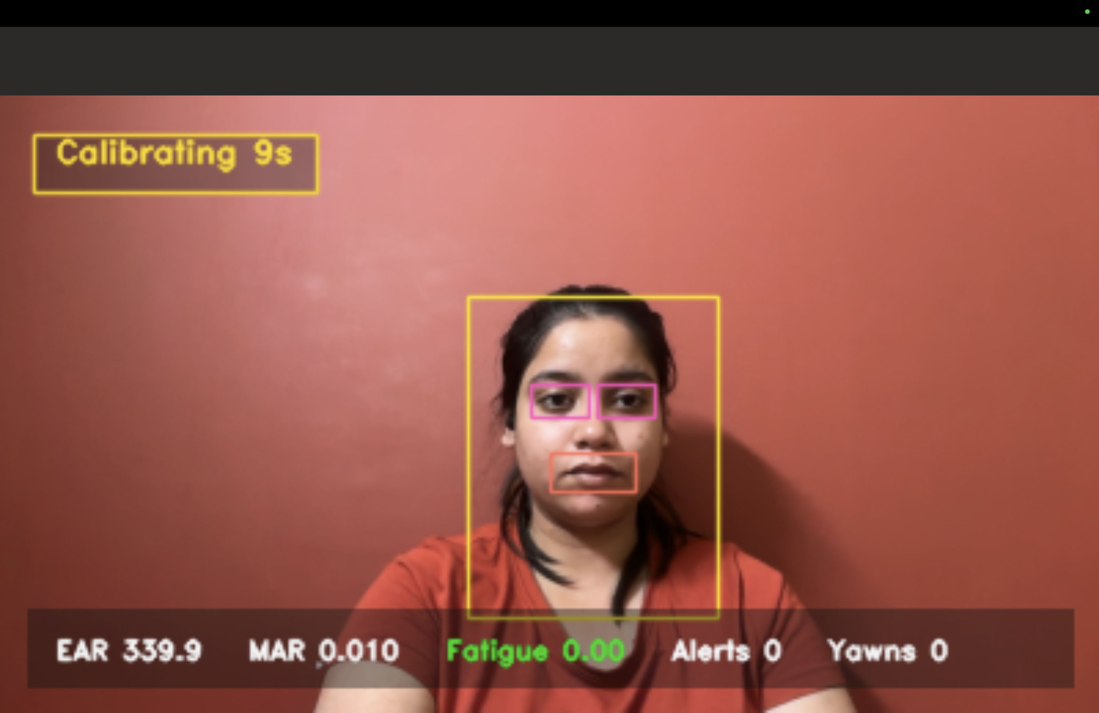
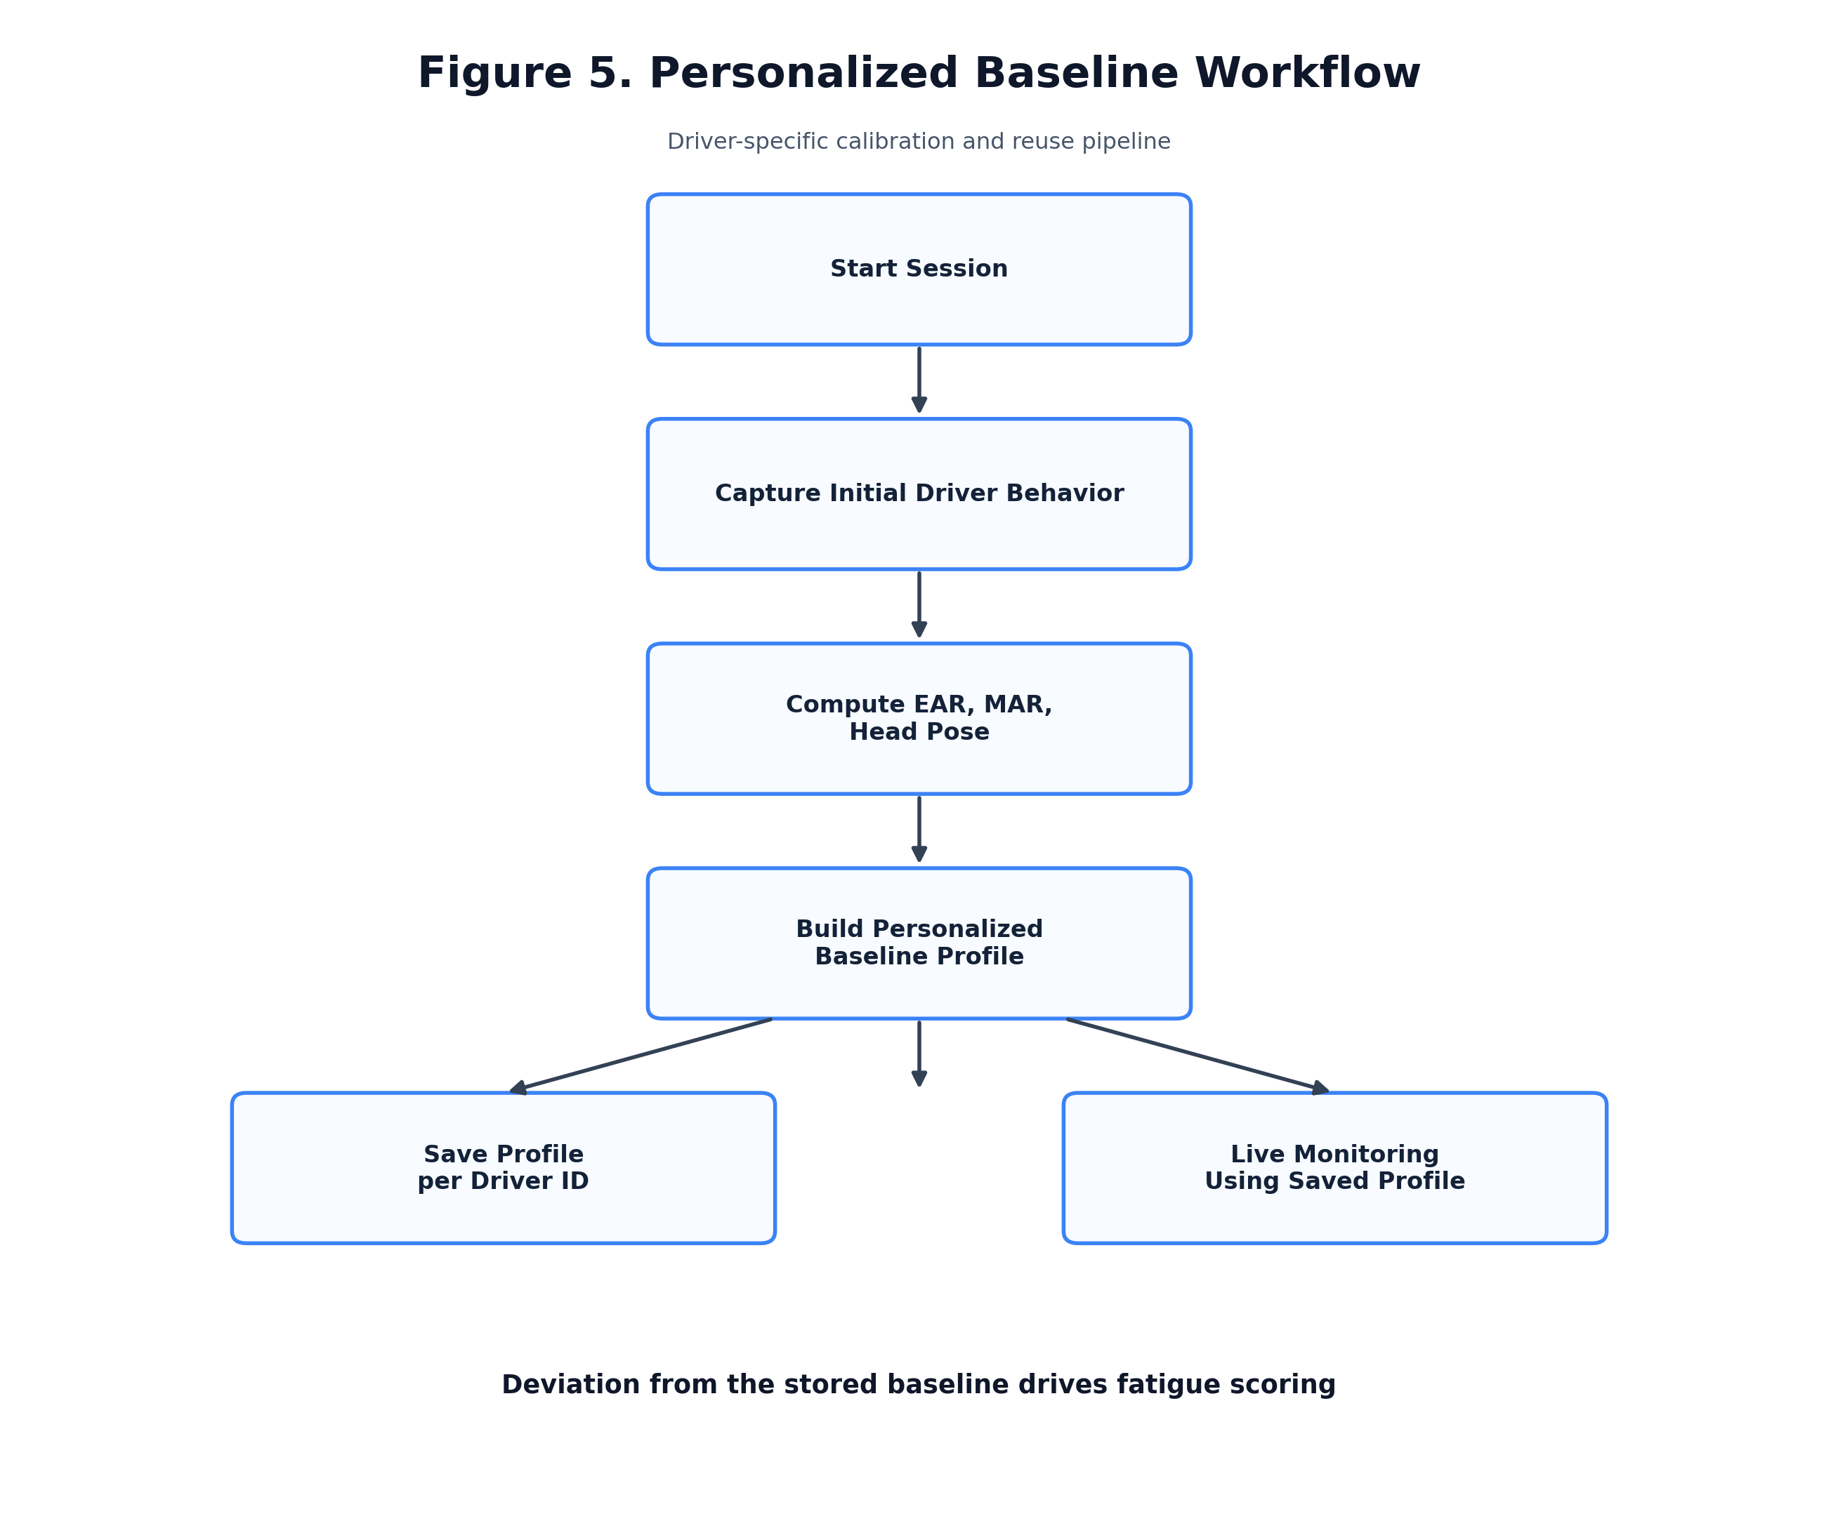
Personalized Baseline Modeling
The system first learns the driver and then monitors deviation from that learned profile.
Research-pitch visual
KEY DIAGRAM

Slide 8
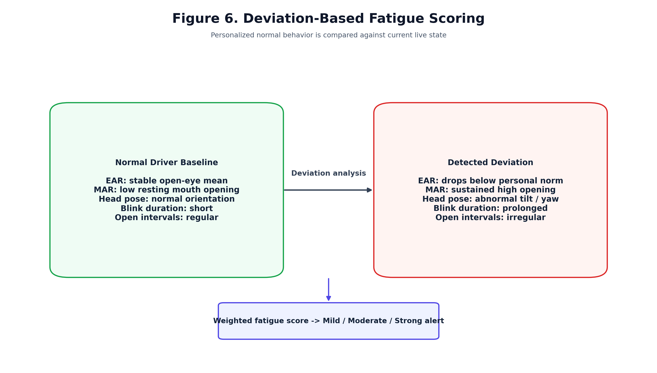
Deviation-Based Fatigue Scoring
Fatigue is inferred from abnormal change relative to the individual’s baseline.
Research-pitch visual
KEY DIAGRAM

Slide 9
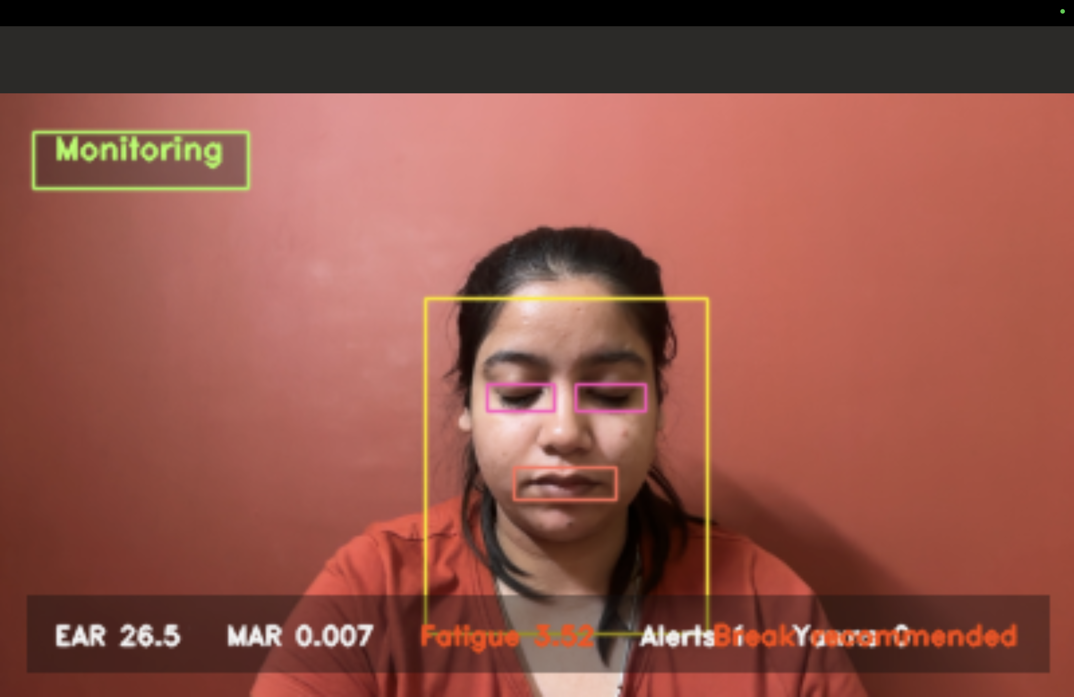
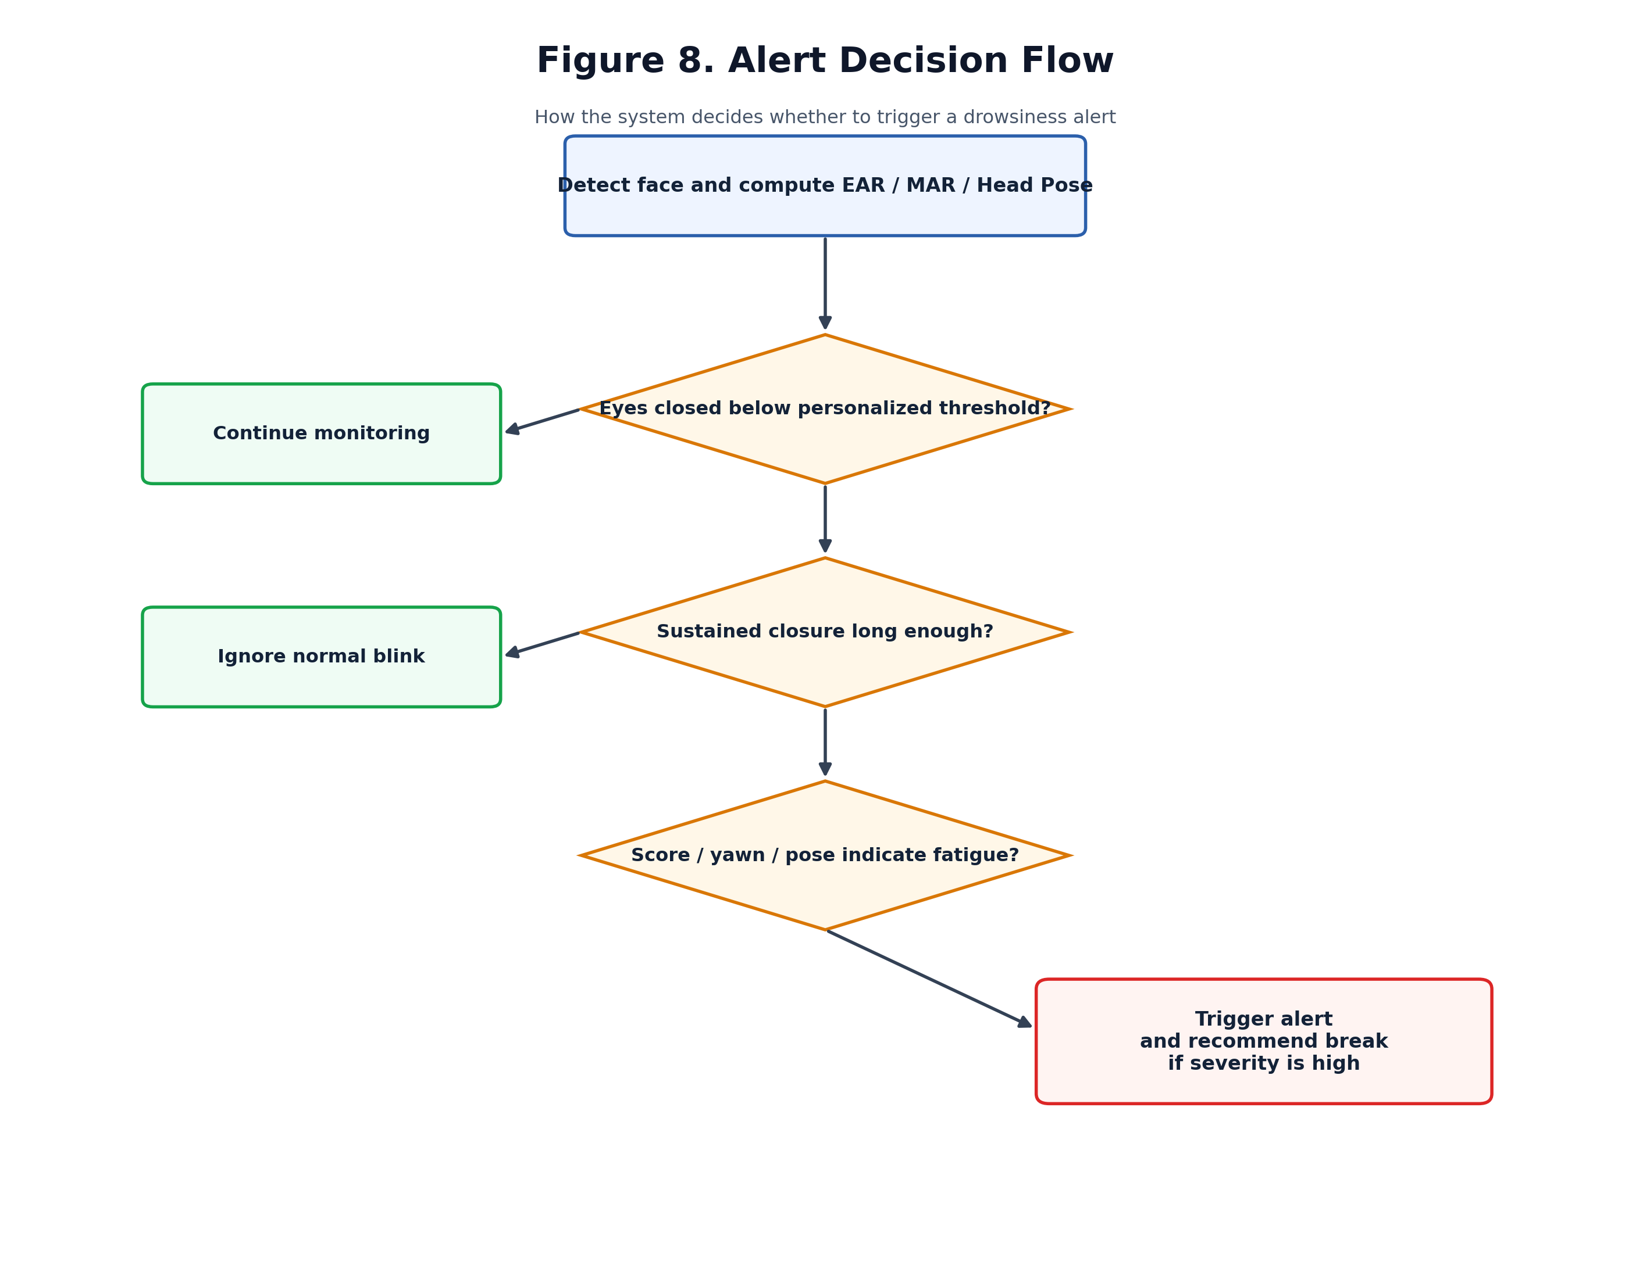
Alert and Yawn Validation Logic
Normal short blinks and casual mouth opening are filtered before triggering an alert.
Research-pitch visual
KEY DIAGRAM

Slide 10
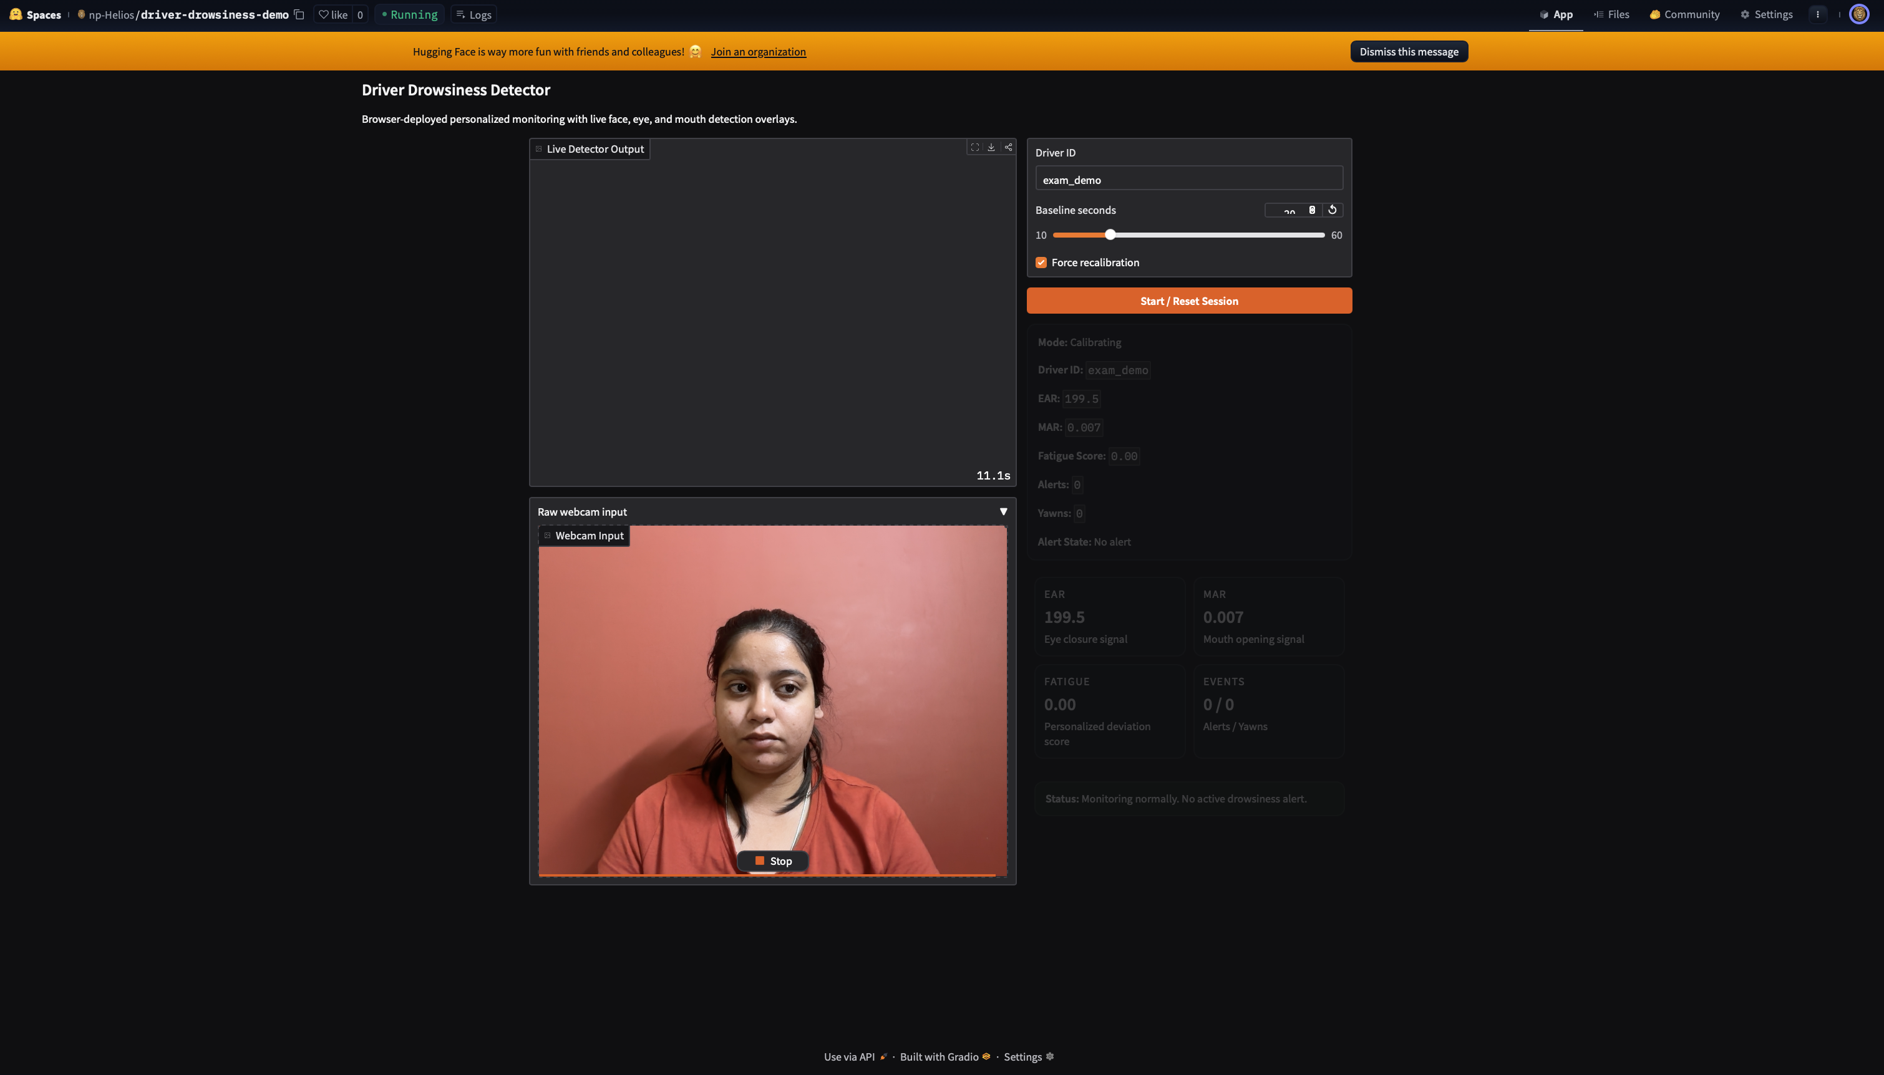
Implementation Highlights
Migrated the runtime from dlib to MediaPipe for modern compatibility.
Refactored the monolithic prototype into a modular Python package.
Added baseline persistence, event logging, session analytics, and deployment paths.
Improved yawn logic to reduce false positives from speaking.
PITCH TAKEAWAY
The project evolved from a script prototype into a structured, research-ready system.
Execution snapshot

Slide 11
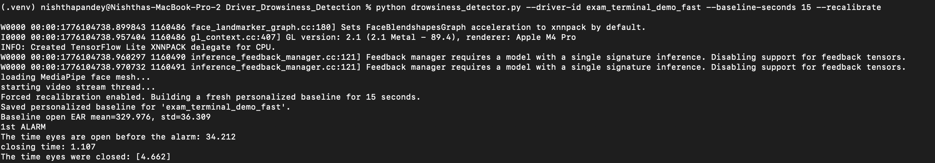
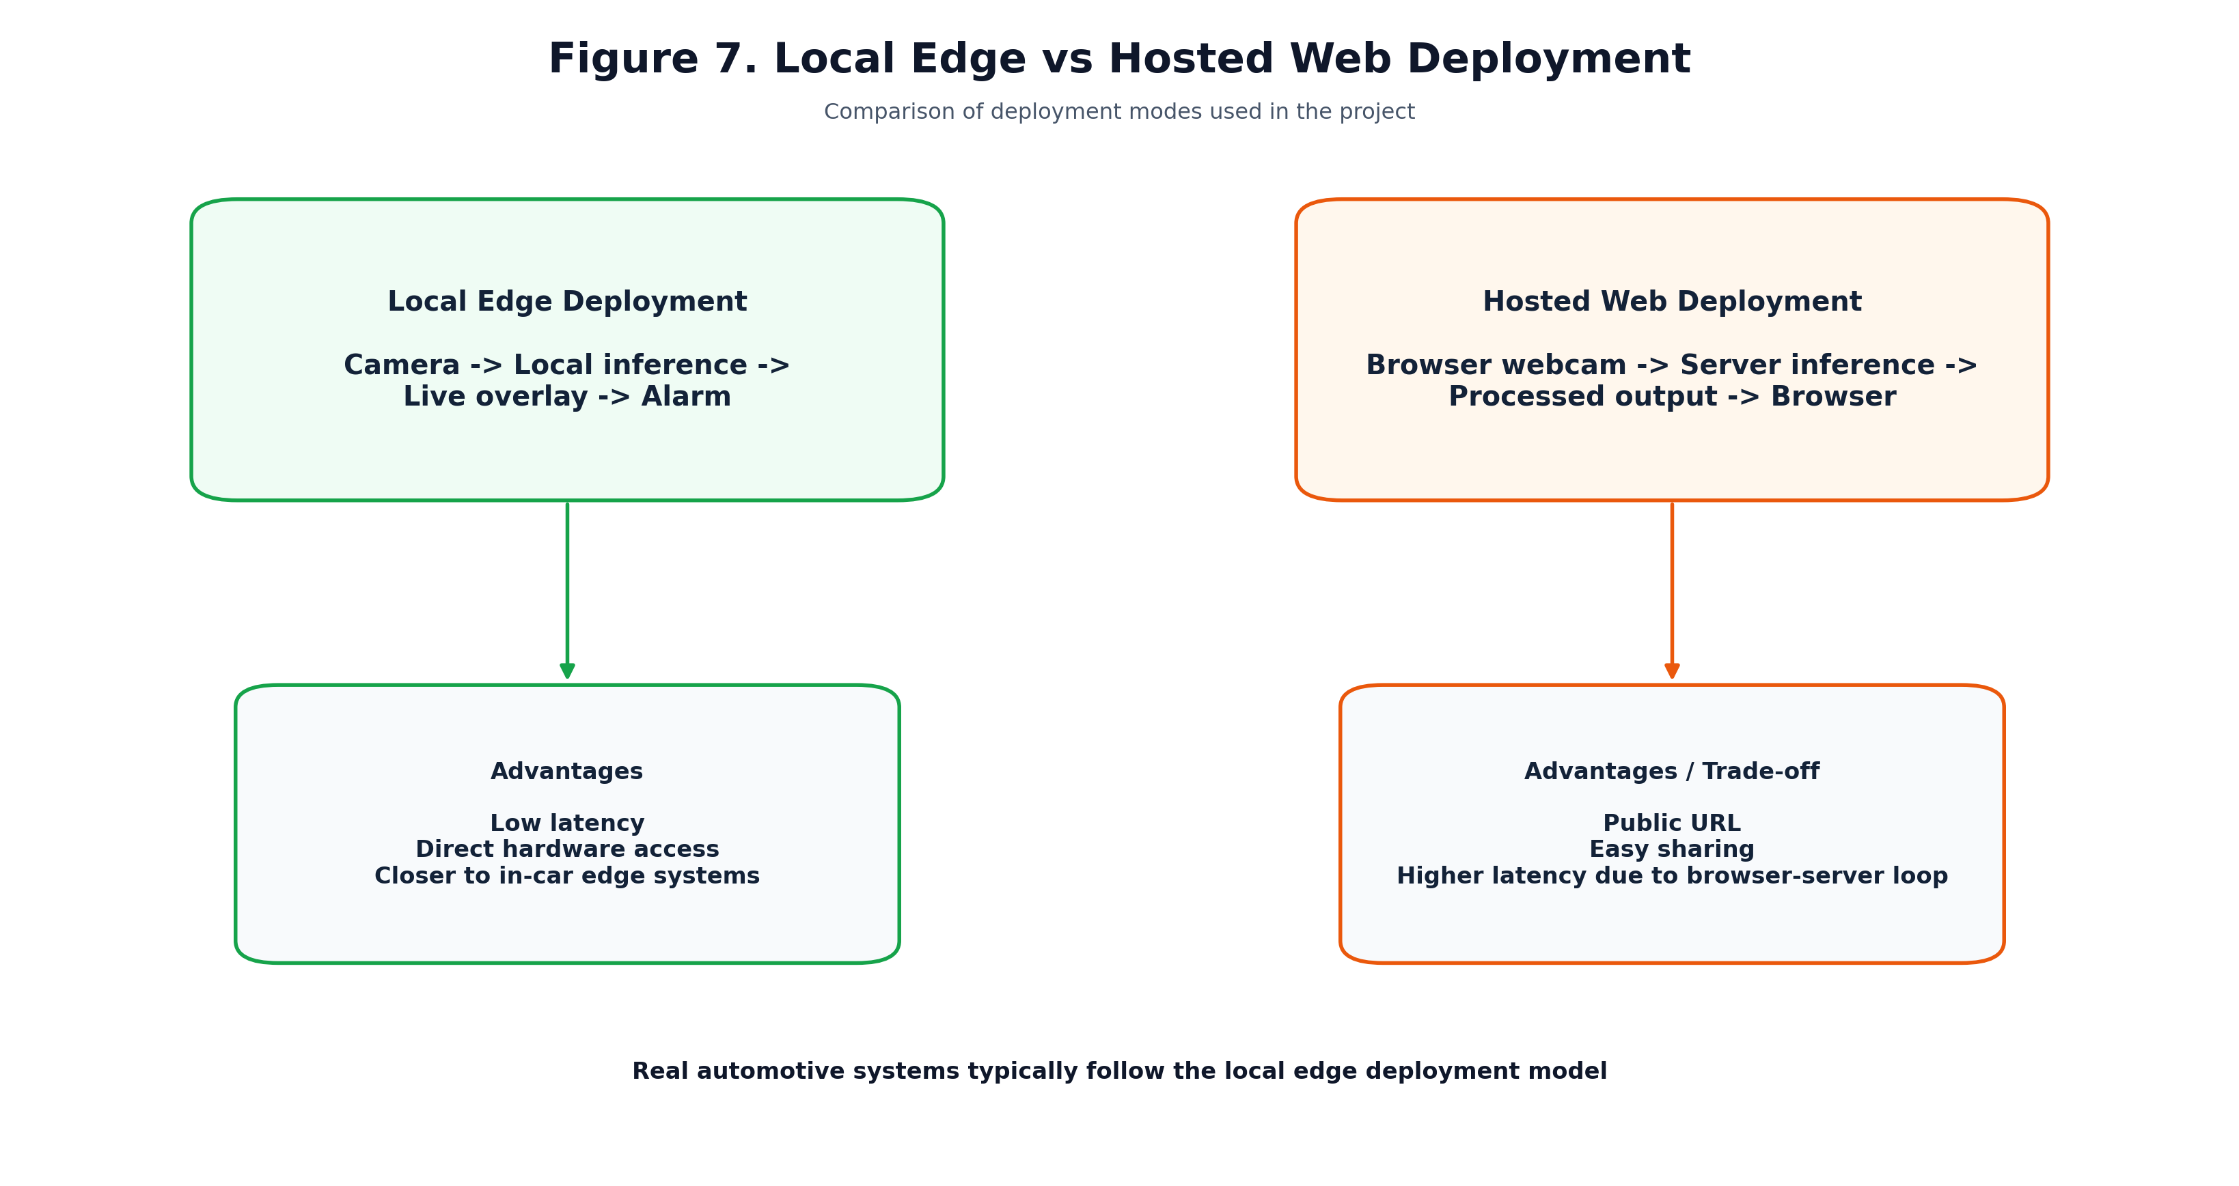
Deployment Story
Local runtime reflects practical edge deployment, while the hosted app demonstrates accessibility.
Research-pitch visual
KEY DIAGRAM

Slide 12
Current Results
Real-time local monitoring runs successfully with live facial boxes and fatigue scoring.
The system builds and reuses a per-driver baseline profile.
Alerts trigger only for sustained abnormal behavior rather than normal blinks.
Hosted deployment is available for public demonstration, though with browser-server latency.
PITCH TAKEAWAY
The strongest real-time behavior is achieved in the local edge-style runtime.
Alert-trigger example

Slide 13
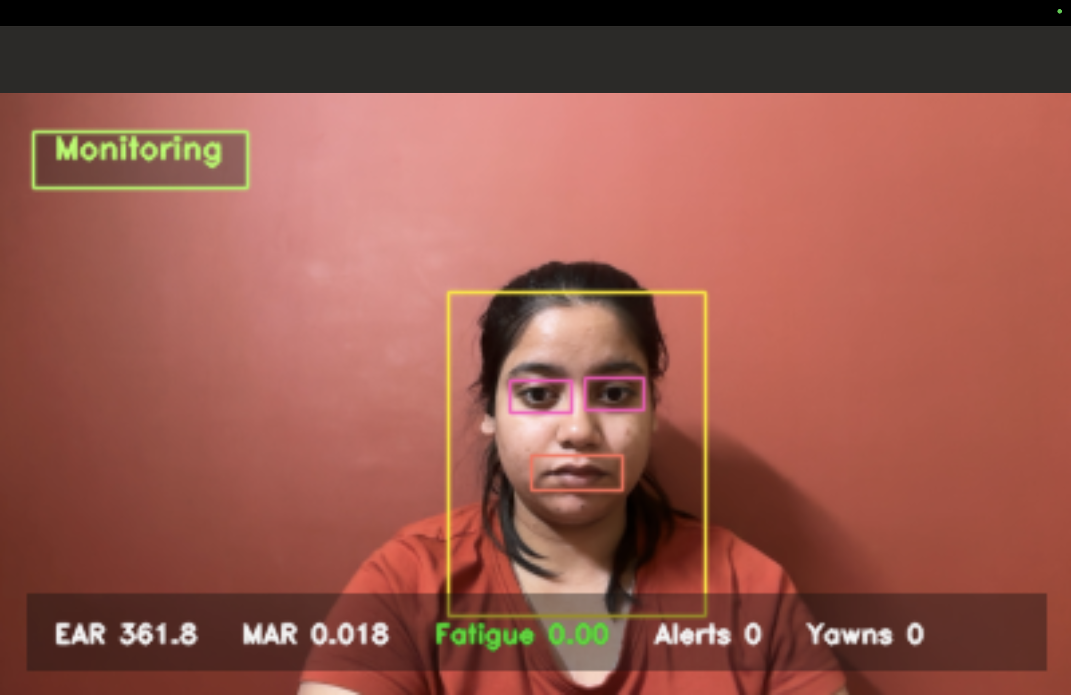
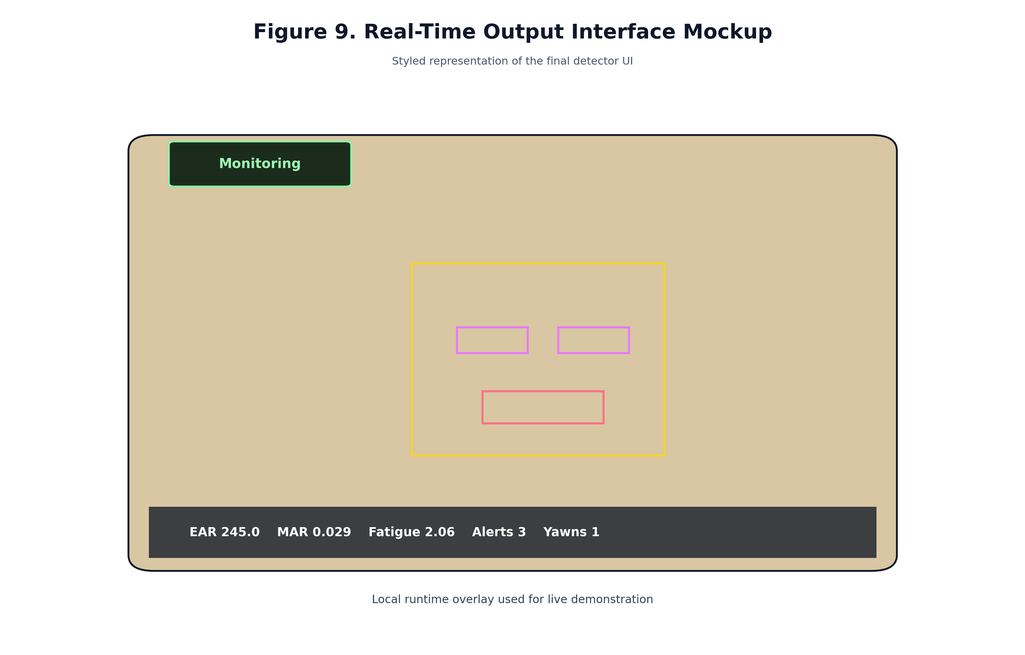
Live Output Interface
Representative interface of the final real-time local monitoring system.
Research-pitch visual
KEY DIAGRAM

Slide 14
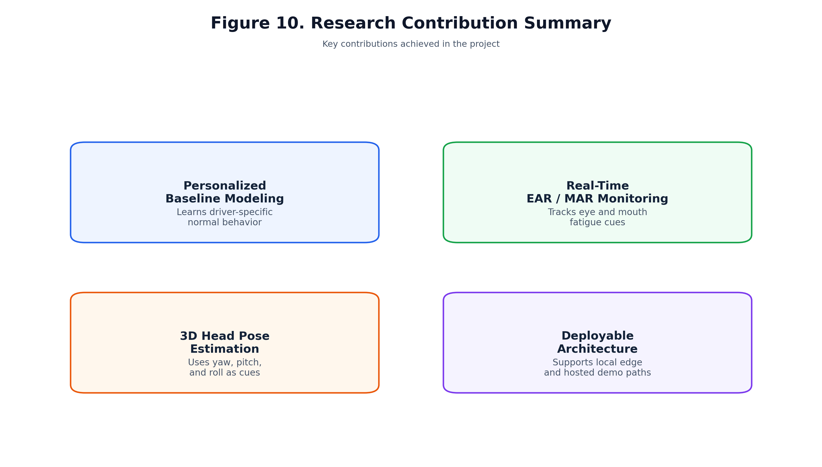
Research Contribution
Summary of the technical contributions implemented in the project.
Research-pitch visual
KEY DIAGRAM

Slide 15
Limitations and Future Scope
No large-scale multi-user evaluation has been completed yet.
Hosted browser deployment is slower than native local execution.
Future work includes gaze estimation, PERCLOS, low-light robustness, and embedded edge deployment.
A comparative study against fixed-threshold systems would strengthen the research contribution further.
PITCH TAKEAWAY
The current system is a strong prototype and a solid base for research-paper-level extension.

Slide 16
Conclusion
Driver drowsiness detection should not rely on universal blink rules.
Personalized baseline modeling improves realism, explainability, and technical defensibility.
This project demonstrates a practical pipeline combining EAR, MAR, head pose, and adaptive scoring.
The local runtime is closest to real edge deployment, while the hosted version shows public deployability.
PITCH TAKEAWAY
Final takeaway: adaptive personalization is a stronger foundation than one-size-fits-all thresholding.

Slide 17
Thank You
Questions and Discussion

