Slide 1
A Feature Engineering Approach
Wind Power Forecast
Team Leustagos – 1st Place
Lucas Eustáquio Gomes da Silva

Slide 2
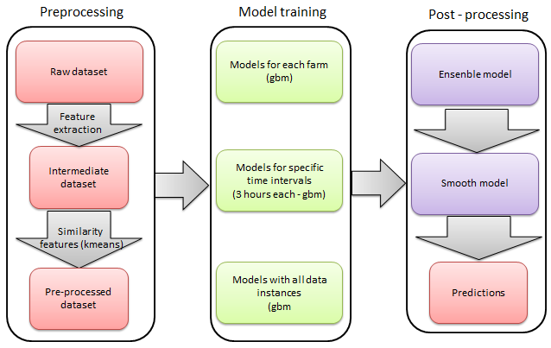
Approach Overview
Feature extraction
Unsupervised features
Models training
Ensemble
Prediction Smoother

Slide 3
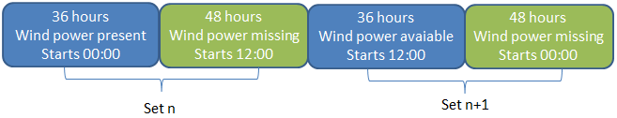
Dataset
Missing time patterns
Validation set splitting, using whole periods (5-fold)
Forecasts only made available at the start of missing points

Slide 4
Algorithms
Algorithm | Used for
GLM | Wind strength and direction components influence on each farm. Ensemble. Post process to smooth (high frequency filter) the predictions.
K-MEANS | Similarity model to detect farm and overall inertia components
GBM | Models by farm. Models by time slot. Overall models

Slide 5
Features
Objectives:
Model the wind power generation equation, based on constants, wind strength, direction and air density (surrogated). These features represent the windmill behavior.
Discover the relationship between wind power generation at T and T±n.

Slide 6
Features
Name | Type | Description
Date | Date and time | This is the date and time of each wind power measurement. It is used mainly to join different tables of features
farm | Categorical (1-7) | Represents each farm
wp | Numeric | Wind power – value to be predicted
hour | Categorical (01-24) | Hour of each wind power measurement (surrogate for density/temperature)
month | Categorical (01-12) | Month of each wind power measurement (surrogate for density/temperature)
year | Categorical (2009-2012) | Year of each wind power measurement (surrogate for density/temperature)

Slide 7
Features - Forecast
Name | Type | Description
date | Date and time | Target forecast date
farm | Categorical (values 1-7) | Represents each farm
start | Date and time | Date when the forecast was issued.
dist | Categorical (values 01-48) | Difference in hours of start and date. Distance of the forecasting.
turn | Categorical (00 and 12) | Indicates the starting hour of forecasting.
set | Categorical (1-312) | Each set represents a period of 36h+48h. This variable was used to do cross-validation training.
ws | Numerical | Predicted wind strength
wd | Numerical | Predicted wind direction
wd_cut | Categorical ([0,30]...(330,360]) | Categorical version of wind direction.

Slide 8
Features – Historical
Name | Type | Description
start | Date and time | Date when the forecast was issued.
farm | Categorical (1-7) | Wind farm
dist | Categorical (01-48) | Difference in hours of start and date. Distance of the forecasting.
wp_hnXX (XX in [01,06]) | Numerical | N previous known values. 01 is the value for the farm at start date and time, 02 is (start – 1h) hour and so on.

Slide 9
Features – Strength and Angle
Name | Type | Description
date | Date and time | Target forecast date
farm | Categorical (1-7) | Wind farm
dist | Categorical (01-48) | Difference in hours of start and date.
wp | Numeric | Wind power
ws.angle | Numeric | Influence of both ws and wd for date ws.angle = wd_cut*(ws + ws2 + ws3) Found by linear regression
ws.angle.p3 | Numeric | ws.angle for date – 3 hours. If not found defaults nearest ws.angle.
ws.angle.p2 | Numeric | ws.angle for date – 2 hours.
ws.angle.p1 | Numeric | ws.angle for date – 1 hours.
ws.angle.n3 | Numeric | ws.angle for date + 3 hours.
ws.angle.n2 | Numeric | ws.angle for date + 2 hours.
ws.angle.n1 | Numeric | ws.angle for date + 1 hours.

Slide 10
Features - Similarity
Name | Type | Description
date | Date and time | Target forecast date
farm | Categorical (1-7) | Wind farm
dist | Categorical (01-48) | Difference in hours of start and date. Distance of the forecasting.
clust.pos | Categorical (1-12) | Position of forecast inside the 12 sequential values. The same as the remainder of the division of (dist-1) by 12.
begin | Categorical | Hour of the first value of the 12 hour sequence.
clust.farm | Categorical (42 = 7 x 6) | Cluster that the 12 sequential hour got assigned.
clust | Categorical (1-24) | General cluster

Slide 11
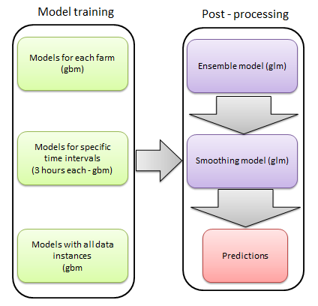
Models
Models that were trained for each farm;
Models that were trained for each predicted time slot (1h-3h ahead, 4h-6h ahead, … 45h-48h ahead);
Overall models trained without splitting the samples (except for the cross-validation).
Ensemble using linear regression
Smoothing model using linear regression

Slide 12
Model 1
GBM with gaussian distribution and formula wp ~ ws + farm + dist + ws.angle + ws.angle.p1 + ws.angle.p2 + ws.angle.p3 + ws.angle.n1 + ws.angle.n2 + ws.angle.n3 + hour + month: The aim of this model was to learn inertial behavior and something about air density and other occasional environment influences. The inertial behavior was learned through ws.angle(T±3). Occasional influences were inferred using hour, month and year categorical variables.

Slide 13
Model 2
GBM with gaussian distribution and formula wp ~ ws + farm + ws.angle + ws.angle.p1 + ws.angle.p2 + ws.angle.p3 + ws.angle.n1 + ws.angle.n2 + ws.angle.n3 + hour + month + year + dist + wp_hn01: Same as before including the latest known value of wind power. This value can provide some valuable context information and a starting point for the time series. The reason why both models exist is because many instances of the testing period were discarded to train this one (they lack wp_hn01)

Slide 14
Model 3
GBM with gaussian distribution and formula wp ~ farm + dist + wp_hn02 + wp_hn03 + wp_hn04 + hour + month + clust.farm + clust + begin + clust.pos

Slide 15
Model - Ensemble and Smoothing
All models mentioned before were trained in tree flavors: per farm, per clustered distance ( (0,3],(3,6]...(45,48] ), and one without distinction
The final model was a linear ensemble of the previously mentioned (9 models)
After that yet another model was trained. A smoothing one. It took the result of the ensemble and did a T±n interpolation of the predictions. This model became almost useless when ws.angle(T±n) was included in the previous ones

Slide 16
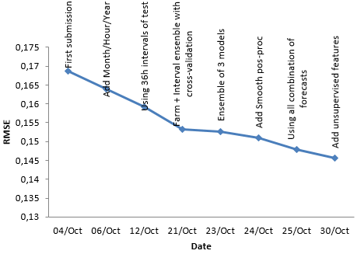
Results
 | Team | Score1 | Score2
1 | Leustagos | 0.14574 | 0.14567
2 | DuckTile | 0.14872 | 0.14720
3 | Gilberto Titericz Jr | 0.14792 | 0.14822
4 | Stefan Henß | 0.14684 | 0.14854
5 | Mz | 0.14804 | 0.14916

Slide 17
Remarks
The final result was pretty good – awarded 1st place
The solution was composed by two parts: extracting features and applying distinct aggregation schemes to create models
The approach used many models: Only the models not aggregated would score almost the same
Of the tree types of models, only two would be needed if we knew all previous values
The smoothing model became almost useless after adding predicted wind strength of neighboring times
Using other forecasts (temperature, humidity) maybe could increase accuracy
It is a time series, so treat it like one! (cross-validation procedure, ensembling, feature creation, etc.)

Slide 18
Questions?

