Slide 1
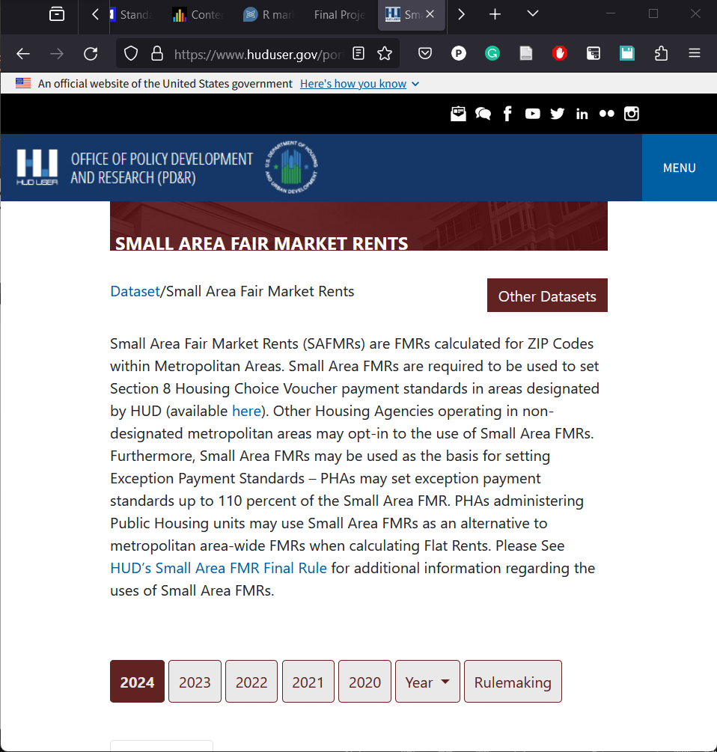
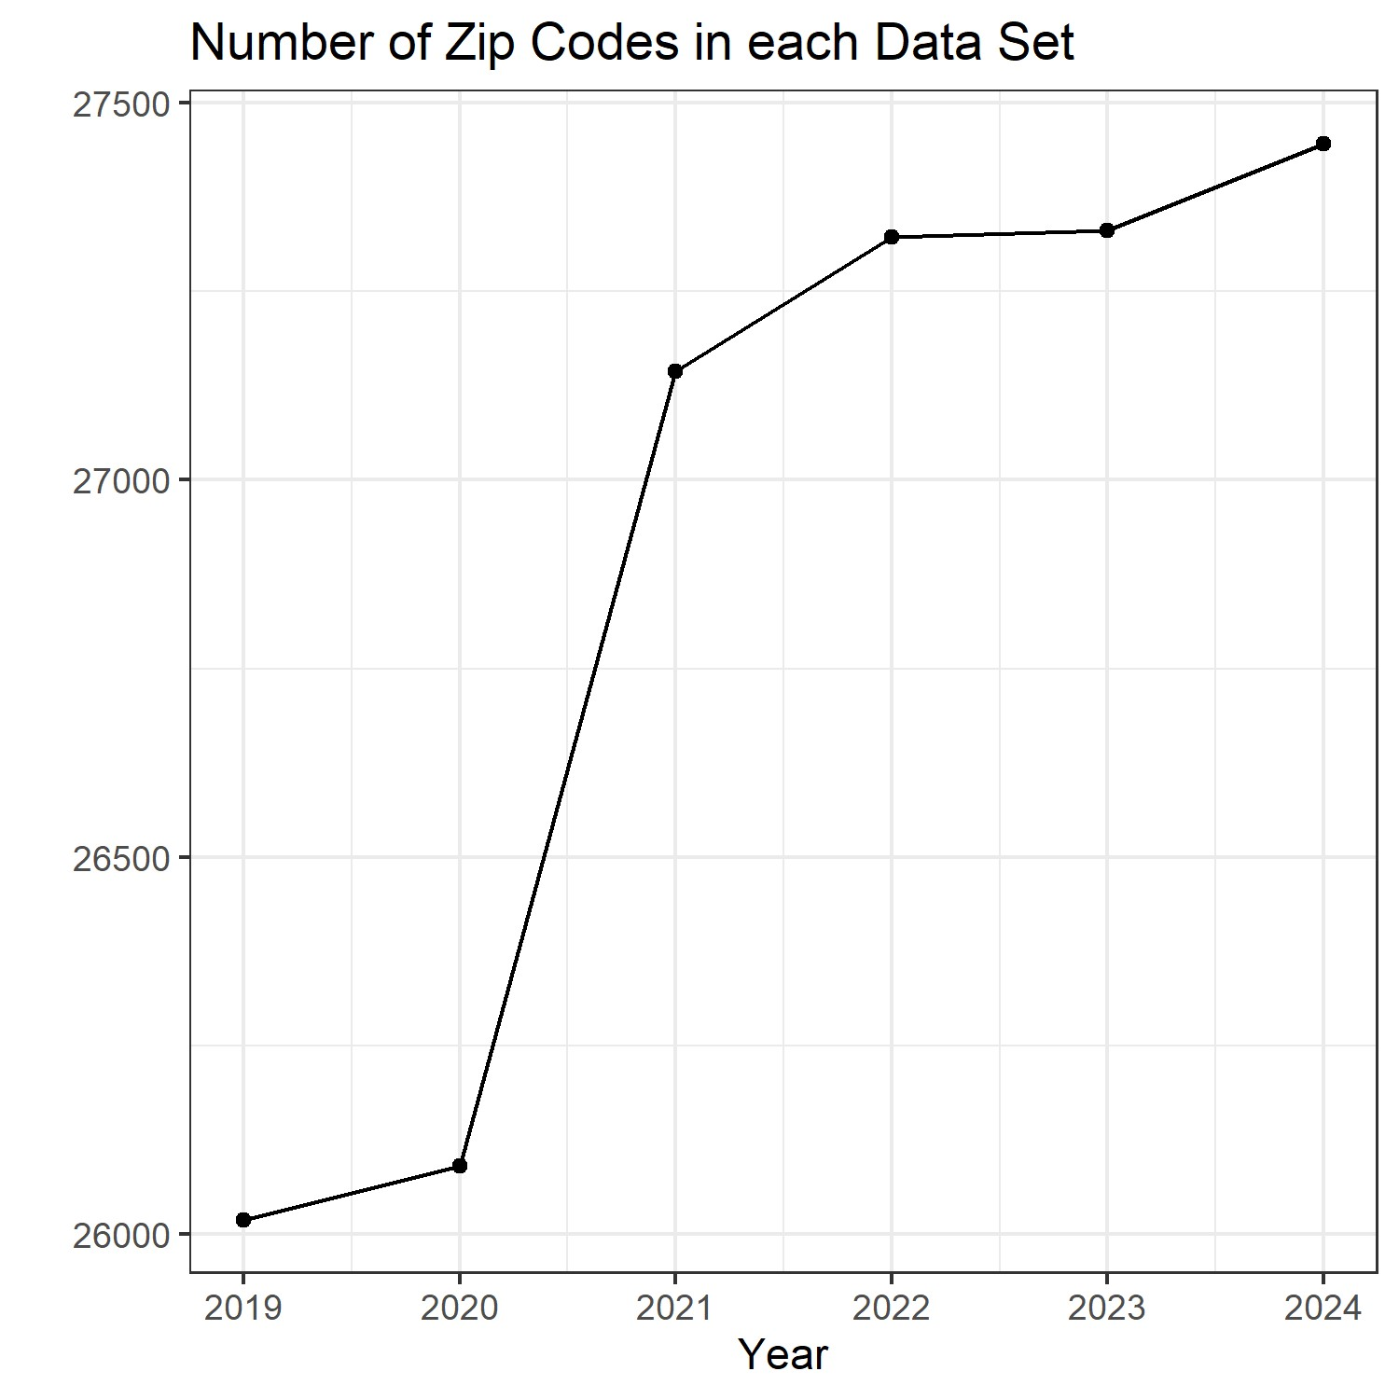
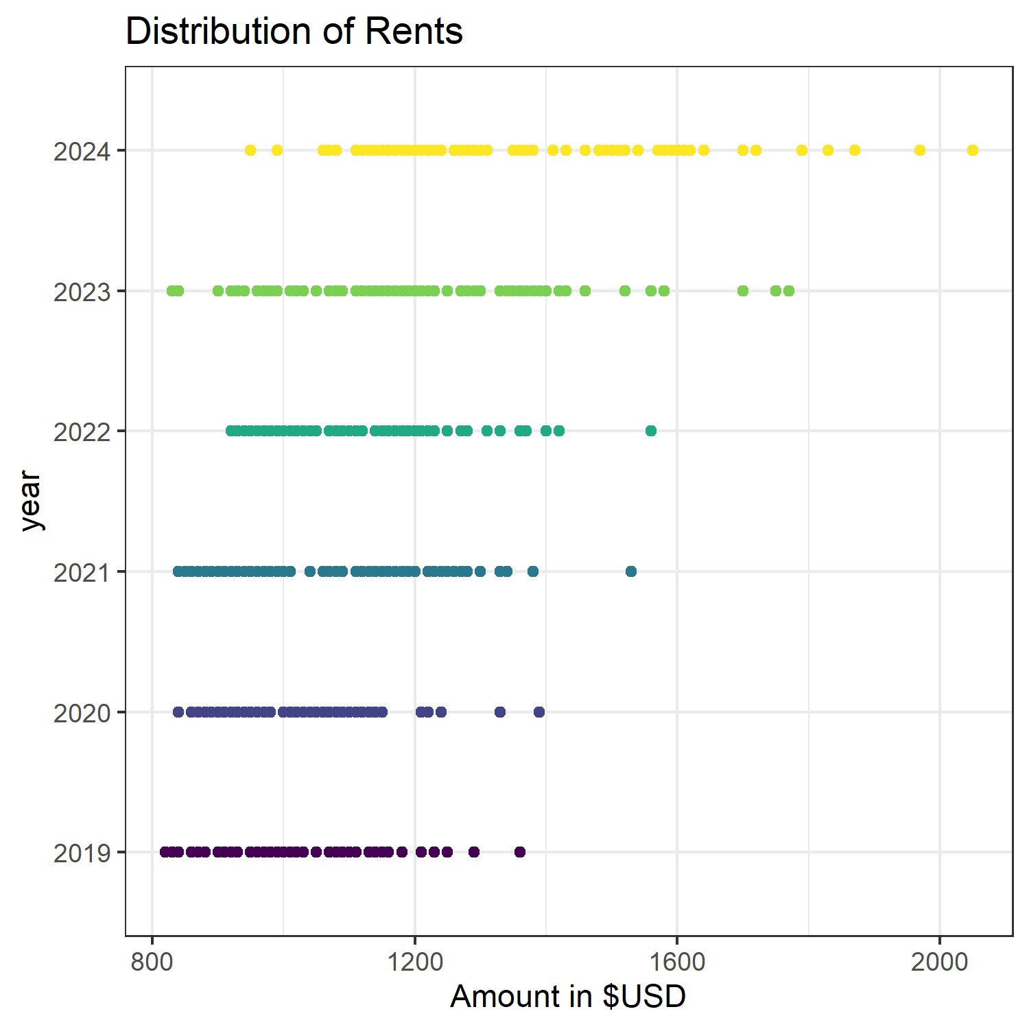
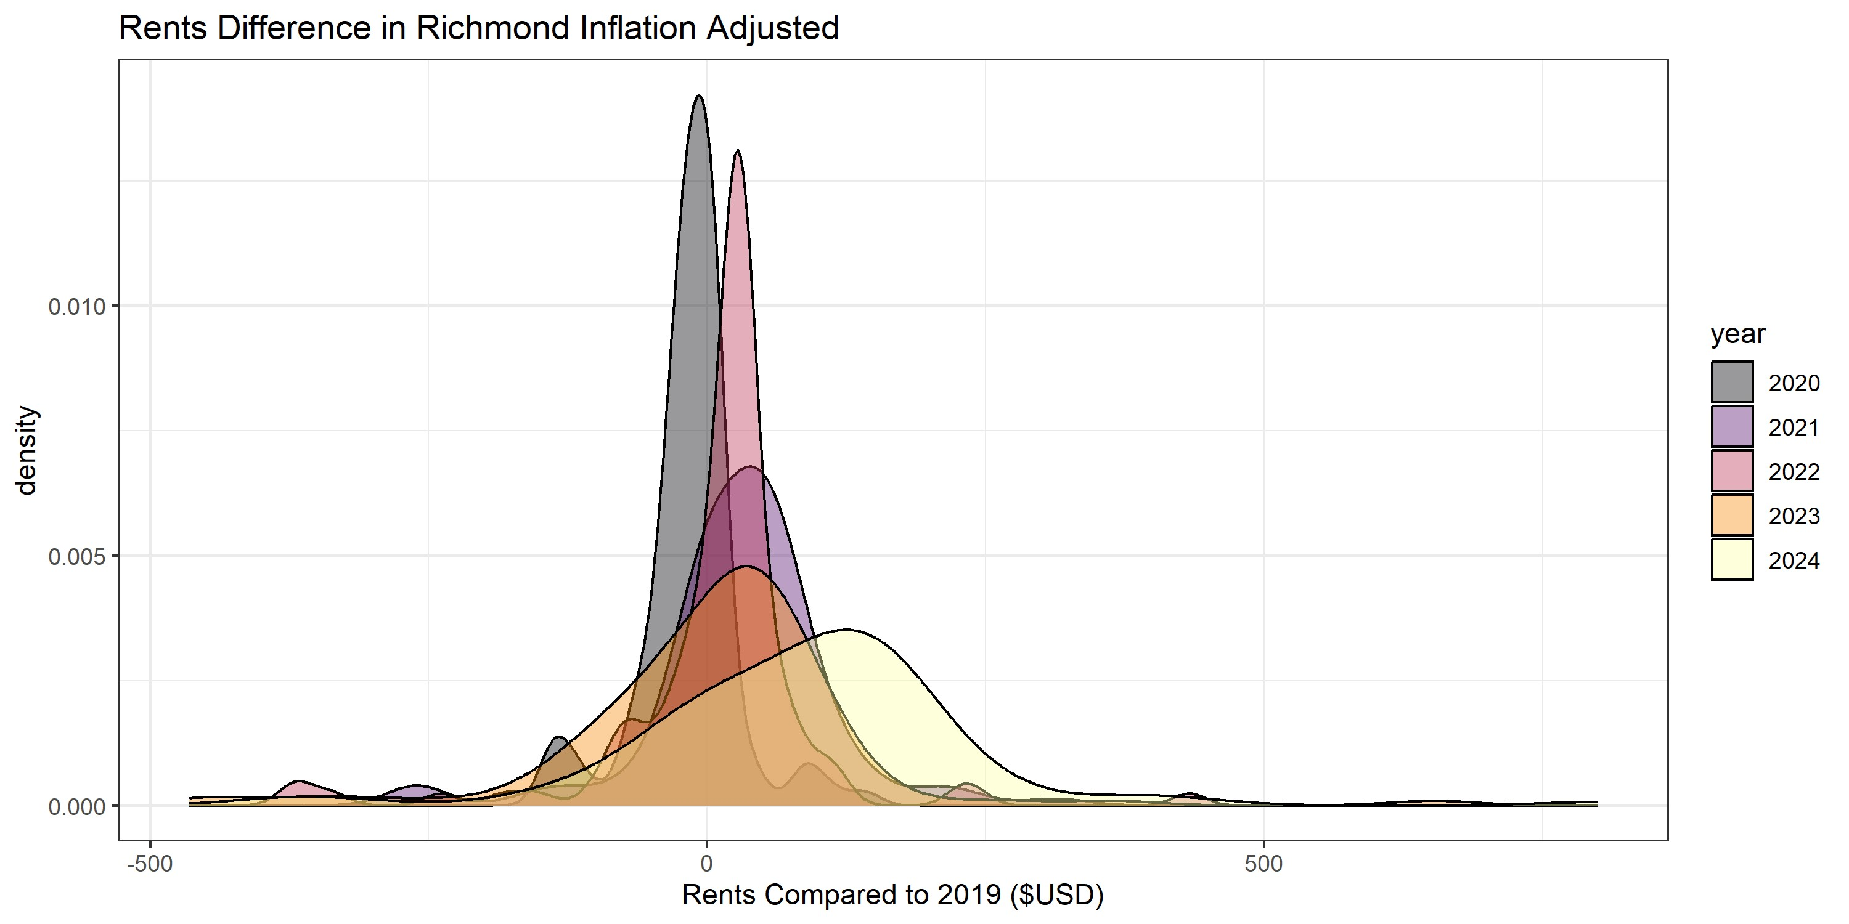
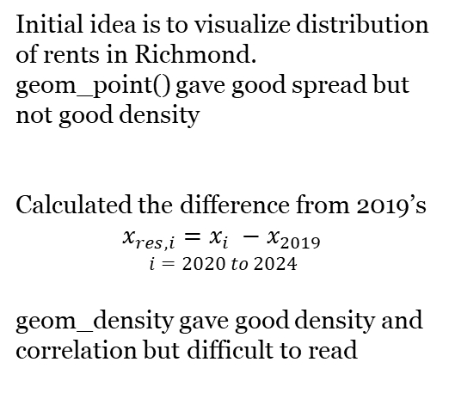
Housing Rents in Post-Covid US
Project by Nam H. Pham
Data Visualization
Initial idea is to visualize distribution of rents in Richmond.
geom_point() gave good spread but not good density
Calculated the difference from 2019’s
$$x_{res,i}=x_{i} −x_{2019}$$
$$i=2020 to 2024$$
geom_density gave good density and correlation but difficult to read
Data Source
The data set contains Fair Market Rents (FMRs) estimates of 40th percentile gross rent values used to determine payment standard amounts for the Housing Choice Voucher program.
Focus primarily on the small area Fair Market Rents (SAFMRs) which are specific for individual zip codes
Data was imported into R using a combination of read_* functions for specific file extensions (.csv, .xls, .xlsx) and assigned to appropriate variables.
Fair market rents (40th percentile rents). Fair Market Rents (40th PERCENTILE RENTS) | HUD USER. Accessed December 3rd,2023. https://www.huduser.gov/portal/datasets/fmr.html
Inflation adjusted values by multiplying by a inflation adjusted factor compared to 2019

Slide 2
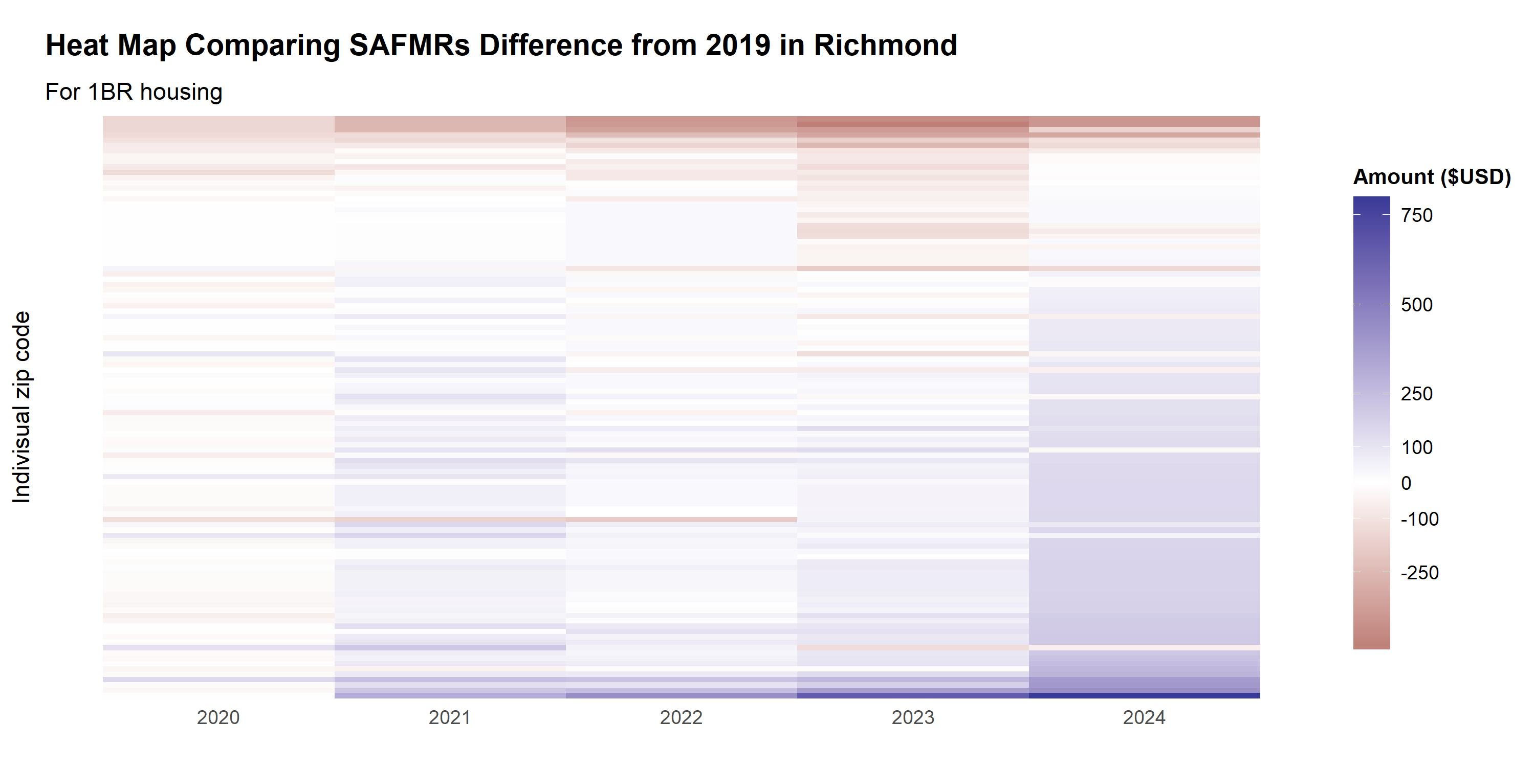
geom_tile()
Color scale represent the difference (in $USD) of SAFMRs from 2019.
Purple means higher price
Brown means lower price
Good indication of spread and can accommodate outliers while maintaining visibility.
We can see an estimate of $250 increase in SAFMRs in all years from 2021.
COVID really hits …

Slide 3
