Slide 1
Introduction to graphs
Lê Sỹ Vinh
Computational Science and Engineering
Email: vinhls@vnu.edu.vn

Slide 2
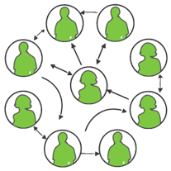
Example
Computer network
Facebook friend network
Road map (Google map)
Airlines routes
Family trees

Slide 3
Graphs
A graph is a pair (V, E), where
V is a set of nodes, called vertices
E is a collection of pairs of vertices, called edges
Vertices and edges are positions and store elements
Example:
A vertex represents an airport and stores the three-letter airport code
An edge represents a flight route between two airports and stores the mileage of the route
849
PVD
1843
ORD
142
SFO
802
LGA
337
1743
1387
HNL
2555
1099
LAX
1233
DFW
1120
MIA

Slide 4
Edge Types
Directed edge
ordered pair of vertices (u,v)
first vertex u is the origin
second vertex v is the destination
e.g., a flight
Undirected edge
unordered pair of vertices (u,v)
e.g., a flight route
Directed graph
all the edges are directed
e.g., route network
Undirected graph
all the edges are undirected
e.g., flight network
flight
AA 1206
ORD
PVD
849
miles
ORD
PVD

Slide 5
Terminology
End vertices (or endpoints) of an edge
U and V are the endpoints of a
Edges incident on a vertex
a, d, and b are incident on V
Adjacent vertices
U and V are adjacent
Degree of a vertex
X has degree 4
Self-loop
j is a self-loop
V
a
b
j
h
U
d
X
Z
c
e
W
g
f
Y

Slide 6
Terminology (cont.)
Path
sequence of alternating vertices and edges
begins with a vertex
ends with a vertex
each edge is preceded and followed by its endpoints
Simple path
path such that all its vertices and edges are distinct
Examples
P₁=(V,b,X,h,Z) is a simple path
P₂=(U,c,W,e,X,g,Y,f,W,d,V) is a path that is not simple
V
a
b
P₁
d
U
X
Z
P₂
h
c
e
W
g
f
Y

Slide 7
Terminology (cont.)
Cycle
circular sequence of alternating vertices and edges
each edge is preceded and followed by its endpoints
Simple cycle
cycle such that all its vertices and edges are distinct
Examples
C₁=(V,b,X,g,Y,f,W,c,U,a,↵) is a simple cycle
C₂=(U,c,W,e,X,g,Y,f,W,d,V,a,↵) is a cycle that is not simple
V
a
b
d
U
X
Z
C₂
h
e
C₁
c
W
g
f
Y

Slide 8
Weighted and unweighted graphs
5
7
3
2
9
3
5
4
7
12
G = (V, E) is a weighted graph if each edge (u,v)∈E is assigned a weight
Example of weighted graph?
Example of unweighted graph?

Slide 9
Graph Presentation
G = (V, E); V = {0, 1,…, n-1}
Present a graph by an adjacency matrix
A[u][v] = 1 if (u,v) ∈ E
A[u][v] = 0 Otherwise
 | 0 | 1 | 2 | 3 | 4
0 | 0 | 1 | 1 | 0 | 0
1 | 0 | 0 | 1 | 0 | 1
2 | 0 | 0 | 0 | 1 | 1
3 | 1 | 0 | 0 | 0 | 0
4 | 0 | 0 | 0 | 1 | 0
0
1
2
3
4

Slide 10
Graph presentation
G = (V, E); V = {0, 1,…, n-1}
Present a graph by edge list structure
0
1
3
.
1
2
4
.
2
0
3
4
.
3
4
3
.

Slide 11
Subgraphs
A subgraph S of a graph G is a graph such that
The vertices of S are a subset of the vertices of G
The edges of S are a subset of the edges of G
A spanning subgraph of G is a subgraph that contains all the vertices of G
Subgraph
Spanning subgraph

Slide 12
Connectivity
A graph is connected if there is a path between every pair of vertices
A connected component of a graph G is a maximal connected subgraph of G
Connected graph
Non connected graph with two connected components

Slide 13
Unrooted trees
An unrooted tree is an undirected graph T such that
T is connected
T has no cycles
Note: This definition of tree is different from the one of a rooted tree
Tree
Forest

Slide 14
Spanning Trees and Forests
A spanning tree of a connected graph is a spanning subgraph that is a tree
A spanning tree is not unique unless the graph is a tree
Spanning trees have applications to the design of communication networks
Graph
Spanning tree

Slide 15
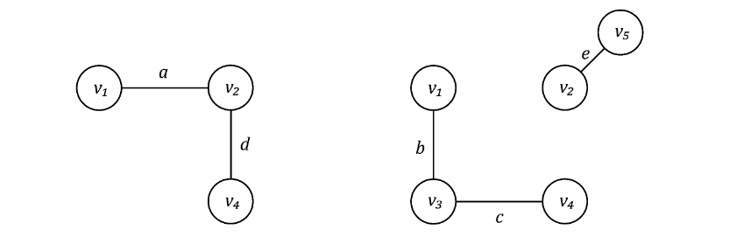
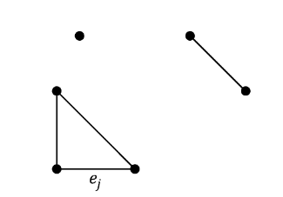
Exercise
Represent the following graph by matrix and linked lists. Determine the number of connected components
G2
G1
G3

Slide 16
Breadth-First Search
L₀
A
L₁
B
C
D
L₂
E
F

Slide 17
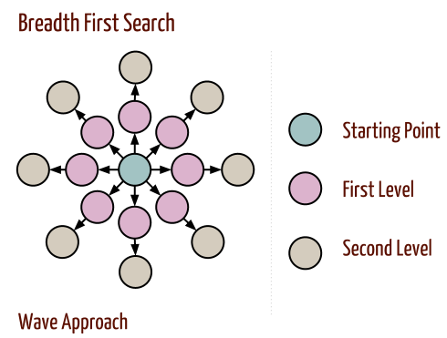
Breadth-First Search
Breadth-first search (BFS) is a general technique for traversing a graph
if vertex u is visited before vertex v, then adjacent vertices of u will be visited before adjacent vertices of v
A BFS traversal is used to determine whether G is connected

Slide 18
Breadth-First Search
A BFS traversal is used to determine whether G is connected
BFS can be used to find a path with the minimum number of edges between two given vertices
Applications:
Crawlers in search engines
Social network website
3
3
3
2
3
2
2
3
3
4
4
3
2
1
2
3
3
4
2
2
3
2
3
3
3
3
4
Shortest path to goal
Goal

Slide 19
Breadth-First Search
1
2
5
3
4
6
Take Node 1 as start

Slide 20
Breadth-First Search
1
2
5
3
4
6
Node 2 is visited next as it was unvisited and at distance of one edge

Slide 21
Breadth-First Search
1
2
5
3
4
6
Node 5 is visited next as it was unvisited and at distance of 1 edge from node 1

Slide 22
Breadth-First Search
1
2
5
3
4
6
Node 3 is visited next as it was unvisited and at distance of 1 edge from node 2

Slide 23
Breadth-First Search
1
2
5
3
4
6
Node 4 is visited next as it was unvisited and at distance of 1 edge from node 2

Slide 24
Breadth-First Search
1
2
5
3
4
6
Node 6 is visited next as it was unvisited and at distance of 1 edge from node 5

Slide 25
Breadth-First Search
BreadthFirstSearch (G, s) {
(1) Set a queue Q empty;
(3) enqueue s onto Q;
(2) Mark s as visited;
(4) while (Q not empty) {
(5) w = dequeue Q;
(6) for (each u adjacent w)
(7) if ( u not visited) {
(8) visit and enqueue u onto Q;
(9) mark u as visited
}
}
3
1
6
1
5
2
4
8
2
S
2
5
7
4
6
Start with all White vertices except s
Q =
S

Slide 26
Breadth-First Search
BreadthFirstSearch (G, s) {
(1) Set a queue Q empty;
(3) enqueue s onto Q;
(2) ark s as visited;
(4) while (Q not empty) {
(5) w = dequeue Q;
(6) for (each u adjacent w)
(7) if ( u not visited) {
(8) visit and enqueue u onto Q;
(9) mark u as visited
}
}
}
3
1
6
1
5
2
4
8
2
S
2
5
7
4
6
After first time through loop
Q =
1
2

Slide 27
Breadth-First Search
BreadthFirstSearch (G, s) {
(1) Set a queue Q empty;
(3) enqueue s onto Q;
(2) ark s as visited;
(4) while (Q not empty) {
(5) w = dequeue Q;
(6) for (each u adjacent w)
(7) if ( u not visited) {
(8) visit and enqueue u onto Q;
(9) mark u as visited
}
}
3
1
6
1
5
2
4
8
2
S
2
5
7
4
6
After second time through loop
Q =
2
3

Slide 28
Breadth-First Search
BreadthFirstSearch (G, s) {
(1) Set a queue Q empty;
(3) enqueue s onto Q;
(2) ark s as visited;
(4) while (Q not empty) {
(5) w = dequeue Q;
(6) for (each u adjacent w)
(7) if ( u not visited) {
(8) visit and enqueue u onto Q;
(9) mark u as visited
}
}
3
1
6
1
5
2
4
8
2
S
2
5
7
4
6
After third time through loop
Q =
3
4
5

Slide 29
Breadth-First Search
BreadthFirstSearch (G, s) {
(1) Set a queue Q empty;
(3) enqueue s onto Q;
(2) Mark s as visited;
(4) while (Q not empty) {
(5) w = dequeue Q;
(6) for (each u adjacent w)
(7) if ( u not visited) {
(8) visit and enqueue u onto Q;
(9) mark u as visited
}
}
}
3
1
6
1
5
2
4
8
2
S
2
5
7
4
6
After fourht time through loop
Q =
4
5
6

Slide 30
Breadth-First Search
// Travel on G=(V, E) by BFS
BreadthFirstSearch_traversal (G) {
(10) for (each v ∈V)
(11) mark v as unvisited;
(12) for (each v ∈V)
(13) if (v not visited)
(14) BreadthFirstSearch(v);
}
Complexity: BFS on a graph with n vertices and m edges takes O(n + m ) time

Slide 31
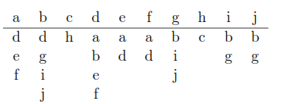
Exercises
Use the BFS to determine the number of connected components.
Use the BFS to find the path with minimum number of edges between the vertices a and b. Consider that the set of vertices is alphabetically ordered.

Slide 32
Depth-First Search
Depth-first search (DFS) is a general technique for traversing a graph
DFS starts from a node and explores as far as possible along each branch before backtracking.
Applications:
Scheduling jobs
Check if a network is connected
1
2
7
8
3
6
9
12
4
5
10
11

Slide 33
Depth-First Search
1
//Depth first search from vertex v
DepthFirstSearch (v) {
for (each u adjacent v)
if (u not visited) {
visit and mark u as visited; DepthFirstSearch (u);
}
}
2
7
8
3
6
9
12
4
5
10
11

Slide 34
Depth-First Search
//Travel on G=(V, E) by DFS
DepthFirstSearch_traversal (G) {
(10) for (each v ∈V)
(11) mark v as unvisted;
(12) for (each v ∈V)
(13) if (v not visited)
(14) DepthFirstSearch(v);
}
DFS on a graph with n vertices and m edges takes O(n + m ) time

Slide 35
Travel on graphs
BFS
DFS
1
1
2
3
4
2
7
8
5
6
7
8
3
6
9
12
9
10
11
12
4
5
10
11

Slide 36
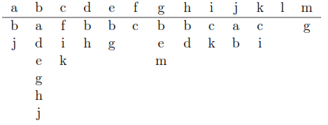
Exercises
Use the DFS to determine the number of connected components

